Slide 1
Adjustable Wrench & Pipe Wrench

Slide 2
Adjustable Wrench
An adjustable wrench is a tool that is usually operated by hand, and is made for tightening or loosening bolts, nuts, or anything that needs a turn. This wrench works as a lever and there are notches at the mouth for gripping. The wrench is pulled at a right angle to the axis of the lever action and the bolt or nut. Some wrenches have mouths that can be tightened to better fit various objects that need turning. The adjustable wrench is also called the crescent wrench.
Site: About.com - http://inventors.about.com/library/inventors/blwrench.htm

Slide 3
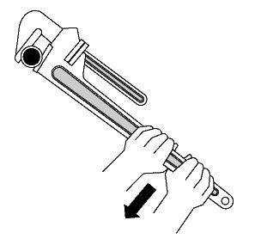
Pipe Wrench
The pipe wrench is used for turning soft iron pipes and fittings with a rounded surface. The design of the adjustable jaws allows it to lock in the frame, such that any forward pressure on the handle tends to pull the jaws tighter together. Teeth (angled in the direction of the turn) dig into the soft pipe. They are not intended for use on hard hex nuts because they would ruin the head; however when a hex nut becomes rounded beyond use with standard wrenches, the pipe wrench is sometimes used to break the bolt or nut free.
Site: http://en.wikipedia.org/wiki/Pipe_wrench

Slide 4
Wrench History
Solymon Merrick patented the first wrench in 1835. Subsequently, a separate patent for a “wrench” was granted to Daniel C. Stillson, a steamboat fireman. Stillson suggested to the heating and piping firm Walworth that they develop a design for a wrench that could be used for screwing pipes together. Previously, serrated blacksmith tongs had been used for that purpose. The owner James Walworth told Stillson to make a prototype and “either twist off the pipe or break the wrench.” Stillson’s prototype twisted the pipe successfully. His design was then patented and Walworth manufactured the wrench.
Site: About.com - http://inventors.about.com/library/inventors/blwrench.htm

Slide 5
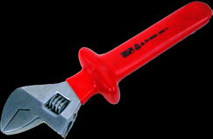
Typical Hazards
Wrench Struck-By’s: The main hazard of using a pipe or adjustable wrench occurs when it loses its grip, slips off and strikes the worker (usually when pulling on the wrench).
Pinching: Another hazard occurs when the item being gripped breaks or when the wrench slips resulting in finger injuries, hand trauma and damage to the wrench itself (usually when pushing on the wrench).
These dangers increase in limited access areas

Slide 6
Fatalities
There were seven fatalities investigated by OSHA from 1990 thru 2009 that involved wrenches
The majority of these fatalities are from struck-by-accidents. However, there is always danger of pinching.
Site: Source: Extracted from OSHA Accident Investigation Data 1990-2009

Slide 7
Fatality Example
A worker was assisting in servicing a duplex mud pump. He was struck by a 36-in. pipe wrench, situated on the rotating shaft of the diesel engine, when the clutch was engaged. Worker was killed. At the time of the accident, the engine was running.
Source: Extracted from OSHA Accident Investigation Data 1990-2009

Slide 8
Fatality Example
A worker, the lead man, was working from a stepladder preparing to remove an industrial roll-up steel overhead door that was stuck in the lowered position. The worker was holding a pipe wrench on the end of the shaft and instructed another worker who was on the opposite side of the stepladder to loosen a bolt. As the bolt was loosened, the tension on the spring caused the shaft to turn and the wrench struck the lead man in the head and he fell from the ladder striking the concrete floor. He died as a result of his injuries.
Source: Extracted from OSHA Accident Investigation Data 1990-2009

Slide 9
Fatality Example
A worker was using a pipe wrench with a cheater bar to turn the steering rod on an earth-boring machine. He was being assisted by a coworker with a second wrench to obtain the necessary torque. One of the two men lost his grip on his wrench, causing the steering rod to turn back suddenly. The worker's wrench was still attached to the steering rod, and the wrench and cheater bar struck him in the back of the head. He died as a result of his injuries.
Source: Extracted from OSHA Accident Investigation Data 1990-2009

Slide 10
Fatality Example
A directional drilling machine was being used to bore a 130-foot-long borehole to be used for a water line. At the time of the accident, the end pipe section was being added to the water pipe by two workers using a pipe wrench. The pipe wrench spun out of control and both employees were struck in the head. One worker was killed and the other was injured.
Source: Extracted from OSHA Accident Investigation Data 1990-2009

Slide 11
Fatality Example
A worker was removing a 12-foot pipe stem from a horizontal drill pipe. The worker used a 60-inch pipe wrench on the connection to hold the pipe stem in place. The jobsite foreman released his end and the worker stepped up to the pipe to remove the pipe wrench when, for undetermined reasons, the pipe rotated. The pipe wrench that was still attached to the pipe struck the worker in the head and killed him.
Source: Extracted from OSHA Accident Investigation Data 1990-2009

Slide 12
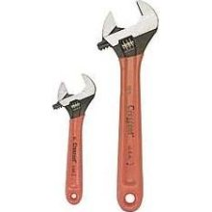
Fatality Example
A worker was attempting to loosen a boring rod from a cable boring machine when the rod rotated, causing the pipe wrench attached to the rod to spin around. The wrench handle struck the worker in the head, killing him.
Source: Extracted from OSHA Accident Investigation Data 1990-2009

Slide 13
Fatality Example
A worker used a 4 ft pipe wrench to remove the starter rod from the end of the boring rods. As he put the wrench on the 2 1/4 in. diameter bore rod, the boring machine operator started turning the bore rods. This caused the wrench to spin around, striking worker on the top of his head. He was killed.
Source: Extracted from OSHA Accident Investigation Data 1990-2009

Slide 14
OSHA Regulation
Pipe Wrenches are addressed in the OSHA Regulations
29 CFR 1926
OSHA Construction Regulations
Subpart I – Tools – Hand and Power
Section 1926.301 – Part B
“Wrenches, including adjustable, pipe, end, and socket wrenches shall not be used when jaws are sprung to the point that slippage occurs.”

Slide 15
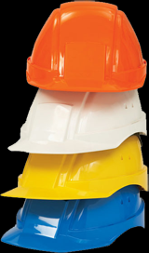
Required PPE
Workers should always wear:
Goggles or other protective eyewear
Gloves / insulated gloves
Safety shoes, typical work boots
Hard hat

Slide 16
Safety Procedures
- Before each use, inspect each wrench for worn gripping teeth and / or a loose mechanism. Inspect periodically for worn or unsafe parts and replace them (e.g., check for worn threads on the adjustment ring and movable jaw)
Select a pipe wrench with sufficient capacity and leverage to do the job (do not use a cheater bar)
Use a pipe wrench to turn or hold a pipe. Never use a pipe wrench to bend, raise or lift a pipe.
Site: http://www.ccohs.ca/oshanswers/safety_haz/hand_tools/pipetools.html

Slide 17
Safety Procedures
Adjust the pipe wrench grip to maintain a gap between the back of the hook jaw and the pipe. This concentrates the pressure at the jaw teeth, producing the maximum gripping force. It also aids the ratcheting action.
Keep pipe wrench teeth clean and sharp
Face a pipe wrench forward. Turn wrench so pressure is against the heel jaw
Site: http://www.ccohs.ca/oshanswers/safety_haz/hand_tools/pipetools.html

Slide 18
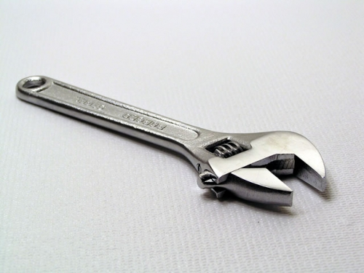
Safety Procedures
The best practice is to pull the wrench across the body while maintaining a wide stance. Pulling and pushing on the pipe wrench handle can lead to off balance dangers. Whatever the physical endeavor or tool, maintain a proper stance with feet firmly placed to maintain balance.
Site: http://www.ccohs.ca/oshanswers/safety_haz/hand_tools/pipetools.html

Slide 19
Think Safety Work Safely

