Slide 1
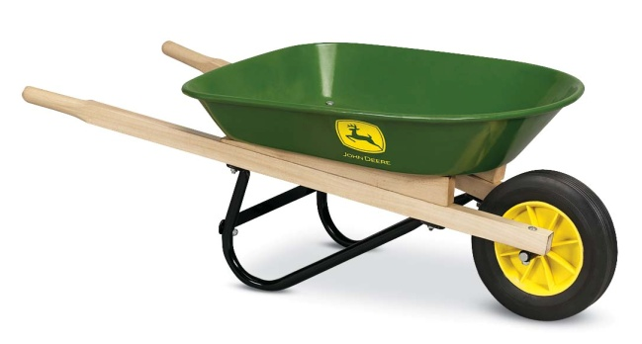
Wheelbarrow Safety
http://www.google.com/images

Slide 2
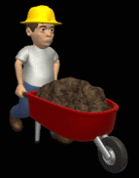
Definition
A wheelbarrow is a small hand-propelled vehicle, usually with just one wheel (some have two wheels), designed to be pushed and guided by a single person using two handles to the rear.
http://www.google.com/images
Source: http://en.wikipedia.org/wiki/Wheelbarrow

Slide 3
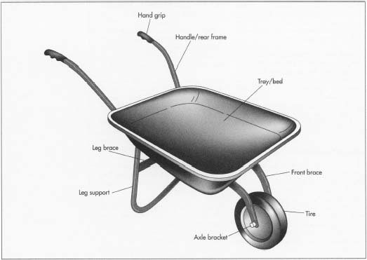
Design Concept
Wheelbarrows are designed to distribute the weight of the load between the wheel and the operator, enabling the convenient carriage of heavier and bulkier loads than would be possible if the weight was carried entirely by the operator
http://www.google.com/images
Source: http://en.wikipedia.org/wiki/Wheelbarrow

Slide 4
History
The wheelbarrow may have been invented in Ancient Greece in the early 400’s B.C.
It was primarily used on construction sites
It reappeared in Medieval Europe sometime between 1170 and 1250
It was used for building construction, mining operations, and agriculture
Source: http://en.wikipedia.org/wiki/Wheelbarrow

Slide 5
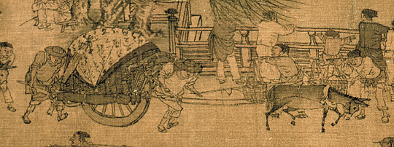
History
China also had a version of the wheelbarrow. The first descriptions came from the 2nd century Han Dynasty tomb murals and brick tomb reliefs
It was used for transporting military supplies
Source: http://en.wikipedia.org/wiki/Wheelbarrow

Slide 6
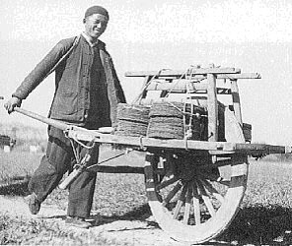
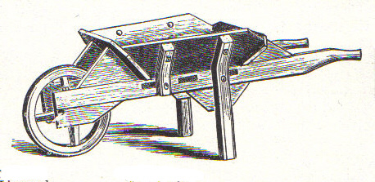
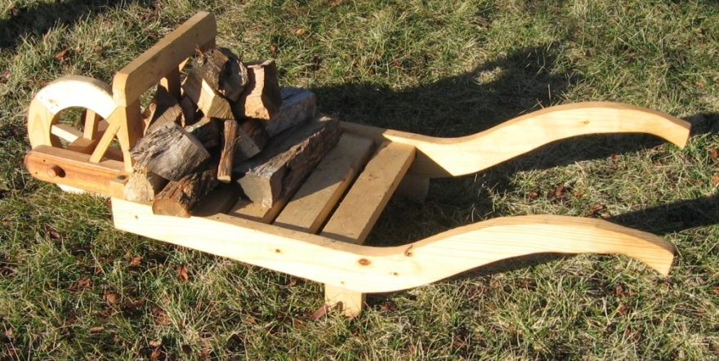
History
The Chinese wheelbarrow had a wheel in the center of the barrow whereas the European wheelbarrow had a front-mounted wheel similar to modern wheelbarrows
Source: http://en.wikipedia.org/wiki/Wheelbarrow
http://www.google.com/images

Slide 7
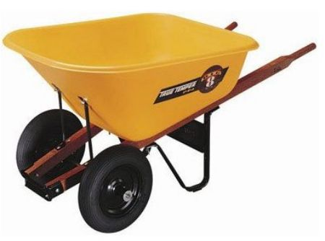
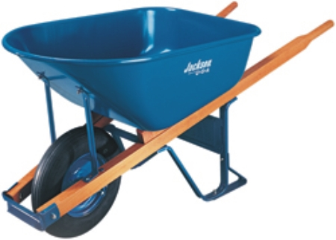
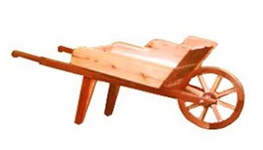
Design Over Time
The wheelbarrow has evolved from using rocks as wheels, to wood as wheels, to modern designs in which rubber tires are used
Some wheelbarrows are equipped with two wheels to allow for greater support
Source: http://en.wikipedia.org/wiki/Wheelbarrow
http://www.google.com/images

Slide 8
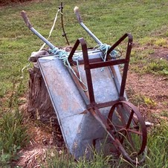
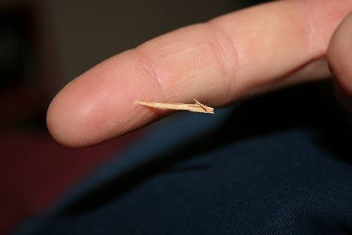
Safety Concerns
Tip-overs
Falls
Blisters
Splinters
http://www.google.com/images

Slide 9
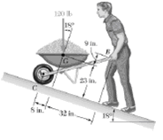
Potential Hazards
Unguarded edges
Narrow walkways
Uneven ground
Obstacles
Inclines
http://www.google.com/images

Slide 10
Statistics on Fatalities
Most wheelbarrow fatalities are due to falls or struck-by accidents
The falls occurred primarily on roofing jobs where wheelbarrows were used with inappropriate guardrail systems or unguarded openings
The struck by accidents were caused by loss of control of another piece of equipment that subsequently killed the worker operating a wheelbarrow
Source: Extracted from OSHA Accident Investigation Data 1990-2009

Slide 11
Fatality Statistics (11 Cases)
Source: Extracted from OSHA Accident Investigation Data 1990-2009

Slide 12
Case #1
A worker was using a wheelbarrow to dump debris from a reroofing job into a trash chute that was hung from a parapet wall. The chute was accessed by a ramp which led to the top of the parapet wall and the chute opening.
There was a 2 inch square bumper at the end of the ramp (smaller than required by OSHA - 4 inches thick and 6 inches high) and there was no guardrail across the chute opening. While dumping a load of debris the worker was killed when he fell into the chute, landing 50 feet below in a dumpster.
Source: Extracted from OSHA Accident Investigation Data 1990-2009

Slide 13
Case #2
Three workers were removing roofing on a 5:12 pitch roof that had a 3 ft flat surface around the perimeter. One worker had loaded a wheelbarrow with roofing debris and was walking backward with the wheelbarrow along the 3 ft flat roof perimeter.
He either tripped, lost his balance, or lost his perspective of where he was. He fell from the roof's edge and was killed by the 30-foot fall. The roof had no catch platform nor were the workers using safety belts with lifelines.
Source: Extracted from OSHA Accident Investigation Data 1990-2009

Slide 14
Case #3
A worker was removing the bricks from a low sloped metal roof with a wheelbarrow. She had made a few trips to the leading edge to dump bricks over the side. The wheelbarrow path led past an unguarded skylight.
After dumping the bricks over the side, the worker turned around, grabbed the wheelbarrow with her arms behind her back and proceeded up the roof to the work area. While pulling the wheelbarrow up the roof, she stepped through an unguarded skylight and fell 23 feet to her death.
Source: Extracted from OSHA Accident Investigation Data 1990-2009

Slide 15
Case #4
A worker was delivering concrete mortar with a wheelbarrow to a wooden platform, which was covering a stairwell shaft opening. The wooden platform gave way and the employee fell 32 feet to his death.
Source: Extracted from OSHA Accident Investigation Data 1990-2009

Slide 16
Case #5
A concrete truck was making a delivery. The driver observed a worker lift the wheelbarrow handles and take two steps toward a nearby testing area. The driver put the truck in reverse and began to back toward the pour location.
Apparently, the laborer had difficulty balancing and moving the full wheelbarrow. The truck had backed up about15 ft when he ran over the worker who died immediately.
Source: Extracted from OSHA Accident Investigation Data 1990-2009

Slide 17
OSHA Regulations
OSHA Standard - 1926.852(f)
Where the material is dumped from mechanical equipment or wheelbarrows, a securely attached toe board or bumper, not less than 4 inches thick and 6 inches high, shall be provided at each chute opening
http://www.google.com/images

Slide 18
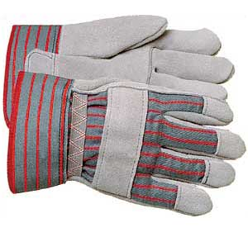
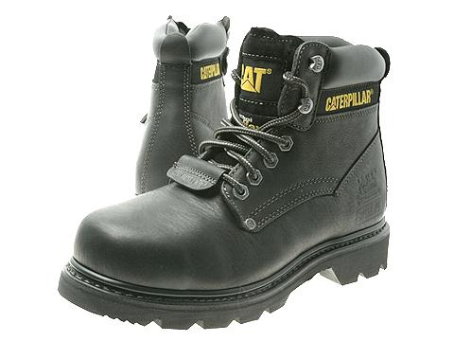
Personal Protective Equipment
Main
Heavy-duty gloves
Steel-toe boots
Additional
Hard Hat
Cover-all clothing
Safety glasses
Safety vest
Back brace
http://www.google.com/images

Slide 19
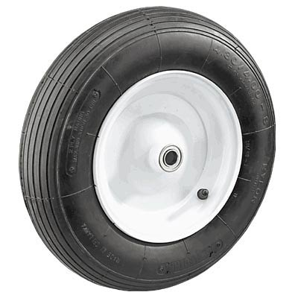
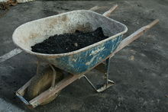
Best Practices
Damage
Check for damage to the frame and bucket
Make sure the tires are fully inflated
Loading
Do not overfill the wheelbarrow
Keep items from sticking out over the sides of the bucket
Take into account the weight to strength ratio of the wheelbarrow to the worker
Make sure that it is loaded evenly
Source: http://www.ehow.com/about_6396476_wheelbarrow-safety.html
http://www.google.com/images

Slide 20
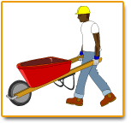
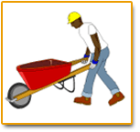
Best Practices
Lifting
Firmly grip handles and lift with the knees, not the back
Speed
Do not move too quickly because, when heavily loaded, a wheelbarrow can have significant momentum and it is hard to stop abruptly
Keep moving forward instead of starting and stopping
Source: http://www.ehow.com/about_6396476_wheelbarrow-safety.html
http://www.google.com/images

Slide 21
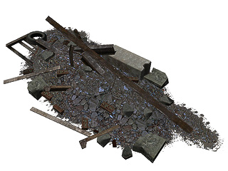
Best Practices
Obstacles
Define a clear pathway
Look ahead to avoid obstacles by going around them
Go over any obstacles at a right angle to avoid tipping the wheelbarrow
Source: http://www.ehow.com/about_6396476_wheelbarrow-safety.html
http://www.google.com/images

Slide 22
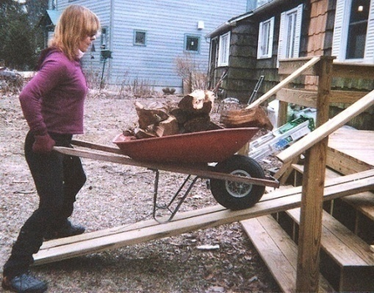
Best Practices
Inclines
Avoid inclines if possible
going up, the wheelbarrow can roll back down and run over the worker. It is important to have adequate momentum so the wheelbarrow can be pushed all the way to the top of the incline without stopping
going down, the wheelbarrow can pick up speed and get out of control
Source: http://www.ehow.com/about_6396476_wheelbarrow-safety.html
http://www.google.com/images

Slide 23
Think Safety Work Safely

