Slide 1
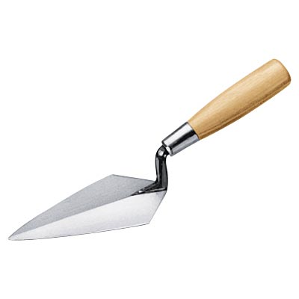
Trowels
<number>

Slide 2
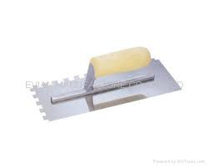
Description
A trowel is a hand tool used to dig, smooth, or move small amounts of material such as mortar, grout or cement.
Source: Extracted from www.Wikipedia.com 2009
<number>

Slide 3
History
The trowel is traced to use prior to the 14th century. In 1344 a trowel was known as a tool used to spread plaster or mortar. It has since served many purposes that include being a highly utilized tool for multiple construction applications.
Source: Extracted from www.Dictionary.com 2009
<number>

Slide 4
Standard Construction Use
Bricklaying: used for leveling, spreading, or shaping cement, plaster, or mortar.
Concrete: used for smoothing, leveling, or texturing the top level of hardening concrete.
Plaster: used for smoothing, leveling, or texturing hardening plaster.
<number>
Source: Extracted from www.Wikipedia.com 2009

Slide 5
Hazards and Concerns
Many trowels contain very sharp edges capable of cutting the skin while in use and during transportation.
The excessive use of trowels may result in fatigue and eventually injuries may occur resulting from extraordinary body movements and pressures for extended periods.
Particulates that become airborne during use may cause damage to the eyes and skin.
<number>

Slide 6
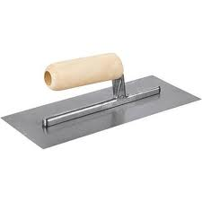
Fatality Statistics
4 deaths were investigated by OSHA from 1990 thru 2007 that occurred while using trowels.
These deaths were the result of falls occurring immediately before or after the use of trowels at high elevation or the retrieval of the tool itself after it was dropped.
<number>
Source: Extracted from OSHA Accident Investigation Data 1990-2007

Slide 7
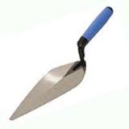
Injury Statistics
Bricklayers had 1.7 times the amount of musculoskeletal lost time injuries to the arms and hands than all other trades due to excessive trowel use from 1994 to 1998.
<number>
Source: Extracted from www.Csao.org 2009

Slide 8
Nature of Accidents
A worker was working from a 14-ft high scaffold troweling grout on the top course of block in order to finish up a concrete block wall. He apparently stepped off the open west end of the scaffold and fell to his death.
<number>
Source: Extracted from OSHA Accident Investigation Data 1990-2007

Slide 9
Fatality Example
A worker had completed the pargeting of a manhole atop an active sewer vault when he accidentally dropped his cement trowel into the sewer vault. As the laborer climbed down into the sewer vault to retrieve the trowel, a coworker called out looking for the laborer who replied from inside the manhole that he was going down into the sewer vault to retrieve his trowel. It is believed that the laborer climbed down to a depth of approximately 10 to 15 feet before falling off of the ladder to the bottom of the sewer vault.
<number>
Source: Extracted from OSHA Accident Investigation Data 1990-2007

Slide 10
Trowel Safety
All hand tools shall be maintained in a safe condition.
Wooden handles must be kept tight to the tool and be free of cracks and splinters.
<number>
Source: OSHA Regulations 2005

Slide 11
Safety Procedures and Practices
PPE requirements include eye protection when the trowel area is overhead or when particulates may become airborne.
Gloves and long-sleeved shirts should be worn when the material being applied may be hazardous to the skin.
Fall protection should be provided when working at elevations 1.8 meters or higher.
<number>
Source: OSHA Regulations 2005

Slide 12
Safety Procedures and Practices
Precautions should be taken to guard the edges of trowels that may be sharp, especially while moving with edges exposed.
Personal injury prevention equipment such as wrist braces or handle ties should be provided and used by workers practicing lengthy actions using trowels to avoid muscle and bone injuries.
<number>
Source: OSHA Regulations 2005

Slide 13
Safety Procedures and Practices
Always use proper PPE when performing applications using trowels.
The most common injuries involving trowels are due to musculoskeletal fatigue.
<number>

Slide 14
Think Safety
Work Safely
<number>

