Slide 1
TOXIC FUMES/GASES

Slide 2
Toxic Fumes
Toxic fumes of various types might be encountered on construction sites. Typical fumes include carbon monoxide, methane, hydrogen sulfide, chlorine, and gases/fumes that displace oxygen, including nitrogen, argon, etc.

Slide 3
Toxic Fumes/Gases
Toxic fumes are often odorless and since there are many types, one cannot rely on a sense of smell alone. This is why air monitors should be used in environments where of various types might be encountered on construction sites.
Air monitors must be understood in order to used them properly,

Slide 4
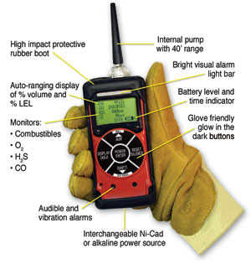
Air Monitors

Slide 5
What is an Air Monitor?
It is commonly a battery- powered device that draws air through a medium and evaluates the air quality. Alarms or alerts are activated when unacceptable levels of toxicity are noted or when inadequate oxygen is present.

Slide 6
Why is Air Monitoring Important?
Construction workers are frequently in danger of inhaling toxic fumes/gases in work areas which may result in death.
Sufficient levels of oxygen must also be observed to ensure worker safety.
To avoid such accidents, the air on construction sites has to be monitored to ensure that the air quality remains within permissible limits.

Slide 7
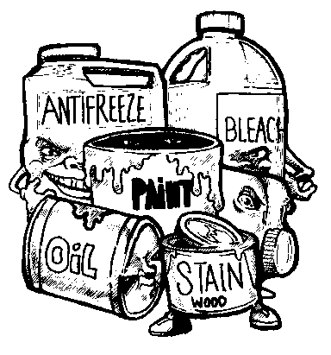
Sources of Fumes/Gases
Toxic fumes/gases can come from a variety of sources. Many of these sources are in products such as bleach, chlorine, paint, kerosene, paint thinner, pesticides, etc.
Dangerous fumes/gases can be found in excavated areas whey they may occur naturally in the ground.
http://www.familymanagement.com/childcare/facility/chemical.toxins.safety.html

Slide 8
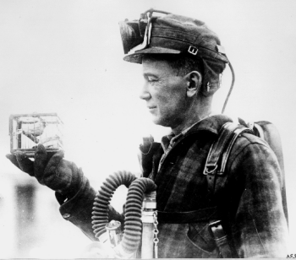
History of Air Monitoring
Practice of air monitoring begun in 1911.
Canaries were used to alert miners of toxic fumes.
The canary is particularly sensitive to toxic fumes/gases such as carbon monoxide which is colorless, odorless and tasteless.
When the canary stopped singing, it signaled a problem for the miners.
Miner with caged canary
http://www.petcaretips.net/canary-coal-mine.html

Slide 9
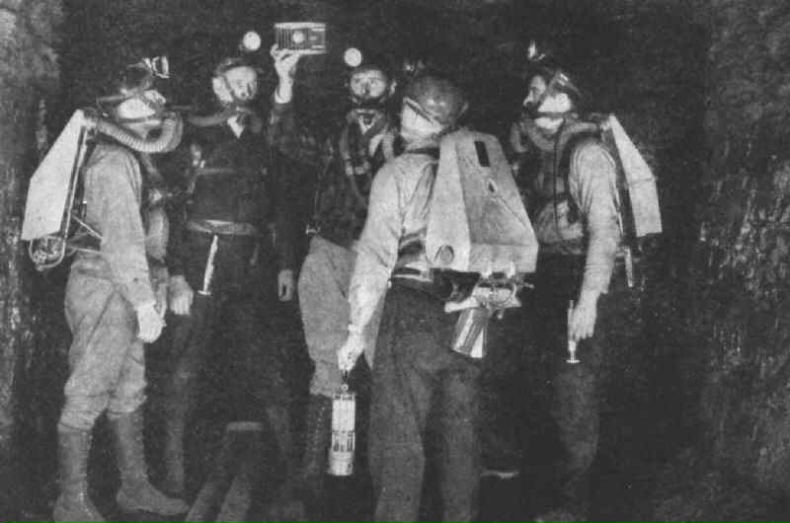
History of Air Monitoring
Canaries are no longer used in mining operations or in any air monitoring application.
The last canaries were used in 1986 in England.
Miners with caged Canary
http://www.sfgate.com/cgi-bin/blogs/pets/detail?entry_id=28551

Slide 10
Terminology
Action Level (AL) - Indicates the level of a harmful or toxic substance/activity that requires remedial actions
Time Weighted Average (TWA) - The average exposure to a contaminant to which workers may be exposed without adverse effect over a period such as in an 8-hour day or 40-hour week

Slide 11
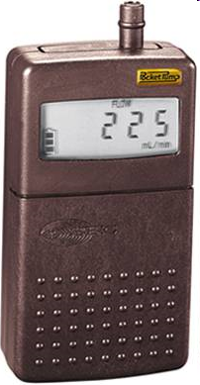
Tools and Equipment
Personal Sampling Pumps
These pumps are one method of inspecting the air in the work environment.
They are small and compact so that the worker can transport them easily while working.
SKC Pocket Pump 210 Series
http://www.skcinc.com/pumps/210-1000.asp

Slide 12
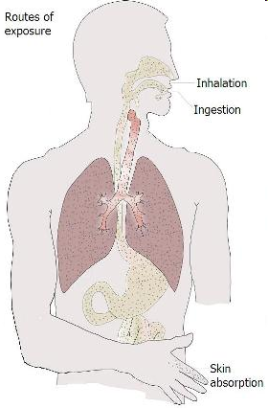
Safety Concerns
There are three major ways to harmfully come in contact with toxic fumes/gases, or oxygen deficient air:
Inhalation
Breathing in the gas
Ingestion
By means of swallowing these fumes
Dermal Contact
Gas that can penetrate through the skin to cause damage
http://www.stewardshipcommunity.com/stewardship-in-practice/human-health/hazard-risk-human-health-and-pesticides/hazard-profile-and-risk-assessment.html

Slide 13
Toxicity Assessment
Dose is the AMOUNT of substance to which one is exposed. The less the toxicity, the greater the dose one can tolerate without ill effects. The greater the toxicity, the less dose one can tolerate without becoming sick.
http://www.free-training.com/osha/hazcom/hhaz/64.htm

Slide 14
Fatalities
Fatalities related to include death by lack of oxygen and overexposure to toxins/gases such as hydrogen sulfide, carbon monoxide, and chloride.
Over 70 construction worker deaths, specifically related to toxic fumes/gases were investigated by OSHA from 1990-2009.
(Source: Extracted from OSHA Accident Investigation Data 1990-2009”)

Slide 15
OSHA Regulations
OSHA 1926.800 Underground Construction
OSHA requires the monitoring of airborne contaminants “as often as necessary” depending on the location of jobsite, geology, previous history of contaminants from nearby worksites, and work practices that may be occurring nearby (running of a diesel engine).
Oxygen levels must be kept between 19.5%-22%

Slide 16
OSHA Regulations
OSHA 1926.910 Inspection After Blasting
“Sufficient time shall be allowed, not less than 15 minutes in tunnels, for the smoke and fumes to leave the blasted area before returning to the shot.”
OSHA Subpart Z- Toxic and Hazardous Substances
OSHA 1926.651- Hazardous Atmospheres

Slide 17
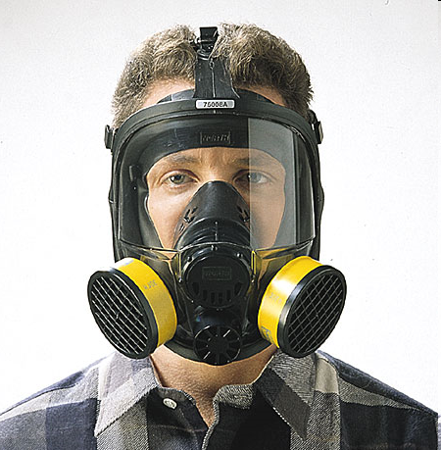
PPE Requirements
Proper Air Monitoring Equipment
Personal Sampling Pumps
Coated Filters
Electric Monitors
Vapor Monitor Badges
Respirators
Supplied Air
Air Purifying
Air purifying respirator
http://cenvironment.blogspot.com/2011/02/clean-air-for-construction-workers.html

Slide 18
Air Monitoring Best Practices
Survey the work area to identify the presence of toxic materials
Anticipate areas where workers might be exposed to naturally-occurring toxic gases
Position internal combustion engines so that the exhaust (carbon monoxide) does not accumulate and endanger workers

Slide 19
Air Monitoring Best Practices
While many toxic fumes/gases are colorless and odorless, they are also extremely dangerous and need to be properly monitored.
Workers should place air monitoring devices as close to the face as possible to ensure that the air being monitored is the same air being inhaled.

Slide 20
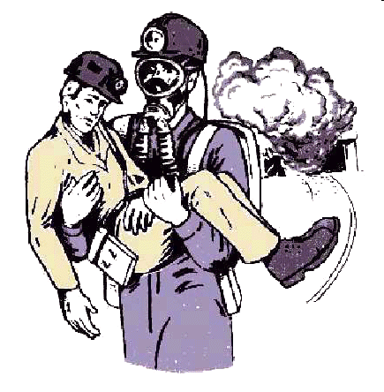
Air Monitoring Best Practices
If a worker succumbs to air poisoning or oxygen deficiency, emergency crews or other workers must remember to take proper precautions when attempting a rescue so that they too do not become victims.
http://www.msha.gov/district/dist_07/rescue/rescue.htm

Slide 21
Think Safety
Work Safely

