Slide 1
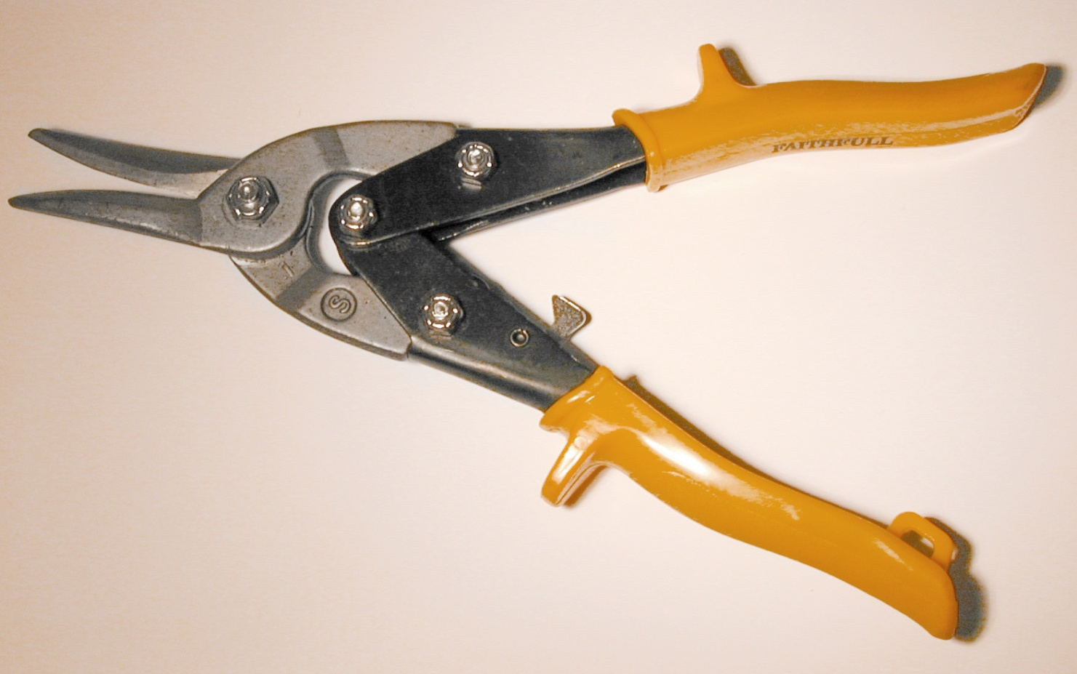
http://www.transtools.co.uk/store/images/uploads/HandTools/sta214562.jpg
Tin Snips

Slide 2
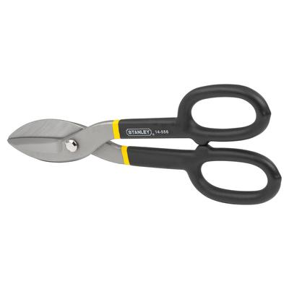
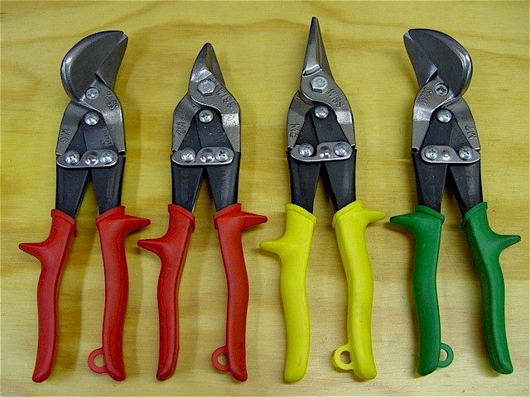
Tin Snips
A tin snip is a tool used to cut lightweight sheet metal, chicken wire, and many other (primarily metal) materials.

Slide 3
Tin Snips
Tin snips have a mechanism that is similar to the operation of scissors, but they are much stronger.

Slide 4
Types
Three basic types of tin snips:
left cutting, straight cutting, and right cutting.
The set of the blades on each type cuts in a slightly different way.
Straight cutting tin snips will cut in a straight line, while left and right cutting snips create curved cuts.
Because sheet metal is stiff and hard to maneuver, it is often necessary to use curved tin snips to create curved cuts such as holes for duct work.
http://www.wisegeek.com/what-are-tin-snips.htm

Slide 5
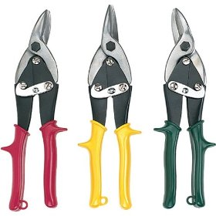
Color Code
Manufacturers often color code tin snips to make it easy to determine the type of tin snips.
Straight cutting snips are yellow
Right cutting snips are green
Left cutting snips are red.
These are fairly standard, but this should be verified.
http://www.wisegeek.com/what-are-tin-snips.htm
http://ecx.images-amazon.com/images/I/518ZYDXD61L._SL500_AA280_.jpg

Slide 6
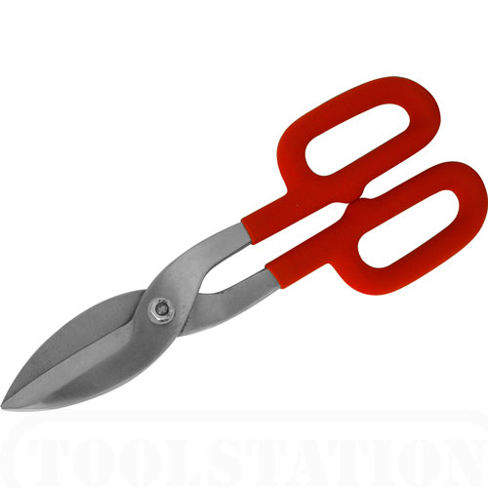
No OSHA Investigations of fatalities involving tin snips occurred from 1990 thru 2009

Slide 7
The OSHA regulations do not specifically mention Tin Snips
CFR 1926

Slide 8
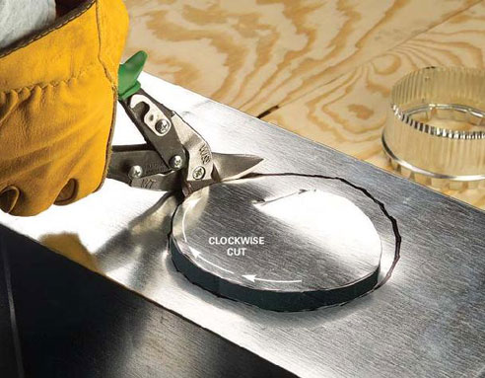
PPE
Be sure to wear heavy gloves.
Be sure to wear safety glasses to protect from flying shards of metal that may splinter and penetrate the eyes or face.
http://www.wisegeek.com/what-are-tin-snips.htm

Slide 9
Safe Practices
Offset handles are best as they create the best workable angles. This prevents hands from being caught on the rough metal edge, making cutting faster and safer.
Always inspect tin snips before use. Make sure they are sharp and rubber handles are secure.
Wear long pants and long-sleeved shirt.
Be cognizant of the “spring” effect of mesh or sheet metal as it is being cut.
http://www.wisegeek.com/what-are-tin-snips.htm

Slide 10
Safe Practices
Periodically wipe down the blades with oil to minimize the risk of rusting.
Make sure to clean up the work area when work is completed.

Slide 11
Think Safety
Work Safely

