Slide 1
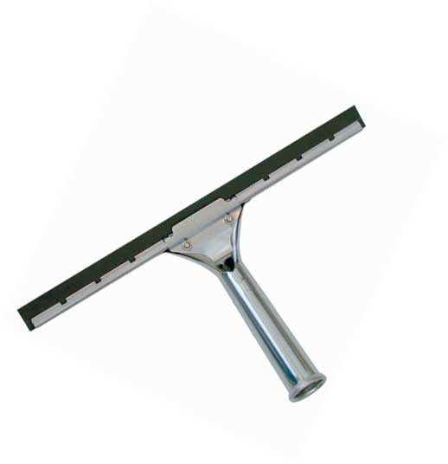
Squeegees

Slide 2
What is a Squeegee
Flat, smooth rubber bladed tool
Some have a foam sponge adjacent to the blade
Has been used in many ways
Patented for window cleaning in 1936
Used to control water flow

Slide 3
Squeegee Uses
Originally used to clean boat decks
Used on horses
Used in photography and t-shirt printing
Commonly found at gas service stations
Most common use: window cleaning

Slide 4
Window Cleaning
A cleaning solution with water is applied to the window
The Squeegee’s rubber blade is then used to remove excess liquid from the window
Removal of water prevents water marks from forming

Slide 5
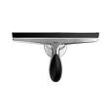
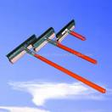
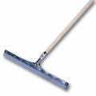
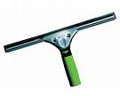
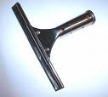
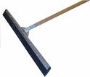
Various Squeegees

Slide 6
Product Details
Rubber blade
Handle: wood, plastic, or metal
Foam Sponge
Grip: rubber or plastic

Slide 7
Safety Concerns
Handle: non-metallic material safest to minimize injury
Most concerns involve surrounding environment, not squeegee itself
Like any blunt object, squeegees have been used as weapons

Slide 8
Safety Concerns
Working at elevation is the main concern when cleaning high-rise windows
Grated standing surface should be used to prevent pooling of cleaning product
Pooling could be a slipping hazard

Slide 9
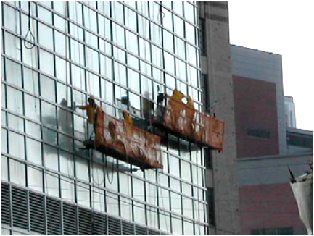
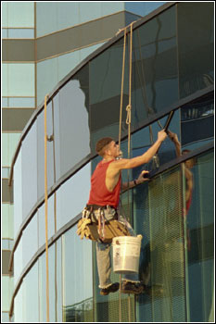
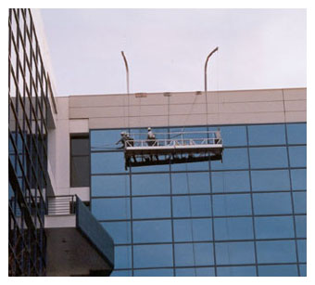
Squeegee Applications

Slide 10
Safety Facts
When using squeegees to clean windows, gloves and eye protection must be worn
No fatalities caused by squeegees have been investigated by OSHA
When used on high-rises, fall protection is the main concern

Slide 11
Think Safety
Work Safely

