Slide 1
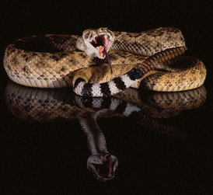
Snakes
Figure 1: Rattlesnake. Source: Extracted from http://www.corbisimages.com/Enlargement/Enlargement.aspx?id=42-17307911&tab=details&caller=search

Slide 2
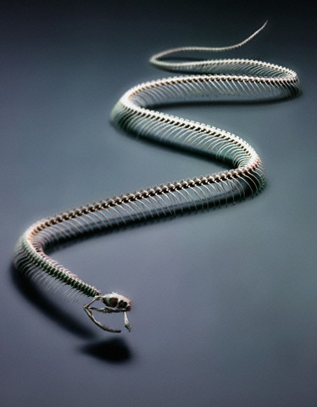
Snakes - Background
Snakes are carnivorous, elongated, legless, ectothermic (cold blooded) reptiles (http://en.wikipedia.org/wiki/Snake)
There are two main types of snakes: venomous and non-venomous
The biological classifications are as follows:
Class: Reptila
Order: Squamata
Suborder: Serpentes
Figure 2: Snake skeleton. Source: Extracted from http://www.corbisimages.com/Enlargement/Enlargement.aspx?id=42-22402114&tab=details&caller=search
http://www.pitt.edu/~mcs2/herp/SoNA.html

Slide 3
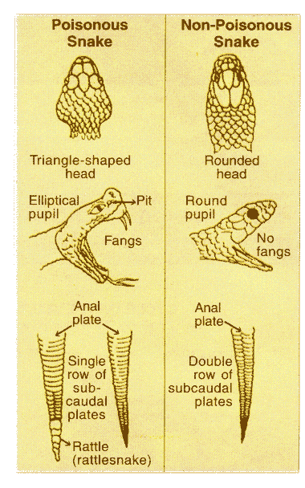
Identifying Snakes
There are two types of venomous snakes:
Hemotoxic: venom attacks the tissue and blood, and
Neurotoxic: venom damages or destroys nerve tissue
Ways to determine if a snake is venomous or not is the shape of the snakes head and eyes and coloring/pattern
Figure 3: Venomous snake vs. Non-venomous snake identifying diagram. Source: Extracted from http://pixdaus.com/single.php?id=202783

Slide 4
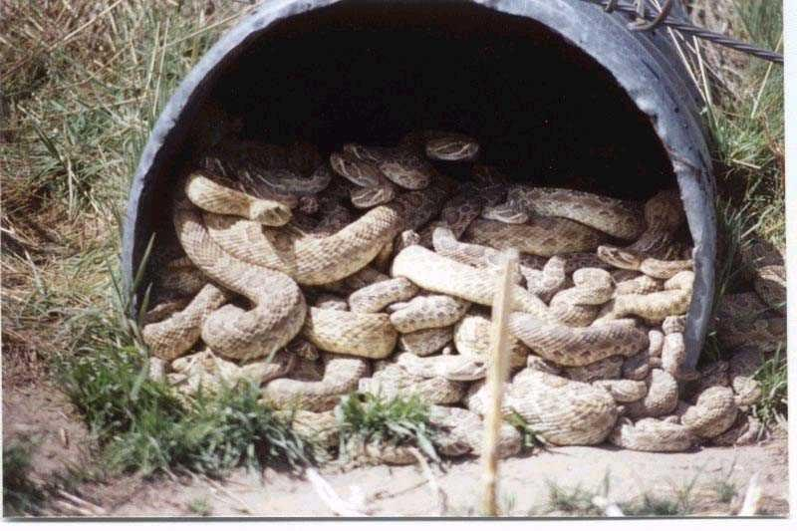
Snakes and Construction
Construction sites can provide ideal places for snakes to hide:
High grasses
Trash/debris piles
Lumber piles
Old equipment not in use for long periods
Sites near recently cleared woodlands and brush areas
Figure 4: Rattlesnakes nesting in construction drainage pipe. Source: Extracted from http://outdoors.webshots.com/photo/1158878138046536283rWWsPU

Slide 5
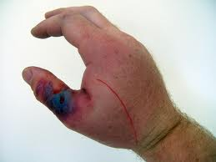
Hazards and Safety Concerns
Snakes have a striking distance equal to ~½ of total body length
Snakes strike when they feel threatened
Venomous snake bites can have immediate and even life-threatening effects
Figure 5: Snakebite from a Boiga dendrophila (Mangrove snake), results after one day. Source: Extracted from http://www.reptileforums.co.uk/forums/snakes/133156-snake-bite-pic-thread.html

Slide 6
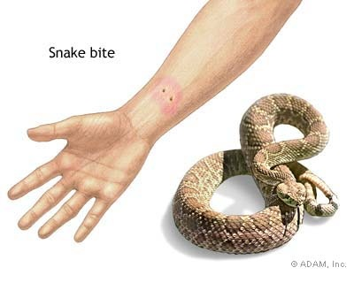
Statistics
Chance of surviving a snake bite is 99.8%
50% of snakebites by venomous species are “Dry Bites” where no venom is injected
95% of snakebites are to the limbs with 75% of these to the leg
Out of the 45,000 estimated snakebites a year occurring in the U.S., 7000-8000 are by venomous species
North Carolina has the highest state incident rate of 19 bites/100,000 persons per year
National average is 4 bites/100,000 persons per year
Figure 6: Snake puncture marks. Source: Extracted from http://hometreatment.net/first-aid-treatment/first-aid-for-poisonous-snake-bite/
Source: Extracted from http://hometreatment.net/first-aid-treatment/first-aid-for-poisonous-snake-bite/

Slide 7
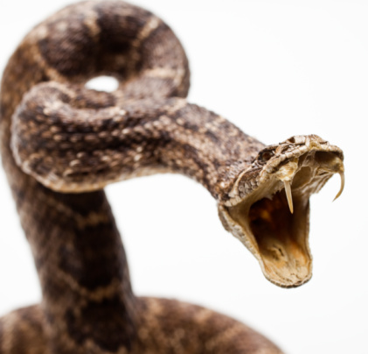
Snake Incidents
From the OSHA Accident Investigation Data from 1990 thru 2009 there were:
0 Fatalities
1 injury incident occurring in the construction industry
Incident occurred in Walnut Creek, CA
While clearing debris on a two story residential project, a worker was bit by a rattlesnake resulting in hospitalization for 2 days
Figure 7: Rattlesnake striking. Source: Extracted from http://www.gettyimages.com/detail/103301193/Photographers-Choice

Slide 8
OSHA Regulations
General Duty Clause- SEC. 5. Duties:
(1) Each employer shall furnish to each of his employees employment and a place of employment which are free from recognized hazards that are causing or are likely to cause death or serious physical harm to his employees;
1926.21(b)(4)
“In job site areas where harmful plants or animals are present, employees who may be exposed shall be instructed regarding the potential hazards, and how to avoid injury, and the first aid procedures to be used in the event of injury.”

Slide 9
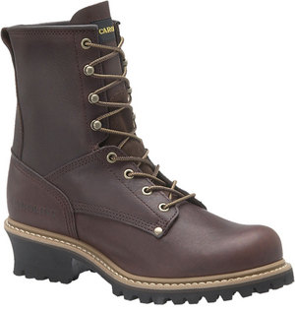
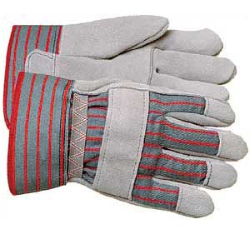
Safety Procedures Involving Snakes
Step carefully in heavy vegetation and with a heavy foot. Snakes feel the vibrations and will vacate.
Do not blindly reach into wood piles and carefully pick up debris
Wear proper PPE:
Thick boots with durable soles and high ankle (at least 10”) protection,
Thick leather gloves
Heavy, durable pants
Figure 8: High ankle work boots. Source: Extracted from http://elevenmagazine.wordpress.com/2008/11/
Figure 9: Leather gloves. Source: Extracted from http://www.lciglove.com/products/split.htm

Slide 10
Safety Procedures Involving Snakes
Assume all snakes are venomous
Avoid making sudden movements which could cause the snake to strike
Either remain still and wait for the snake to leave or slowly back away
Call animal services to have the snake removed safely

Slide 11
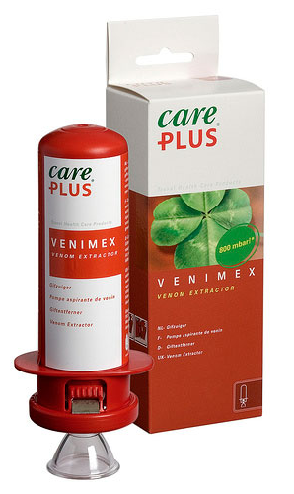
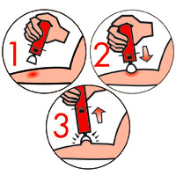
First Aid
For best treatment, note the coloring and head shape if bitten
Seek medical treatment immediately!
Treat all bites as venomous
Keep the individual calm and as still as possible
Apply a designated snake bite suction device to the wound if the individual is more than an hour away from professional medical treatment
Do NOT cut the wound open or apply ice packs
Figure 10: Venimex venom removal device. Source: Extracted from http://www.e-outdoor.co.uk/268924/products/Care_Plus_Venimex_Venom_Extractor.aspx
Figure 11: Proper venom removal steps diagram. Source: Extracted from http://www.interdelta.ch/index.php?page=produits&affiche=venimex&lang=de

Slide 12
Think Safety Work Safely

