Slide 1
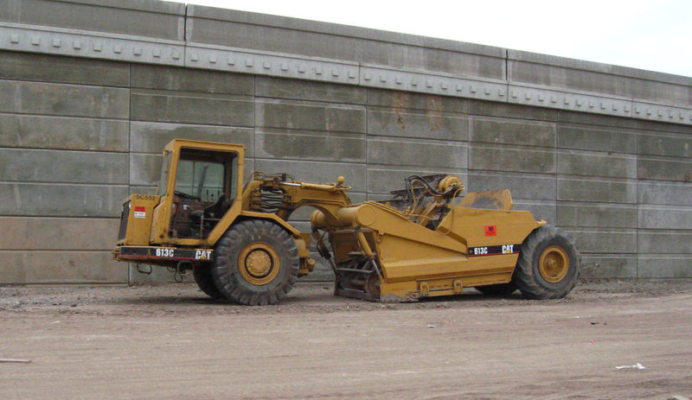
Scrapers
Caterpillar 613C Scraper

Slide 2
What is scraper?
Scrapers are a type of heavy machinery used for earthmoving
Scrapers are capable of excavating, hauling, and dumping material over medium-to long haul distances.
Scrapers are useful construction equipment when hauling distances range between 500 to 3000 feet.
Source: Caterpillar Performance Handbook: Edition 24, 8-1 to 8-5
S. W. Nunnally, Construction methods and management, 7th edition, 2007

Slide 3
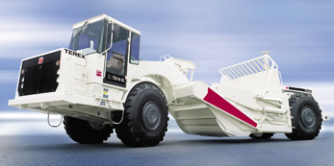
Standard usage
Loading and transporting earth over short and medium distances.
Source: www.terex.com/main.php?obj=prod&action=VIEW&id=21&nav=prod&cid=e3959eefdc65adcc4e0e616b833694b1

Slide 4
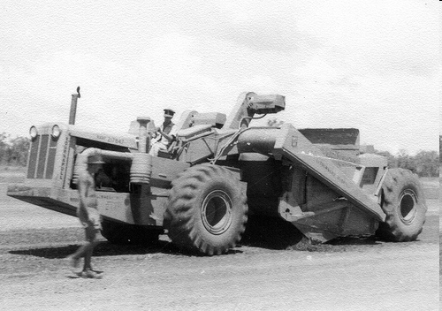
History of scraper
Self-propelled scrapers were invented in the 1930s by R.G. LeTourneau
Source: Dr. John H. Niemela, “A History of R.G. LeTourneau’s Earliest Scrapers,” Ver. 1.1B 10–31–07, MoL©

Slide 5
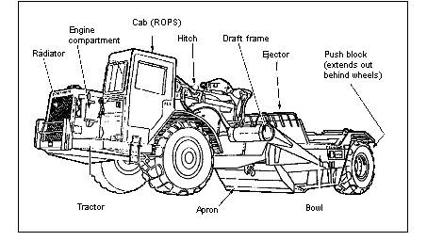
Components of scraper
Source: United States Army Training Support Center

Slide 6
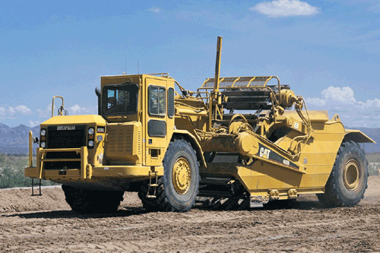
How it works?
The scraper excavates (cuts) by lowering the front edge of its bowl into the soil. The bowl front if equipped with replaceable blades, which may be straight, curved, or extended at the center.
Source: S. W. Nunnally, Construction methods and management, 7th edition, 2007

Slide 7
How it works?
Hopper (the rear part of the machine ) is lowered or raised to cut into the ground collecting the dirt
The collected earth can be moved and dumped accordingly as this process is repeated
Some scrapers work in tandem with a bulldozer
Source: S. W. Nunnally, Construction methods and management, 7th edition, 2007

Slide 8

Some features
Features of Caterpillar Scrapers include:
Standard cubic yard capacities range from 14 yd³ to 66 yd³
Weight of machinery can be 67,195 lb up to 146,770 lb
Source: Caterpillar Performance Handbook: Edition 24, 8-1 to 8-5

Slide 9
types of scrapers
Each type has different characteristics of rolling resistance, maneuverability, stability, and speed in operation.
Although there are a number of different types of scrapers, principal types are as follows:

Slide 10
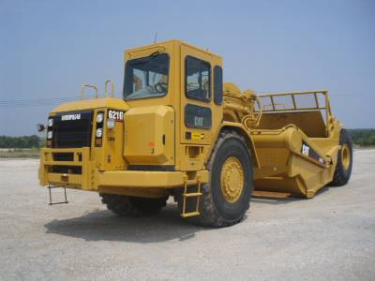
Major types of scrapers
Single engine overhung (two or three axle) scrapers

Slide 11
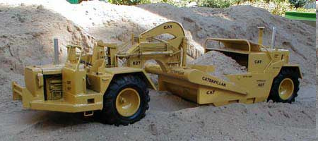
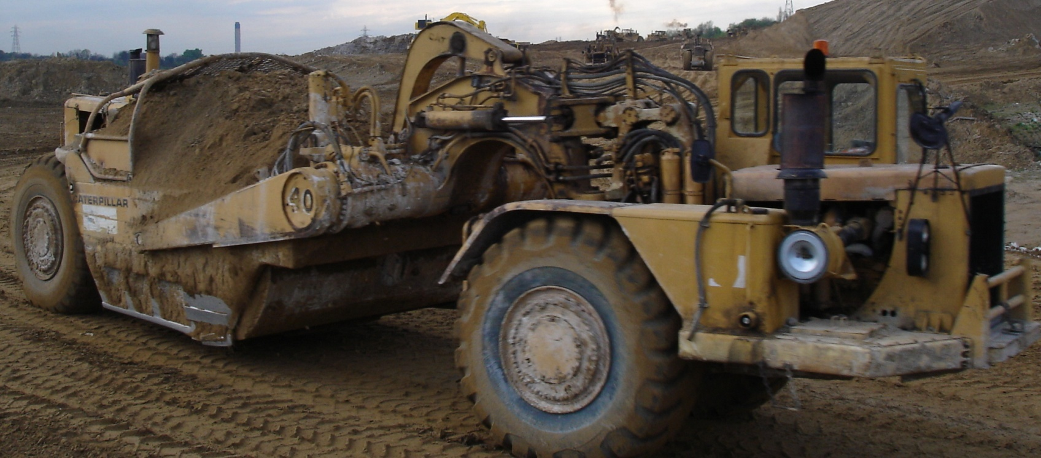
Major types of scrapers
Twin-engine all-wheel-drive scrapers
Cat 627 Twin Engined Scraper

Slide 12
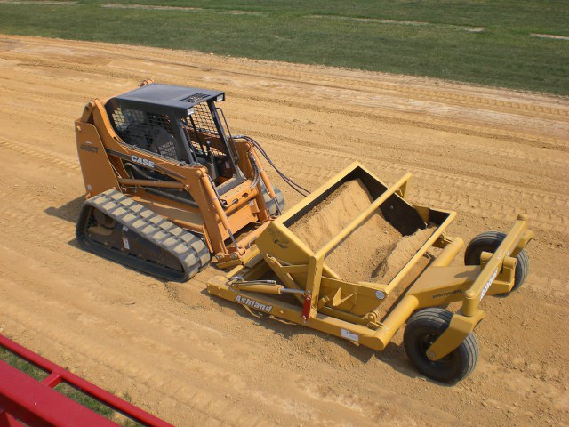
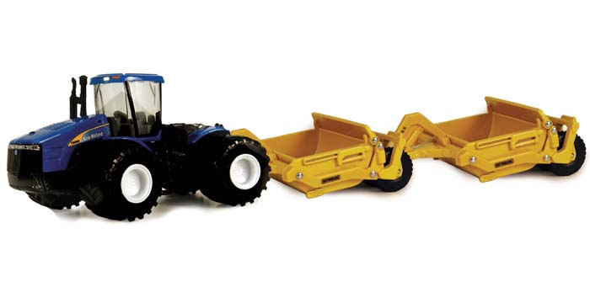
Major types of scrapers
Towed scrapers

Slide 13
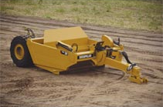
Towed Scrapers
Capacity (heaped) - 18.8 yd³ to 23.5 yd³
Capacity (struck) - 13 yd³ to 17 yd³
Least expensive
Source: http://www.cat.com/cda/layout?m=111776&x=7

Slide 14
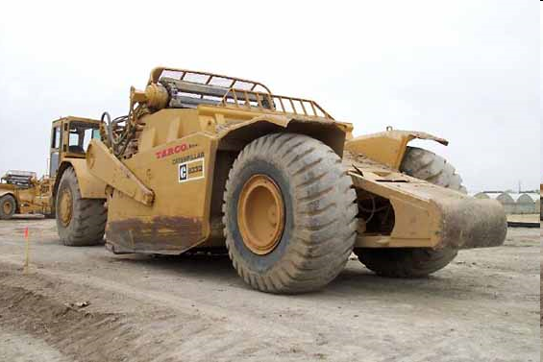
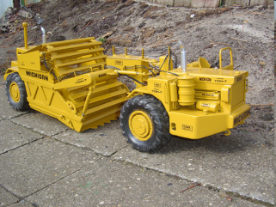
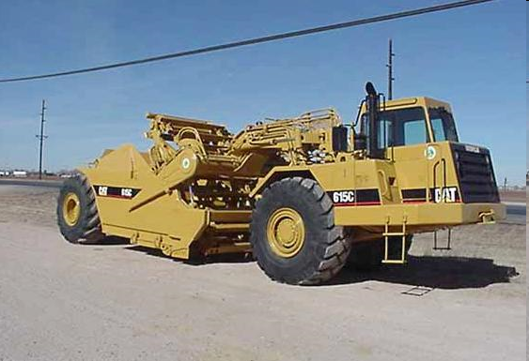
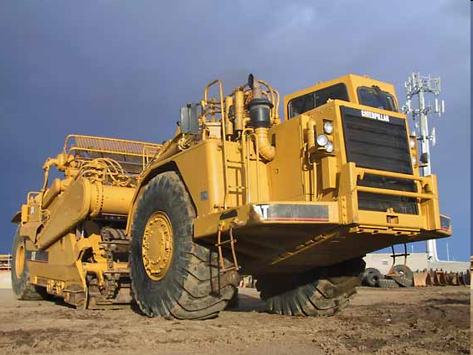
Major types of scrapers
Elevating scrapers
(also known as Paddle Wheel or Self-loading scrapers)
Caterpillar 633D elevating scraper
Michigan scraper
Caterpillar 615C elevating scraper
Caterpillar 633 elevating scraper

Slide 15
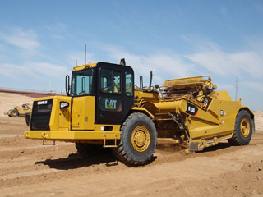
Source: http://www.cat.com/cda/layout?m=111776&x=7
Elevating Scrapers
Capacity(heaped) - 11 yd³ to 23 yd³
Max. Speed - 24.4 mph to 32 mph
Ability to homogenize
and condition soil
while loading

Slide 16
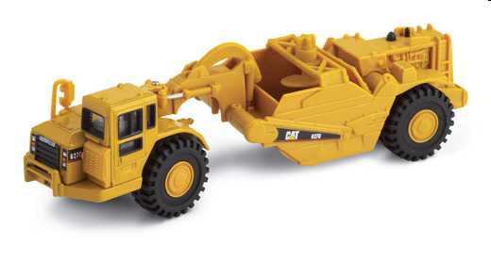
Major types of scrapers
Auger Scrapers
Caterpillar 627G Auger Scraper

Slide 17
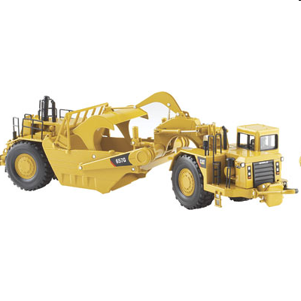
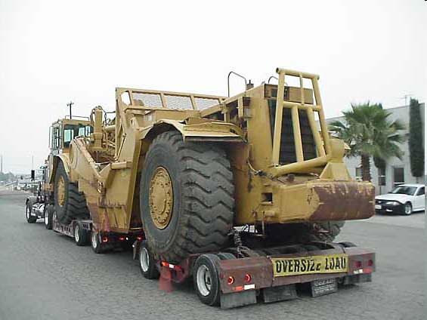
Major types of scrapers
Push-pull (twin-hitch) scrapers
657G Push Pull Scraper
Caterpillar 637E tandem push-pull scraper

Slide 18
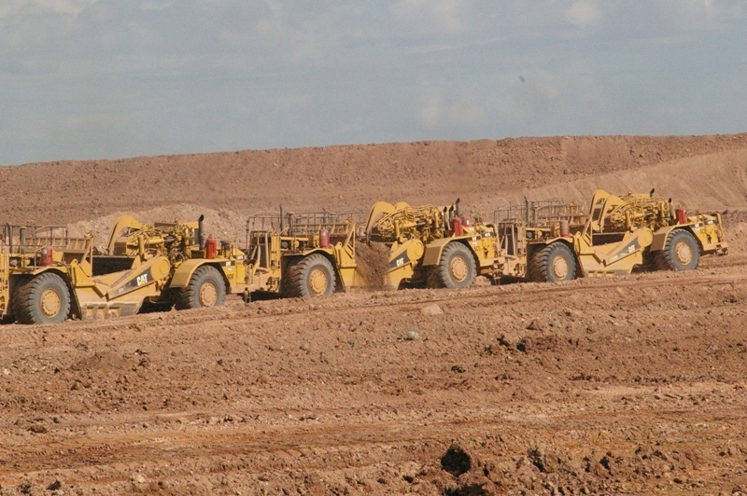

Slide 19
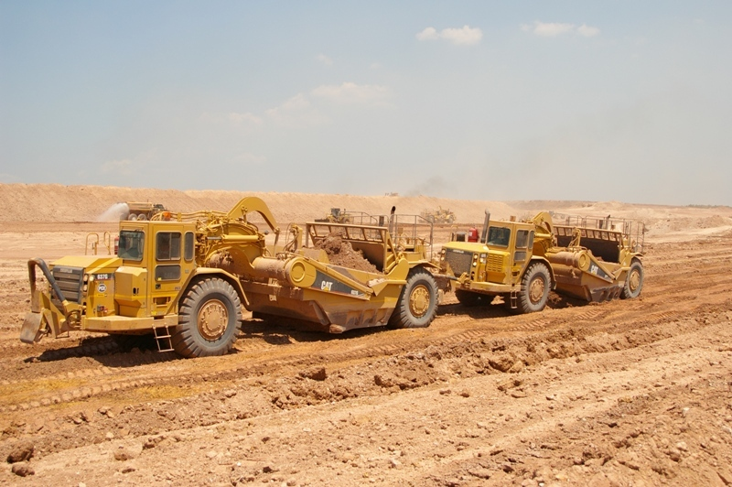

Slide 20
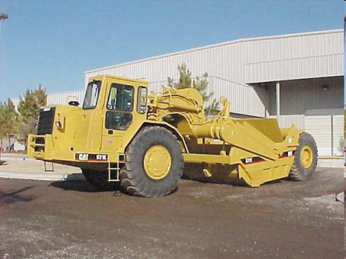
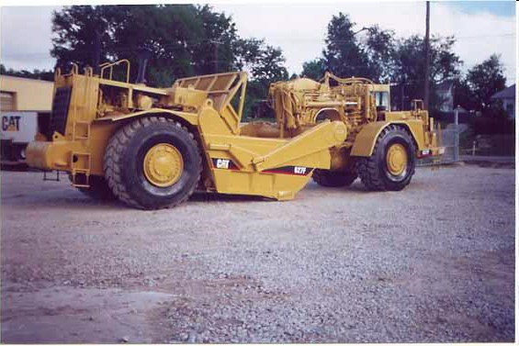
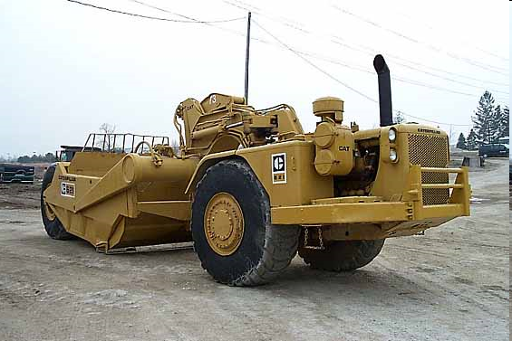
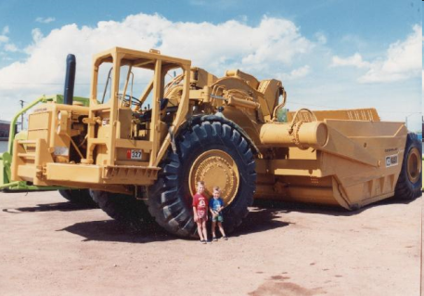
Major types of scrapers
Open-bowl scrapers
(Capable of being loaded by front-end loaders or hydraulic excavators)
Caterpillar 631E open bowl scraper
Caterpillar 627F tandem open bowl scraper
Caterpillar 621 open bowl scraper
Caterpillar 651 open bowl scraper

Slide 21
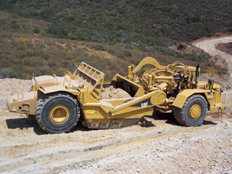
Source: http://www.cat.com/cda/layout?m=111776&x=7
Open Bowl Scrapers
Capacity (heaped) - 22 yd³ to 44 yd³
Max. Speed - 32 mph to 36 mph
Often have push/pull
ability

Slide 22
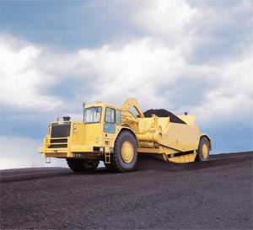
Source: http://www.cat.com/cda/layout?m=111776&x=7
Coal Bowl Scrapers
Capacity (heaped) - 50 yd³ to 73 yd³
Max. speed - 31.1 mph to 34.1 mph
Often powered by
twin engines
Most Expensive

Slide 23
Scraper hazards
Rolling over on uneven ground and during turns, especially with full loads
Failure of brakes or other machinery components
Low visibility behind and around the machine
Crushing and wedging in between other objects

Slide 24
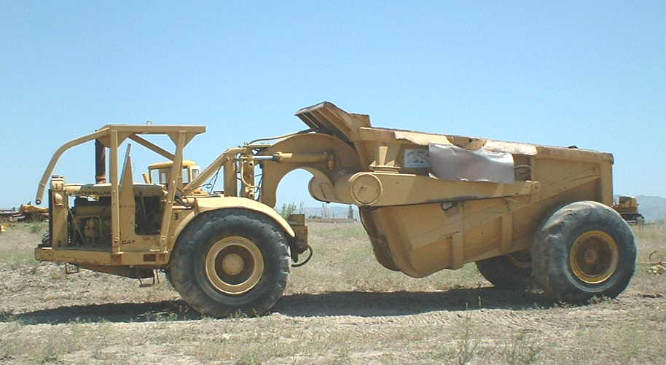
Some concerns
Failure of safety measures such as ROPS, backup alarms, safety belts
Poor communication among workers and operators
Hazardous road conditions
Dangerous maintenance situations

Slide 25
Scraper Fatality Statistics
From 1990 thru 2009 OSHA investigated 52 incidents involving scrapers

Slide 26
Type of Scraper Movement

Slide 27
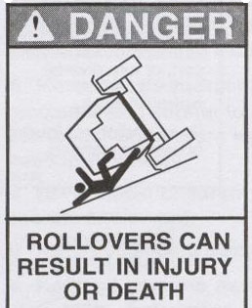
Fatality Example 1
An operator was pulling a pan scraper with a tractor
The operator was driving along a ditch
The slope caused a rollover
The man was crushed because of a lack of rollover protection
Source: Extracted from OSHA Accident Investigation Data 1990-2009

Slide 28
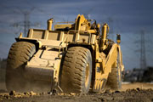
Fatality Example 2
Source: Extracted from OSHA Accident Investigation Data 1990-2009
Operator was working with a surveyor
The surveyor knelt down to place a grade stick
The backup alarm was not working and the operator backed over the surveyor with a scraper
There was no third observer to communicate between the two men

Slide 29
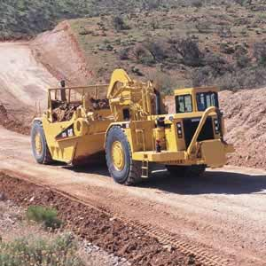
Fatality Example 3
An employee just finished dumping a full pan load
As he made another pass he fell off of the machine
He was run over by the front left tire
Source: Extracted from OSHA Accident Investigation Data 1990-2009

Slide 30
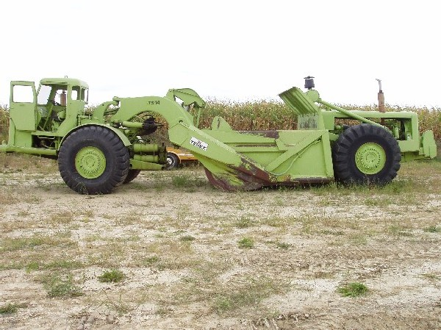
Fatality Example 4
The owner/operator of an E200 International was completing a sharp left turn down a slope
The right rear wheel lifted off the ground and the scraper tilted down the hill
The machine rolled over and crushed the operator
Source: Extracted from OSHA Accident Investigation Data 1990-2009

Slide 31
Fatality Example 5
Source: Extracted from OSHA Accident Investigation Data 1990-2009
An employee was standing next to a scraper with his back facing another scraper
To move out of the way, the operator shifted the front scraper in reverse
The employee on the ground was crushed between the two machines

Slide 32
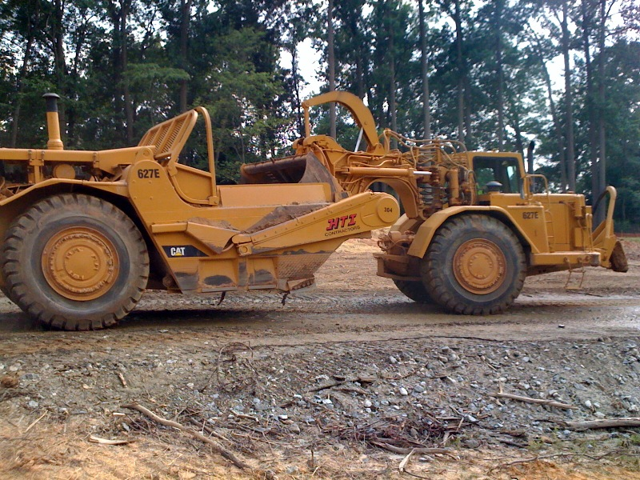
Fatality Example 6
A scraper was parked on a downhill incline
The scraper rolled forward and pinned an employee between the scraper and a service truck.
Source: Extracted from OSHA Accident Investigation Data 2007-2009

Slide 33
Fatality Example 7
A worker noticed a piece of wood lodged in the cables under the scraper
He told the operator to wait a minute but the message was missed due to the operator talking on his mobile telephone
The employee was crushed by the rear tire when the operator proceeded to drive the scraper
Source: Extracted from OSHA Accident Investigation Data 2007-2009

Slide 34

OSHA regulations
Subpart O- Motor Vehicles, Mechanized Equipment, and Marine Operations
  1926.602 Material Handling Equipment
    9. Audible alarms.
      (I) All bidirectional machines, such as {…} [scrapers] shall be equipped with a horn, distinguishable from the surrounding noise level, which shall be operated as needed when the machine is moving in either direction. The horn shall be maintained in an operative condition.
Source: OSHA 29 CFR 1926 Construction Industry Regulations

Slide 35
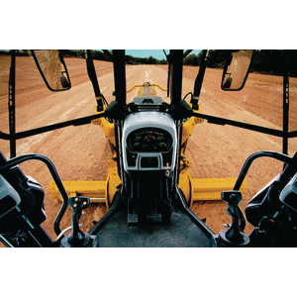
OSHA regulations
Subpart W:
  1926.1000(c)(2) Rollover protective structures (ROPS) and supporting attachment shall [be] {…} installed in a manner which will support, based on the ultimate strength of the metal, at least two times the weight of the prime mover applied at the point of impact.
Source: OSHA 29 CFR 1926 Construction Industry Regulations

Slide 36
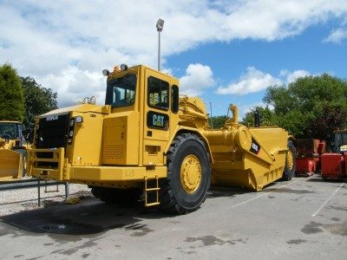
OSHA regulations
1926.1000(c)(2)(i) The design objective shall be to minimize the likelihood of a complete overturn and thereby minimize the possibility of the operator being crushed as a result of a rollover or upset.
Source: OSHA 29 CFR 1926 Construction Industry Regulations

Slide 37
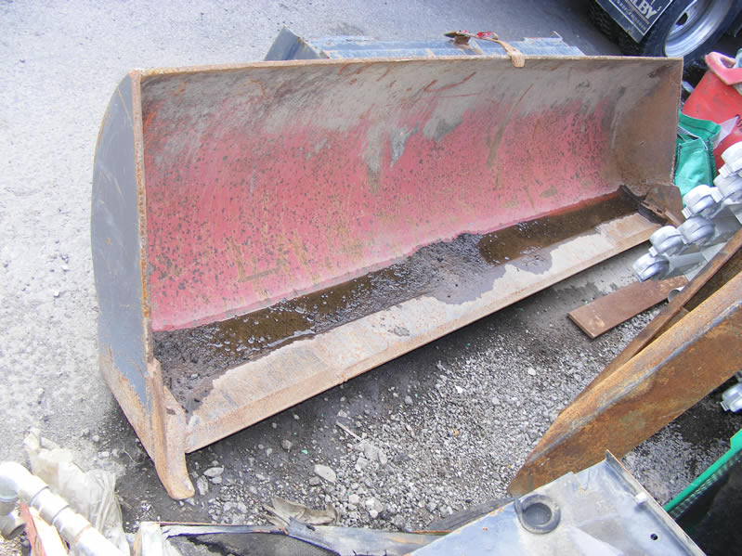
OSHA regulations
1926.600(a)(3)(i) scraper blades {…} shall be either fully lowered or blocked when being repaired or when not in use. All controls shall be in a neutral position, with the motors stopped and brakes set, unless work being performed requires otherwise.
Source: OSHA 29 CFR 1926 Construction Industry Regulations

Slide 38

OSHA regulations
1926.602(a)(2)(i) Seat belts shall be provided on all [scrapers]. and shall meet the requirements of the Society of Automotive Engineers, J386-1969, Seat Belts for Construction Equipment.
Source: OSHA 29 CFR 1926 Construction Industry Regulations

Slide 39
OSHA regulations
1926.602(a)(4) All earthmoving equipment [including scrapers] shall have a service braking system capable of stopping and holding the equipment fully loaded, as specified in Society of Automotive Engineers SAE-J237.
Brake systems for self-propelled rubber-tired off-highway equipment manufactured after January 1, 1972 shall meet the applicable minimum performance criteria set forth in the following Society of Automotive Engineers Recommended Practices:
Self-Propelled Scrapers; SAE J319b-1971.
Source: OSHA 29 CFR 1926 Construction Industry Regulations

Slide 40
OSHA regulations
1926.602(a)(5) Pneumatic-tired earth-moving haulage equipment [ such as scrapers] whose maximum speed exceeds 15 miles per hour, shall be equipped with fenders on all wheels to meet the requirements of Society of Automotive Engineers SAE J321a-1970, Fenders for Pneumatic-Tired Earthmoving Haulage Equipment.
An employer may, of course, at any time seek to show under 1926.2, that the uncovered wheels present no hazard to personnel from flying materials.
Source: OSHA 29 CFR 1926 Construction Industry Regulations

Slide 41
OSHA regulations
1926.1000(c)(2)(ii) The design shall provide a vertical clearance of at least 52 inches from the work deck to the ROPS at the point of ingress or egress.
1926.1000(d) Remounting. ROPS removed for any reason, shall be remounted with equal quality, or better, bolts or welding as required for the original mounting.
1926.1000(e) Labeling. Each ROPS shall have the following information permanently affixed to the structure:
Manufacturer or fabricator's name and address;
ROPS model number, if any;
Machine make, model, or series number that the structure is designed to fit.
Source: OSHA 29 CFR 1926 Construction Industry Regulations

Slide 42
Proper operation and maintenance of the scraper prevents accidents !

Slide 43

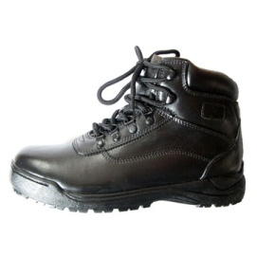
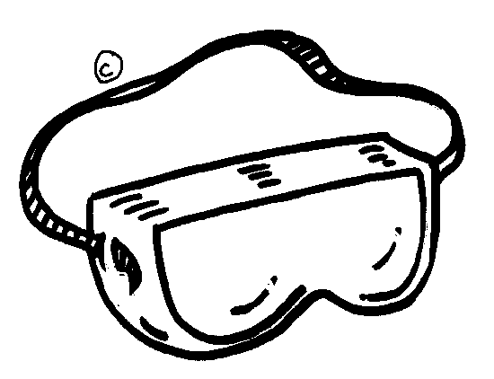



Safe work practices - PPE
DRESS RIGHT FOR THE JOB:
Safety hat
Safety Shoes
Safety Glasses / Goggles
Heavy Gloves
Hearing Protection
Reflective Vest
Respirator(when needed)
Source: Construction Industry Manufacturers Association, Scraper safety manual for operating and maintenance personnel, 1980

Slide 44
Know the working area
Think ahead! Become familiar with all conditions in the area, such as:
  Condition of haul roads.
  Holes, obstructions, mud and ice.
  Traffic routes and rules.
  Dust, smoke or fog.
  Underground utilities
Source: Construction Industry Manufacturers Association, Scraper safety manual for operating and maintenance personnel, 1980

Slide 45
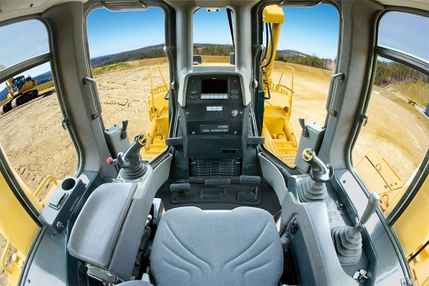
Pre-operation instructions
Read the manufacturer’s operating manual.
Know the capabilities of the equipment; and its limitations.
Become thoroughly familiar with all controls, gauges and instruments.
Work slowly and carefully
until accustomed with the equipment.
Know the protective devices on the scraper. For example: Guards, Canopies / Roll-over Protective Structures, Shields, Backup Alarms, Seat Belts.
Source: Construction Industry Manufacturers Association, Scraper safety manual for operating and maintenance personnel, 1980

Slide 46
Pre-operation walk-around check
Walk-Around the scraper at the start of each shift; and inspect:
Check to be sure there is nobody working on it, under or nearby.
Check the area to be sure it is clear of obstructions and/ or people.
Machine and engine compartments / instruments
Check utility / pressurized lines
Safety devices
Source: Construction Industry Manufacturers Association, Scraper safety manual for operating and maintenance personnel, 1980

Slide 47
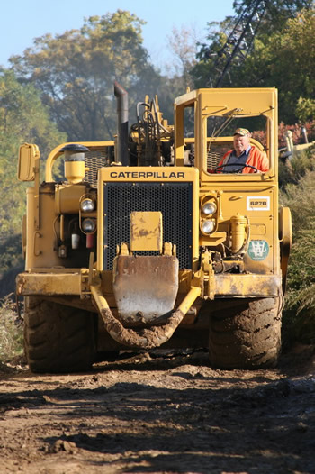
Pre-operation walk-around check
continued
Brake systems
Headlights and warnings
Dirt or trash buildup
Oil or coolant leaks
Structural maladjustments/ Looseness/ cracks
Wear or damage to moving parts
The scraper operator is responsible for operations and has the authority to stop work when conditions are unsafe.
Source: Construction Industry Manufacturers Association, Scraper safety manual for operating and maintenance personnel, 1980

Slide 48
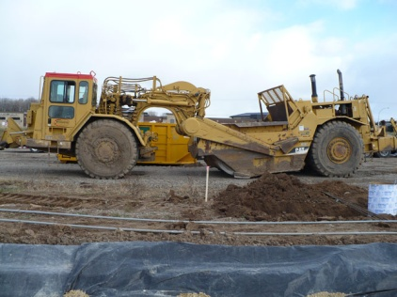
Safe work practices - DOs
Sound horn before starting
Observe all signs and signals
Mount and dismount carefully (Never forget three-point contact!)
Check warning devices
Obey traffic rules
Maintain control of scraper at all times
Be sure that communication between ground employees is clear and evident

Slide 49

Safe work practices – DON’Ts
Don’t overspeed especially with full pans
Don’t carry passengers
Don’t service a machine in motion
Don’t operate an unsafe machine
Don’t engage in horseplay
Don’t forget safety belt. Uneven terrains may cause a scraper to tilt

Slide 50
Operating scraper - safely
Be aware of overhangs / electrical wires, slide areas, or other dangerous conditions
Cross ditches, sidehills and ridges slowly, usually at an angle
Do not coast in neutral
Make sure clearance flags and other required warnings are on machine when roading
Watch for flagman or other personnel
Always apply retarder / brakes to reduce speed before entering sharp turns
Always anticipate grade; and select proper gearing range accordingly.
Source: Construction Industry Manufacturers Association, Scraper safety manual for operating and maintenance personnel, 1980

Slide 51
Service and repair scraper - safely
Attach appropriate warning tags to the steering wheel to prevent accidents.
Read and understand maintenance, lubrications, and engine manuals.
Keep hands and clothing away from moving parts.
Lower all raised equipment before servicing. Always block the apron and ejector securely.
Do not use gasoline or diesel fuel to clean parts.
Pressurized systems / Electrical systems can cause burns or serious injuries if not handled properly.
Source: Construction Industry Manufacturers Association, Scraper safety manual for operating and maintenance personnel, 1980

Slide 52
Think safety
Work safely

