Slide 1
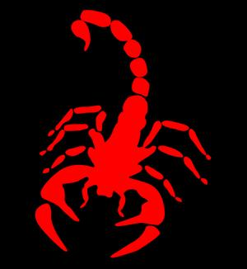
SCORPIONS

Slide 2
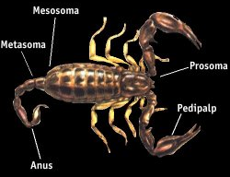
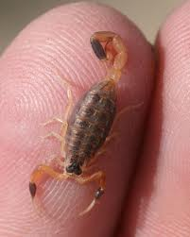
Introduction
Scorpions are nocturnal arthropods with eight legs, two pedipalps and a tail with a venom-injecting barb. They have exoskeleton made of chitin
They can live from 3 to 25 years
There are over 2,000 different species found on six of the seven continents, only 40 exist in the United States.
They Range in size from ½” – 7’-¼” long depending on the species
The exoskeleton allows them to maintain body temperature and conserve water, making them adept for living in arid climates.
http://www.scorpsweep.com/facts.html

Slide 3
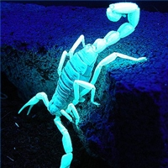
Life And Habitat
They are nocturnal and fossorial (Burrowing), finding shelter during the day in the relative cool areas and coming out at night to hunt and feed.
Where found? stacked lumber or bricks, firewood piles, cellars, and attics, sandy soils and under rocks.
While there are numerous scorpion species throughout desert climates, scorpions can be found in nearly any dry habitat including pine forests and grass lands.
US scorpions are most common in southern Arizona and in parts of Texas and central Oklahoma.
Scorpions exhibit photophobic behavior
http://www.scorpsweep.com/facts.html,
http://en.wikipedia.org/wiki/Scorpion

Slide 4
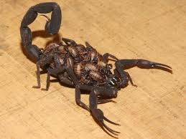
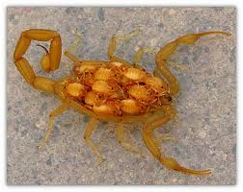
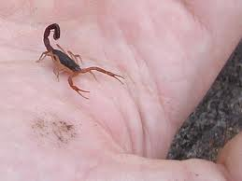
Life And Habitat
Some scorpion species can have over 100 viviparous (live birth) offspring, followed by the young climbing onto the mother's back for weeks until first molt and then living independently
Young scorpions can inject their prey with the same amount of venom as adults
http://en.wikipedia.org/wiki/Scorpion
http://en.wikipedia.org/wiki/Scorpion

Slide 5
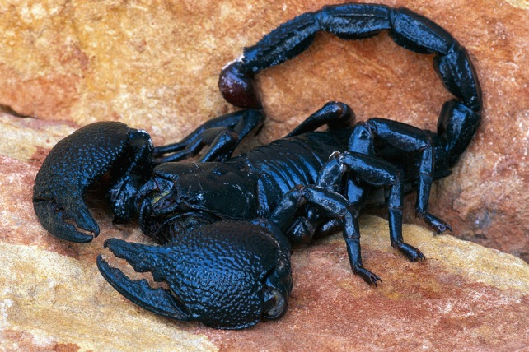
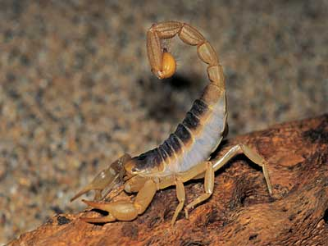
Types of Scorpions
Scorpions are classified a venomous arthropods in the class Arachnida
Scorpions with large, heavy pinchers are non-lethal; however, scorpions with slender pinchers generally contain lethal venom
In the United States, only one, the Arizona bark scorpion (Centruroides excilicauda), is considered lethal
http://www.slate.com/id/2107022,
http://www.scorpsweep.com/facts.html,
http://www.netdoctor.co.uk/travel/diseases/scorpions_and_spiders.html
http://firstaid.about.com/od/bitesstings/ht/08_Scorpions.htm

Slide 6
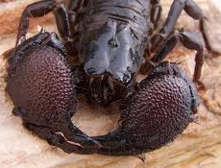
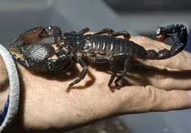
Scorpion types and severity of stings
The majority of scorpions are harmless to humans, although the sting is extremely painful and will require painkilling treatment.
Severe Symptoms
Severe symptoms may include sweating, heart palpitations, rise in blood pressure, salivation, nausea, vomiting, diarrhea, restlessness, and random movements and tremors of the neck or eyes.
hyperacute (typically allergic) reactions in the form of blurring of vision, unconsciousness, convulsions, fall in blood pressure, shock and consequently may lead to death.
http://www.slate.com/id/2107022,
http://www.scorpsweep.com/facts.html,
http://www.netdoctor.co.uk/travel/diseases/scorpions_and_spiders.html
http://firstaid.about.com/od/bitesstings/ht/08_Scorpions.htm

Slide 7
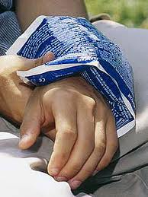
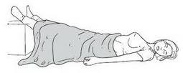
First Aid
Wash the area of the scorpion sting with soap and water, do not submerge.
Apply a cool compress (ice wrapped in a washcloth or other suitable covering) on the area of the scorpion sting.
If stung on a limb (arm or leg) elevate the limb to heart level.
Keep the victim relaxed and avoid alcohol consumption
Acetaminophen (Tylenol) 1-2 tablets every 4 hours may be given to relieve pain.
http://www.scorpsweep.com/facts.html,
,

Slide 8
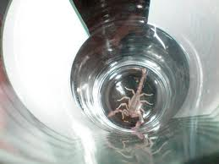
First Aid
Avoid aspirin and ibuprofen (Advil, Motrin).
Antibiotics are not helpful
Do not attempt to cut the sting area or suck the venom out
If possible, capture the scorpion for proper identification.
For serious reactions: call 911, poison control, or take the victim to the ER
http://www.scorpsweep.com/facts.html,
,

Slide 9
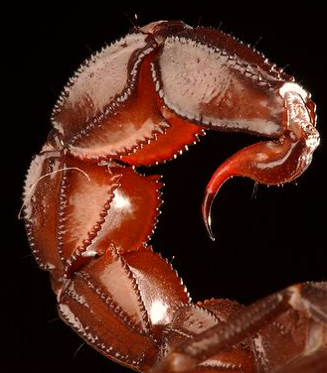
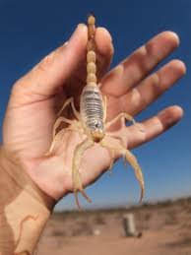
Handling scorpions.
Never handle a scorpion with bare hands.
The tail of a dead scorpion can inject venom
Exception- the African emperor scorpion
Usually docile and can sometimes be carefully and gently handled
Can and will sting if it is startled or handled roughly
www.arkive.org
Wearing personal protective equipment, such as gloves and boots, can prevent a sting
http://) www.geocities.com/CapeCanaveral/Hangar/2437/scorpionhandling.html,

Slide 10
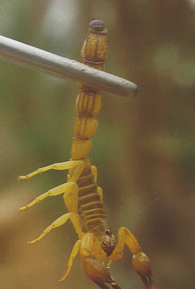
Handling scorpions.
Safest way to handle any scorpion is to use a long pair of tongs or forceps (padded with foam rubber) to grasp the animal at the end of the abdomen, just behind the telson
http://www.ipernity.com/home/33138
A safer method for handling scorpions (most applicable for pet scorpions) is to lure them into open areas. Cover the scorpion with a container, such as a transparent cup. Slide a piece of hard cardboard slowly under the cup and the scorpion will be safely contained in the covered cup.
http://members.tripod.com/~c_kianwee/care.html

Slide 11
Statistics
In the US in 2004, a total of 14,950 scorpion stings were reported to the American Association of Poison Control Centers; however, because of underreporting, this is probably an underestimation of the true number of stings.
The highest reported mortality rate is recorded in data from Mexico, with estimates as high as 1000 deaths in one year.
In the United States, 4 deaths were reported in an 11-year period according to one source (Langley, 1997), but according to another source, only one death from the Arizona bark scorpion has been reported since 1964 (Boyer, 2001)
No deaths were reported to the American Association of Poison Control Centers from 1983 to 1999.
Children and elderly persons have an increased risk of mortality.
http://www.emedicine.com/emerg/topic524.htm

Slide 12
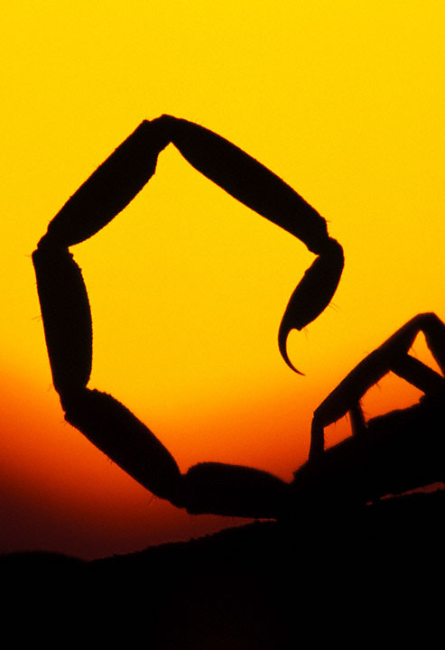
OSHA Investigated Fatalities
There were no OSHA-investigated fatalities from 1990 thru 2009

Slide 13
OSHA Regulations
There are no OSHA regulations that specifically mention scorpions, some regulations clearly apply to them.
1926.604 - Site Clearing
General requirements
1. Workers engaged in site clearing must have protection from plants, insects, and animals that may be hazardous. They must also know first aid for these hazards.
1926.21 – Safety Training and Education
(b) Employer Responsibility
4. The employer must instruct workers about harmful plants and animals around the job site, potential hazards, how to avoid injury and required first aid.

Slide 14
OSHA Regulations
1926.51 - Vermin control
Every enclosed workplace shall be so constructed, equipped, and maintained, so far as reasonably practicable, as to prevent the entrance or harborage of rodents, insects, and other vermin. A continuing and effective extermination program shall be instituted where their presence is detected.
1926.250 - House Keeping
Storage areas shall be kept free from accumulation of materials that constitute hazards from tripping, fire, explosion, or pest harborage.

Slide 15
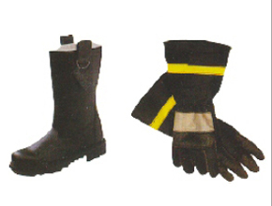
Scorpion Safety on a Construction Site
Safety Precautions:
If gloves or boots are stored at the jobsite, check them in the morning before wearing them.
To avoid being stung, wear long pants, socks, and long-sleeved shirts.
Wear gloves and thoroughly inspect any wood or other materials before handling them.
Watch for scorpions near ditches, ponds, etc. Keep the site clean and reduce the number of insects in the immediate environment.
http://www.whatsthatbug.com/2006/02/14/south-african-scorpion-dangerous-pseudolychas-pegleri/

Slide 16
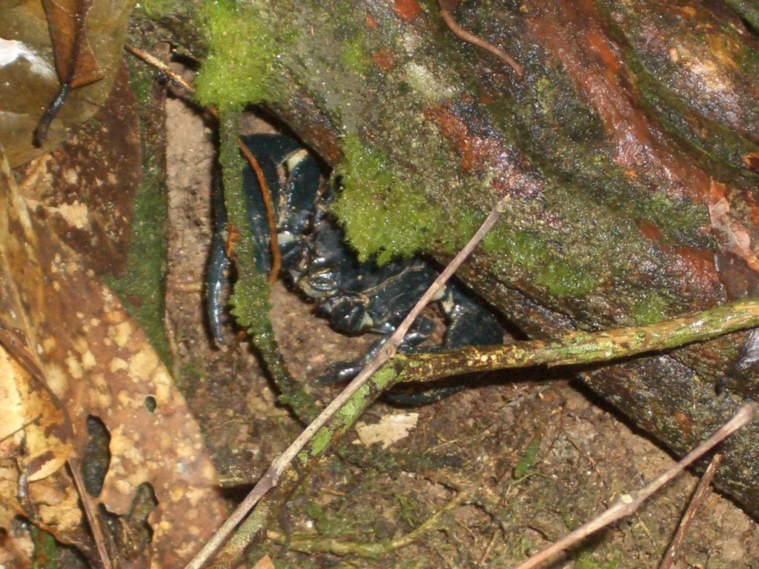
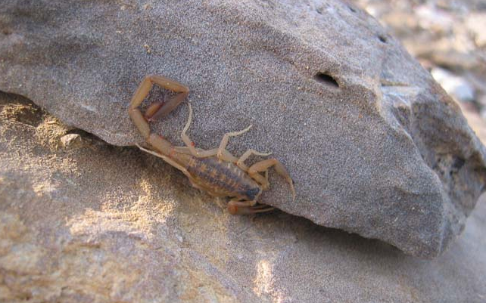
Scorpion Safety on a Construction Site
General Hiding places on construction site :
In stacked lumber or bricks, firewood piles, cellars, and attics
Burrowing scorpions can be found in sandy soil or under rocks
Scorpions only need a crack of 1/16 inch to enter a home.
Scorpions like water, especially in more arid climates. Any dark, damp place in contact with the earth is also a potential scorpion habitat.
http://www.whatsthatbug.com/2006/02/14/south-african-scorpion-dangerous-pseudolychas-pegleri/

Slide 17
Think Safety
Work Safely

