Slide 1
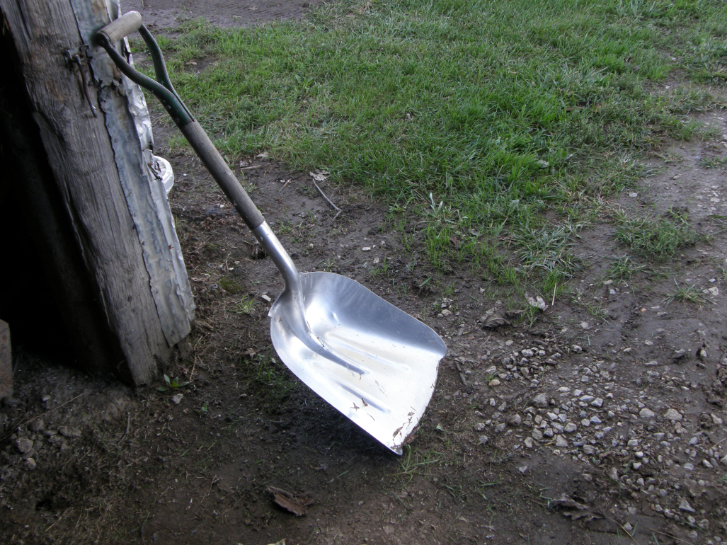
SCOOPS

Slide 2
What are they?
Scoops, also called shovel-scoops are tools used for lifting and moving loose materials such as coal, gravel, snow, soil and debris.
They are commonly used in construction, agriculture and gardening
http://en.wikipedia.org/wiki/Shovel

Slide 3
History
Shovel scoops, evolved over the years as a result of the need for moving lighter materials instead of digging
Similar garden tools date back to 6000 B.C. The Romans later mastered the shape of the shovels used today http://historiccamdencounty.com/ccnews69.shtml

Slide 4
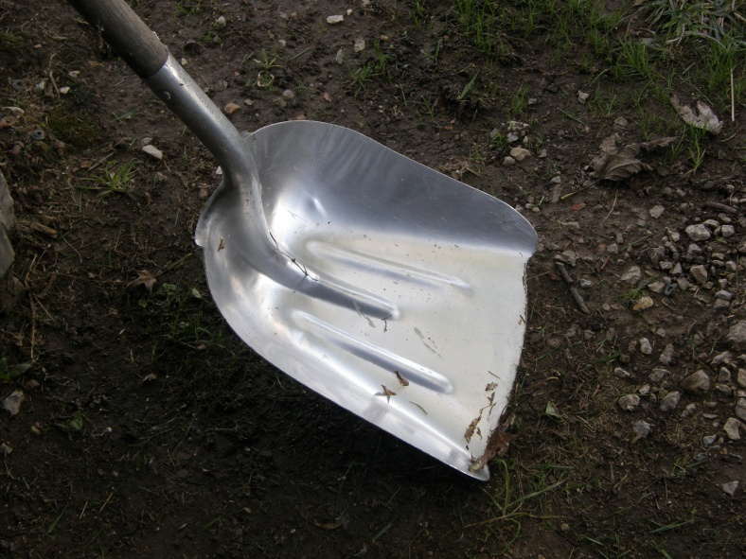
Industry Usage
Shovel scoops in the construction industry are used in removing light materials, especially non-cohesive soil and debris

Slide 5
Safety Concerns & Hazards
Typical safety concerns generally are about straining fatigue on the back from prolonged use
Other sources cite heart attacks, from over-exertion
http://www.cbsnews.com/stories/2003/01/16/earlyshow/saturday/main536799.shtml

Slide 6
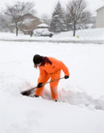
Injury Report
Most of the injuries resulting from shovel-scoops are from straining the back and heart attacks as a result of over working

Slide 7
Fatality Example
A worker was shoveling sand, as part of a stucco job
The work was strenuous but non-continuous and plenty of water and breaks were provided
Worker collapsed from heart attack and died

Slide 8
OSHA
OSHA does not address the issue of shovel-scoop safety and citations
Fatalities data 1999- 2007, line 7828

Slide 9
Safe Usage
Safe Usage of shovel-scoops involve foremost a visual and physical inspection
PPE that is needed;
Hard hats
Safety goggles
Steel-toed boots

Slide 10
Safe Work Procedures
Assess the appropriate weight of material to be in each scoop
Lift with the legs, not the back
Do not try to cast the material too far
Take frequent breaks

Slide 11
THINK SAFETY
WORK SAFELY

