Slide 1
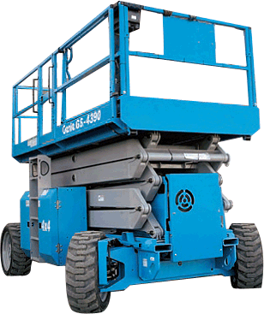
SCISSOR LIFTS
Source: http://www.aerialift.com/scissor_lifts.htm

Slide 2
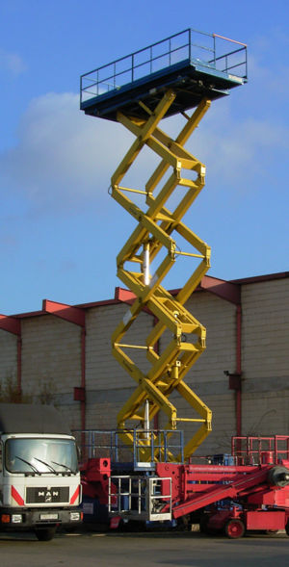
What is a Scissor Lift?
An aerial device or elevating work platform used to provide temporary access for people or equipment to inaccessible areas, usually at height
Source: http://www.mecaniquetechnipro.com/equipements/nacelles/index.html

Slide 3
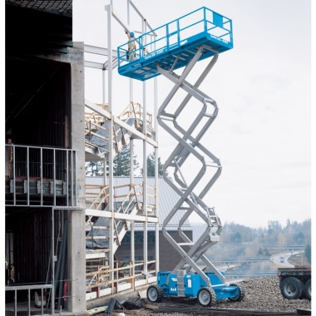
What is a Scissor Lift?
Fueled by either electricity, gasoline, diesel, or propane
May be equipped with outriggers for supplementary stabilization
Equipped with a platform extension for a larger walking and working space
Source: http://www.diamondtool.net/assets/product_images/pg_2493/pg_2493_0_md.jpg

Slide 4
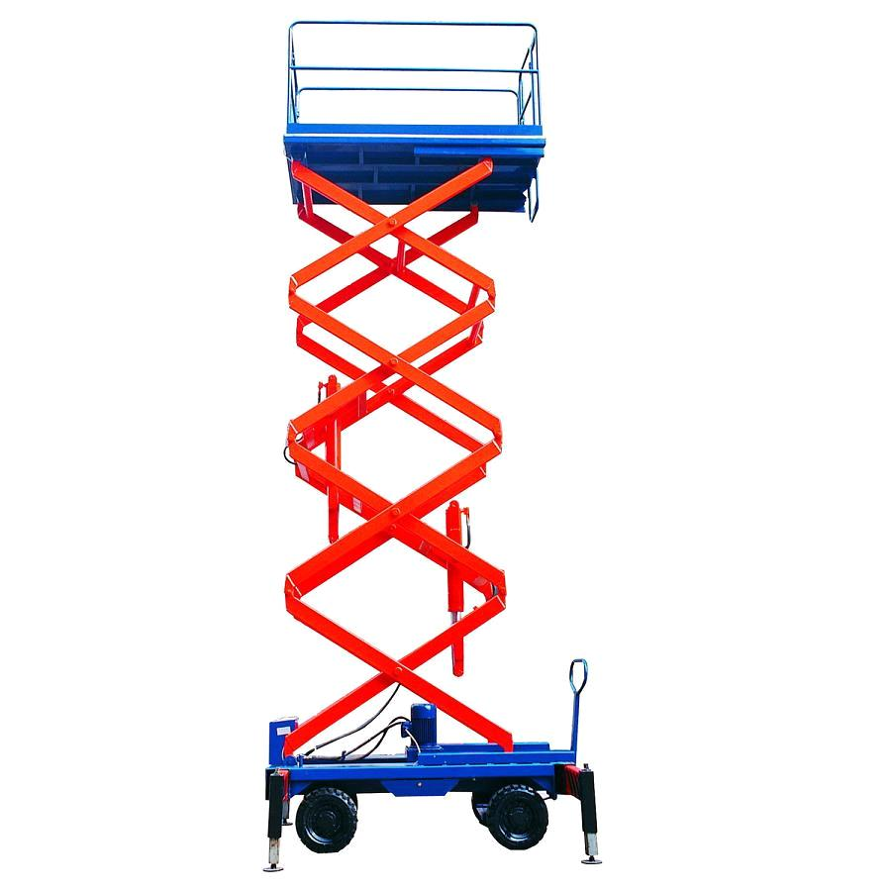
How it Works
Pressure is applied to the outside of the lowest set of supports, which then returns an upward force to the rest of the supports.
Source: http://www.locostusa.com/forums/viewtopic.php?f=1&t=11963

Slide 5
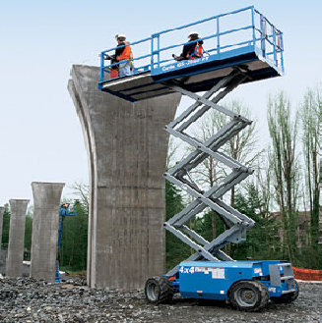
Scissor Lift Applications
Elevates workers to reach heights that would not be practical with extension ladders (from 8’ to 55’)
Able to provide multiple workers with a mobile platform and working surface that is easier to move than scaffolding
Source: http://abccreditapplication.info/scissor%20lifts009001.jpg

Slide 6
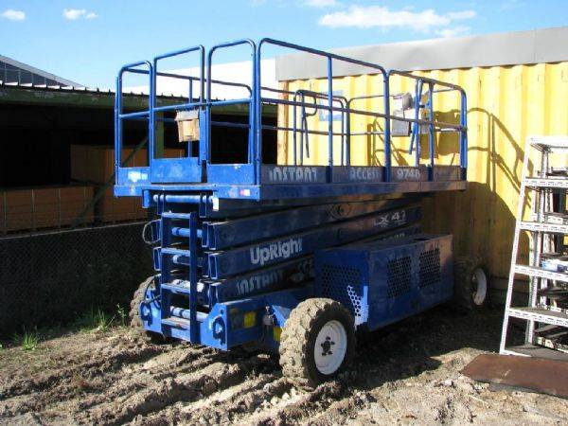
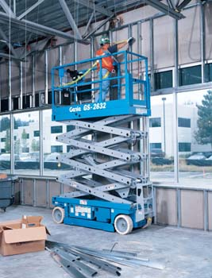
Scissor Lift Applications
Can work on either rough terrain such as gravel or dirt, or on finished floors such as concrete.
Source: http://www.graysonline.com/lot/0035-55454/earth-moving-and-mobile-plant/all-terrain-scissor-lift-upright-4wd-model-l-x-41-s-n-1208-mfd-1996-swl
Source: http://www.billstoolrental.com/tools

Slide 7
Safety Concerns
Operating on an uneven surface
Encountering holes, debris, and drop-offs while operating at elevation
Climbing above or leaning over the 42-inch minimum top rail
Overloading and collapsing the boom (using a man-lift as a material crane)
Making contact with electrical conductors with an un-insulated portion of the lift

Slide 8
Safety Concerns
Neglecting to deploy outriggers or brace sufficiently against tip-over
Making body contact with electrical conductors or entering the induction field
Operating the lift in inclement weather or low visibility conditions
Inexperienced or untrained operators
Unobserved, uncorrected mechanical or structural defects in equipment

Slide 9
Fatalities (1990 thru 2007)
There were 95 construction worker deaths involving scissor lifts that were investigated by OSHA from 1990 thru 2007
There are 26 deaths per year on average involving aerial lifts in industry work
Source: Extracted from OSHA Accident Investigation Data 1990-2009

Slide 10
Fatality Example
A worker was installing a sprinkler system in the auditorium of a movie theater under construction. He was using a self-propelled scissor lift which he was driving with the lift raised to its maximum height of 20 ft. He apparently drove the scissor lift off a 4 in. high ledge. It overturned and the employee fell approximately 25 feet. He was killed.
Source: Extracted from OSHA Accident Investigation Data 1990-2009

Slide 11
Fatalities in Construction
44 OSHA recorded accidents resulted from:
Being caught between scissor lift and building structure
Falls from scissor lift platform or guardrail
Scissor lift tip-over
Electrocution
Of these accidents, 33 resulted in fatalities. It is not explicitly stated in the accident details whether or not the remaining 11 were fatal.
Source: Extracted from OSHA Accident Investigation Data 1990-2009

Slide 12
Applicable OSHA Regulations
Scissor lifts are classified by OSHA as scaffolding
§1926.452(w) - Mobile Scaffolds
This regulation describes the requirements for bracing members, wheel locks, height limit for manually applied forces, use of outriggers, appropriate power systems, maximum speeds, stabilization measures, and ground leveling requirements

Slide 13
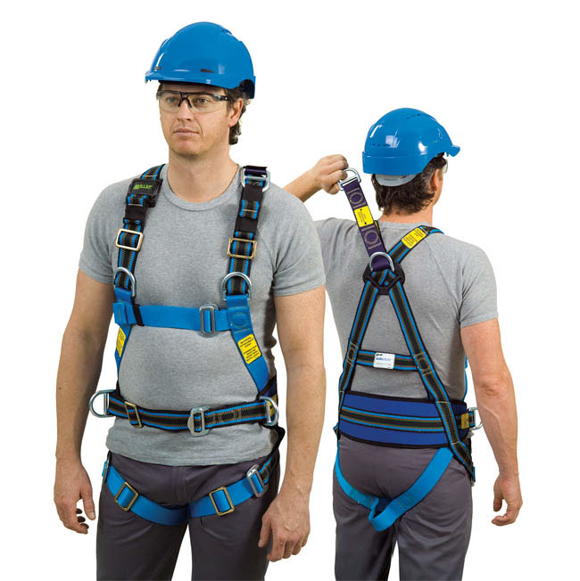
Scissor Lift Safety
Workers must wear a personal fall-arrest system at all times while in the basket
Workers must not ride in the basket unless the scissor lift is travelling on a surface that is within three degrees of level
Source: http://www.safetysupplies.com.au

Slide 14
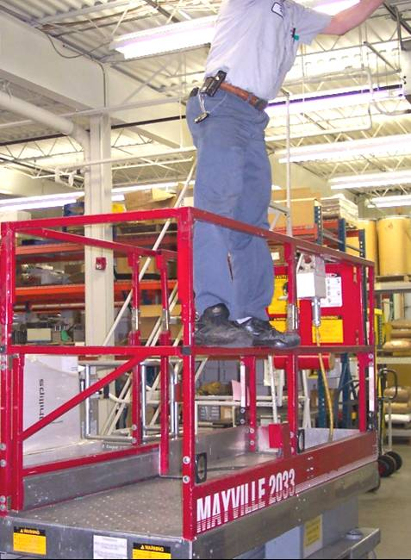
Scissor Lift Safety
Employees shall always stand on the floor of the basket and shall not sit or climb on the edge of the basket or use planks, rails or other devices for a work position
Source: http://safetyrealworldchallenges.blogspot.com/

Slide 15
Scissor Lift Safety
Do not overload the lift or use the basket as a material transportation device
Exercise extreme caution in the vicinity of overhead power lines or other sources of energy
Inspect the machine and its corresponding parts before every use
When renting a scissor lift, it is best to first obtain and review all rental and repair records

Slide 16
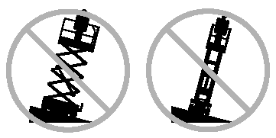
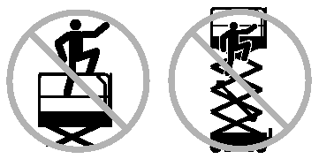
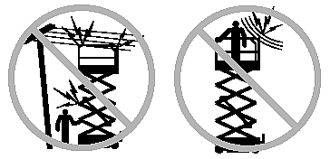
Scissor Lift Safety
Source: http://www.rentrain.com/allrental/product.php?id=57942&type=safety

Slide 17
Accident Prevention
Develop maintenance and documentation procedures for rental yard clients
Emphasize the need to document pre-delivery and return inspections
Training
Only allow licensed and authorized employees to operate the scissor lift
Allow time to instruct for safe operation of machinery

Slide 18
Think Safety
Work Safely

