Slide 1
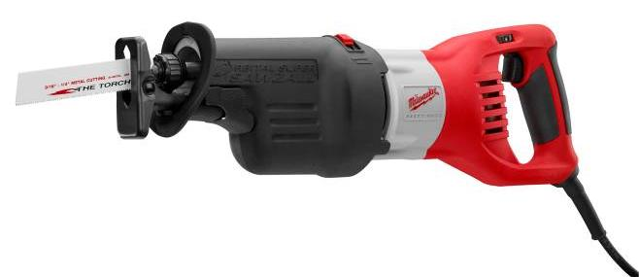
Reciprocating Saws
http://www.milwaukeetool.com/CMS/Publications/Super%20Sawzall%206538-21_FR.jpg

Slide 2
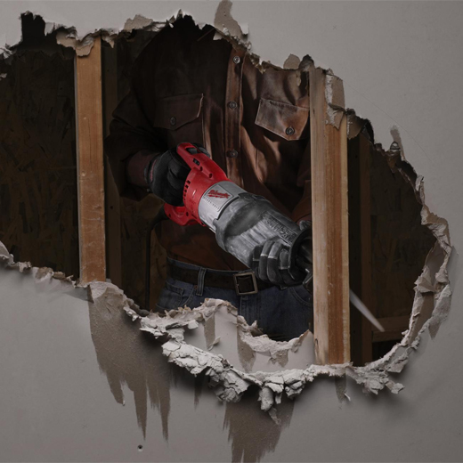
Introduction
A reciprocating saw is a type of saw in which the cutting action is achieved through a back and forth motion of a toothed blade
Typically used in the construction industry for demolition and rough cutting of drywall, metal, plaster, tubing, and wood
Commonly referred to as a Sawzall
http://en.wikipedia.org/wiki/Reciprocating_saw

Slide 3
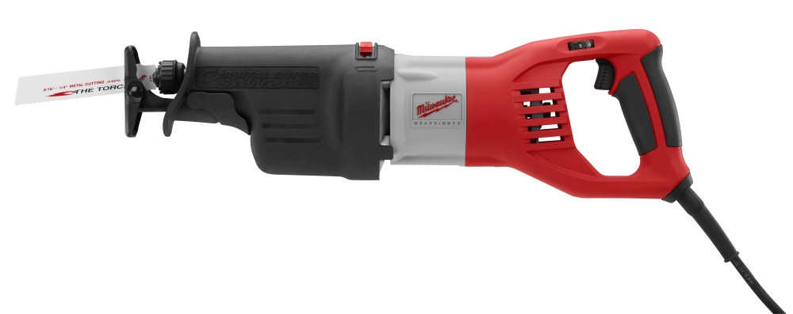
Features and Controls
Saw Blade
Blade Clamp
Motor
Handle with Variable Speed Trigger
Adjustable Pivot Shoe
Front Handhold
Insulating Boot
http://www.milwaukeetool.com/CMS/Diagrams/58-14-4126d2.pdf

Slide 4
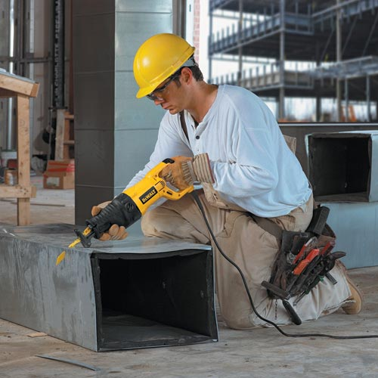
Operation
For cutting from an edge, align the blade with the cutting surface before pulling the trigger
Always hold the shoe flat against the work piece to avoid excess vibration
http://www.milwaukeetool.com/CMS/Diagrams/58-14-4126d2.pdf

Slide 5
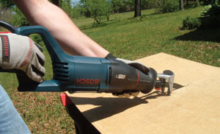
Operation
For plunge cuts, rest the shoe on the work surface and with the blade about to contact the material, pull the trigger
As the blade begins cutting, raise the handle of the saw until the shoe firmly contacts the cutting surface
http://www.extremehowto.com/xh/hotprod_images/4_2005_0414alligator0017.jpg

Slide 6
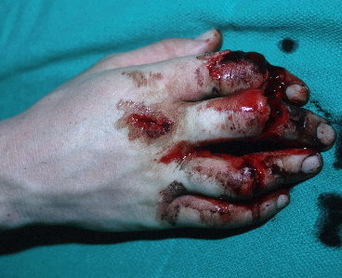
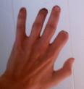
Injuries
Most injuries occur to the fingers, hands, and arms in the form of lacerations and amputations due to improperly handling the saw and not following safety guidelines
Other reported injuries have occurred due to electrocution and collapsing loads
http://www.associatedcontent.com/article/2536917/common_saw_defects_and_sawrelated_injuries.html

Slide 7
OSHA Statistics
There were 10 fatalities involving reciprocating saws that were investigated by OSHA from 1990 thru 2009
Electrical Shock
50%
Struck by Debris
20%
Heart Failure
10%
Crushed by Debris
10%
Struck by Blade
10%
Source: Extracted from OSHA Accident Investigation Data 1990-2009

Slide 8
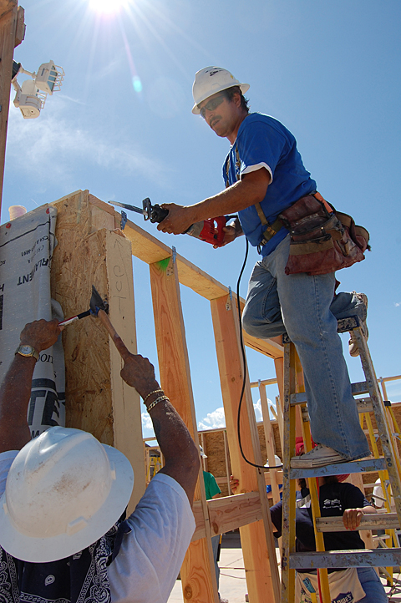
Fatalities
A worker was demolishing an interior partition using a portable reciprocating saw when he was struck by debris from the partition, causing him to fall from a ladder. He died from his injuries.
Source: Extracted from OSHA Accident Investigation Data 1990-2009

Slide 9
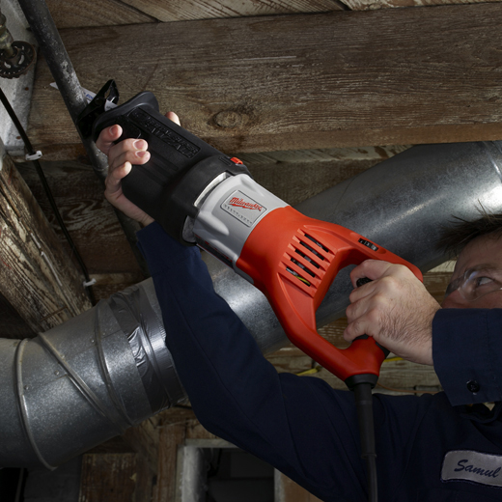
Fatalities
A worker was cutting a ceiling joist when he hit a section of Romex electrical wire. He continued to saw which resulted in his electrocution.
Source: Extracted from OSHA Accident Investigation Data 1990-2009

Slide 10

Fatalities
A plumber was attempting to cut a hole in a roof when he lost control of the Sawzall and struck himself between his eye and temple with the blade. The plumber later died from his injuries.
Source: Extracted from OSHA Accident Investigation Data 1990-2009

Slide 11

OSHA Regulations
1926.300(d)(2)
  Reciprocating saws…with blade shanks greater than a nominal one-fourth inch…shall be equipped with a constant pressure switch or control, and may have a lock-on control provided that turnoff can be accomplished by a single motion of the same finger or fingers that turn it on.
http://www.osha.gov/pls/oshaweb/owadisp.show_document?p_table=STANDARDS&p_id=10688

Slide 12
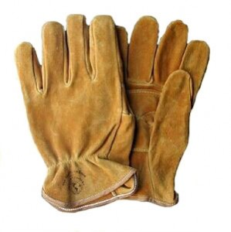
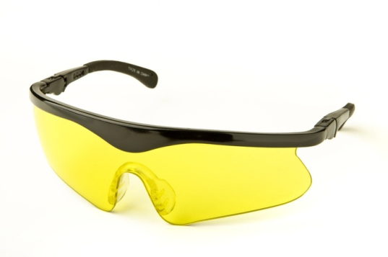
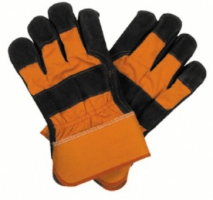
Personal Protective Equipment
Leather or general work gloves
  To ensure proper grip on saw
  To protect hands from saw blade and debris
Safety glasses
  To protect eyes from debris or broken blade
http://guttercleaningtips.com/work-gloves/

Slide 13
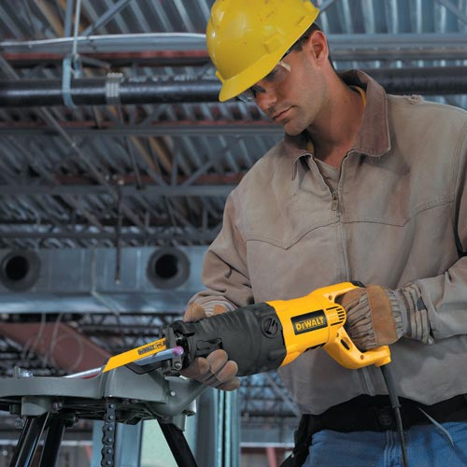
Safety Procedures
Read Operating Instructions Before Use
Avoid accidental starting by ensuring switch is off prior to plugging into outlet
Check blade for breakage before each use
http://www.milwaukeetool.com/CMS/Diagrams/58-14-4126d2.pdf

Slide 14

Safety Procedures
Discontinue use if power switch is malfunctioning
Remove blade tightening key or wrench before turning power on
Use clamps or other restraining devices to secure and support work piece to stable platform
http://www.milwaukeetool.com/CMS/Diagrams/58-14-4126d2.pdf

Slide 15
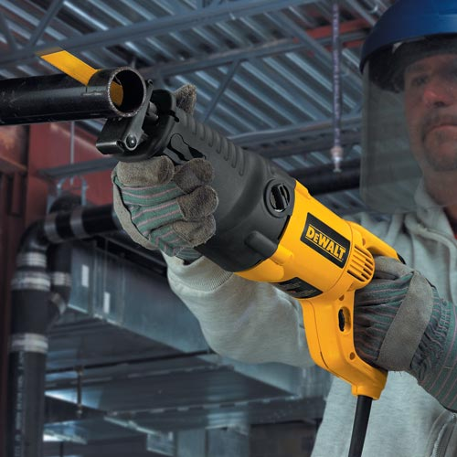
Safety Procedures
Keep cutting edges sharp and clean
Keep hands away from all cutting edges and moving parts
When possible, keep the shoe flat against the material being cut
Wear insulating gloves when cutting operations are performed where the blade may contact hidden wiring
http://www.milwaukeetool.com/CMS/Diagrams/58-14-4126d2.pdf

Slide 16
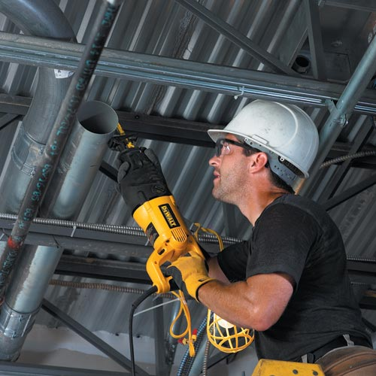
Safety Procedures
Do not handle by the cord at any time
Do not force through cutting material
Do not overreach but keep proper footing and balance
Disconnect from power before making any adjustments, changing accessories, or storing
http://www.milwaukeetool.com/CMS/Diagrams/58-14-4126d2.pdf

Slide 17
Think Safety
Work Safely

