Slide 1
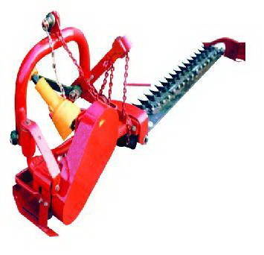
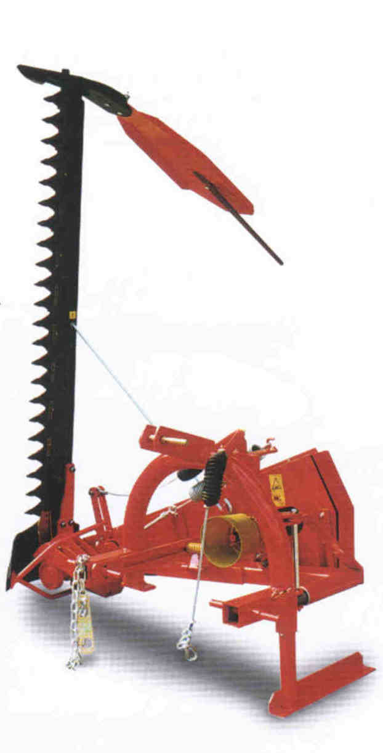
Mowing Machines

Slide 2
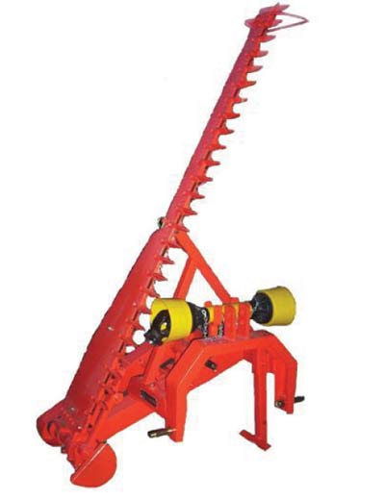
Purpose and Uses
Tractor-Mounted Mowing Equipment
Mowing machines for construction projects are mostly for long term sites that require maintenance in the form of site mowing and agricultural trimming.
Keeping grasses at safe lengths so that equipment does not become lost or tangled in overgrown grass and bushes
Keeping foliage from pushing off site
Keep up appearance of the site

Slide 3
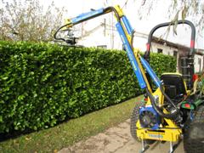
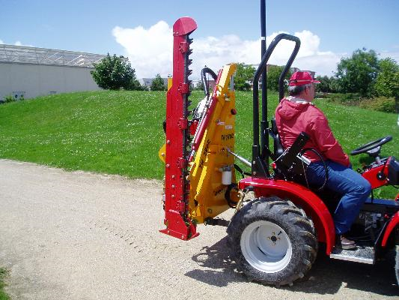
Types of Equipment
Mowers are removable and mounted on almost any utility or crop tractor in a number of different ways
They can be mounted statically to the tractor, on a movable boom arm, pushed like a lawn mower or towed behind like a trailer

Slide 4
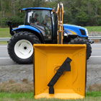
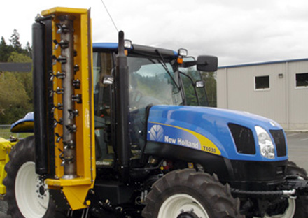
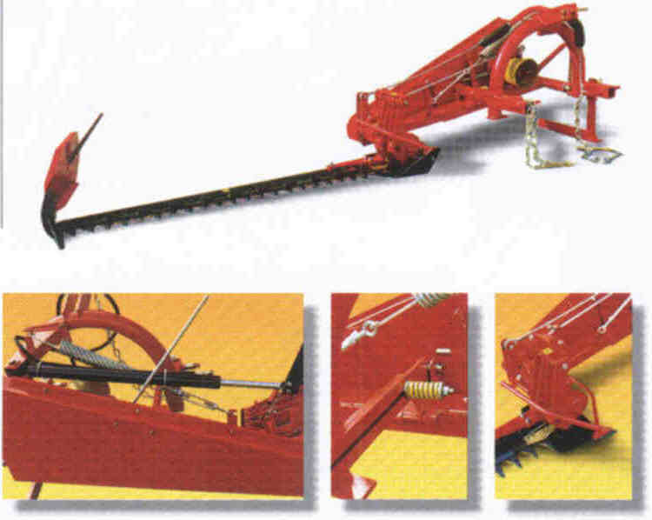
Different Types of Blades
Flail Mower
Rotary Mower
Reciprocating Mower
Long rotating shaft held in place horizontally with spinning teeth
Reciprocating blades much like a hedge trimmer that can be attached to the sides of a tractor
Spinning blade can be positioned on boom arm to cut at almost any angle (traditional mower blade style)

Slide 5
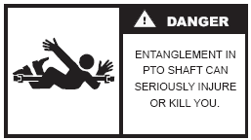
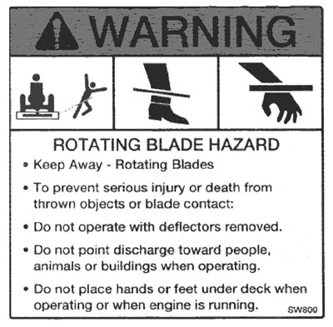
Safety Concerns
People in the vicinity of mowing equipment
Being caught in moving parts can result in serious injury or death
Blades: sharp spinning or reciprocating blades can be very dangerous do to the threat of lacerations and amputations
Hearing and Eye Protection should be warn to prevent injury from prolonged noise exposure and flying debris

Slide 6
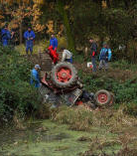
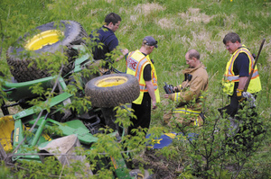
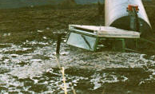
Dangerous Work Areas
Steeply Sloped Areas: While mowing on a slope tractors are at higher risks for rollovers and loss of control due to sliding or tipping
Unseen Hazards:
Holes or objects that could tip the tractor
Mud, water, or soft ground that could get the tractor stuck or even sink it
Getting hit by traffic while along roadsides

Slide 7
There were 7 reciprocating mower fatality accidents investigated by OSHA from 1990 thru 2009
Source: Extracted from OSHA Accident Investigation Data 1990-2009

Slide 8
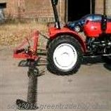
Example Fatality Case

Slide 9
Example Fatality Case
An Employee was operating a tractor mower when the machine rolled into a ditch, hit a culvert, rose into the air, and then jerked to a stop on a cement driveway at the side of the road. The employee was thrown from the tractor and died.

Slide 10
Example Fatality Case
An employee was clearing vegetation from a 4ft drainage canal when he hit an unanticipated 23ft deep hole that was the result of unauthorized excavation. The mower dropped into the hole and the employee drowned.

Slide 11
Example Fatality Case
Three workers wanted to tighten bolts attaching a gear box to a mowing machine, so they drove the tractor up two wooden ramps onto a trailer leaving a portion hanging off the back of the trailer. They then raised the mower as high as possible with its built in hydraulics. One of the employees was underneath the mower when the hydraulic fluid leaked out and the mower dropped on top of him. He was extracted but died later at the hospital.

Slide 12
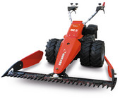
OSHA Fatality Data 2007-2009
While trying to mow the side of a dam, an employee lost traction and his tires slid over the sides of the dam and flipped over. Due to the age of the tractor no safety systems were in place and he was crushed when the tractor rolled over

Slide 13
There are no OSHA regulations that specifically mention reciprocating mowers

Slide 14
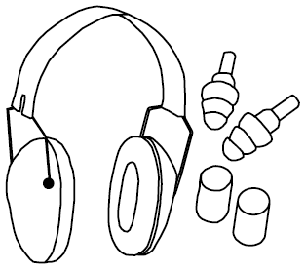
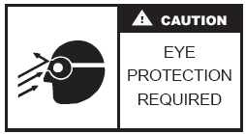
Safe Work Procedures
Wear eye and ear protection
Wear appropriate gloves
Work Boots with non-slip soles and plenty of traction
Wear hard hats when on site in open cockpit vehicles
Wear high visibility colors when working along roads or in areas with poor visibility

Slide 15
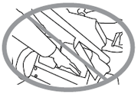
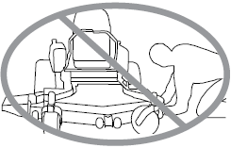
Safe Work Procedures
Always conduct a pre-trip inspection of equipment, tractor, and work zone
Never Service mower attachment while it is still running
Proper signs, markers and lights should be used to mark vehicles and cutting blades

Slide 16
Safe Work Procedures
Beware of presence of other persons, vehicles and surroundings while operating mower attachment
Always look and use caution when backing up
Whenever possible, use a tractor equipped with a Rollover Protection Structure (R.O.P.S.)

Slide 17
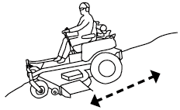
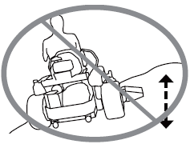
Safe Work Procedures
Only use tractor attachments on slopes and in places where they were designed to be used
Do not transport passengers on the tractor or drag passengers behind the tractor
Make sure tractor has a Slow-Moving Vehicle (SMV) sign, usually bright orange or red attached

Slide 18
Safe Work Procedures
Keep plenty of clean drinking water on-hand to prevent heat exhaustion and dehydration
Always mow up and down slopes with any kind of ride on mowers

Slide 19
Think Safety Work Safely

