Slide 1
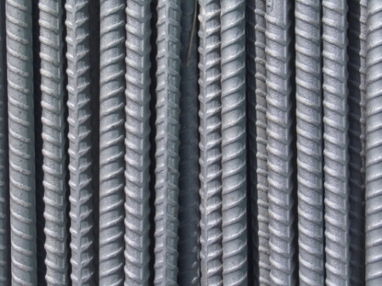
Rebar Safety

Slide 2
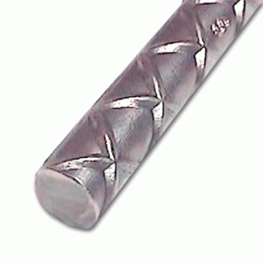
Rebar
Rebar, also known as reinforcing bar, is typically composed of carbon steel and is used in concrete and masonry structures for increased structural strength
http://www.bennys.bz/images/uploads/rebar.gif

Slide 3
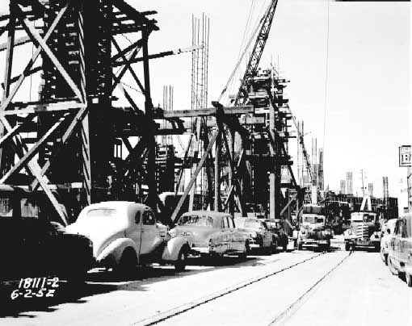
History of Rebar
The first system was patented in 1878 in the United States that regulated the production of reinforcing steel bars to be used in concrete.
The Pacific Coast Borax Company refinery building in California was the first building to be constructed using rebar in 1893
http://www.wsdot.wa.gov/Projects/Viaduct/Photos/

Slide 4
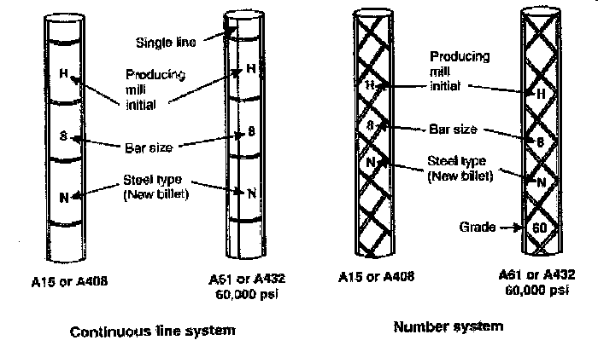
Rebar in the Field
Rebar adds strength and flexibility to concrete which helps prevent cracking and breakage
Individual bars contain information that comes in ribbing and markings in order to easily identify specifications
www.constructionknowledge.net

Slide 5
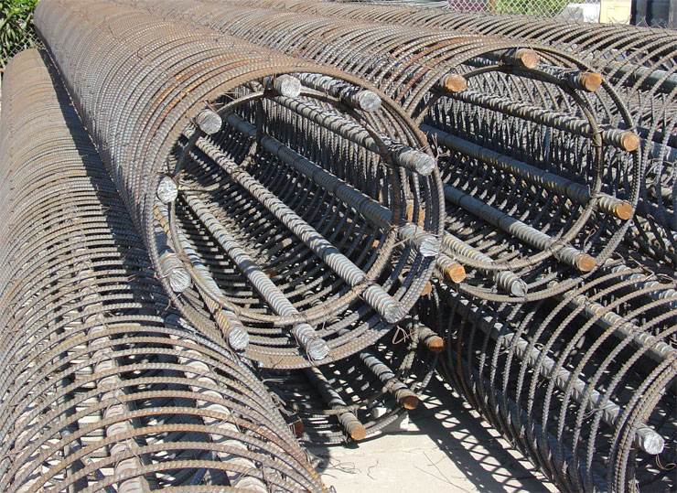
Rebar in the Field
Rebar can be used in concrete walls, columns, beams, and footings
Rebar is used to strengthen concrete structures
www.rebarsupply.net

Slide 6
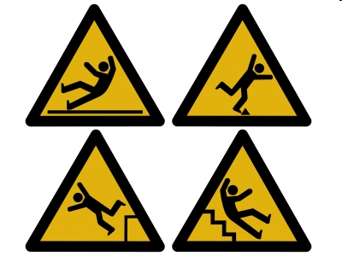
Rebar Safety Concerns
Several types of injuries can occur:
Trips and falls
Impalements
Cuts and Abrasions
Falling when erecting due to improper tie-offs
www.sandiegopersonalinjurylawyersblog.com

Slide 7
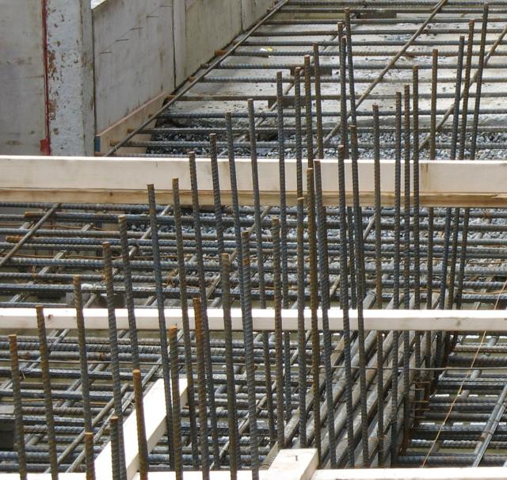
Rebar Hazards
Hazards to consider when working directly with rebar
Weight of the rebar
Cuts from tie wire
Trip hazards
Slip/trip hazards created by waste ends
cdn2.content.compendiumblog.com

Slide 8
Rebar Fatality Cases
From 1990 to 2009 there were 51 cases of construction (rebar) fatalities
Source: Extracted from OSHA fatality investigation data 1990-2009

Slide 9
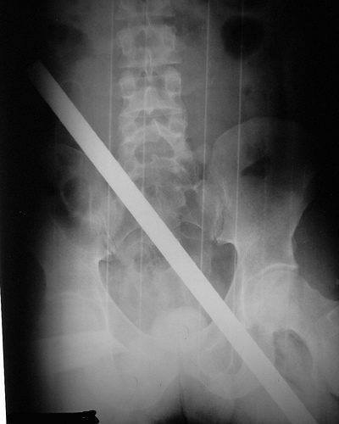
Example Rebar Fatality Case
A worker was on scaffolding at about the fourth floor elevation. Rebar was being stored on the 19th floor. The rebar became unbundled and a single piece of rebar fell from the 19th floor vertically. The piece of rebar impaled the employee on the scaffolding entering through his shoulder and continuing through his body killing him
Source: Extracted from OSHA fatality investigation data 1990-2009
http://www.flickr.com/photos/nottlong/1331690117/

Slide 10
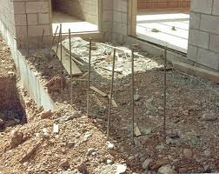
Example Rebar Fatality Case
A worker was standing at ground level holding the concrete hose assisting another worker. The worker was walking backwards and stepped into a hole, falling approx. 6 feet striking a 2" x 12" beam with his left torso and continued falling with his head striking an uncapped piece of rebar.
www.osha.gov
Source: Extracted from OSHA fatality investigation data 1990-2009

Slide 11
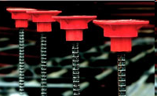
OSHA Rebar Regulations
1926.701(b): Reinforcing steel. All protruding reinforcing steel, onto and into which employees could fall, shall be guarded to eliminate the hazard of impalement.
Source: OSHA Regulations 1926
Source: OSHA Regulations 1926

Slide 12
OSHA Rebar Regulations
1926.703 - Reinforcing steel for walls, piers, columns, and similar vertical structures shall be adequately supported to prevent overturning and to prevent collapse.
Source: OSHA Regulations 1926

Slide 13
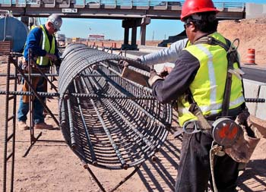
Safe Work Practices
Always use the correct PPE when working with rebar
Hard hat
Stee-toed shoes
Long pants
Harness and tie off
lanyard at elevation
Gloves
Safety glasses
Hearing protection
www.nmshtd.state.nm.us

Slide 14
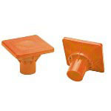
Safe Work Practices
Rebar Plate Caps
Plate caps are not abrasion-resistant caps
Rebar caps and troughs must be tough enough to withstand a drop of 250lb at 10ft.
http://www.heavydutystore.com/allsafe-3011839-pc-110-bar
-guard-rebar-cap-pr-22714.html

Slide 15
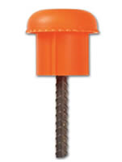
Safe Work Practices
Mushroom Caps
Mushroom caps do not protect against impalement
They are used to protect against abrasion
http://www.polylok.com/files/main_images/rebar_cap.jpg

Slide 16
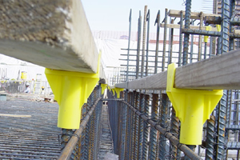
Safe Work Practices
Trough impalement protection
When a force is applied to the trough system, the impact is distributed evenly over the entire length of the lumber
Caps are not needed on each individual rebar
http://www.bossteel.com/Safety-RPC.html

Slide 17
Think Safety
Work Safely

