Slide 1
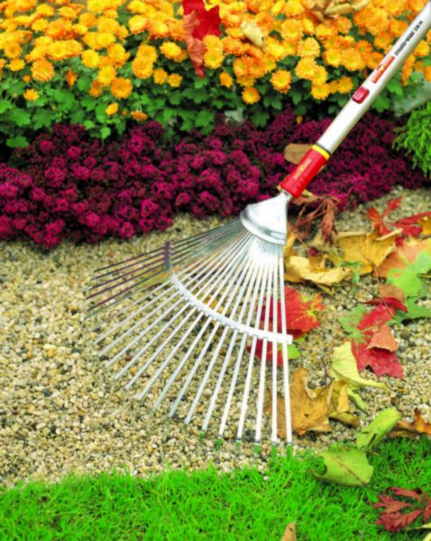
GARDEN RAKES
http://www.bluestonegarden.com/images/D/d-16186-02.jpg
Notes:
Changed all backgrounds to Black
Changed all text to White color
Changed all titles to bolded Yellow

Slide 2
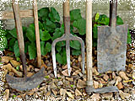
History
Ever since there was farming and cultivation of food, there have been tools to help do the work
The industrialization of farming would lead one to believe that some of these tools would be lost in history
This is incorrect. Today we still have many of the tools such as garden rakes which our ancestors used in ancient Greece and early America.
The quality of the products have gotten better, but the general use of the garden rake remains the same
http://historiccamdencounty.com/ccnews69.shtml
Notes:
“Since” was capitalized

Slide 3
Description
A garden rake has a long handle with a head on it used to organize leaves, mulch, and sometimes stones
The proper way to use a garden rake is hold it with two hands and run it across the materials to be organized. The rake will consolidate the materials on the ground into a pile

Slide 4
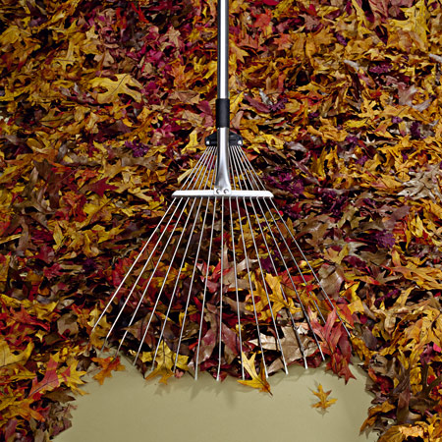
Different Types of Garden Rakes
Leaf Rake-Leaf rakes have large, often somewhat triangular groups of teeth that are quite flexible. They are used to pull together piles of leaves.
https://www.titchmarshbybulldog.co.uk/images/rake%20for%20web.jpg
http://img2.timeinc.net/toh/i/g/0907_rakes/intro-rake.jpg
http://www.myluxurycruise.info/gardentoolguru/wp-content/uploads/rake1.jpg

Slide 5
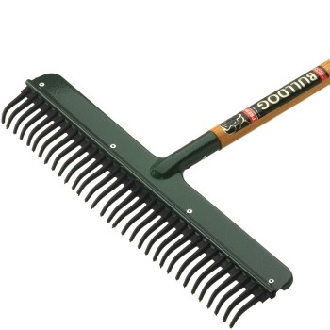
Bow Rake
The bow rrake, with large, thick, unbending teeth, both can level and work the soil. One of its uses is to prepare the ground for planting after the soil has initially been broken up.
Notes:
Changed “can both” to “Both can”

Slide 6
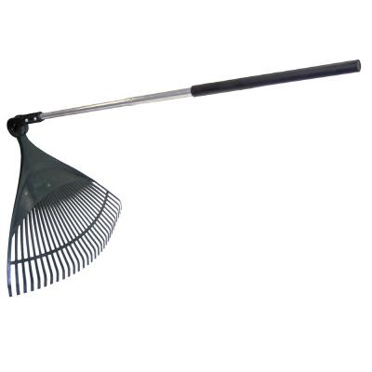
Adjustable Leaf Rake
The adjustable leaf rake is similar to the normal leaf rake except the head can be adjusted to get into hard to reach places.

Slide 7
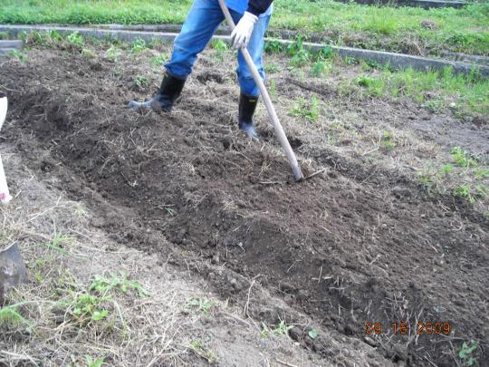
http://s3.amazonaws.com/readers/2009/09/16/raking-bed_1.jpg
http://img1.photographersdirect.com/img/12375/wm/pd1663211.jpg

Slide 8

Safety Problems and Concerns
Back problems from bending over
Hand blisters
Danger of striking a foot with the rake
Stepping on the end when stored improperly, resulting in a head hit
Encountering live electrical wires

Slide 9
Fatalities and Injuries
No fatalities were investigated by OSHA from 1990 thru 2009

Slide 10
Fatalities and Injuries
One rake-related fatality, presumably in agriculture gave the following account:
A man was unloading corn into an extremely large bin and there was a jam with the unloading. He used a garden rake which then unclogged the blocked corn. He was dragged into the bin and suffocated.
Rakes tend to involve first aid incidents, insect bites, back strains etc. than death
http://www.cdc.gov/niosh/face/stateface/mn/92mn001.html
Notes:
Added OSHA Data mention and minor injuries

Slide 11

OSHA Regulations
There are no OSHA regulations that specifically mention garden rakes.

Slide 12
Safe Operating Tips
Move the whole body and not just the spine to prevent back problems
Switch sides for raking to reduce stress on just one side of the body
Use the correct rake. If raking leaves, then use one made for raking leaves
When storing the rake, make sure to do so with its face down properly leaning on something to where it cannot fall down
Notes:
Changed sentence 2

Slide 13
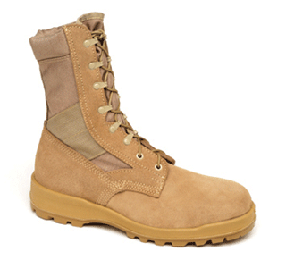
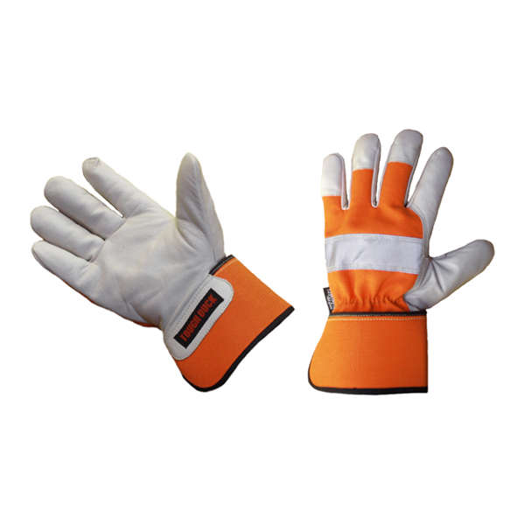

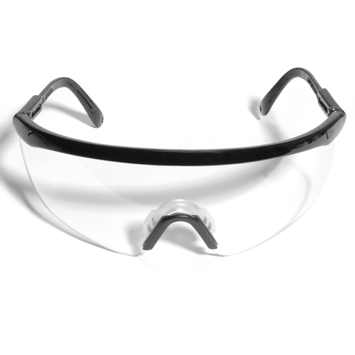
Personal Protective Equipment
Wear the proper PPE:
  Eye Protection
  Foot Protection
  Leg Protection
  Hand Protection
PowerPoint Clip Art Gallery

Slide 14
Safe Operating Procedures
Stand over the raking area with legs firmly planted
Grip the rake with both hands
Move the rake back and forth over the surface to be cleared
Organize the raked material into a pile
Dispose of the leaves, rocks, etc. appropriately

Slide 15
Think Safety
Work Safely

