Slide 1
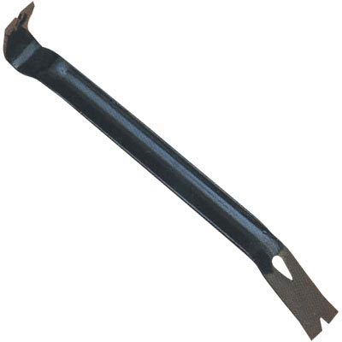
PRY BARS
http://www.hand-tools.us/images/pictures/pry-bar--18in.-length.jpg

Slide 2
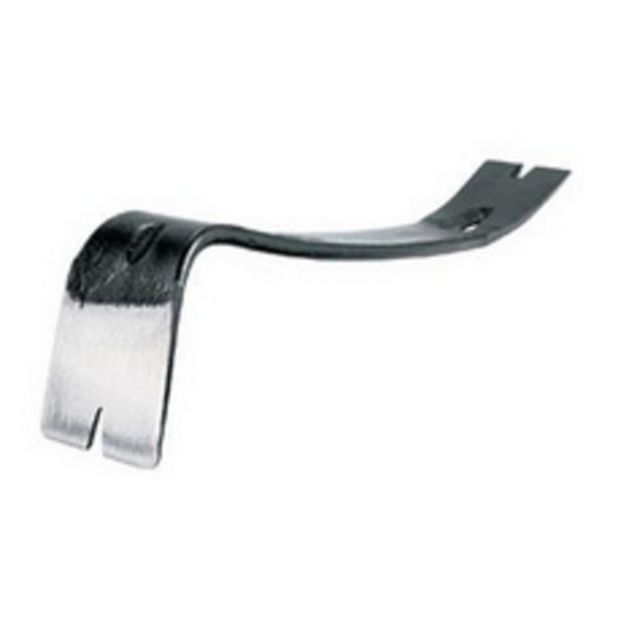
PRY BARS
A pry bar is an iron or flat steel bar used as a lever, with a single curved end and flat points with a single small groove on each end.
Flat Pry Bar
http://curbly_uploads_production.s3.amazonaws.com/photos/0000/0001/1432/pry_bar_large.jpg

Slide 3
PRY BARS
Typical pry bars are made of flat iron
Flat pry bar
http://www.hand-tools.us/images/pictures/pry-bar--18in.-length.jpg
http://www.steritool.com/images/product/10294.jpg

Slide 4
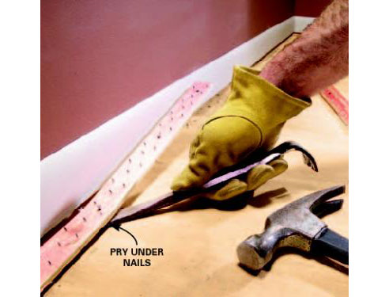
USAGE
Pry bars are used for various tasks such as:
Demolition
Setting and stripping forms
Removing nails
Proper usage of pry bar
http://media.rd.com/rd/images/rdc/family-handyman/2004/06/restretch-carpet-09-ss.jpg

Slide 5
SAFETY HAZARDS
The main safety hazards for pry bars are:
Pinched extremities such as fingers
Breaking loose large building components
Bruised knuckles
Back strain
Danger to workers below work area (falling objects)
Fall from lost balance
Electrocution

Slide 6
FATALITIES
12 pry bar deaths were investigated by OSHA from 1990 thru 2007.

Slide 7
FATALITY EXAMPLES
A carpenter's helper was attempting to free a stuck auger from a guide by using a pry bar. When the auger was freed, it slid forward out of the guide and caused the pry bar to strike the employee on the right side of his head. He died as a result of this injury.
A worker was straddling trusses while trying to adjust the girder truss with a pry bar. The pry bar slipped and he lost his balance. He fell approximately 15 feet to the concrete floor below.

Slide 8
FATALITY EXAMPLE
A worker was in the process of installing foundation support brackets and bolts to the foundation of a condo residence. He was installing this bracket in the area of an exterior electric hot water heater on the patio of this unit. He had installed the hold down bolts and was attempting to straighten the bolt with a pry bar. It appears that the pry bar, which was pressed against the wall support stud came into contact with and pinched or otherwise broke the insulation on a piece of Romex cable which was energized. He suffered a fatal electrical shock when his pry bar made contact with the 110 volt circuit.

Slide 9
OSHA REGULATIONS
Pry bars are not specifically mentioned in the OSHA Regulations.

Slide 10
SAFETY PROCEDURES
All workers should wear proper PPE such as
Hardhats
Eye protection
Gloves
Steel-toed shoes
Safety harnesses for work at heights

Slide 11
SAFETY PROCEDURES
The following should be done prior to using a pry bar:
Inspection of the tool (make sure edges are clean and in good condition)
Check work area for fall hazards, danger to workers below, and loose debris.
Use pry bar only for its intended purposes
Do not use pry bars with other tools to gain leverage (consider using a crow bar or wrecking bar if the pry bar is too small)
Always be aware of possible pinch points

Slide 12
THINK SAFETY WORK SAFELY

