Slide 1
Pruning Saws
http://2.bp.blogspot.com/_kM7t6IwmQlQ/SQc65HgEWBI/AAAAAAAAE4Y/8CHm5hW_L4g/s400/professional+pruning+saws.JPG
Notes:
First Slide

Slide 2
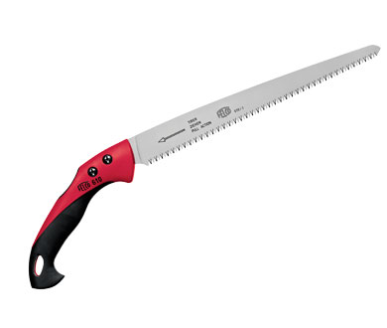
Description
Pruning saws allow for quick and easy cutting of smaller branches and limbs. They are especially useful when cutting sticky, gummy plants and live wood. Pruning saws come in fixed and folding blade designs, and some have belt scabbards so they are always handy.
An example of a pruning saw.
http://ecx.images-amazon.com/images/I/31Zdk9SnemL._SL500_AA300_.jpg
http://gardening.about.com/od/toolschool/ig/Pruning-Tools/Pruning-Saws.htm
Notes:
Description / Historical Data

Slide 3
Kinds of Pruning Saws
Curved Blade Saw
Best for home use and in nurseries
This type has a 12” -16” blade with six teeth per inch
An example of a curved blade pruning saw.
http://ecx.images-amazon.com/images/I/31Zdk9SnemL._SL500_AA300_.jpg

Slide 4
Kinds of Pruning Saws
Straight Double-Edged Saw
Best for cutting sap or green wood
This type has a 6 - 8 teeth per inch on one side and 4 - 6 larger teeth per inch on the other side
An example of a straight double-edged pruning saw.
http://www.fhwa.dot.gov/environment/Fspubs/05232810/fig023.gif

Slide 5
Kinds of Pruning Saws
Tri-Cut Blade Saw
This type has teeth that are sharpened on three sides, like a triangle
Designed to cut faster and easier
Stays sharper longer than traditional saws
An example of a tri-cut blade.
http://esscodist.com/shopsite_sc/store/html/media/Trie250.GIF

Slide 6
Kinds of Pruning Saws
Tree Saws
This type has a straight or curved 12- 16 inch blade and a pistol style handle
The saw’s teeth cut on the pull stroke and slides back on the push stroke
An example of a tree pruning saw.
http://www.fs.fed.us/eng/pubs/htmlpubs/htm88232601/images/proprune.jpg

Slide 7
Kinds of Pruning Saws
Folding Saws
Ideal for light pruning
Very portable and safe to transport
An example of a folding pruning saw.
http://www.heimerdingercutlery.com/pruning-tools-felco-pruning-saws-c-29_78.html

Slide 8
Kinds of Pruning Saws
Pole and Rope Saws
Used for cutting high limbs without the aid of a cherry-picker
However, found to be difficult and awkward to use
An example of a pole and rope pruning saw.
http://www.benmeadows.com/images/xl/CORONA-Professional-Pole-Saw-BEN-_i_bmw150430.jpg

Slide 9
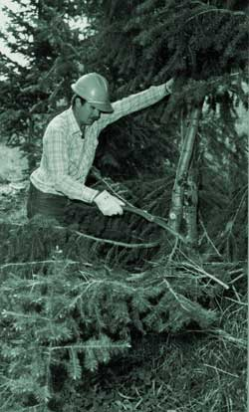
Construction Uses
Pruning saws have a blade that is used to cut branches and small trees. Their construction use relates primarily to landscaping and site clearing. Pruning saws can be used for thick or high, difficult to reach branches.
A worker using a pruning saw for site clearing.
http://www.fs.fed.us/eng/pubs/htmlpubs/htm88232601/images/figure04.jpg
Notes:
Relevance to Construction

Slide 10
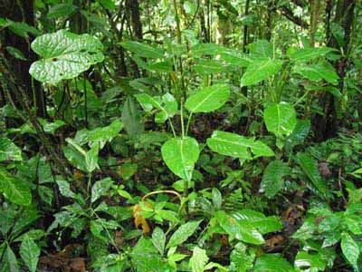
Pruning Hazards
Many pruning activities require workers to enter into thick brush, creating a safety hazard. Such an environment can cause skin lacerations or eyes harmed due to ricocheting branches, flying debris, or sharp twigs.
A potentially hazardous area in which pruning saws would typically be used.
http://www.pansite.org/vegetation.JPG

Slide 11
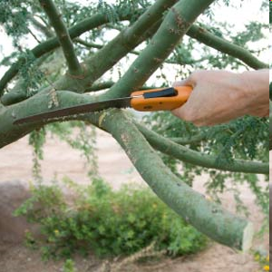
Pruning Hazards
Branches or Foliage
Sawing branches may cause particulate matter to fill the air. This presents an inhalation hazard.
Falling limbs and debris are dangerous and may be fatal.
Cutting branches with pruning saws can be hazardous.
http://static.howstuffworks.com/gif/rd/how-to-know-when-to-use-saws-for-pruning-trees0.jpg

Slide 12
Pruning Hazards
Blade Condition and Maintenance
It is important to check the condition of the pruning blade before use. A dull or rusty blade can be a safety hazard as well as inefficient.
Pruning saws need regular maintenance and upkeep to keep them in pristine condition.
http://www.ehow.com/pruning-saw/#ixzz1HSJ6f3AQ
http://i.ehow.co.uk/images/a07/a8/ca/remove-rust-saw-800X800.jpg
Notes:
Typical hazards / Safety concerns

Slide 13
Pruning Hazards
Pruning Saws
Pinch Point: Many pruning saws are collapsible. Fingers could be caught between the blade and the handle
Slipping: Proper control must be maintained over the blade to avoid slipping. A slip could result in a severe cut.
Breaking: Using excessive force while pruning may cause the blade to break. The resulting metal shards could injure the user

Slide 14
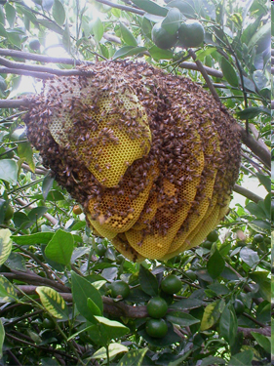
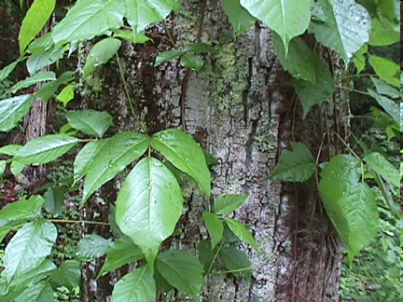
Pruning Hazards
Miscellaneous
Bee hives can hang from branches that need to be pruned, causing greater potential for stings.
Bees, wasps, snakes and ticks within trees and foliage.
Heat stroke
Poison Ivy
kauaihoney.com/images/FeralHive.jpg
Workers can brush up against poison ivy while pruning, causing skin irritation.
http://thepracticalhorse.com/_Media/poison_ivy.jpg

Slide 15
Pruning Hazards
Fall Potential
Often times pruning activities take place in high trees which leads to falling concerns. The fact that a pruning saw is involved may cause a hazard in itself. For instance, a falling worker may land on an open pruning saw they were working with.

Slide 16
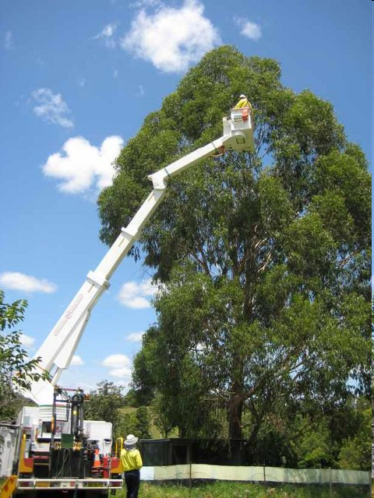
Example of Pruning Fatalities
A worker died while pruning trees in Scotland when he plunged 30ft from a cherry picker.
Worker pruning on a cherry picker.
http://www.friendsofthekoala.org/fok/files/images/koala%20country%20energy%20cherry%20picker%20003.preview.jpg
www.dailyrecord.co.uk/.../man-dies-after-falling-from-cherry-picker-as-he-pruned-trees-86908-21441916/
Notes:
Statistics of fatalities

Slide 17
Example of Pruning Fatalities
A worker was trimming trees along an electric utility line. Numerous high- and low-voltage lines ran through the trees at various heights in this area. The worker was trimming a large branch when he leaned back to prune some small branches above his head. The back of the victim's neck came into contact with a 7,200-volt power line and he was electrocuted.

Slide 18
OSHA and Pruning Saws
OSHA has not recorded any serious injuries or deaths related to pruning saws from 1990 thru 2009.
An image of the OSHA logo.
http://www.commercialcleaningincharlotte.com/wp-content/uploads/2009/05/osha-logosvg.png
Notes:
OSHA regulations

Slide 19
OSHA and Pruning Saws
There are no OSHA regulations directly pertaining to pruning saws.
An example of a OSHA poster.
http://eshpartnering.com/topics/wp-content/uploads/2010/04/OSHA-poster.jpg

Slide 20
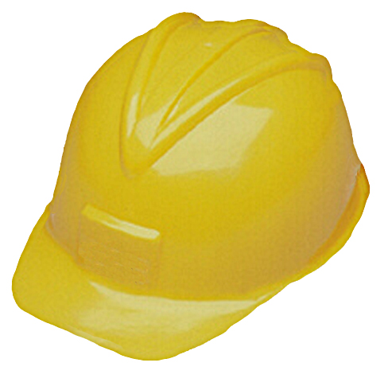
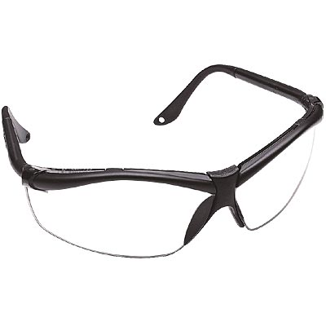
Pruning Safety
Proper Attire
Pruners should wear protective eyewear, gloves, headwear, shoes, long-sleeved shirts, and pants
Wear light-colored, thin clothing for hot days and warmer layers for cold or wet days.
Wear sunscreen and wide-brimmed hats to protect against the sun
Examples of proper protective equipment.
http://www.cordless-drills.net/images/pictures/ao-safety-sx-safety-eyewear-full-frame-clear-lens.jpg
http://thatwoman.files.wordpress.com/2008/07/hard_hat.jpg

Slide 21
Pruning Safety
Proper Training
Before pruning begins, survey the area for hidden hazards such as snakes, bees, and poison ivy. Workers should be trained in pruning hazards, safe pruning techniques, proper tool handling, ladder safety, and appropriate personal protective equipment.
Notes:
Safety Procedures / Best Practices

Slide 22
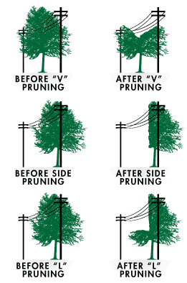
Pruning Safety
Proper Practices
Never prune trees or branches within 10 feet of power lines.
Maintain a safe working distance from other people when using pruning tools.
Do not attempt to cut branches bigger than the pruning tool was designed to cut.
Should not prune trees or branches within 10 feet of a power line.
http://www.srpnet.com/electric/graphics/pruning2.gif
Notes:
Tied off?

Slide 23
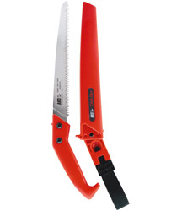
Pruning Safety
Proper Practices
Maintain a constant awaremess of the location of hands and fingers.
The blade on a pruning saw needs to be sharpened with regular sharpening tools.
Sheath pruning saws immediately after use to prevent accidental cuts.
Covering pruning saws when not in use is safe practice.
http://www.yates.co.nz/images/nz/products/books-tools-and-propagation/ars-pruning-saw-and-sheath-cam-24ln.jpg

Slide 24
Think Safety
Work Safely
Notes:
Last Slide

