Slide 1
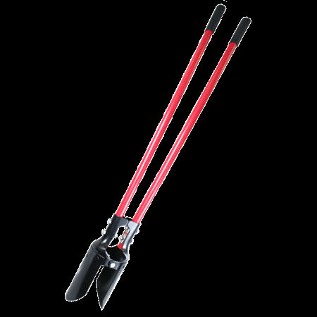
POST HOLE DIGGERs

Slide 2
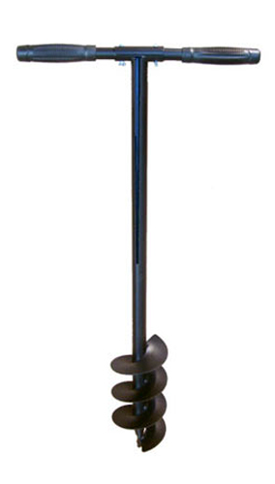
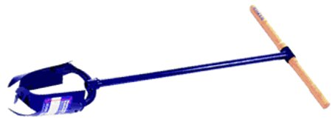
INTRODUCTION
The Post Hole Digger consists of one or two handles attached to metal shovel blades and joined via a hinge or can be fixed.
Standard-Post Hole Digger
To properly operate a post hole digger the tool is thrust into the ground, the handles pulled apart to grasp the soil, and the entire apparatus lifted out of the ground leaving a hole; this kind of post hole digger is commonly referred to as a “clamshell” digger.
Auger-Style Post Hole Digger
This type of post hole digger features a fixed T-shaped handle design attached to a blade; the user twists the handle, which in turn twists the blade and digs into the soil similar to an auger.

Slide 3
HISTORY
The Post Hole Digger was created by American William Stoyner and debuted at a farm equipment show October 13,1899 in Auckland,
New Zealand.*
The Post Hole Digger was soon recognized for its utility for landscaping projects and farm applications. It soon became an important piece of equipment for performing specialized earthwork.
* http://paperspast.natlib.govt.nz/cgi-bin/paperspast?a=d&d=HBH18991013.2.28.4&l=mi&e=-------10--1----0-all

Slide 4
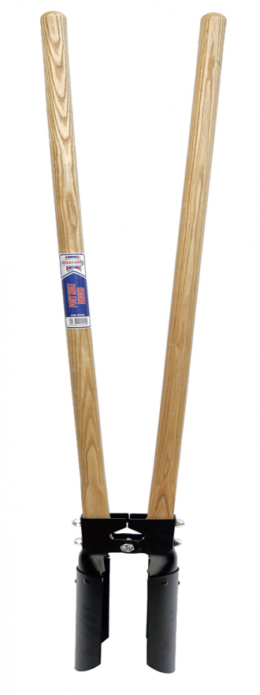
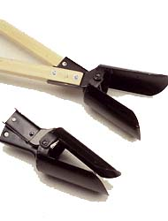
TYPES OF POST HOLE DIGGERS
Traditional
Designed for heavy duty and professional, commercial use
Split-Handled
Split handles are used with a front to back motion, similar to a scissor action
Narrow handle profile allows for digging in hard, rocky soil

Slide 5
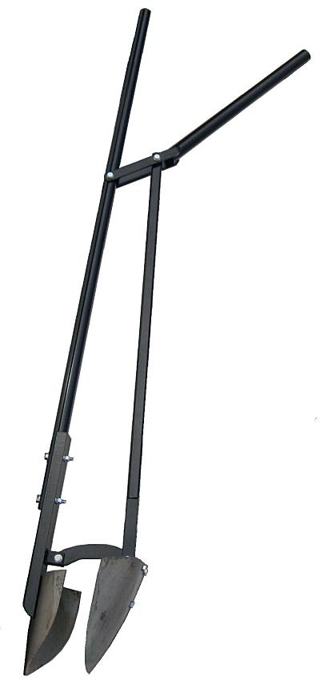
TYPES OF POST HOLE DIGGERS
Hole-Deal
Boston-Digger
Adjustable handle pivot increases blade leverage for compacted soils
Designed for dislodging stones, cutting roots, and shaping holes

Slide 6
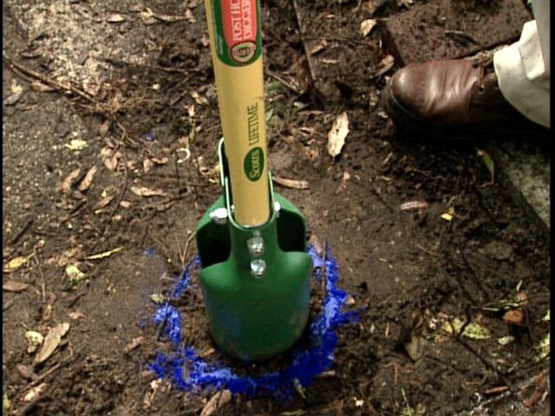
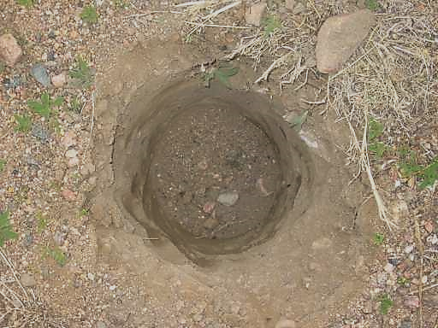
STANDARD OPERATING USES
The Post Hole Digger is a multi-utility tool; however, it is designed
specifically for the task of digging holes to set posts - this tool can dig a
fairly small diameter hole (4-6 inches) to a depth of 1-3 feet.
Fence posts
Flag pole
Excavation to a utility
In ground supports
Compared to a standard shovel, this tool will enable the task to be done
in little time with minimum effort, as well as allowing the operator to
keep the hole more suitably sized.

Slide 7
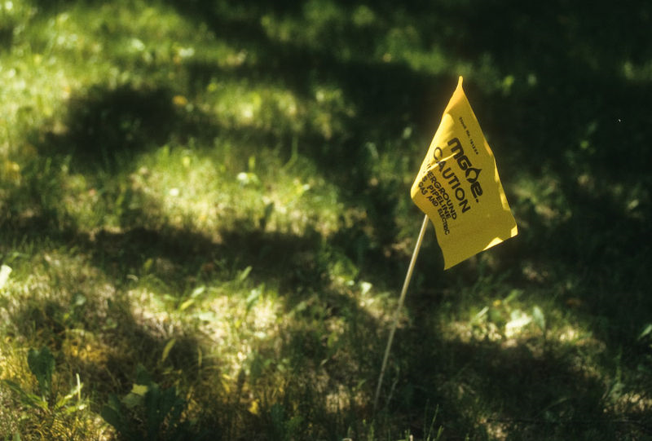
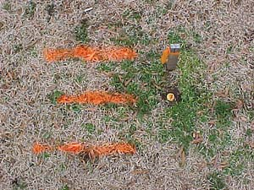
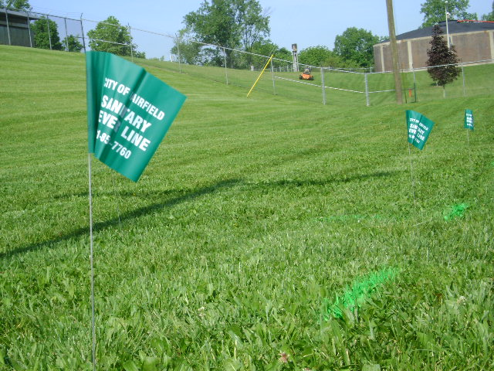
MAJOR SAFETY CONCERNS
Underground Utilities
When doing any digging, it is possible to damage buried utilities.
A single call to 811 will notify all utilities that they are to mark the
location of any utility lines they may have at the excavation location
that must be provided.*
Subsurface utilities can be marked with color coded flags, paint, or a
combination of both.
* http://www.callsunshine.com/ssocof/about/what.htm

Slide 8
OSHA Statistics 1990-2009
There were no post hole digger-related construction worker fatalities investigated by OSHA from 1990 thru 2009.
Source: Extracted from OSHA investigation data 1990-2009

Slide 9
FATALITY CASES
(most are not construction specific)
In 1985, a 25-year-old Tennessee County highway worker was electrocuted when the steel handle of a modified post hole digger he was holding made contact with a 7200 volt power line*
In 2002 an Oregon man was killed instantly when his post hole digger struck an underground 30,000 volt high voltage transmission line.
On June 28, 2008, a plumber in West Philadelphia was electrocuted after striking a 13,000-volt underground power line, causing a short circuit that shut off service to 1,300 customers; he had not called 811 to identify existing utilities
* http://www.cdc.gov/niosh/face/In-house/full8543.html
** http://library.state.or.us/repository/2009/200907010915163/03contac.pdf
*** http://www.uncc2.org/web/news/news_06-30-2008_plumber_electrocuted.shtml

Slide 10
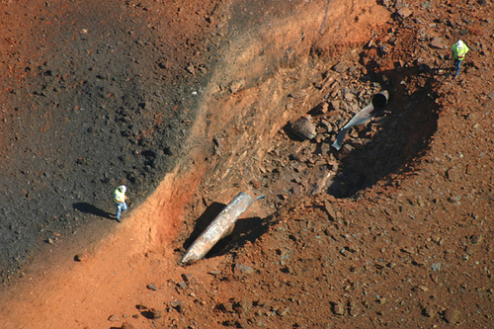
ADDITIONAL DAMAGES (Probably mechanized post hole diggers)
In Appomattox, VA, brick homes were demolished when a person struck an underground gas line with a post hole digger. It was also determined that the pipe had corrosion and fatigue to were the post hole digger was able to pierce the pipe. The person operating the post hole digger was never found.
Two homes in Houston, TX were completely destroyed when an
underground gas line was ruptured by a crew digging with post hole
diggers igniting a fire started by a spark from an air conditioning unit**
* http://www.appomattoxnews.com/2008/appomattox-gas-line-explosion-update.html
** http://www.khou.com/news/local/65848307.html

Slide 11
OSHA REGULATIONS
OSHA describes “Post Hole Diggers, Hand” as part of the Industry
Group 342: Cutlery, Hand-tools, And General Hardware
3423:Hand and Edge Tools, Except Machine Tools and
Handsaws*
OSHA Regulation: § 1926.651 - Specific excavation requirements
(b)(2) Utility companies or owners shall be contacted within
established or customary local response times,
advised of the proposed work, and asked to establish
the location of the utility underground installations prior
to the start of actual excavation. When utility companies
or owners cannot respond to a request to locate under-
ground utility installations within 24 hours, or cannot
establish the exact location of these installations, the
employer may proceed, provided the employer does so
with caution, and provided detection equipment or other
acceptable means to locate utility installations are used**
* http://www.osha.gov/pls/imis/sic_manual.display?id=717&tab=description
** http://www.osha.gov/Publications/Homebuilders/Homebuilders.html#subp

Slide 12
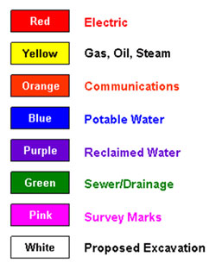
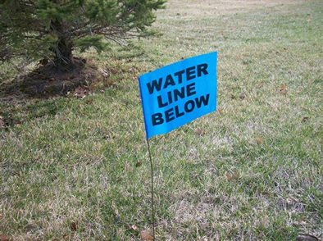
SAFETY PROCEDURES
Remember, “call before you dig” before any work is started.
Every year nearly 700,000 utility lines are hit by digging projects. Of those, almost half are cases in which the digger did not use one of the 62 state and local "Call Before You Dig" centers.

Slide 13
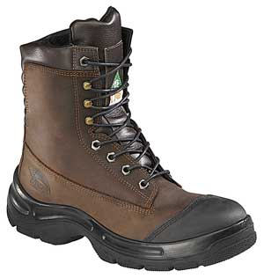
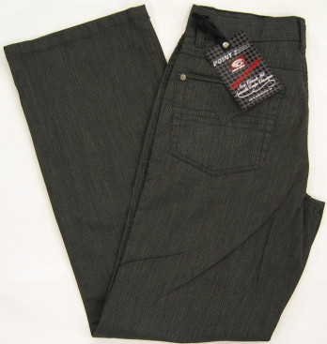
SAFETY PROCEDURES
When operating a Post Hole Digger use the following PPE:
Steel-Toed Boots
Leather Gloves
Safety Glasses
Long Pants

Slide 14
SAFETY PROCEDURES
Contact “Call Before You DIG” and have them mark existing utilities.
Inspect the post hole digger. Make sure all parts are intact and the cutting edges are sharp. Perform light exercises prior to beginning to work to avoid strains
Straddle the location where the hole is to be dug, feet wide apart and slightly back from the center of the hole location. Be sure there is no debris in the hole area.
Maintain erect posture as the post hole digger is thrust downward.

Slide 15
SAFETY PROCEDURES
Rotate the post hole digger slightly so the successive thrusts loosen the soil with greater ease.
When sufficient material is loosened, bring up the material and deposit it next to the hole being dug.
Take frequent breaks, especially if the weather is hot and digging is difficult.
Maintain hydration and wear sun screen

Slide 16
SAFETY PROCEDURES
Clean the post hole digger before storagej. Keep the tool lubricated
Clean all PPE prior to storage

Slide 17
Think Safety
Work Safely

