Slide 1
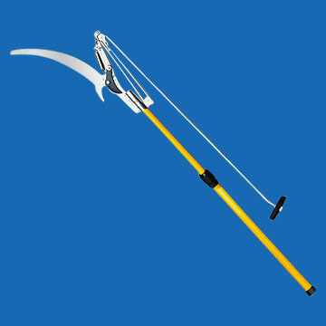
Pole Tree Pruner

Slide 2
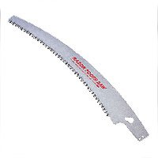
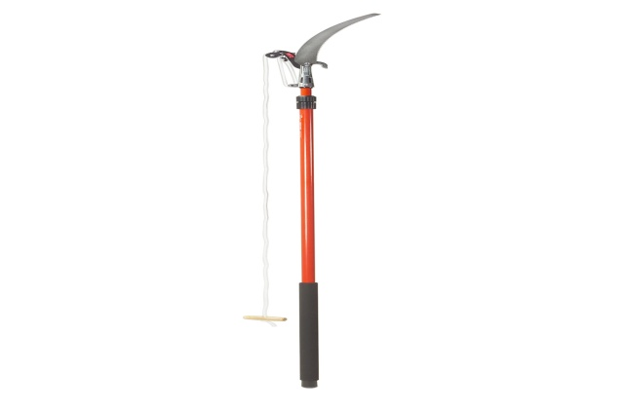
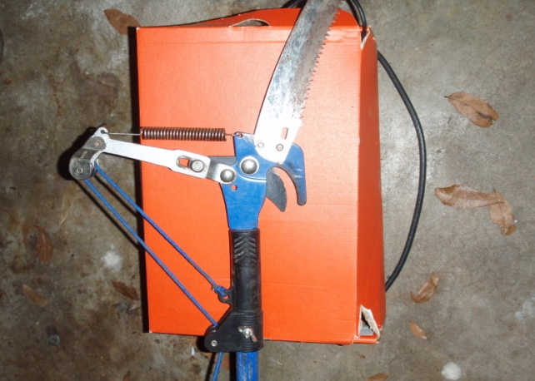
Basic Features
12-16” Saw Blade
- 1-2” diameter cutting
capacity
6 - 12’ Reach
- Fixed length or telescoping pole
Lopper Cutter

Slide 3
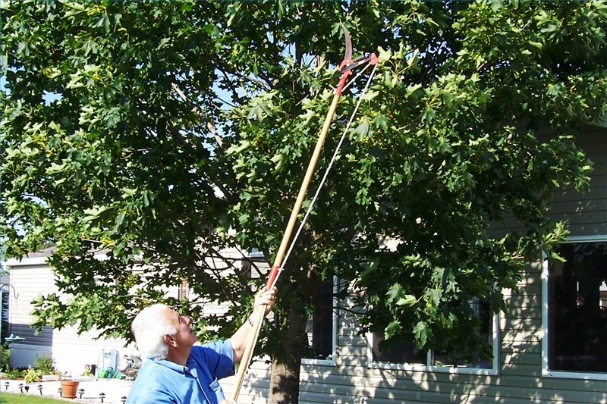
What Is It Used For?
Allows cutting and sawing of tree limbs at heights
Advantages
12-16’ Extended Reach
1”-2” diameter cutting capability
Sharp Saw Blade
Increases Work Efficiency
- Amount Cut/Hour
Remove and Cut:
Small branches
Pods
Rotten wood
Brush
Removing insect nests
Pruning

Slide 4
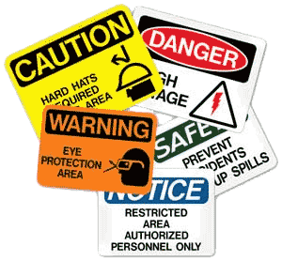
Safety Concerns
Electrocution By Power Lines
Slipping Due To Weather
Falling Debris
Insects Stings and Bites
Clear Landing Zone & Fall Area
Personal Protective Equipment
Avoid Climbing Trees

Slide 5
OSHA Investigations of Pole Tree Pruner Fatalities from 1990 thru 2009
http://www.landcarenetwork.org/planetFile/pdfs/TCIA-accident-data-2007.pdf

Slide 6
Census of Fatal Occupational Injuries 1990-2009
44% of the occupational injury deaths associated with tree care operations in the United States from 1990-2009 happened through the activity of Trimming and Pruning
http://www.cdc.gov/mmwr/preview/mmwrhtml/mm5815a2.htm#Tab2

Slide 7
Pole Tree Pruning Fatality Example
A worker was in an aerial lift with a pole tree pruner when a gust of wind caused a 40’ tree limb to fall onto the worker. The worker was struck and died instantly
http://www.emcins.com/lc/insights/insights09v45/Con_TreeCareFatalities.htm

Slide 8
Pole Tree Pruning Fatality Example
A worker was in an ariel lift with a pole tree pruner cutting tree branches when he came into contact with a power line. The worker was electrocuted.
http://www.emcins.com/lc/insights/insights09v45/Con_TreeCareFatalities.htm

Slide 9
OSHA
- No current OSHA regulations specifically pertain to fall protection requirements for tree trimmers working with pole tree pruners.
- OSHA does state that all tree trimming within 10 feet of a power line must be done by trained and experienced line-clearance tree trimmers.
http://www.cdc.gov/niosh/92-106.html

Slide 10
OSHA (Continued)
Protect workers exposed to electrical hazard [29 CFR 1910.333(c)(3)].
Ensure that line-clearance tree trimmers maintain minimum working distances from energized conductors [29 CFR 1910.268(q)(2)(iv), Table R-3]
All workers must perform a site evaluation of the limbs that are to be trimmed to determine if power lines pose a danger prior to the beginning of work [29 CFR 1910.269(r)(1)(i)]
http://www.cdc.gov/niosh/92-106.html

Slide 11
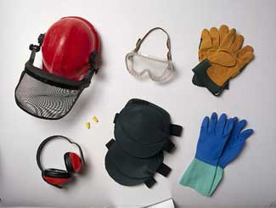
Personal Protective Equipment
Head Gear
Eye Gear
Gloves
Ear Covers
Covered Shoes
Long Sleeved Wshirts
Long Pants

Slide 12
Safe Practice
Pre-Task Assessment
Avoid Unsafe Weather
Have A Safe Exit Path
Stay Alert At All Times

Slide 13
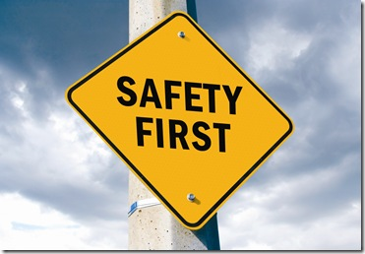
Safe Practice
Assume All Power Lines are Hot
Always use PPE
Clear any fallen or lose debris prior to beginning work
Know the Co-Workers
Stay Hydrated

Slide 14
Think Safety Work Safely
b

