Slide 1
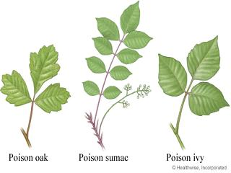
Poison Ivy, Poison Oak and Poison Sumac

Slide 2
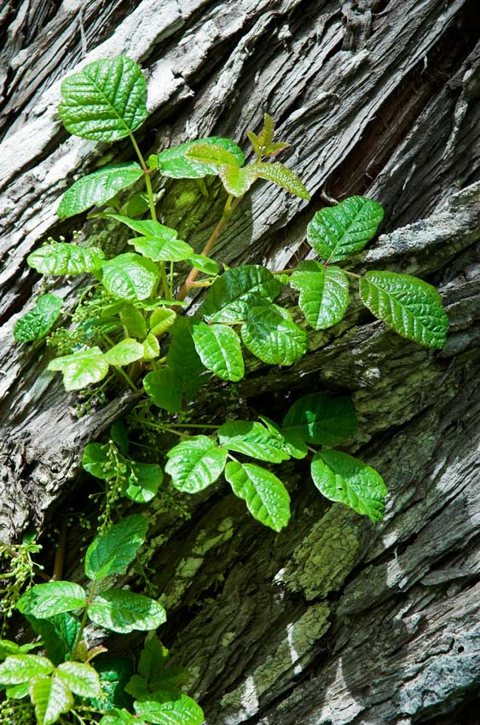
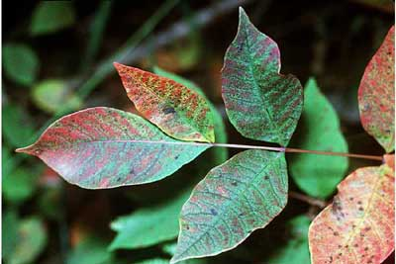
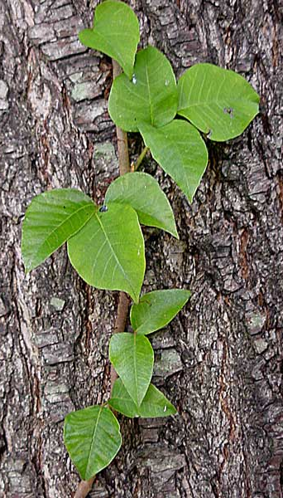
Poison Ivy, Poison Oak and Poison Sumac
Most common allergy in the country claiming half the population
Sensitivity to urushiol can develop at any time
Solutions or cures are those that annihilate urushiol
Covered by workers compensation in some states (CA, for example)
People with serious deficiency in cellular (T-cell) immunity such as AIDS patients may not have problems with dermatitis.
http://www.poisonoakrash.net/images/poison_oak.jpg
http://blog.jekyllclub.com/wp-content/uploads/2010/07/poison-ivy.jpg
http://www.pisgahfamilyhealth.com/Newsletters/PFHnewsMay2006_files/PoisonSumac.jpg

Slide 3
Myth vs. Fact
MYTH
Poison Ivy rash is contagious.
Contagion spreads from coughs at close contact.
Leaves of three, let them be.
Dead plants are not poisonous
Breaking the blisters releases urushiol oil that can spread
FACT
Rubbing the rashes will not spread poison ivy to other parts of the body
Direct contact is needed to release urushiol oil. Anything that can cause the oil to become airborne.
Poison sumac has 7 to 13 leaves on a branch, although poison ivy and oak have 3 leaves per cluster.
Urushiol oil stays active on any surface, including dead plants, for up to 5 years.
Breaking blisters increases the chance of infection and scarring.

Slide 4
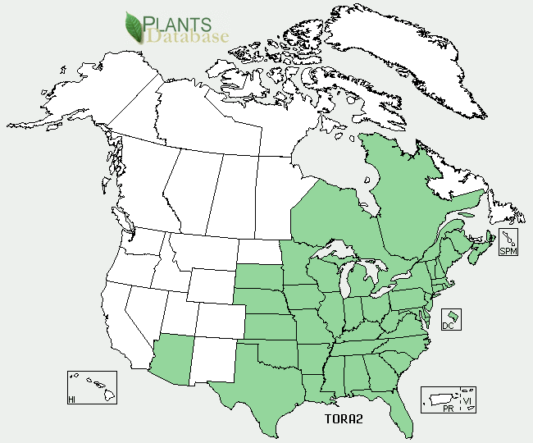
The Main Ingredient Urushiol Oil
The plants produce a resin called urushiol
It is an oil that seeps from the leaves of the plant and does not evaporate; leaving the plant active year round
Urushiol is a yellow liquid and is nearly insoluble in water.
After about 15 minutes of exposure, the Urushiol is chemically bonded to the skin and can no longer be washed off
Around 15% to 20% of people are immune to Urushiol and have no allergic response to it
The reaction to Urushiol is unique in that:
Most times the allergy does not emerge until an exposure occurs, but some people develop a rash after their very first exposure
Over time with repeated or more concentrated exposure to Urushiol, some people can become immune while others can lose their immunity

Slide 5
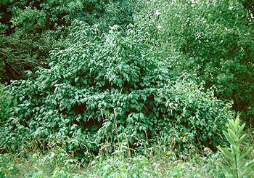
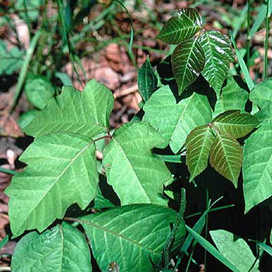
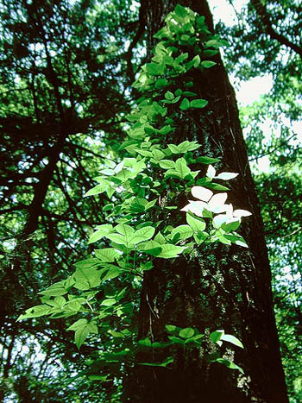
Poison Ivy
These plants can be anywhere — from the woods to backyards. The green leaves of poison ivy blend right in with other plants and brush, so it is possible to sit down in a patch of poison ivy and not even notice, until later.

Slide 6
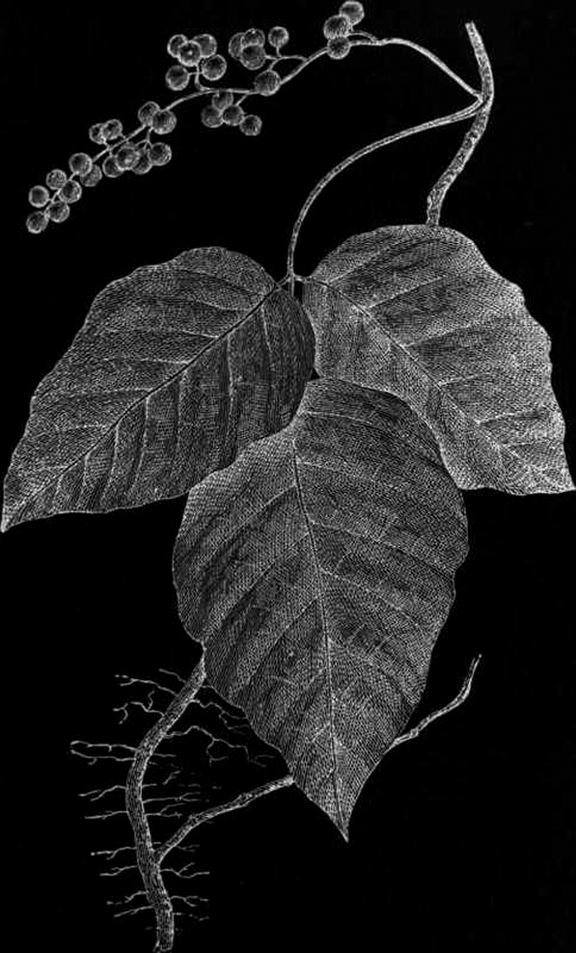
Poison Ivy
A red, swollen, itchy rash with blisters usually develops 12 to 72 hours after exposure.
It may appear in thick patches or where the plant rubbed against the skin.
Blisters are clear or have a yellowish liquid.
Rash turns crusty and scaly. The skin may break out all at once or over a period of days.
The first 5 days of a poison ivy rash are usually the most uncomfortable. The rash lasts up to 3 weeks.
http://chestofbooks.com/flora-plants/flowers/Harper-Wild-Flowers-Guide/images/Poison-Ivy-Poison-Oak-Mercury-Vine.jpg

Slide 7
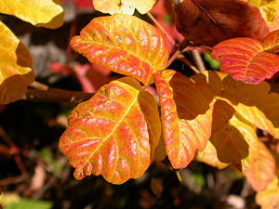
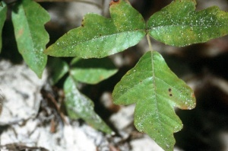
Poison Oak
There are two types of poison oak
Western Poison Oak
Found only on the Pacific Coast of North America, ranging from southern Canada to Baja California
Found in damp, shady areas near running water and out of direct sunlight
Atlantic poison oak
Grows mostly in sandy soils in eastern parts of the United States
Found growing in forest, thickets, and dry, sandy fields
Poison oak, with its oak-like leaves, is a shrub.
https://www.thedacare.org/crs/wha/poison.gif

Slide 8
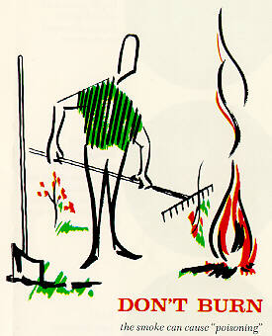
Urushiol poisoning can spread in the smoke of burning plants
Never burn it!!

Slide 9
Poison Sumac
Identified by its row of paired leaflets with an additional leaflet at the end.
Often the leaves have spots like blotches of black enamel paint. These spots are actually urushiol, which when exposed to air turns brownish black.
Poison sumac is a tall shrub or small tree.
http://www.drhull.com/EncyMaster/EncyImages/poison_sumac.gif

Slide 10
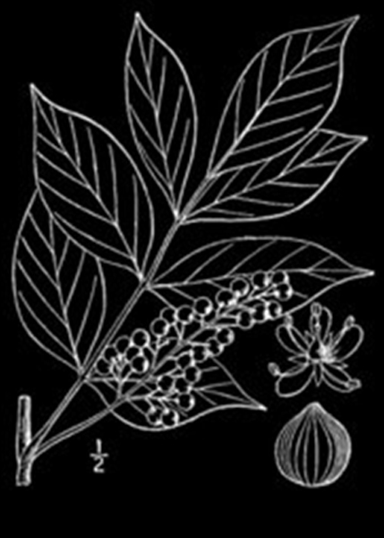
Poison Sumac
Leaflets are smooth
No hair on leaves or stems
7-13 leaves
Leaves arranged in pairs with a single leaf on the end
Have small yellowish-green flowers that mature into berries resembling those of poison oak or poison ivy
In early fall, leaves turn to a red-orange or russet shade

Slide 11
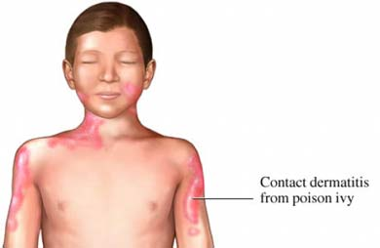
Symptoms of Urushiol Exposure
Itching
Redness
Burning sensation
Swelling
Blisters
Rash (may take up to 10 days or longer to heal)

Slide 12
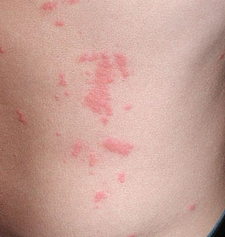
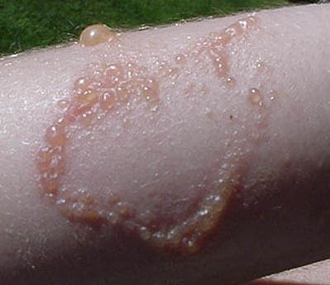
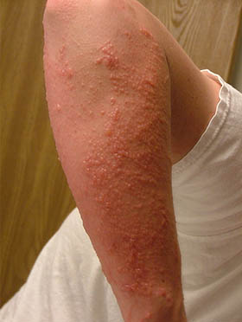
Symptoms of Urushiol Exposure
The symptoms begin with a severe itching of the skin that develops into reddish colored inflammation or non-colored bumps, followed by blistering of the skin

Slide 13
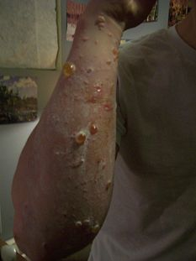
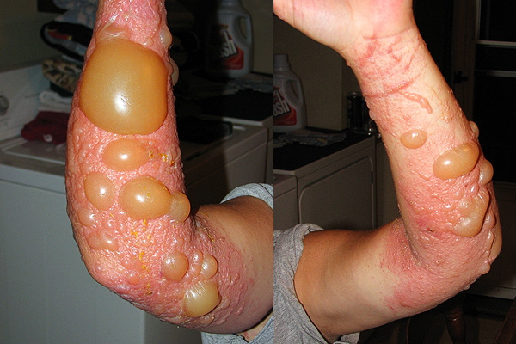
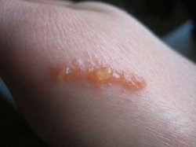
Reactions
Extreme Poison Ivy Rash
Urushiol Rash
Poison Oak Rash
http://upload.wikimedia.org/wikipedia/commons/thumb/d/dd/URUSHIOL_BLISTERING.jpg/233px-URUSHIOL_BLISTERING.jpg
http://i2.squidoocdn.com/resize/squidoo_images/250/draft_lens8480231module73463801photo_1260402435poison-oak1.jpg

Slide 14
The Reaction Facts
The oozing fluids, released by scratching the blisters, does not spread the poison
Larger amounts of exposure have an earlier onset and larger reaction, while smaller amounts of exposure produce a delayed reaction.
Extreme itching
Red, streaky, patchy rash where the plant touched the skin
Red bumps which form blisters
The rash lasts up to 3 weeks.
http://images.clipartof.com/small/439308-Cartoon-Black-And-White-Outline-Design-Of-A-Man-Scratching-Itches-Poster-Art-Print.jpg

Slide 15
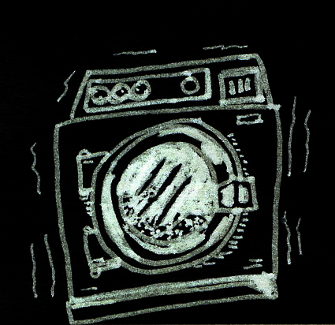
First Aid
Wash the skin thoroughly within 30 minutes of exposure.
Scrub under the fingernails with a brush to prevent continued exposure
Wash clothing and shoes with soap and hot water,
Immediately bathe animals to remove the urushiol
Body heat and sweating can aggravate the itching.
Calamine lotion and hydrocortisone cream reduce itching and blistering.
http://www.education.umd.edu/EDMS/mislevy/Drawings/washing.jpeg
http://1.bp.blogspot.com/_5o6OBitvjwM/Sfs2RDBnejI/AAAAAAAABf8/ANO8gMq9xz0/s400/WashHands2.jpg
http://www.cartoonstock.com/lowres/gmc0175l.jpg

Slide 16
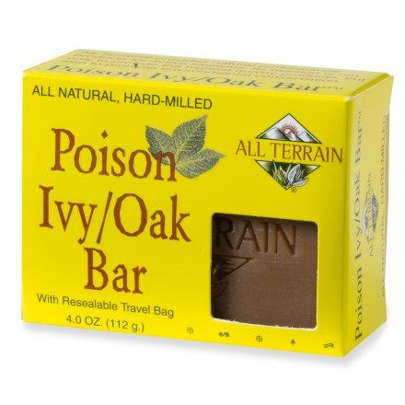
First Aid
Bathing in lukewarm water with an oatmeal bath.
Aluminum acetate (Domeboro solution) soaks can help to dry the rash and reduce itching.
If creams, lotions, or bathing do not stop the itching, antihistamines may be helpful.
In severe cases, especially for a rash around the face or genitals, a health care provider may prescribe steroids, taken by mouth or given by injection.

Slide 17
When to Call 911
Call 911 or go to an emergency room if:
Someone has a severe allergic reaction, such as swelling or difficulty breathing, or has had a severe reaction in the past.
Someone has been exposed to the smoke of a burning plant.
Call a health care provider if:
Itching cannot be controlled.
The rash affects the face, lips,
eyes, or genitals.
The rash shows signs of infection
Yellow fluid leaking from blisters, odor, or
increased tenderness.

Slide 18
Prevention
Wear long pants and sleeves
When pulling up weeds, be sure to tuck sleeves into gloves at all times.
It is an employer’s responsibility to communicate the potential hazards associated with these plants to their employees
Wash all tools, clothes, and other items where urushiol may have collected and might be touched in the future
Learn how to identify the plants and avoid contact with them

Slide 19
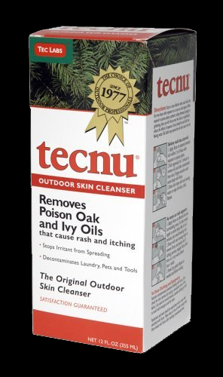
Prevention
Wash tools and other objects with a dilute bleach solution or rubbing alcohol.
A product called Tecnu, available in camping stores and some pharmacies, is very effective at removing the oils, but expensive. It should not be used on the skin.
http://www.mohawksafety.com/images/tecnu.jpg

Slide 20
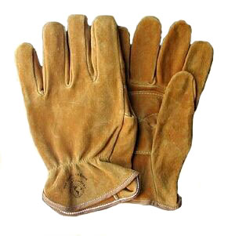
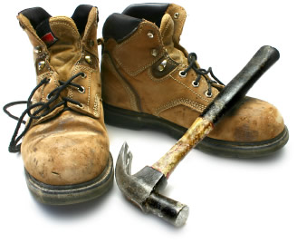
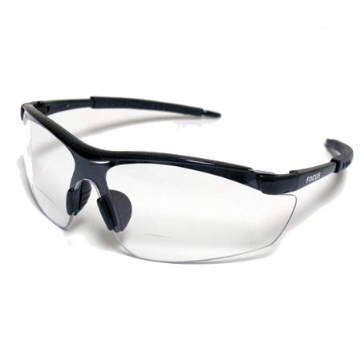
Protective Clothing
Long-sleeved shirts
Long pants
Gloves
Boots
Safety glasses
Make sure that the clothing overlaps to prevent any exposure

Slide 21
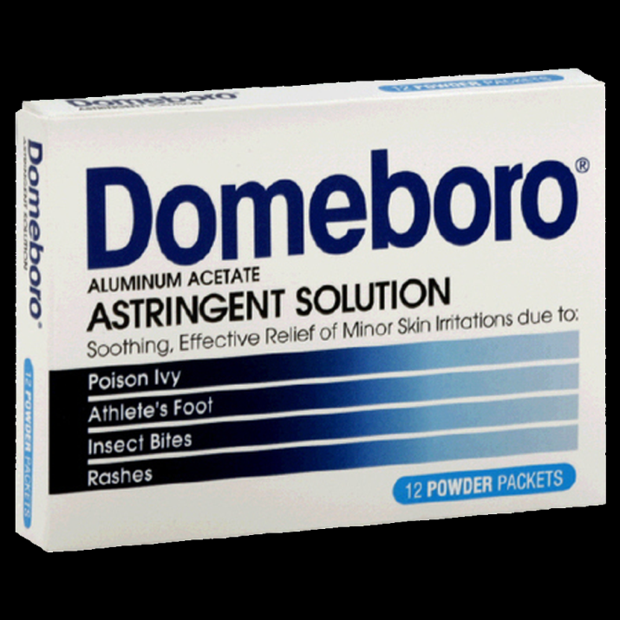
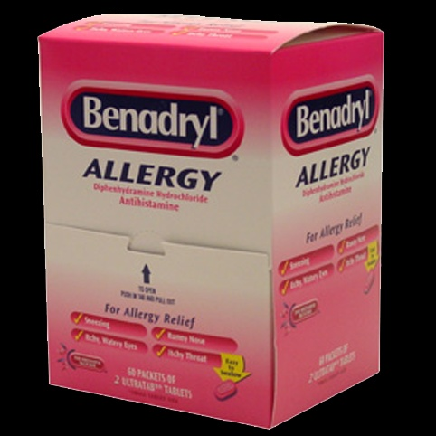
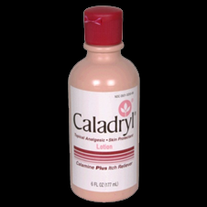
Treatment Options
Helps to relieve itch and dry up blisters.
Over the counter oral medicines (antihistamines) to control itching, such as Chlor-Trimeton and Benadryl
Helps to relieve itch and dry up blisters.
http://images.buzzillions.com/images_products/02/14/domeboro-astringent-solution-powder-packets-12ea_90153_175.jpg
http://www.universalws.com/images/300450175533.jpg

Slide 22
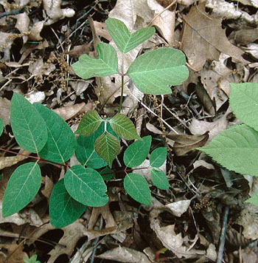
Poison Ivy Quiz Which is Poison Ivy?
POISON IVY!!!
http://www.poison-ivy.org/quiz/quiz2.htm

Slide 23
Fatalities
There were no OSHA-investigated fatalities related to these plants for the years 1990 thru 2009.
Source: OSHA Fatality Data-1990-2007
There were no Poison Ivy, Oak, or Sumac related deaths in the general population found by an Internet search.
http://2.bp.blogspot.com/_M9uPz0yiGvQ/THQOFDTjWsI/AAAAAAAAAvQ/nf34Za_ot0U/s1600/US-OSHA-Logo.png

Slide 24
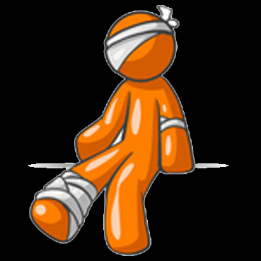
Injuries
While no fatalities were found during this search, there are probably countless times that employees are “injured” or inconvenienced by these plants
Inconveniences can include itching, swelling, rash, and general discomfort
These inconveniences can lead to distractions from more serious tasks and decrease worker productivity
These “injuries” are more likely to show up on workers compensation claims for medical treatment then as OSHA recordable injuries
http://www.imageenvision.com/150/34334-clip-art-graphic-of-an-orange-guy-character-injured-and-bandaged-on-the-head-elbow-and-ankle-by-jester-arts.jpg

Slide 25
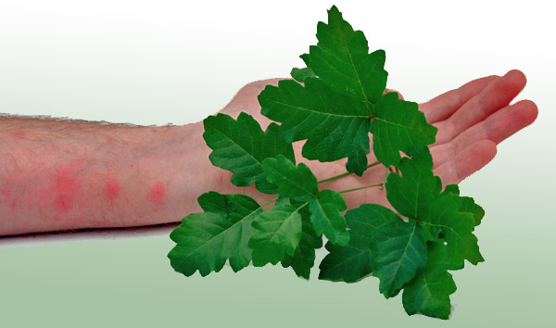
References
How Poison Ivy Works, http://science.howstuffworks.com/poison-ivy.htm
Poison Ivy, Oak, and Sumac Information Center, http://poisonivy.aesir.com/view
Medicine.Net, http://www.medicinenet.com/poison_ivy/article.htm

Slide 26
Think Safety
Work Safely

