Slide 1
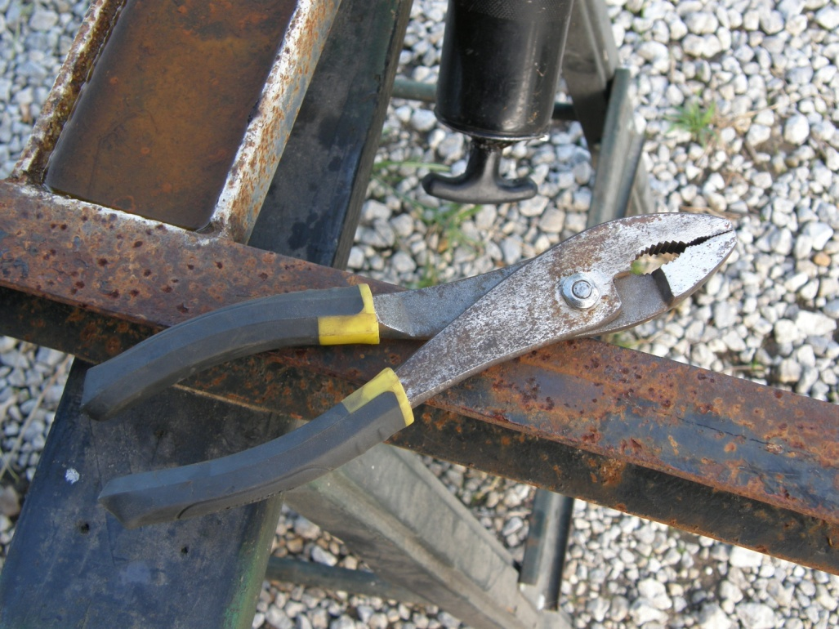
Pliers
Photo Courtesy of Dr. Hinze

Slide 2
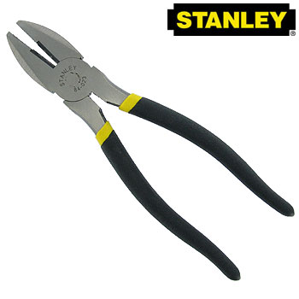
What are Pliers?
Pliers are a type of hand tool used to grasp objects firmly for cutting, bending, and compression
Reference: http://www.stanleytools.com/default.asp?TYPE=STATIC&PAGE=HOME.HTM

Slide 3
Parts of Pliers
“Levers”
Needle Nose Pliers
“Fulcrum” is positioned closer to one end to create a jaw-like motion
“Handles”
Note: The above image was released into the public domain by its author.

Slide 4
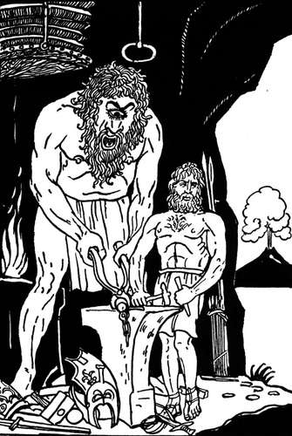
History
Pliers were used consistently over the last several millennia for metal working and other construction related purposes
No single person or event in history has been credited with the origin of pliers
The first bronze pliers were most likely used around 3000 BC
Reference: http://en.wikipedia.org/wiki/Pliers

Slide 5
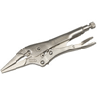
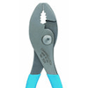
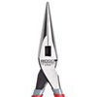
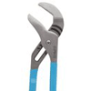
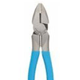
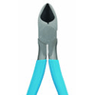
Types of Pliers
Vice Grips
Slip Joint
Needle Nose
Channel Type
Linesman
Diagonal Cutting

Slide 6
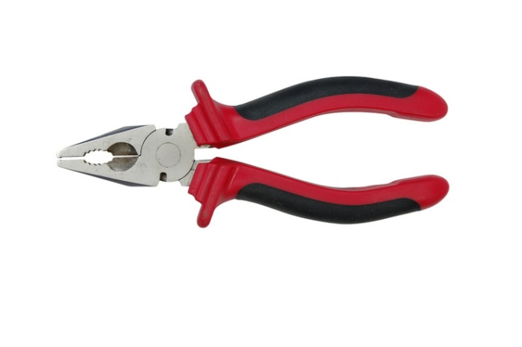
Uses of Pliers
Gripping: Lineman’s, Flat-Nose, Round Nose, Needle Nose, Locking, Tongue & Groove, Parallel
Special Purpose Pliers: Wire-Stripping, Fencing, Circlip, Nail-Pulling, Breaker-Grozier
Adjustable Pliers: Slip Joint, Channel, Groove Joint
Cutting Pliers: Lineman’s, Diagonal, Pinching, Needle-Nose
Crimping: Slip Joint, Channel

Slide 7
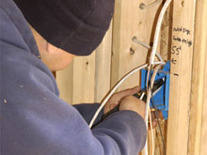
Uses in Construction
Pliers are used in several aspects of construction
They are most commonly seen in areas of electrical construction where they cause the greatest concern for safety
Reference: http://ckelectric.info/

Slide 8
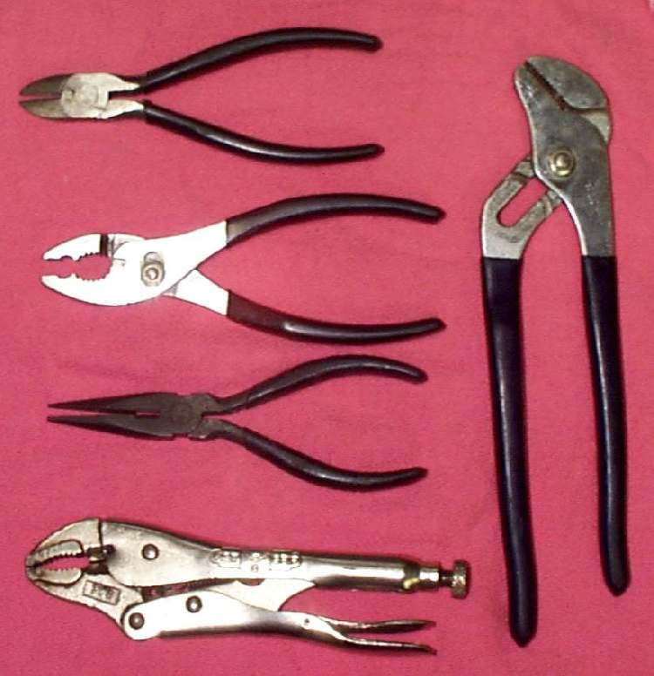
Concerns
-Using pliers with any electrical materials: Possibility of electrical contact with skin
-Pinching Hazards
-Slipping off items being grasped
and striking other objects
-Improper handling

Slide 9
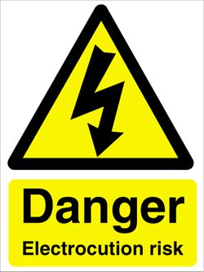
Statistics
Fatalities:
7 Construction Fatalities from 1990 to 2009, which indirectly involved the improper use of pliers, were investigated by OSHA
All 7 incidences involved death
from electrocution due to contact
between pliers and electrically
charged wires
Source: Extracted from OSHA Accident Investigation Data 1990-2009

Slide 10
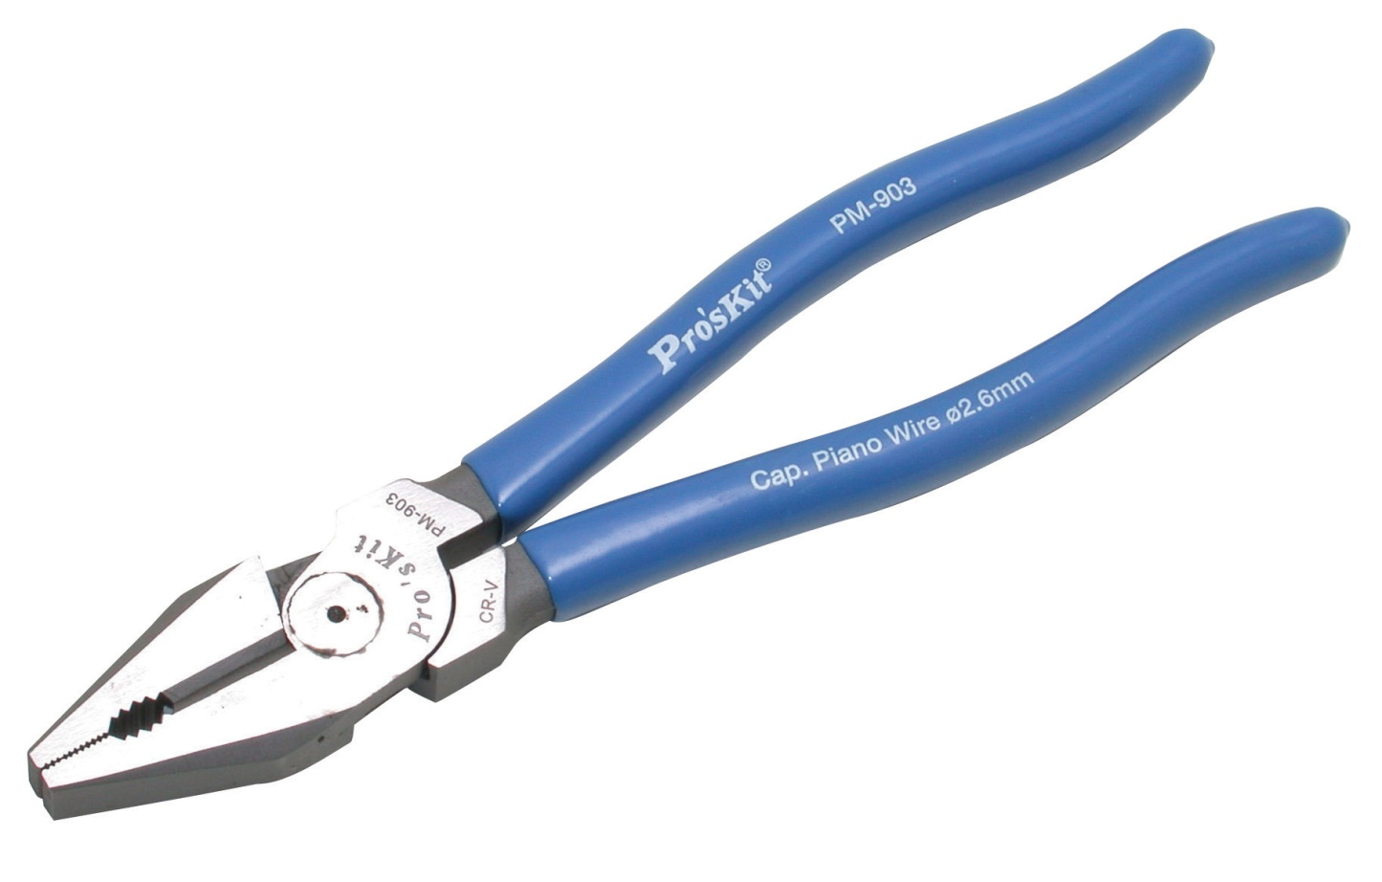
OSHA Regulations
There are no OSHA regulations that specifically mention the use of pliers

Slide 11
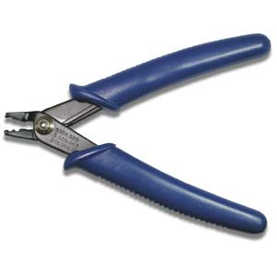
Safe Work Practices
Always wear applicable gloves
Always wear proper eye protection
Select the appropriate pliers for the task
Inspect the pliers for proper functioning and ensure that the pinchers are in good condition

Slide 12
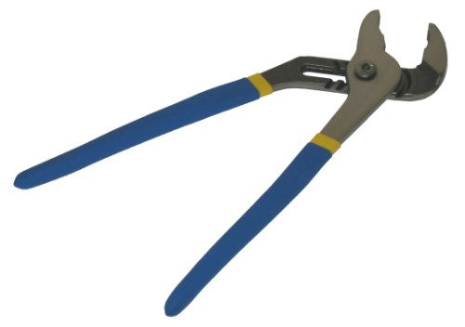
Safe Work Practices
Always test to make sure that any materials that will be in direct contact or indirect contact with pliers are not electrically charged
Secure the item being grasped
Do not grasp items with pliers and vigorously pull toward the body or face (injury can result if the pliers slip off)

Slide 13
Think Safety
Work Safely

