Slide 1
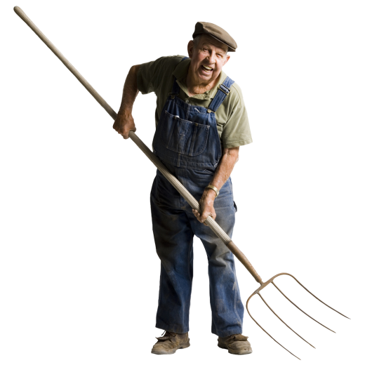
Pitch Forks /
Garden Forks
Images from Microsoft Clip Art

Slide 2
General Description
Pitchforks and Garden forks are tools that have a long handle attached to long, thin, widely separated tines which are used to lift loose material and “pitch” it.
They generally have wooden handles with steel heads and tines.
The number of, and spacing between tines, can vary depending on the purpose.
http://en.wikipedia.org/wiki/Garden_fork
http://en.wikipedia.org/wiki/Pitchfork#cite_note-0

Slide 3
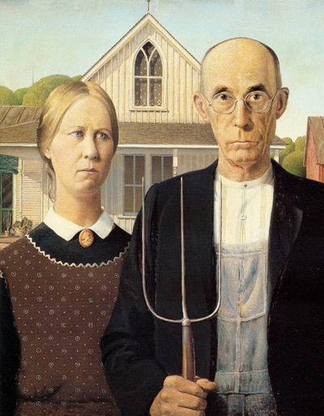
Historical Origins
Pitchforks were first used in Europe in the early Middle Ages.
They have often been seen by stereotypical “angry mobs” carrying flaming torches, pitchforks and clubs.
A pitchforks is also pictured in the famous painting “American Gothic.”
http://en.wikipedia.org/wiki/Pitchfork#cite_note-0
http://smithmeadows.com/kitchen/farm-raised-local-valentin/attachment/american-gothic/

Slide 4
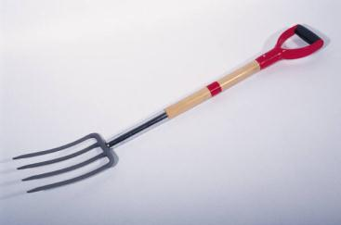
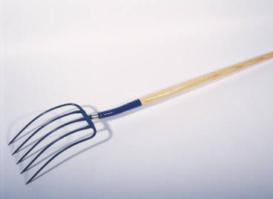
Differences
Pitchfork vs. Garden Fork
Garden forks have much shorter handles and usually have only 4 tines, they are most commonly used for disturbing the soil in gardening or farming applications.
Pitchforks have longer handles and have anywhere between 3 to 10 tines (usually 5), and are used to move loose materials such as leaves, hay and compost.
Garden Fork
Pitchfork
http://en.wikipedia.org/wiki/Garden_fork
http://en.wikipedia.org/wiki/Pitchfork#cite_note-0
Images from Microsoft Clip Art

Slide 5
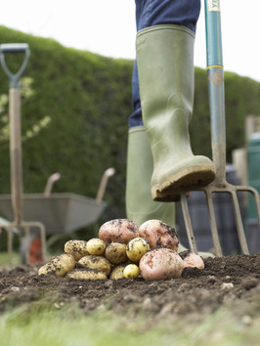
Standard Usage
Both pitchforks and garden forks are generally used in the agricultural industry, but are occasionally used for landscaping and/or site work in the construction sector.
Discussion with Professor Jimmie Hinze
Picture: http://www.hgtv.com/landscaping/starting-a-garden/index.html

Slide 6
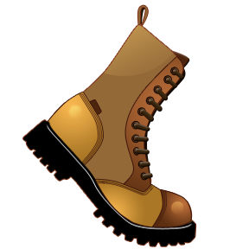
Potential Hazards
Punctures
  The most common and most dangerous hazard.
  This usually happens when one person stabs their own foot.
  It can also happen if one person punctures another person due to carelessness.
Discussion with Professor Jimmie Hinze
Pictures from Microsoft Clip Art

Slide 7
Potential Hazards (Cont.)
Dehydration: Becoming dehydrated while working outdoors is always a safety hazard; be sure to drink plenty of water.
Back strain: Proper technique should be used to avoid straining the back.
Blisters: Proper measures must be taken to avoid blistering while using these tools; wear gloves.
Discussion with Professor Jimmie Hinze

Slide 8
How to Avoid Back Problems
Workers should keep their feet well separated for good balance, always keeping their knees flexed.
When using a pitchfork for mulch relocation/spreading, workers should load their pitchfork sparingly on their first load and gradually increase their next load size until they reach the capacity, which they can handle in a safe and efficient manner.
Workers should bend their knees but not their backs while using a pitchfork. Their knees should be flexed so that their leg muscles take most of the load.
Workers should be keeping their arms and elbows close to their body while handling loads. This move will set worker’s body in balance and in a power position.
http://www.ehow.com/how_6055655_dig-hole-injuring-yourself.html

Slide 9
Fatality Data
There were no pitchfork-related or garden fork-related fatalities investigated by OSHA from 1990 to 2009.
Source: Extracted from OSHA Accident Investigation Data 1990-2009

Slide 10

OSHA Regulations
Pitchforks and Garden forks are not specifically mentioned in the OSHA Regulations.
Source: OSHA Regulations
http://windowguysflorida.com/page_view.php?id=4&id_version=1&id_page=3

Slide 11
Best Practices
Steel toe shoes must be worn because foot injuries are the most common way to be hurt with a pitchfork or garden fork.
  Also wear the typical PPE; (gloves, glasses, and hats)
Keep a minimum of 8 ft from others while pitching to avoid injury.
Discussion with Professor Jimmie Hinze
Pictures from Microsoft Clip Art

Slide 12
Best Practices Cont.
Always load the pitchfork/garden fork with foot pressure.
Always lift loaded pitchfork/garden fork with your legs (not your back).
Always inspect the handle to make sure it is not cracked.
  Also make sure that the handles attachment to the head is solid.
Discussion with Professor Jimmie Hinze

Slide 13
Think Safety
Work Safely
Pictures from Microsoft Clip Art

