Slide 1
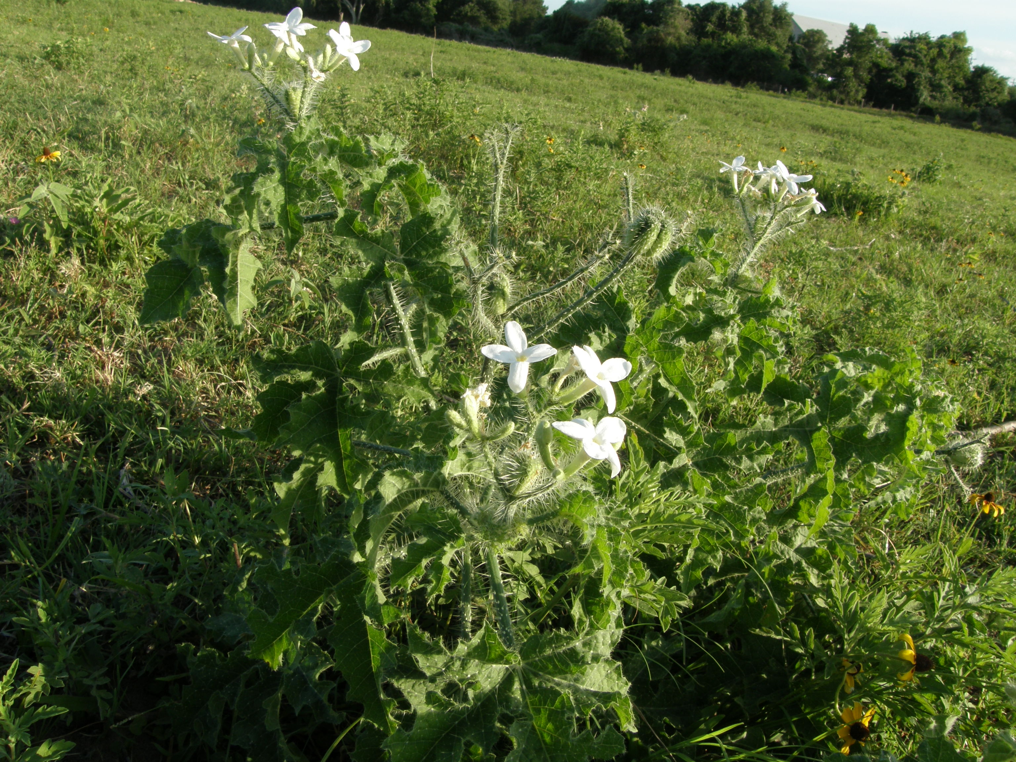
BULL NETTLE

Slide 2
BULL NETTLE
Coarse prickly weed
- Fragrant white flowers
Common throughout southern and eastern United States
Blooms from April to August.
Other names include Cnidoscolus texanus, Mala Mujer, stinging nettle, horse nettle, ball nettle, and ball nightshade.
Normally an indicator of compaction and anaerobic soil, meaning there is very little oxygen available.
Grows to be about 80 cm tall
Has a large, finger-shaped deep branching root
Leaves have 3 to 5 lobes which are toothed similar to a maple leaf
Source: Jimmie W. Hinze

Slide 3
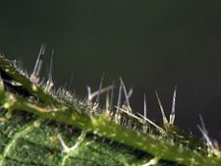
BULL NETTLE - ANATOMY
5 Lobe Leaves
White Flowers
Glass-like Hairs
Source: Jimmie W. Hinze

Slide 4
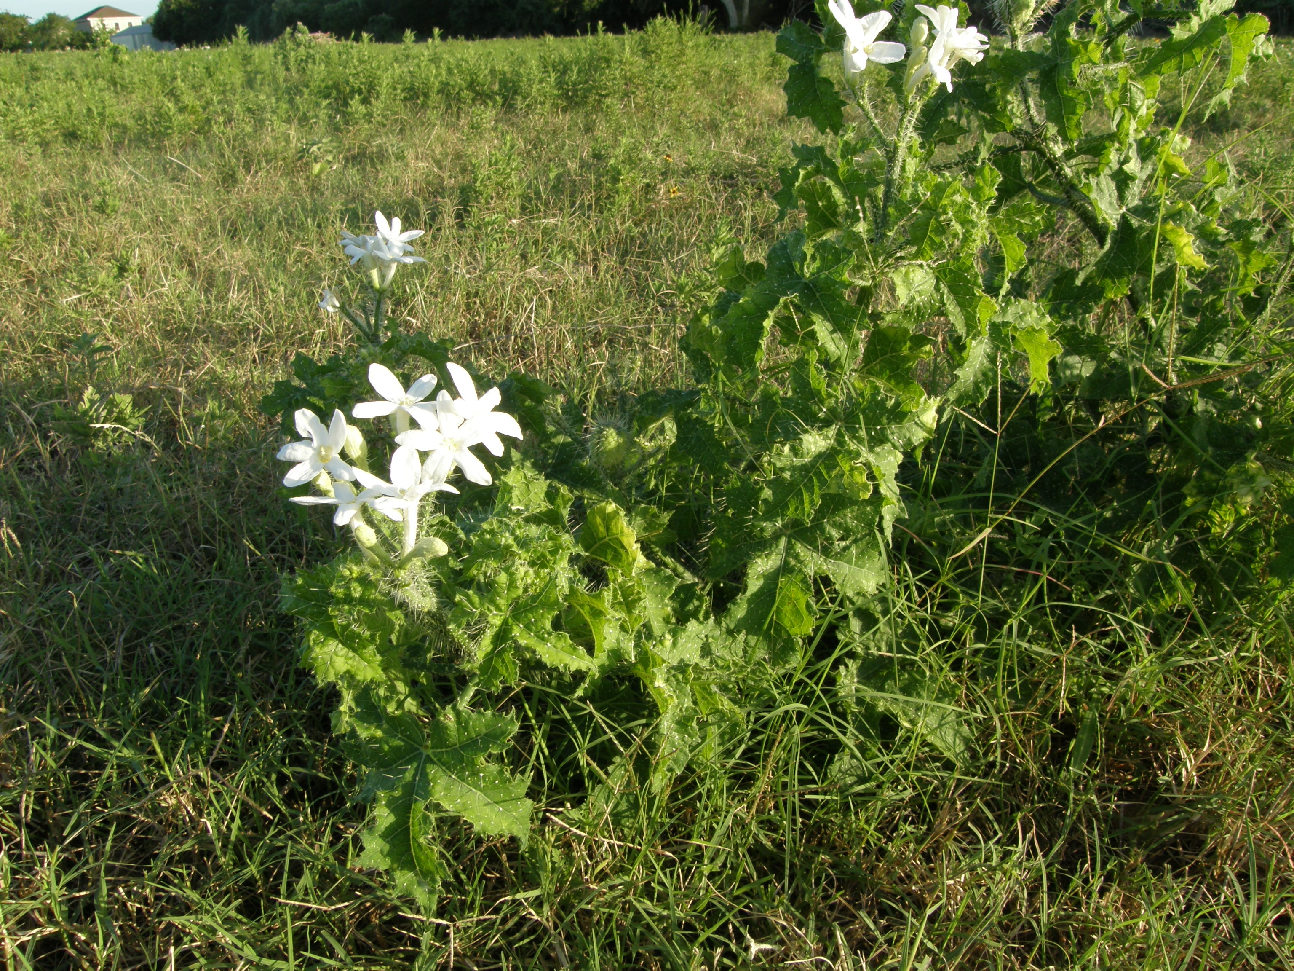
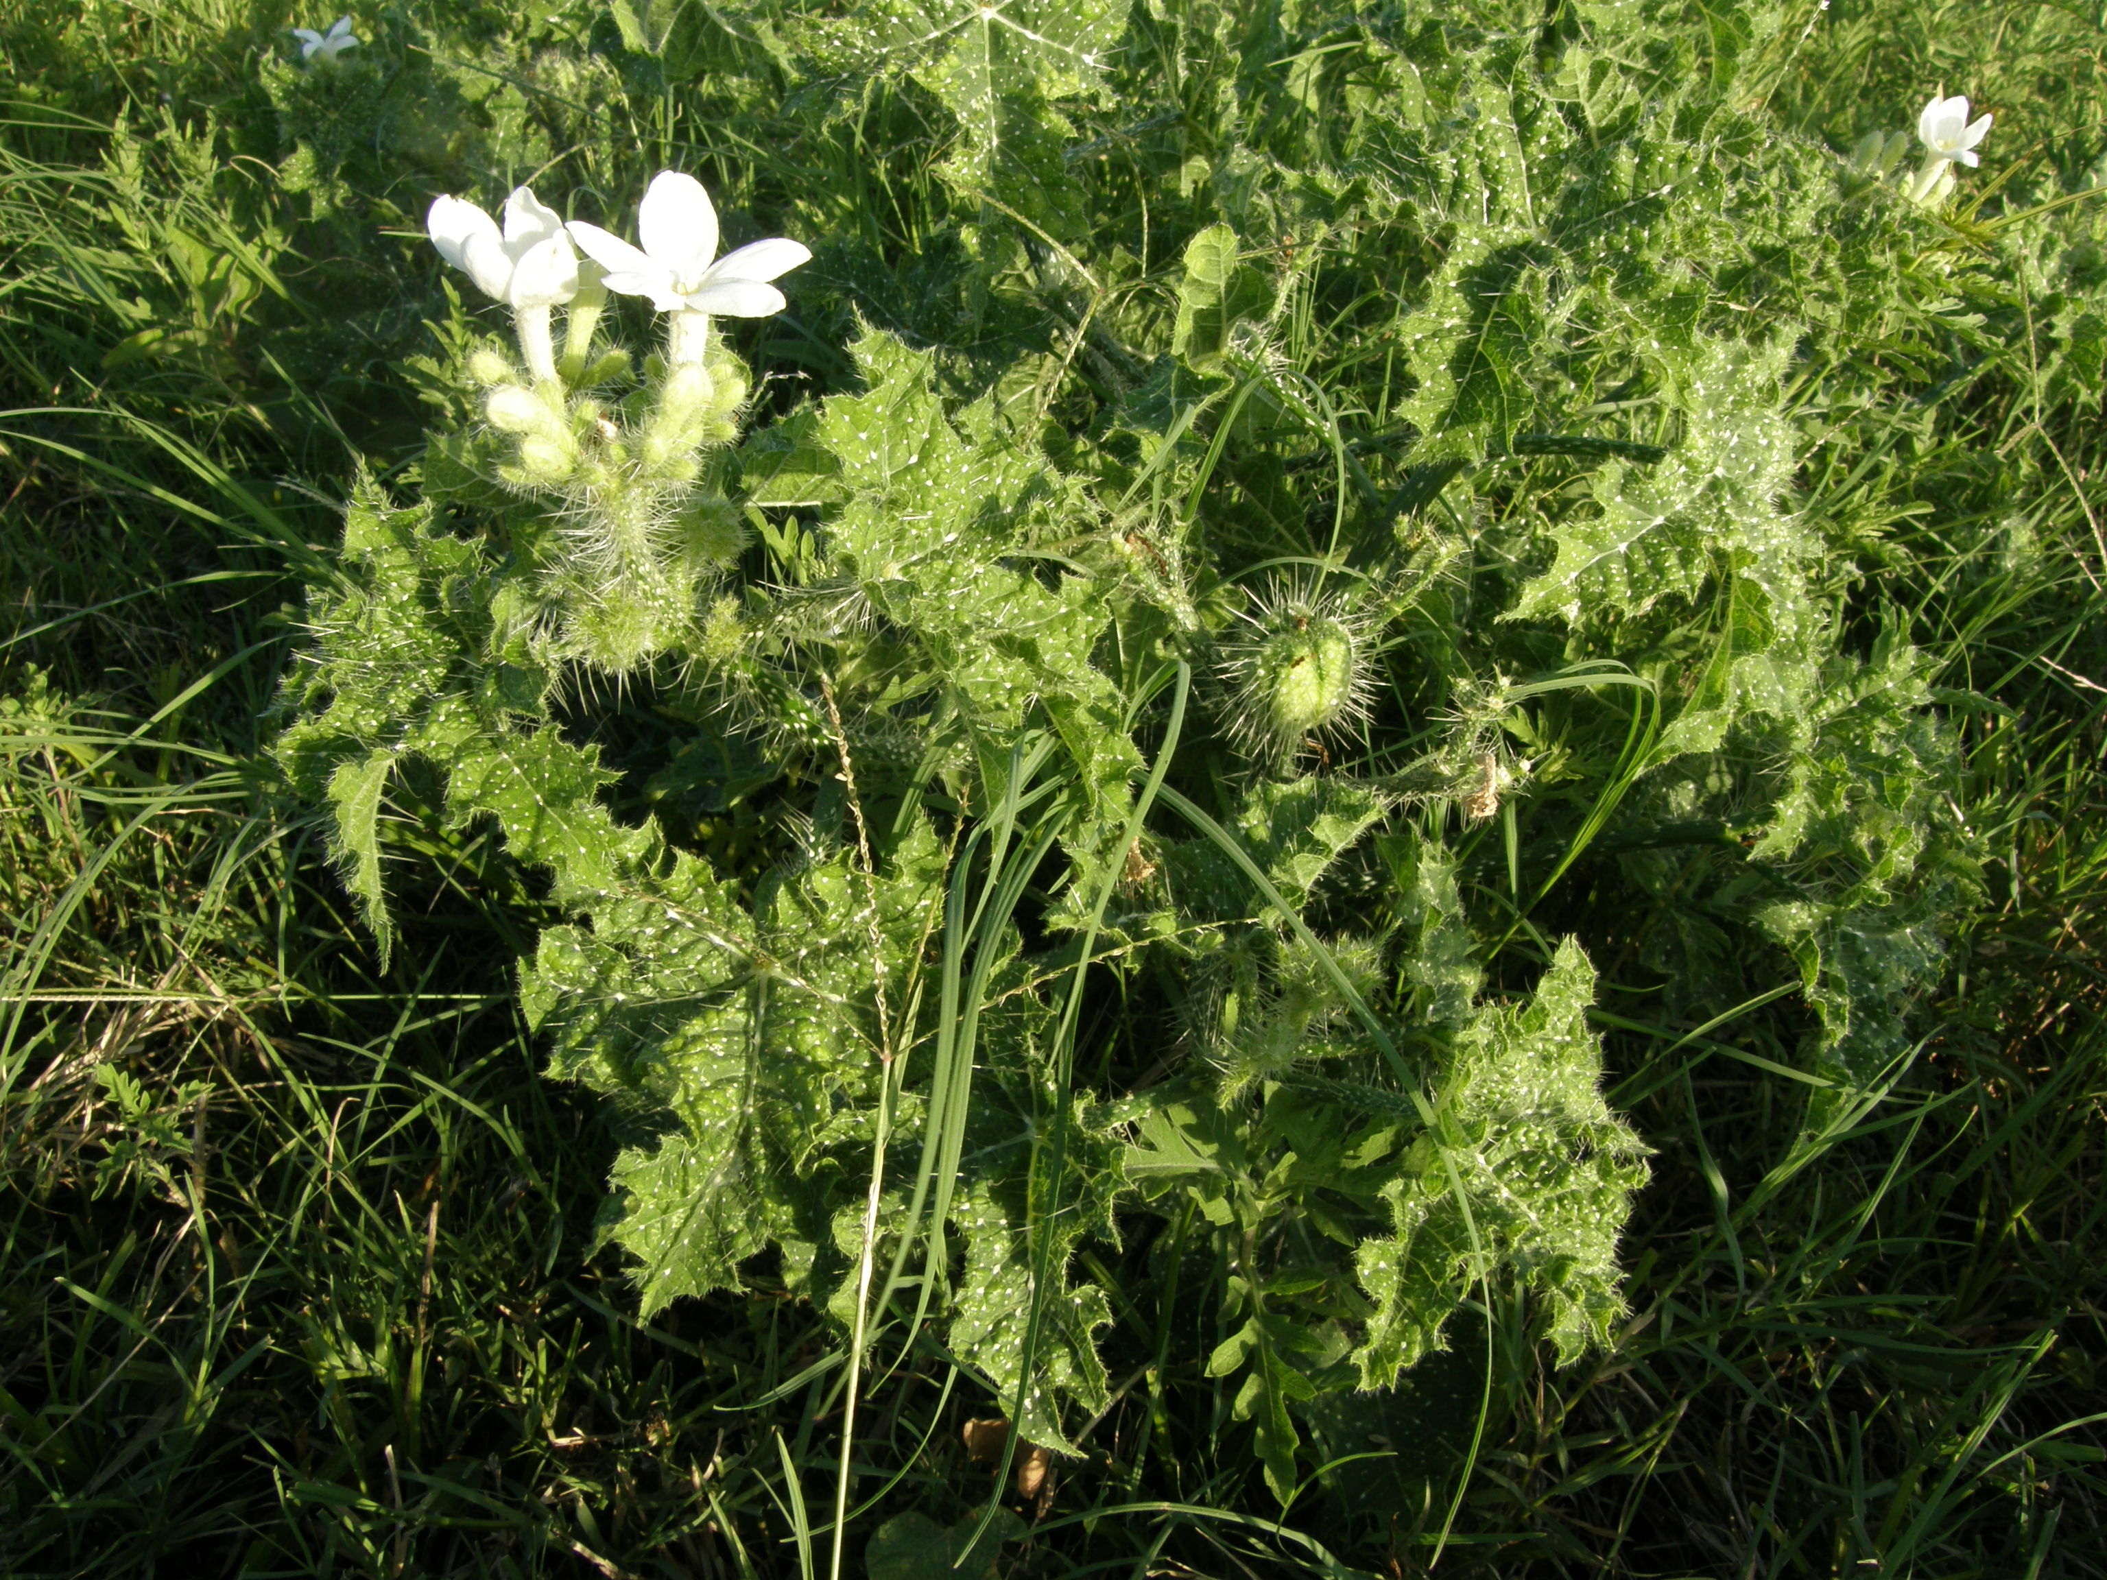
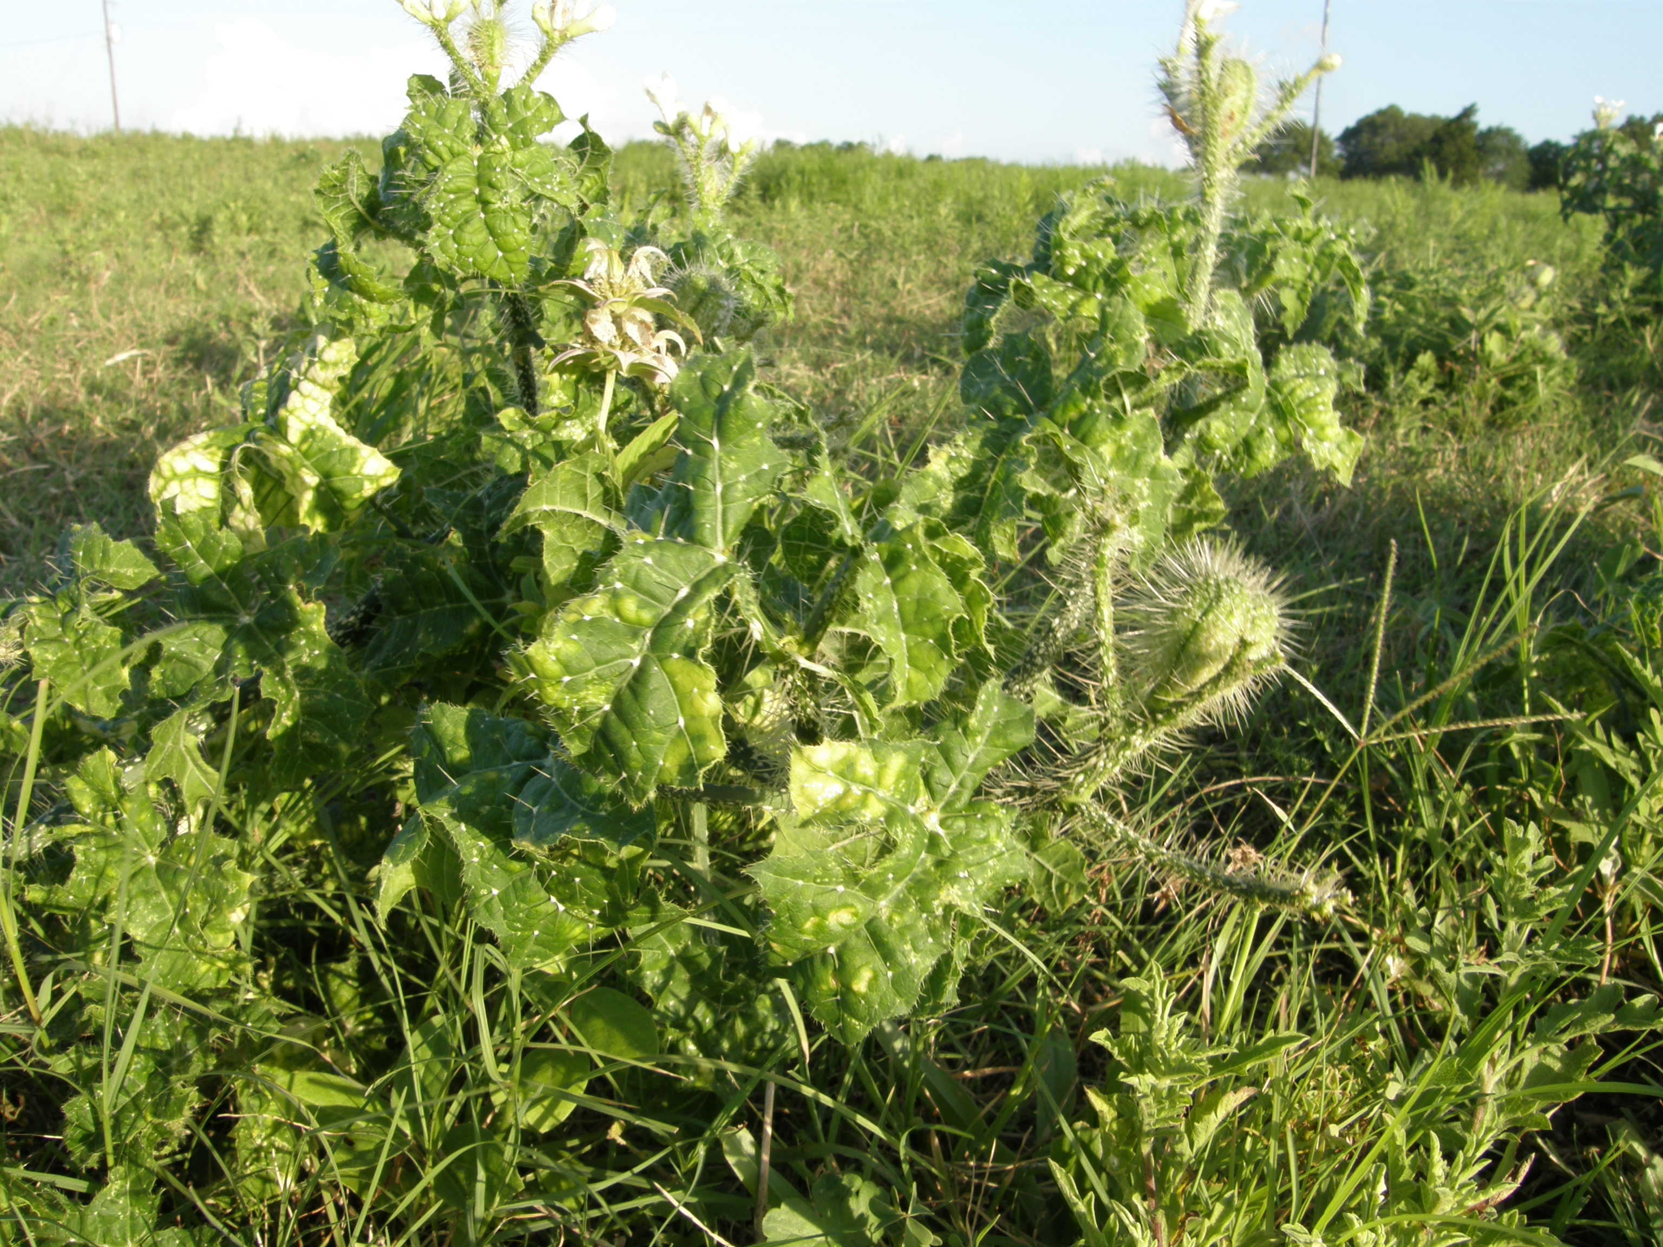
IDENTIFICATION
Source: Jimmie W. Hinze

Slide 5
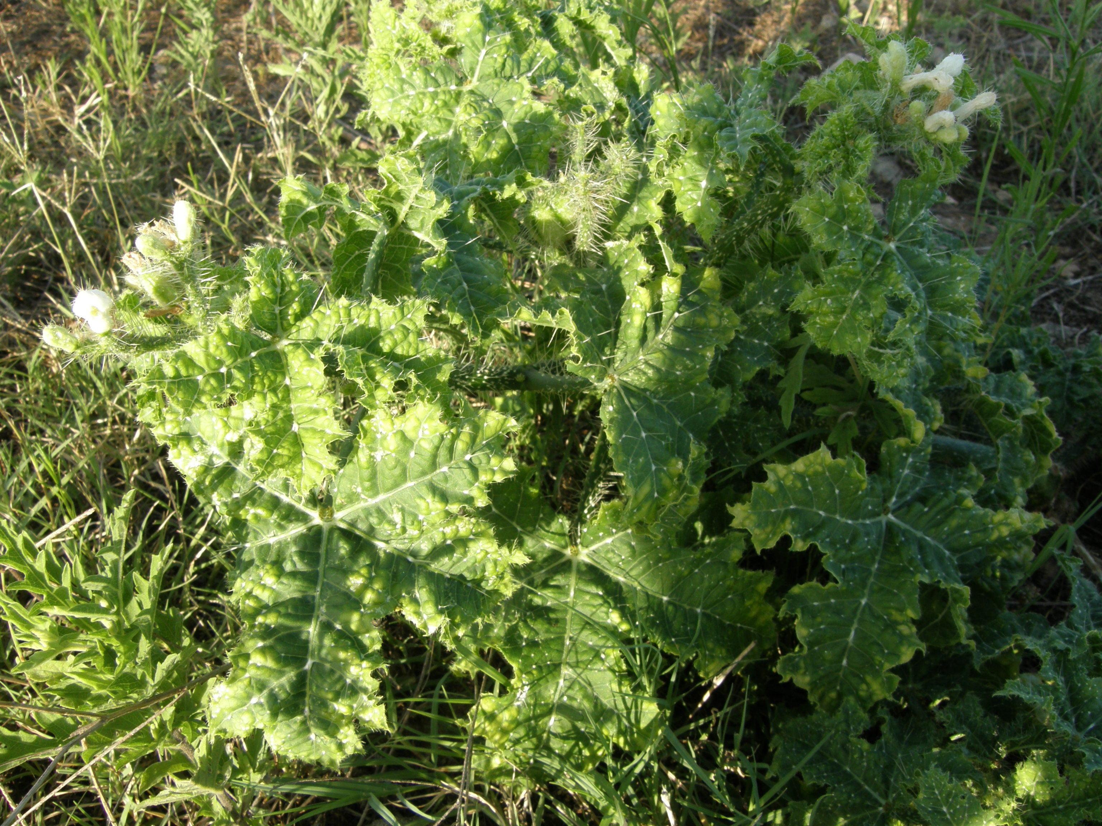
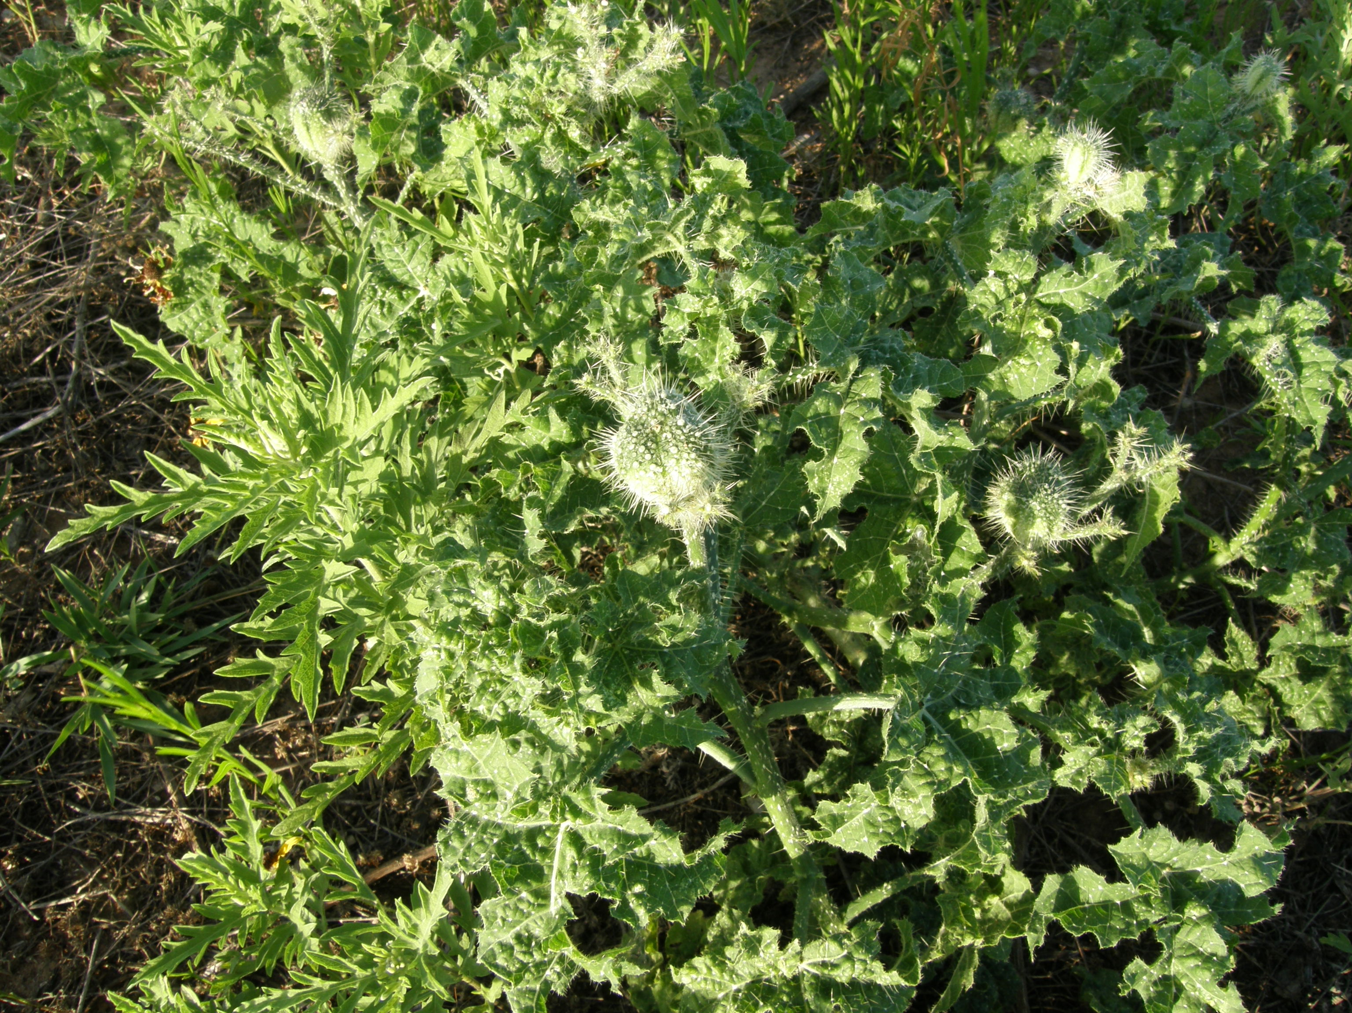
IDENTIFICATION
Source: Jimmie W. Hinze

Slide 6
SAFETY CONCERNS
Releases a toxin into skin when touched
Toxin causes an intense burning sensation
Can remain red and swollen for a number of days after initial contact.
Burning sensation can be intensified if allergic to Bull Nettle
If allergic, contact with the plant may be fatal.

Slide 7
REPORTED FATALITIES
No fatalities were investigated by OSHA from 1990 thru 2007 that pertained to nettle.

Slide 8
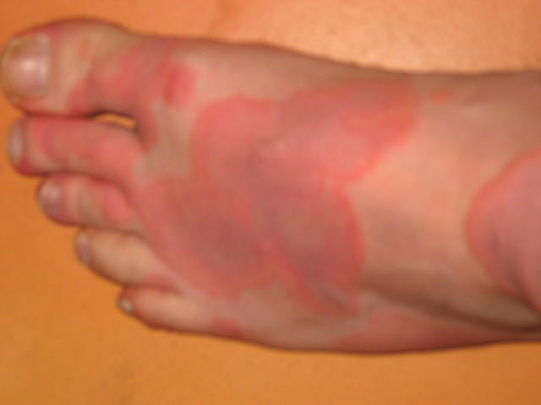
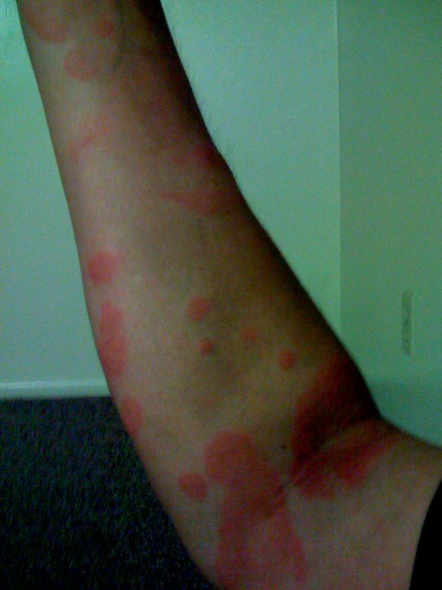
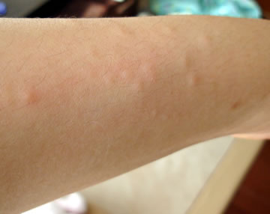
NETTLE RASH- URTICARIA
Source: www.wikipedia.com

Slide 9
OSHA 1926.604
Site Clearing
(a) General requirements
(1) Workers engaged in site clearing must have protection from plants, insects, and animals that may be hazardous. They must also know first aid for these hazards.

Slide 10
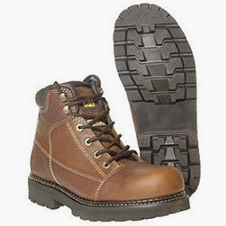
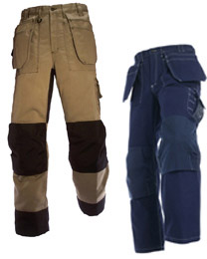
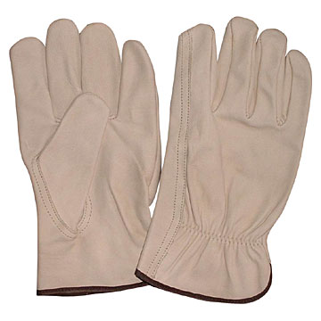
SAFETY PRECAUTIONS
Long Thick Pants
Close-Toed Shoes
Working Gloves
Source: www.made-in-china.com

Slide 11
SAFETY PRECAUTIONS
The most effective precaution is avoidance of contact.
To avoid contact, workers must be able to identify nettle on site.

Slide 12
SAFETY PROCEDURES
Minor rashes – Apply sting relief cream
Severe rashes – Obtain Medical Treatment
Source: www.firstaidmonster.com

Slide 13
Think safety
Work Safely

