Slide 1
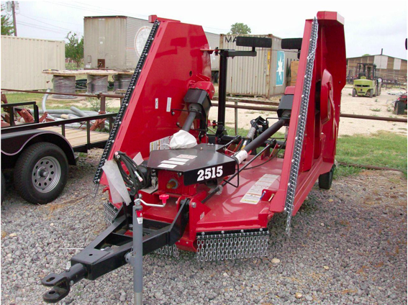
Mowing Decks
Single spindle model
Flex-wing model

Slide 2
Also known as a:

Slide 3
Mowing Deck Components
Mowing Deck is bladed rotary mower that is pulled behind a tractor and is powered via the Power Take Off (PTO)
Driveline
(operated via the PTO)
Power Divider Gearbox
Blade Gearbox
Axle
Self Leveling
Clevis Hitch
Wing Hinge
Bush Hog 3715 Operator’s Manual, Available at http://www.bushhog.com/ContentFiles/Documents/Manuals/3715.pdf

Slide 4
Mowing Decks
Typically used for cutting thick/tall grass or brush on the sides and middle portions of public roadways
Rotary blade

Slide 5
History of Mowing Decks
The first mower was invented by English engineer Edwin Beard Budding in 1827
Rotary mowers were not developed until engines were powerful enough to run the blades at high speeds

Slide 6
History cont.
On May 9, 1899, John Albert Burr designed and patented a rotary blade mower with traction wheels and a rotary blade.
In the 1930’s, Power Specialties Ltd. introduced a gasoline-powered rotary mower.
http://www.paralumun.com/garmower.htm

Slide 7
Typical Hazards/Safety Concerns
Holes, ditches, or embankments present in the terrain and whether it is slick or muddy
Sloped or uneven terrain
Rocks and pieces of trash not visible in terrain to become projectiles

Slide 8
Mowing Deck Fatalities
Man was sitting on the fender of the tractor while a boy put the tractor in gear and let out the clutch. The tractor reared up and lurched forward and the man slipped off the fender and fell under the mowing deck and died
www.tractorbynet.com/forums/safety/5353-killed-brush-hog.html

Slide 9
Mowing Deck Fatalities
67 year-old man was driving his mowing deck on the slope of a hill at his property when he hit a stump which threw him off the mower, it then rolled on top of him and killed him http://portfolio.hkeely.com/2008/07/local-man-killed-in-bush-hog-accident.html

Slide 10
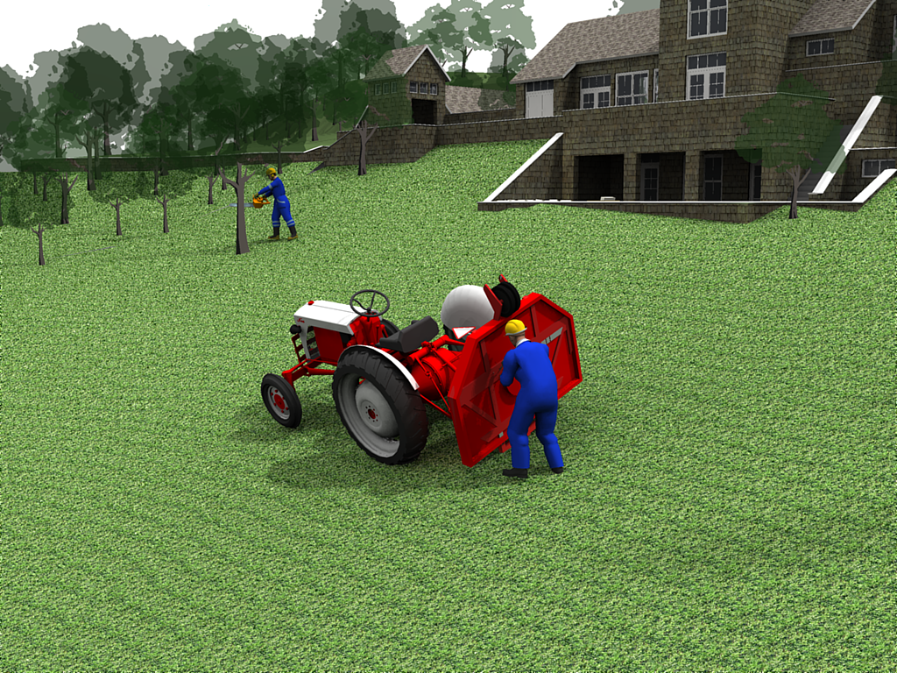
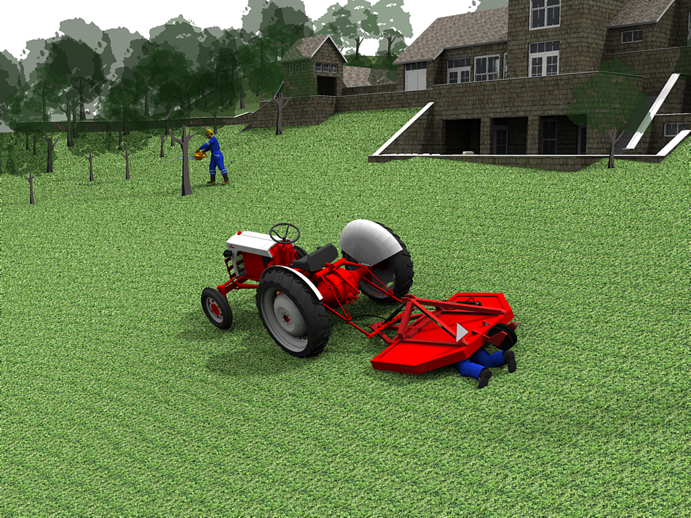
Mowing Deck Fatalities
Man propped his mowing deck up to access the bottom for maintenance. The piece of equipment fell directly on him crushing him to death because he did not secure it well enough www.tractorbynet.com

Slide 11
OSHA Data: Injuries and Fatalities
Worker was mowing tall grass with a tractor and an attached Bush Hog. He was later found underneath the 48” Bush Hog with his head sticking out.
Worker tied a rope around himself and a coworker held the other end to help stabilize him so he could clear brush around a pond. A tractor with an attached bush hog was mowing grass in the area. The loose end of the rope got caught in the bush hog and pulled the employee into the tractor’s protective cage. Employee died from head injuries.
Information extracted from OSHA construction worker fatality data (1990-2007)

Slide 12
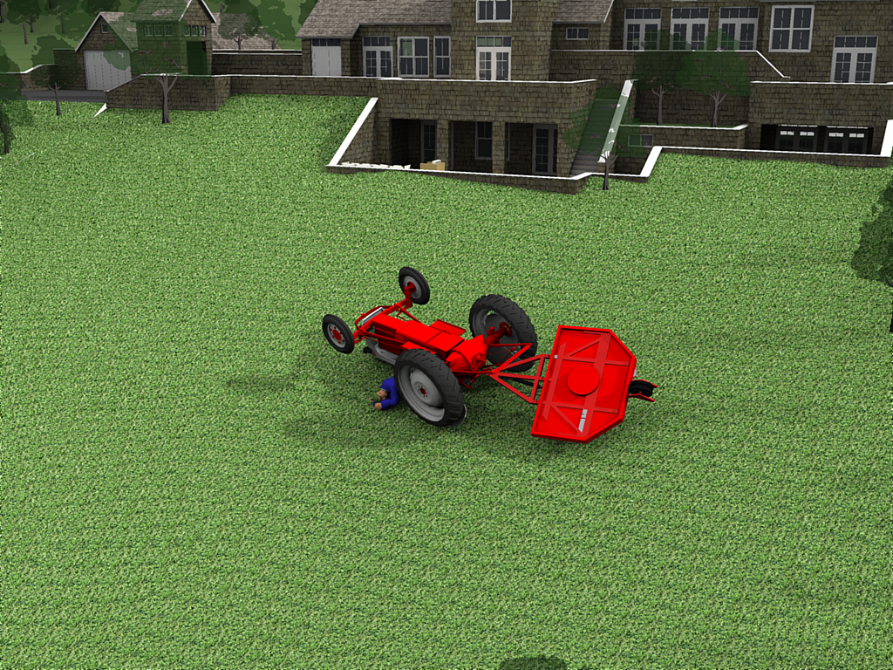
OSHA Data: Injuries and Fatalities
Worker was driving his personal farm tractor with an attached bush hog while clearing vegetation on a construction lot. Employee drove tractor assembly close to an embankment when the tractor overturned and pinned him under the right side of the tractor.

Slide 13
OSHA Regulations U.S. Public Law 91-596 (The Williams-Steiger Occupational and Health Act of 1970) OSHA
Current OSHA regulations state (but are not limited to) instructions to:
Keep all guards in place when the machine is in operation
Permit no riders on equipment
Make sure everyone is clear of machinery before starting the engine, engaging power, or operating the machine.
Bush Hog 3715 Operator’s Manual, Available at
http://www.bushhog.com/ContentFiles/Documents/Manuals/3715.pdf

Slide 14
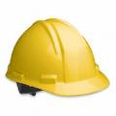
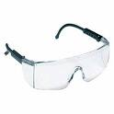
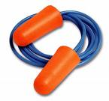
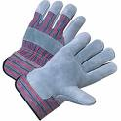
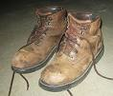
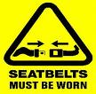
Safety Precautions- PPE
Personal protective equipment such as, protection for eyes, hearing, feet, hands, and head, along with seatbelt should be worn by operator at all times during operation and maintenance.

Slide 15
Safety Precautions
First and foremost- READ OPERATOR’S MANUAL
By becoming familiar with this manual, operator will learn pertinent facts on maintenance and safety procedures.

Slide 16
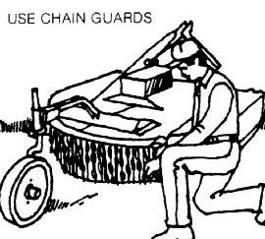
Safety Precautions cont.
Before starting or operating the equipment, make a walk around inspection to check for any defects on the equipment.
Do not operate shredder without all guards and shields in place and in good condition.

Slide 17
Safety Precautions cont.
Do not operate machinery while other workers are working in the relative vicinity.

Slide 18
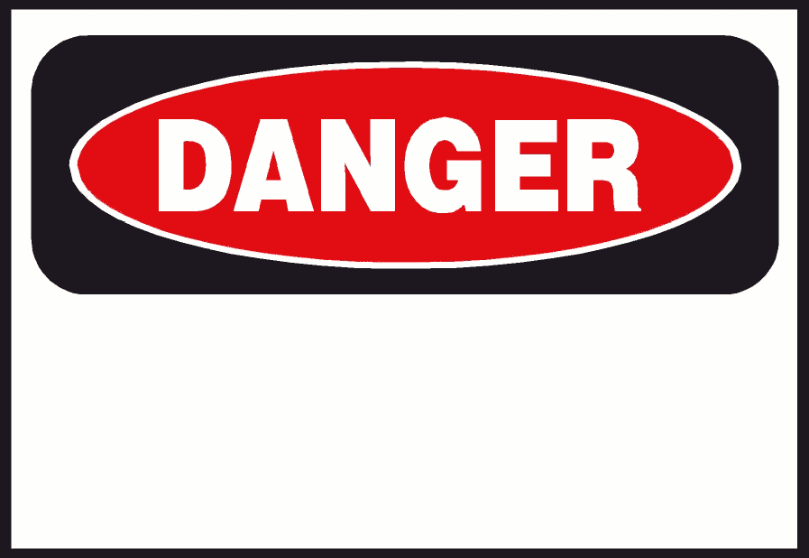
Safety Precautions cont.
Pay attention to and become aware of all safety alert symbols and signs.

Slide 19
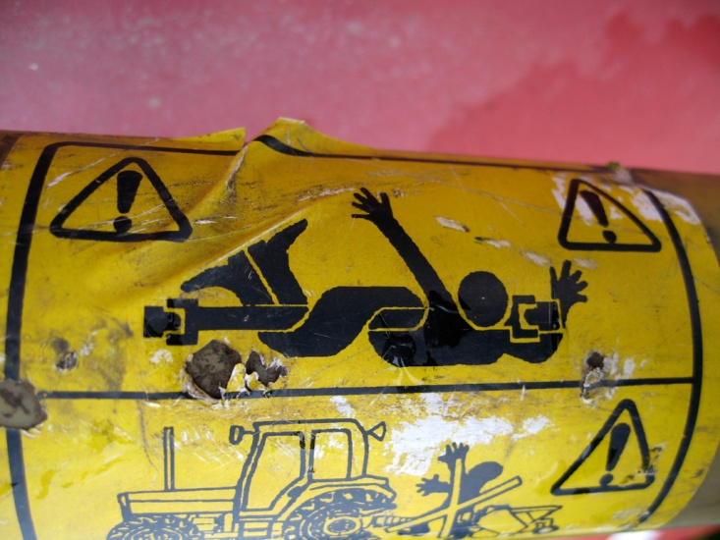
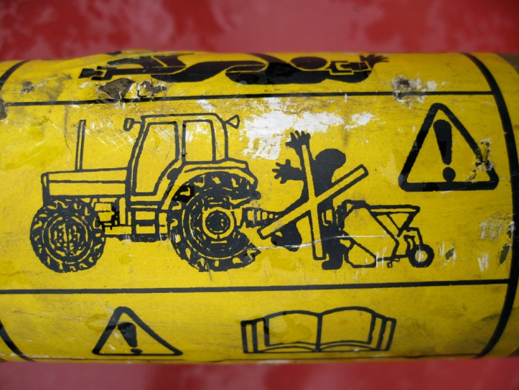
Safety Precautions cont.
Make sure that all equipment, tractor and mowing deck, has appropriate safety signs and are visible at all times

Slide 20
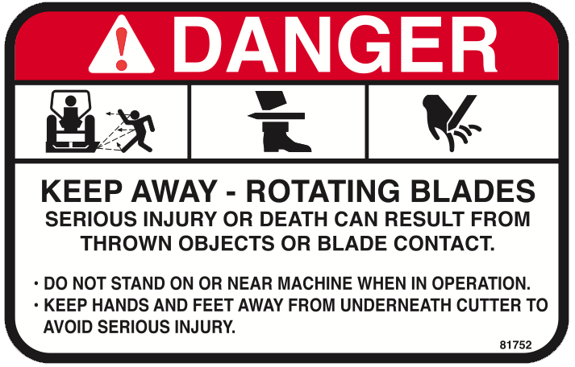
Safety Precautions cont.
Never touch equipment while running. Keep hands and feet away from the blades, and do not start the equipment if a person is in close proximity.

Slide 21
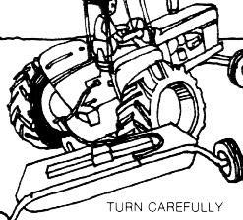
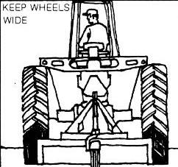
Safety Precautions cont.
Clear the area of any object that can be picked up and thrown and inspect terrain conditions for soft spots, ditches, or holes.
If possible, work in pairs in order to foresee any problems that the operator might not notice.

Slide 22
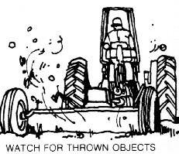
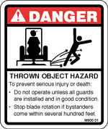
Safety Precautions cont.
Determine a reasonable cutting time when there is minimal traffic. While cutting is in operation, maintain a safe working distance from the traffic and bystanders

Slide 23
Caring for the Mowing Deck
Blade sharpness is a key to efficient, safe mowing. Inspect the blades often, and replace them when they become too dull for additional sharpening.
Check hydraulic lines for wear and leaks before every use.

Slide 24
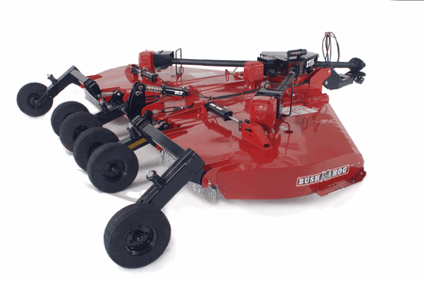
Caring for the Mowing Deck
Stop engine, disconnect the power source, and wait for all machine movement to stop before servicing, adjusting, cleaning or unclogging the equipment.
Keeping all parts in good condition is paramount to ensure safe machinery.

Slide 25
Caring for the Mowing Deck
Before each use….Lubricate:
Driveline Universal joints
Driveline Guard
Constant Velocity joint
Axle Arms
Axle Pivots
Drivelines
Gearboxes

Slide 26
Think safety
Work Safely

