Slide 1
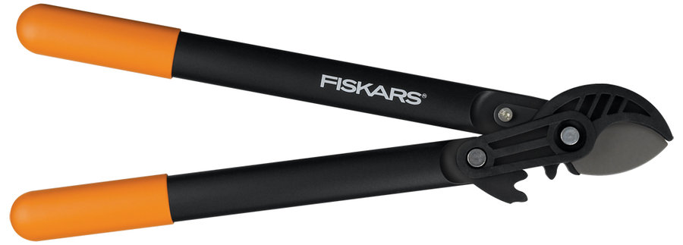
Limb Loppers

Slide 2
Limb Loppers
A tool designed to cut off limbs, branches, and twigs from a tree or other plant.
A form of scissors with blades from 2” - 4” in length with long handles that extend for 2’ - 2.5’ in length.

Slide 3
Standard Usage
Remove dead branches.
Have hazardous trees taken down
Prune out weak or narrow-angled tree branches that overhang job sites, parking areas, and sidewalks — anyplace falling limbs could injure people or damage property.
Eliminate branches that interfere with street lights, traffic signals, and overhead wires.
Prune branches that obscure vision at intersections.
Source: http://www.extension.umn.edu/distribution/horticulture/DG0628.html

Slide 4
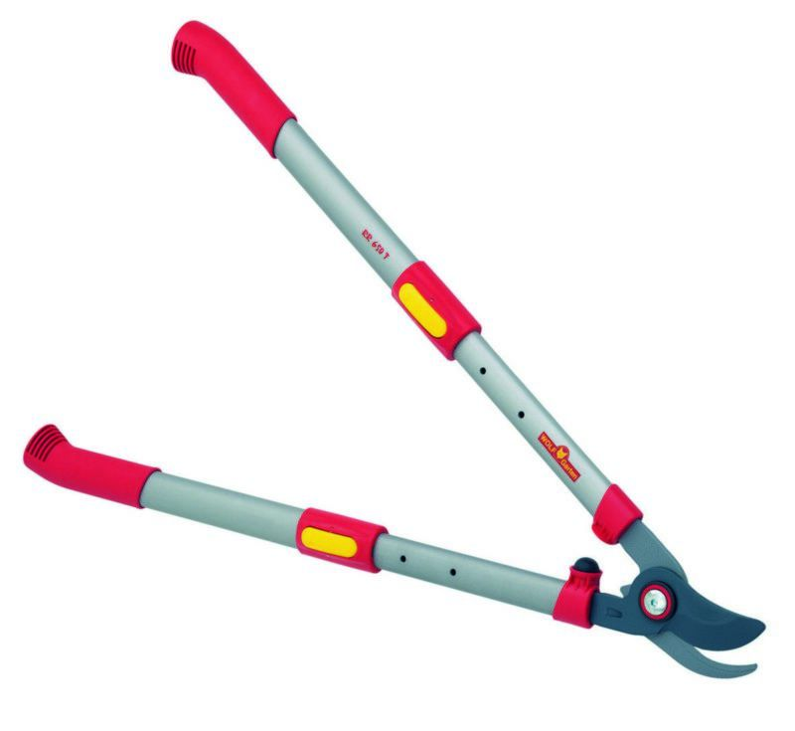
Types of Limb Loppers
Bypass Loppers: have two blades moving together to cut, similar to scissors.

Slide 5
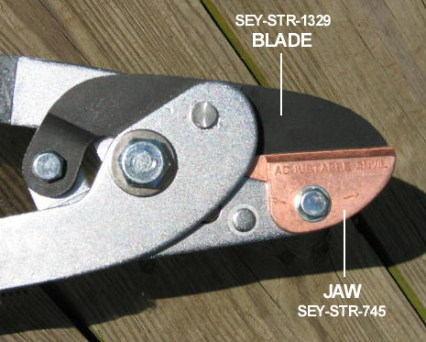
Types of Limb Loppers
Anvil Loppers: use a stationary flat edge, or jaw, on one side and a sharp blade that moves on the other side to cut.

Slide 6
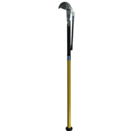
Types of Limb Loppers
Hydraulic Loppers: have bypass blades and use mechanical assistance to cut.

Slide 7
Historical Background
The first known use of the word lopper was in 1953.
Source: www.merriam-webster.com
Loppers are a form of scissor. The first scissors were most likely invented in Egypt around 1500 BC.
Pivoted scissors were invented by the Romans around 100 AD.
Source: www.uncommonscissors.com

Slide 8
General Uses
Limb loppers are used most by those in the landscaping industry, referred to as aborists.
They are also used by the general public for common trimming tasks.

Slide 9
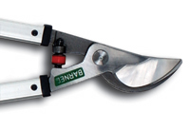
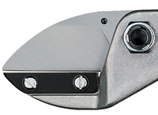
Specific Uses
Bypass Loppers
  Used on small branches and bushes, <1”.
Anvil Loppers
  Used on medium branches and tree limbs, 1”>2”.
Hydraulic Loppers
  Used on large branches, >2”, and hard to reach areas.

Slide 10
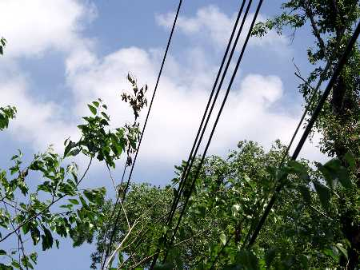
Relevance to Construction
The main use of limb loppers in the construction industry is to trim over-grown trees and bushes for power lines, traffic, and site clearing.
They are much easier to use in tight spaces than power tools.

Slide 11
Hazards and Safety Concerns
Work injuries that involve limb loppers include:
  Falls
  Struck-by
  Electrical Shock
  Amputations / Lacerations
  Asphyxiation

Slide 12
Non-Fatal Accident
A worker was trimming a tree in close proximity to an energized power line when the tree branch being trimmed came into contact with a 7.3 KV power line. The worker grabbed the branch and suffered electrical shock. The employee received burns to the left hand and right foot.
Source: IMIS Accident Summary: CY 2007 [SIC 0783]

Slide 13
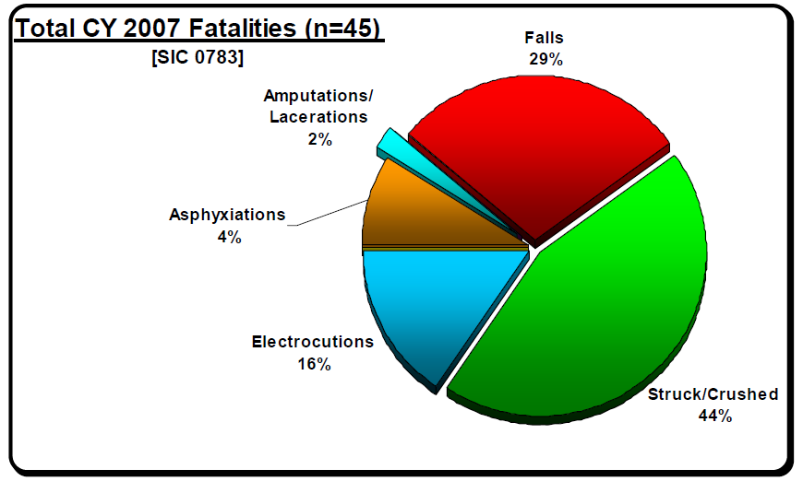
Fatal Accidents
In 2007, there were 45 fatal arborist injuries that occurred.
The fatalities were all males age 20 - 72, with a mean age of 35.7 years old.
Source: IMIS Accident Summary: CY 2007 [SIC 0783]

Slide 14
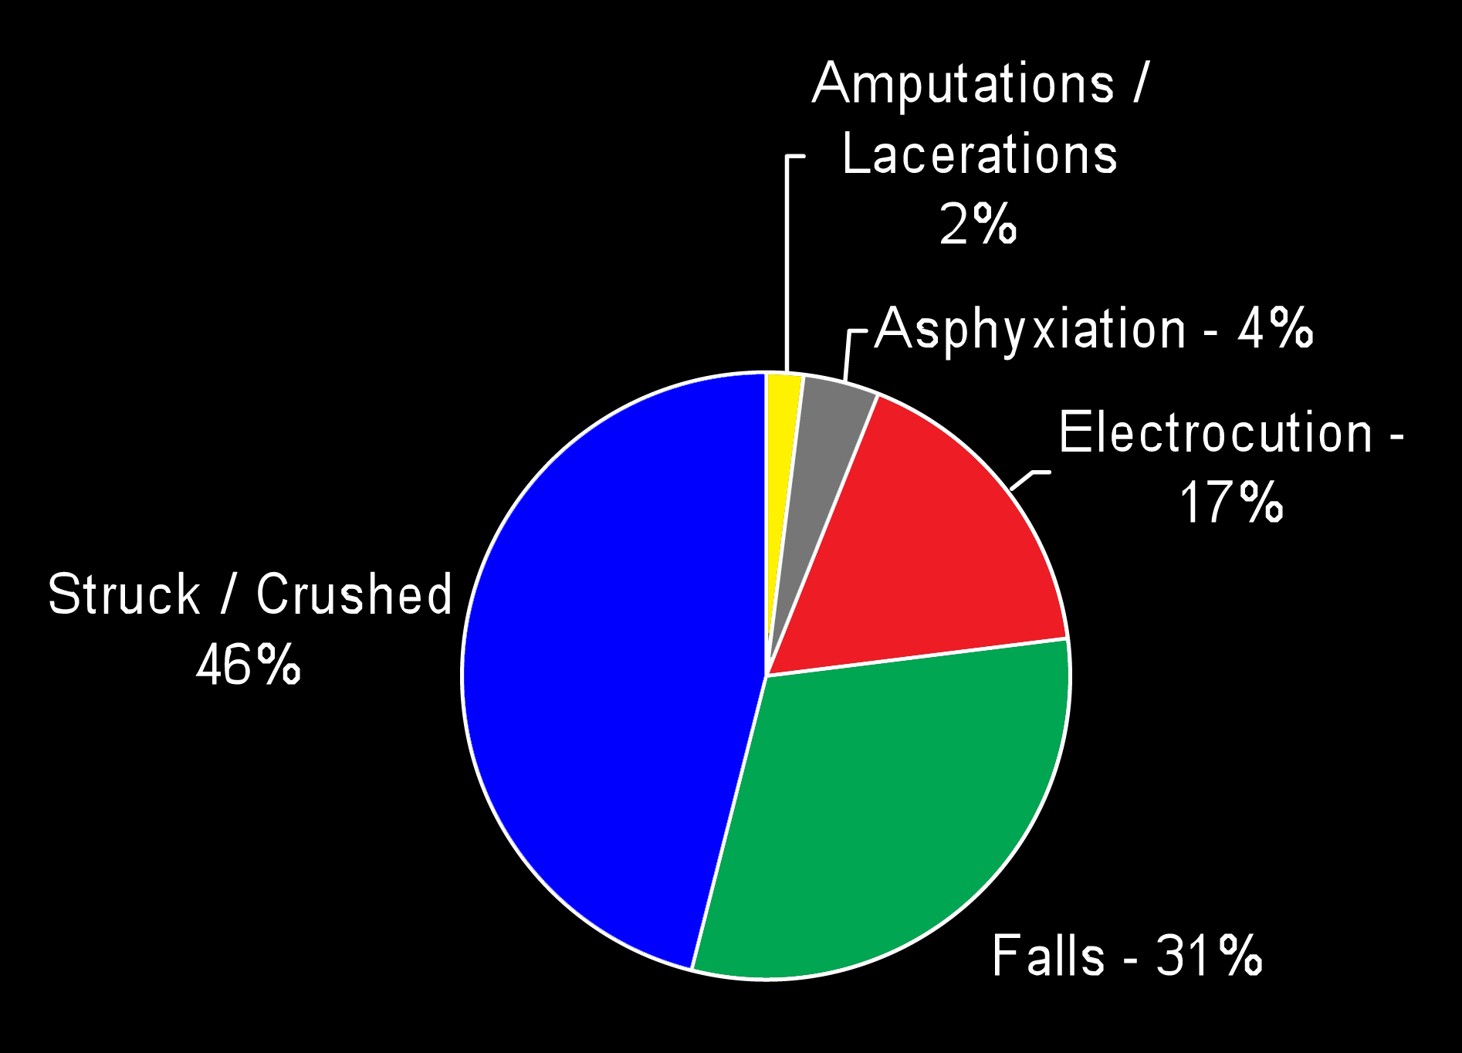
FATAL CONSTRUCTION ACCIDENTS
Source: IMIS Accident Summary, CY 2007 [SIC 0783],
Extracted from OSHA Accident Investigation Data 1990-2009

Slide 15
Fatality Example
The owner of a home improvement company, was working on the roof of a private residence for which he had contracted to clean roof gutters. As he leaned over the roof edge to prune over-hanging tree limbs, he lost his balance and fell to the ground, suffering fatal spinal injuries.
Source: Extracted from OSHA Accident Investigation Data 1990 - 2009

Slide 16
Fatality Example
A worker was cutting tree branches while standing on a ladder. The branch broke prematurely, striking the employee, knocking him off the ladder. The employee fell 18 feet to his death.
IMIS Accident Summary, CY 2007 [SIC 0783]

Slide 17
Fatality Example
A worker was trimming tree limbs from around a 138 kV power transmission line when he was electrocuted. The limb he was cutting was not roped off and it fell, coming in contact with or falling close enough to the line that the electricity could arc across the limb and into the tree killing the victim.
IMIS Accident Summary, CY 2007 [SIC 0783]

Slide 18
OSHA Regulations
OSHA defines limb loppers as a hand and portable power tool. This means it falls under OSHA Standard 1926.300:
  Tools - Hand and Power: General Requirements
Another OSHA Standard that applies is 1910.269 which pertains to line-clearance tree-trimming operations.
Source: www.osha.gov

Slide 19
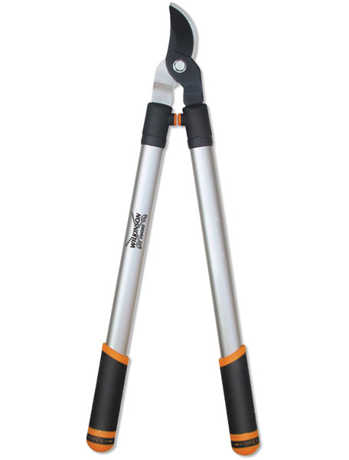
Safe Work Practices
Personal Protective Equipment
  Safety Vest
  Hard Hat
  Gloves
  Eye Protection
  Long-Sleeved Shirt
  Long Pants

Slide 20
Safe Work Practices
Clean the limb loppers before using them on a different plant (diseases can be transmitted through the debris on the limb loppers).
Keep the limb loppers sharp. Defective shears must not be used.
Do not force the limb loppers. If cutting is difficult, use a saw.

Slide 21
Safe Work Practices
Always carry pruning shears with the point facing down when walking or standing.
Always know where the fingers and hands are before making a cut.

Slide 22
Safe Work Practicess
Pruning Operations
Hold safety meetings before every shift, warning workers of dangers in their area.
Work as a team. Other tree trimmers on the job site should be on the look-out for danger.
Do not throw or drop tools from trees, unless warning has been given and the ground area is clear.
Be alert and aware of other employees working nearby.
http://nasdonline.org/document/2104/d000056/tree-trimmer-electrocuted-in-orchard.html

Slide 23
Safe Work Practices
Assume that all overhead wires are energized at lethal voltages. Never assume that a wire is safe to touch even if it is down or appears to be insulated.
Never touch a fallen overhead power line. Call the electric utility company to report fallen electrical lines.
Always use caution when working near electricity.
Source: http://www.osha.gov/OshDoc/quickcards.html

Slide 24
Safe Work Practices
If working at heights or handling long objects, survey the area before starting work for the presence of overhead wires.
All tree trimming or removal work within ten feet of a power line must be done by trained and experienced line-clearance tree trimmers. A second tree trimmer is required within normal voice communication range.

Slide 25
Safe Work Practices
Do not trim trees in dangerous weather conditions.
Perform a hazard assessment of the work area before starting work.
Eliminate or minimize exposure to hazards at the tree and in the surrounding area.
Source: http://www.osha.gov/OshDoc/quickcards.html

Slide 26
Safe Work Practices
Use personal protective equipment such as gloves, safety glasses, hard hats, etc., recommended in the equipment manufacturer’s operating manual.
Determine the tree’s felling direction. Address forward lean, back lean, and/or side lean issues.
Inspect tree limbs for strength and stability before climbing. Tree trimmers working aloft must use appropriate fall protection.

Slide 27
Safe Work Practices
Use extreme care when felling a tree that has not fallen completely to the ground and is lodged against another tree.
Always face a falling tree.
Be alert and avoid objects thrown back by a tree as it falls.
If broken trees are under pressure, determine the direction of the pressure and make small cuts to release it.
Source: http://www.osha.gov/OshDoc/quickcards.html

Slide 28
Safe Work Practices
Use extreme caution when moving ladders and equipment around downed trees and power lines.
Do not climb trees while carrying tools.
Line-clearance tree trimmers must be aware of and maintain the proper minimum approach distances when working around energized power lines.

Slide 29
Think Safety
Work Safely

