Slide 1
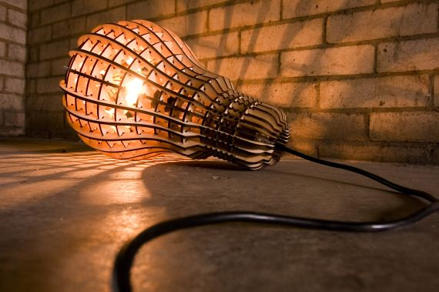
Lighting

Slide 2
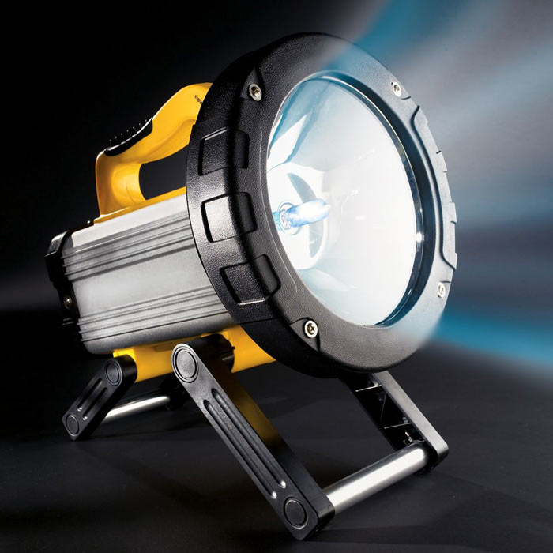
Lighting in
Construction Safety

Slide 3
Potential Effects of Inadequate Lighting:
Unsafe working conditions resulting in injury/ death
Loss of Productivity
  Blurred vision, headaches, eye strain
Compromising the Quality of Work

Slide 4

Lighting - Is it Important ?
If a worker cannot see, a worker cannot work.
Insufficient lighting can cause:
  Unsafe working conditions resulting in Injuries from unseen hazards/ death.
  Loss of productivity.
  Loss of quality.
  Eye strain
  Blurred Vision
  Head aches
  A reduction in mental alertness

Slide 5

Why is Good Lighting Important?
Increases Productivity
Enhances Comfort
Most importantly improves safety

Slide 6
Amount of Temporary Lighting needed depends on…
Size or design of building
Working Hours
Time of the Year
Weather Conditions

Slide 7
Aspects of Adequate Lighting:
Quantity
  Only quantity of light is measurable (footcandles)
  OSHA uses quantity to establish minimum standards for illumination
Improper Contrast
Brightness
Glare
Reflection

Slide 8
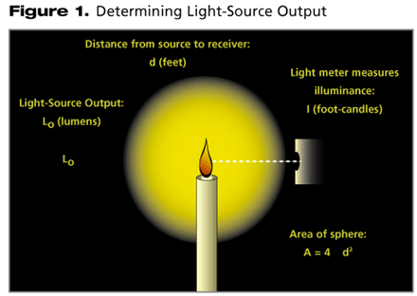
Determining Foot-candles
A foot-candle is a unit of measure of the intensity of light falling on a surface, equal to one lumen per square foot.

Slide 9
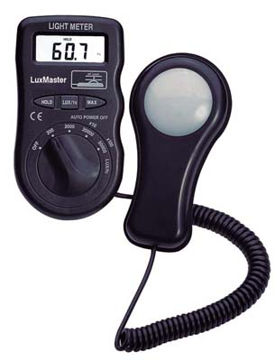
A light meter can be used to measure
the number of foot candles.

Slide 10
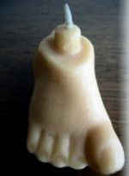
How to measure lighting ?
Lighting is measured by foot candles
1 Foot Candle = The amount of light given off by
one candle on a surface one foot away
1 Lumen
Area = 1 sf
1 ft

Slide 11
At about 200 foot-candles most people begin to squint. This is when sun glasses are appropriate.

Slide 12

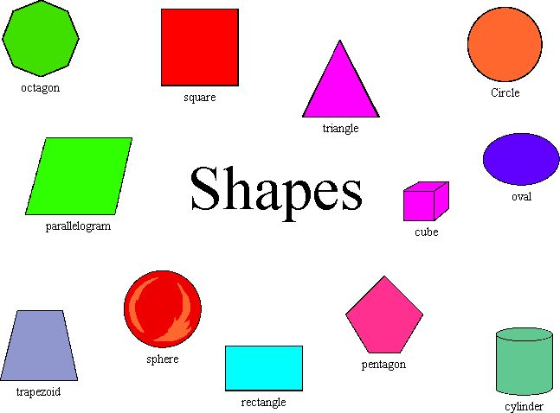

It is more than the light source ?
.
The color of the surrounding surfaces
The shape of the surrounding surfaces
The texture of the surrounding surfaces
The location of the light source in the room

Slide 13
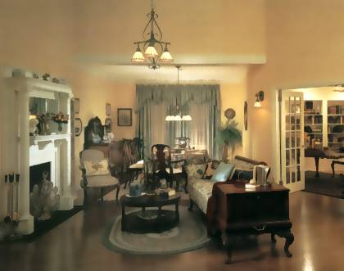
Example
This is an example of a living room that reads 10 foot candles.

Slide 14
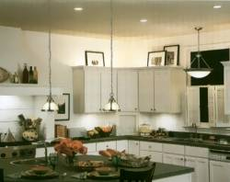
Example 2
This kitchen reads about 25 foot candles

Slide 15
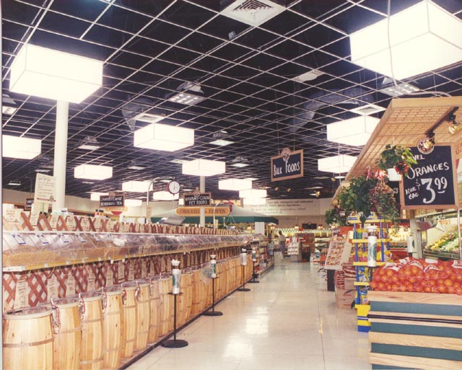
Example 3
This grocery store reads about 150 foot candles

Slide 16
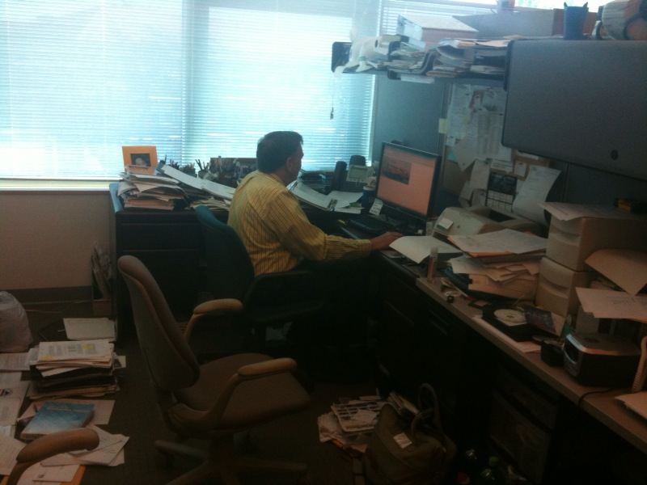
Example of measurements within the same room
The same room can have a measurement variance that may exceed 200 foot candles depending on the location where the measurements take place.
200 FC
45 FC
5 FC
50 FC

Slide 17
Common Misconception
People often think lighting is only a problem if it is too dark but lights that are too bright can also be dangerous
Having to work in awkward positions because light is in the eyes can cause eye strain and head aches making work more dangerous

Slide 18
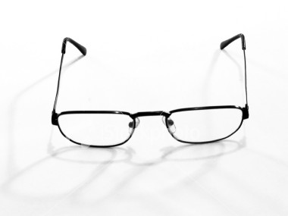
Other poor lighting problems
Poor lighting can lead to myopia (nearsightedness), increased headaches, and increased stress

Slide 19
According to the OSHA Accident Investigation Data from 1990 thru 2007
There were seven deaths that can be
directly attributed to poor illumination.
Source: Extracted from OSHA Accident Investigation Data 1990-2007

Slide 20
Accident Summary
Worker was inside a 180 ft diameter dome, greasing the pins on an excavator bucket.
A 10-wheel dump truck with an inoperable back-up alarm backed into the dome, heading toward the excavator bucket.
The excavator engine was running and the worker neither saw nor heard the dump truck approach.
The truck driver’s vision was impaired by the change in lighting from outside to indoors and did not see anyone around the backhoe.
The right rear corner of the dump truck struck the excavator bucket, pinning the worker between the truck and the bucket.
He sustained massive internal injuries, and was killed.
Source: Extracted from OSHA Accident Investigation Data 1990-2007

Slide 21
Accident Summary
A company was pouring a foundation adjacent to a recently constructed area that contained pits about 11 feet deep.
The pits had been covered with plywood and sheet metal to guard the open surfaces.
A worker was using a Fresno to smooth out freshly poured concrete.
A welder needed to perform welding in the pit area, but lacked adequate lighting for the job.
A cover was removed from the pit to allow sunlight to penetrate the space, providing light for the welder.
A worker who was focused on the work, stepped back into the unguarded space and fell to the surface below.
Source: Extracted from OSHA Accident Investigation Data 1990-2007

Slide 22
Accident Summary
A worker was using a metal bull float to finish a concrete highway slab.
The bull float had a 19' handle and the power lines were 17' above the ground.
The work was being done at the end of the day when it was dark.
No temporary lighting was installed.
The worker raised the float and struck an energized overhead power line
The worker was electrocuted.
Source: Extracted from OSHA Accident Investigation Data 1990-2007

Slide 23
Case of Too Much Light
At 9:00 AM, a worker was putting a steel deck roof on a large tilt up structure. He walked out to the edge of the roof deck. The glare of the morning sun may have caused him to be unable to distinguish the steel roof decking from the white vinyl sheet used to support the insulation. He fell through the vinyl to the concrete floor 33’-6” below. The injuries proved fatal.
Source: Extracted from OSHA Accident Investigation Data 1990-2007

Slide 24
Case of Too Much Light
A worker was crushed by a road grader that was backing up. It pinned the worker against a pickup killing him. The afternoon sun and dirty glass caused excess glare for operator.

Slide 25
Case of too Little Light
Worker was walking in a mall under construction to throw trash away.
On the way to the dumpster he stepped into a two foot depression in the floor.
He tripped, causing lower back injury.
Nearest light source was 150’ away.
“Source: Extracted from OSHA Accident Investigati7n Data 1990 – 2008”

Slide 26
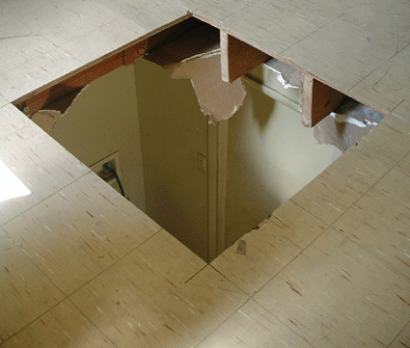
Case of Too Little Light
Uncovered hole in floor
Single tinted window was the only light source in the room
Laborer stepped in the floor opening and fell to the floor below
A study showed only .2 foot-candles in area where he fell!

Slide 27
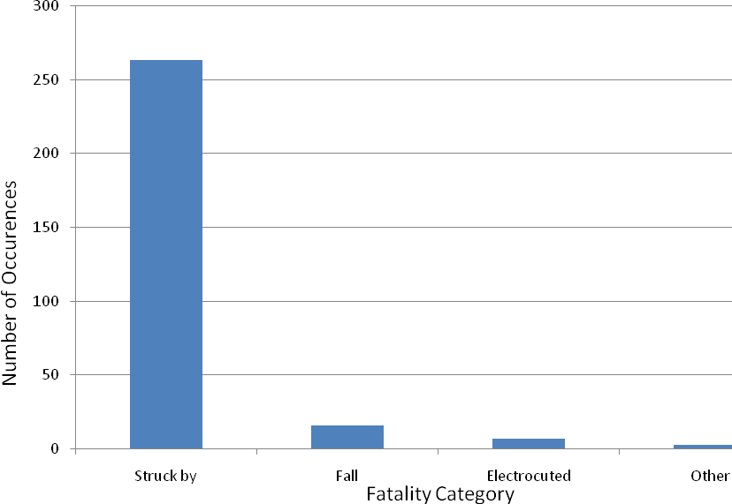
Fatalities
According to OSHA, 289 fatality cases were recorded between 1990 thru 2007 as visibility related cases.
Most of the 289 cases had a direct link to the amount of lighting where the accident took place
“Source: Extracted from OSHA Accident Investigati7n Data 1990 – 2008”

Slide 28
OSHA
Subpart C
  1926.26
    Construction areas, aisles, stairs, ramps, runways, corridors, offices, shops, and storage areas where work is in progress shall be lighted with either natural or artificial illumination.

Slide 29
OSHA 29 Subpart K
1926.405 (a) 2 <E>, <F> and <J>
Wiring methods, components, and equipment for general use.
All lamps for general illumination shall be protected from accidental contact or breakage. Metal-case sockets shall be grounded (E).
Temporary lights shall not be suspended by their electric cords unless cords and lights are designed for this means of suspension (F).
Flexible cords used with temporary and portable lights shall be designed for hard or extra-hard usage (J).

Slide 30
OSHA 29 Subpart O 1926.600 Equipment (a) 1
All equipment left unattended at night, adjacent o a highway in normal use, or adjacent to construction areas where work is in progress, shall have appropriate lights or reflectors, or barricades equipped with appropriate lights or reflectors, to identify the location of the equipment

Slide 31
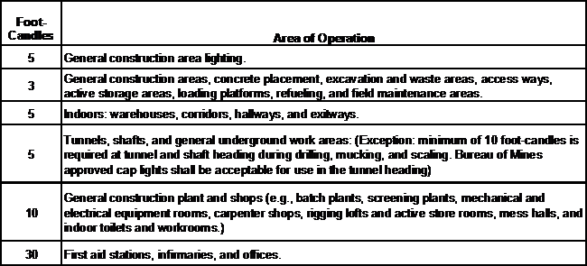
OSHA 29 Subpart D 1926.56
Illumination
General Construction areas, ramps, runways, corridors, offices, shops, and storage areas shall be lighted to not less than the minimum illumination intensities listed in Table D-3 while any work is in progress:
Table D-3
Table D-3

Slide 32
Task Lighting
Task lighting is the lighting available at the work area where a specific task is performed.
General lighting provides light for the entire building
Properly implementing task lighting will make work safer, increase productivity, and overall quality

Slide 33
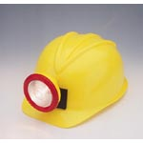
Types of Task Lighting
Floodlights
Headgear
Compact Balloon Lights
  Provide nearly shadow free illumination
Light Towers
  Should be positioned at highest point over specific area to avoid glare

Slide 34
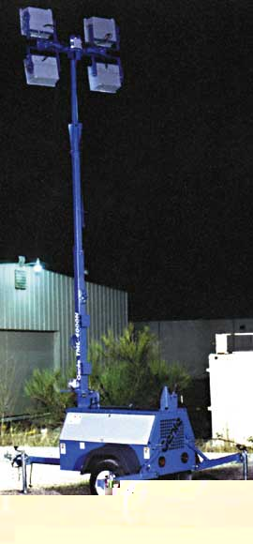
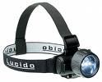
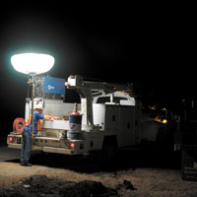
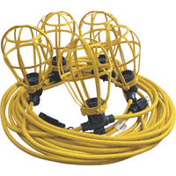
Task Lighting
What is Task Lighting
    Task lighting is the lighting available at the work area where a task is performed.
Types :
1- Head Lamps 2- Light Towers
(Avoid Glare)
3 - Compact Balloons 4- Extension Cords

Slide 35
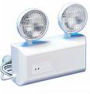
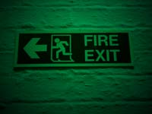
Emergency Lighting
What is Emergency Lighting
    - According to OSHA 1910.37(b)(1), Each exit route must be adequately lighted so that an employee with normal vision can see along the exit route.

Slide 36
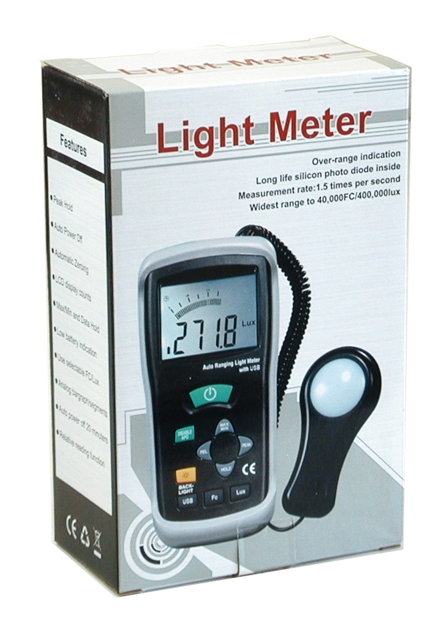
Best Practices
Controlled zones for authorized personnel
Preconstruction design of temporary lighting and identification of potential hazards
Proper hazard signs and notifications
Frequent and detailed inspections to check foot-candles
  Foot-candle Meter

Slide 37
Best Practices
Hardhats with lights
Reflective vests
Proper emergency lighting
Inspection on lighting sources
Protect all the temporary lighting
Avoid too much lighting, and too little lighting.

Slide 38
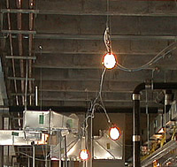
Temporary Lighting
Extension Cords/ String Lighting
Head Lamps/ Flash lights

Slide 39
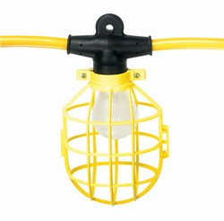
Extension Cord/ String Lighting
Extension cord with light bulbs attached at set intervals
Each bulb must be covered with a plastic cage to protect bulbs from breaking
Very important to be strung properly

Slide 40
Think Safety
Work Safely

