Slide 1
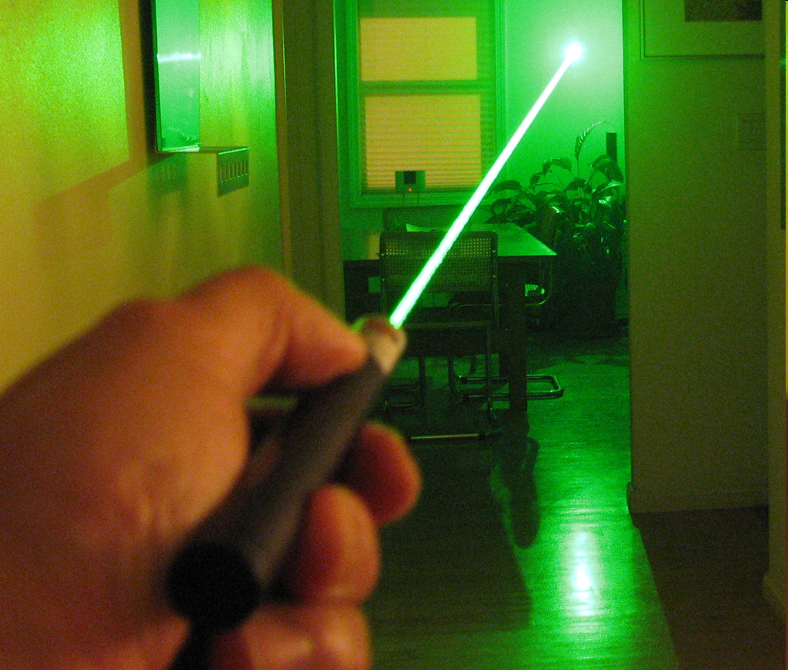
Lasers
http://www.rainydaymagazine.com/RDM2007/Home/Oct2007/RainyDayScience/WickedLaser/FocusedBeam2Big.jpg

Slide 2
Laser
L Light
A Amplified By
S Stimulated
E Emission of
R Radiation
“Thus the laser is a device which produces and amplifies light.”
OSHA STD 01-05-001 - PUB 8-1.7 - Guidelines for Laser Safety and Hazard Assessment

Slide 3
A Brief History
The mechanism by which this stimulated emission is accomplished was first postulated by Albert Einstein in 1917.
Lasers have been used in construction since the mid 70’s. Lasers came to be used in construction to improve the performance of existing tools.
The accuracy of lasers has helped improve the accuracy of construction by helping to eliminate problems due to inaccuracy in measurements.
This is why lasers have become increasingly popular since their introduction to the industry.
OSHA STD 01-05-001 - PUB 8-1.7 - Guidelines for Laser Safety and Hazard Assessment

Slide 4
Laser Safety
There are 2 different types of lasers in construction
Type 1
Invisible Lasers
These lasers are generally used in exterior settings for checking grade, setting concrete forms, checking depths of footers and trenches, and more advanced uses include setting elevations for laser receivers mounted on excavators and motor graders.
OEMBuddy.com
www.jamesriversupply.com/whatis.htm
http://web.princeton.edu/sites/ehs/laserguide/sec3.htm#class1

Slide 5
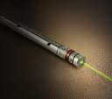
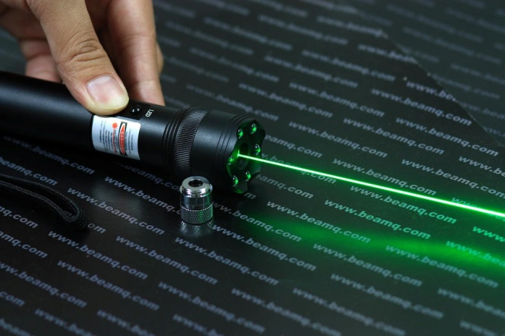
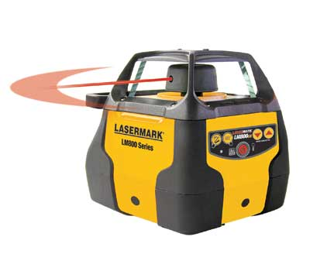
Laser Safety
Type 2 Visible Lasers
These types are usually used in indoor applications such as:
Using a laser as a plane of light
Setting sewer pipe
Hang ceiling grids
Aligning and mounting floor and ceiling brackets for walls
Aligning studs
Leveling and hanging cabinets
Any other application where a level is used.
OEMBuddy.com
www.jamesriversupply.com/whatis.htm
http://web.princeton.edu/sites/ehs/laserguide/sec3.htm#class1

Slide 6
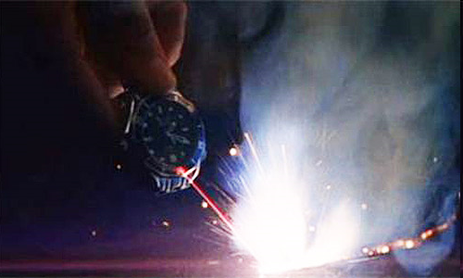
Laser Safety
Typical Hazards
Burning eye and retina damage
Burning skin creating blisters
Many accidents occur when someone is using a laser but is not paying attention to their surroundings and gets injured by something else such as getting struck by equipment.
http://www.osha.gov/pls/oshaweb/owadisp.show_document?p_table=DIRECTIVES&p_id=1705

Slide 7
Laser Safety
How lasers can do harm
The laser produces an intense, highly directional beam of light. The most common cause of laser-induced tissue damage is thermal in nature, where the tissue proteins are denatured due to the temperature rise following absorption of laser energy.
It is now widely accepted that the human eye is almost always more vulnerable to injury than human skin.

Slide 8
Laser Safety
Statistics
Although there have been no recorded fatalities from lasers, there are many cases of people using a laser and not paying attention to their surroundings. Then they have been involved in the following types of accidents:
Struck by
Trench cave in
Crushed by
Caught between
Fall
http://www.osha.gov/OshDoc/toc_FatalFacts.html http://www.issm-iseb.org/b2b/pics/Motor_Grader__PQ190II_.jpg

Slide 9
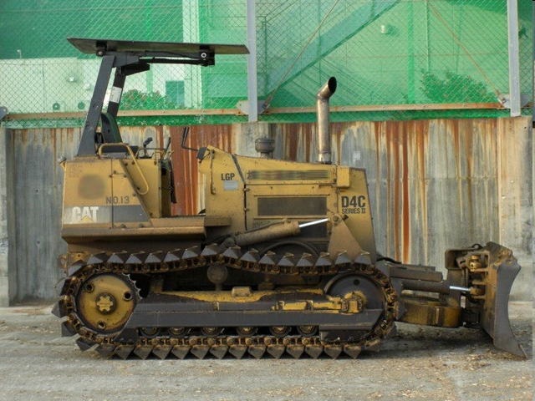
Typical Accident When Using Lasers
A worker and coworkers were constructing a driveway. One worker was operating a dozer while another worker was behind the dozer measuring the grade of the earth with a laser. The bulldozer backed over the second worker. He was crushed and killed.
OSHA Fatality Data 1990 to 2009

Slide 10
Typical Accident When Using Lasers
A worker was attempting to shoot a grade with a laser device in a trench. The trench had no protective system in use to protect employees from cave-in hazards. The worker entered the trench to find the laser (light) with a shovel. His legs were then trapped at the knees due to a small cave-in on the west side of the excavation. During the rescue attempt, both the worker and a dozer operator (who tried to assist in the rescue) were buried due to a collapse of the east wall of the trench.
OSHA Fatality Data 1990 to 2009

Slide 11
Laser Fatality Example
Two workers were instructed to replace a storm drain concrete pipe in a section of a trench. An operator of an excavator was nearby but working on a different portion of the trench. Employee #2 removed a bucket of dirt and swung around and dumped the bucket of dirt onto the spoil pile. As the operator was moving a bucket of material, he heard one of the workers yelling. The worker was buried up to his neck in the dirt. When the worker was being removed from the trench, he lost consciousness and went into cardiac arrest. Since no witnesses observed the accident, the situation had to be surmised. The workers in the trench had utilized a laser and target during the course of their work. The laser was utilized to ensure that the pipe was installed at the proper grade. The trench had not been properly supported to prevent the cave-in.
OSHA Fatality Data 1990 to 2009

Slide 12
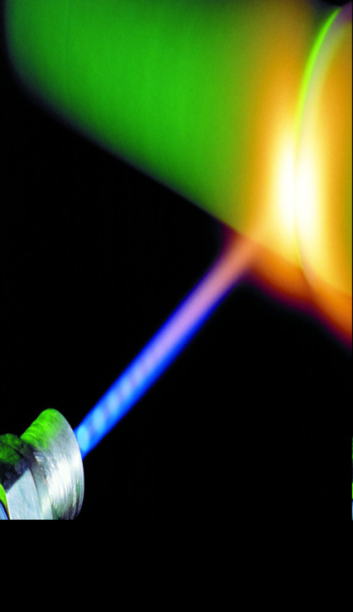
Laser Safety
Classes of Lasers
Class I Example: Laser Printer, CD players
Less than .4 mW of power output
Not harmful
Class II Example: Laser Pointers
Between .4 and 1 mW of power output
Can be harmful over an extended period of time
Class III
III(a) between 1 and 5 mW Example: Laser pointers
Injury if stared at
III(b) between 5 and 500 mW Example: Laser Light show
Injury if looked at directly or from reflection
Class IV Example: Cutting, Welding
Over 500 mW power output
Most dangerous: can cause ignition of materials
OSHA STD 01-05-001 - PUB 8-1.7 - Guidelines for Laser Safety and Hazard Assessment
http://www.force.dk/NR/rdonlyres/2AD0D02F-15A1-4681-851F-F01C357CB662/0/051215_laser_100x90.jpg
http://74.125.47.132/search?q=cache:sjIB7KgYljsJ:ehs.uky.edu/radiation/laser_fs.html+class+2+laser+examples&cd=3&hl=en&ct=clnk&gl=us

Slide 13
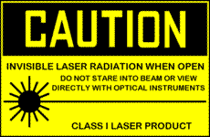
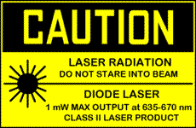
Laser Safety
Class I and II "Caution"
The lasers under Class I and II are usually considered "safe" to human eyes. That means human eyes exposed to the laser radiation would not sustain permanent retina damage. It is also suggested that people do not look into the laser beam a long time or view the beam directly with optical instruments.

Slide 14
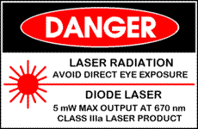
Laser Safety
Class IIIa and IIIb "Danger“
It is generally thought that the beam will be unsafe to human eyes. To expose eyes to the laser radiation would result in a permanent retina damages. Direct eye or skin exposure to the laser beam is prohibited.

Slide 15
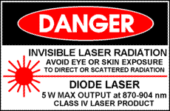
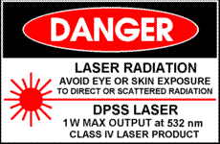
Laser Safety
Class IV "Danger“ The powerful radiation including the reflected and scattered radiation can permanently cause human skin and eye retina damages. It is important to avoid eye or skin exposure to direct or scattered radiation. The Class IV lasers should be used strictly under the professional control.

Slide 16
Laser Safety
Training
The level of training shall be appropriate to the level of the
laser hazard being used (ANSI 5.5).
designated by the supervisor to provide training
according to EH&S.
• Class I and II – training not required
• Class IIIa– training not required
• Class IIIb and 4 – training is required
Refresher training is required every two years. Attendance at
a laser safety class or completing an on-line refresher course
will meet this requirement.
http://www.ehs.cornell.edu/file/Laser_Safety_Program_Guide_v2.pdf

Slide 17
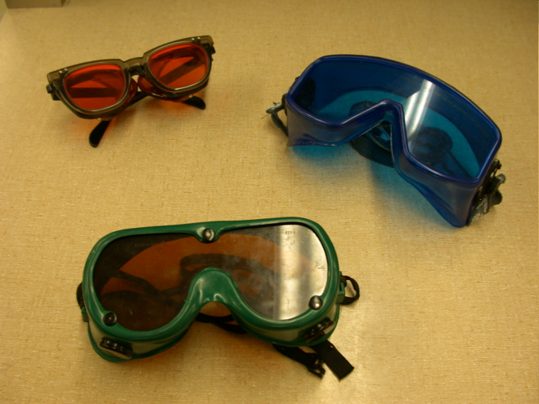
Laser Safety
OSHA Authority for 1910 Subpart I - Personal Protective Equipment
1910.133(a)(5) – Eye and face protection
The employer shall ensure that each affected employee uses equipment with filter lenses that have a shade number appropriate for the work being performed for protection from injurious light radiation.
http://www.westernsafety.com/guardair/osha_big_fn.jpg
http://www.ee.byu.edu/photonics/safety.parts/images/goggles.bmp
http://www.osha.gov/pls/oshaweb/owadisp.show_document?p_table=DIRECTIVES&p_id=1705

Slide 18
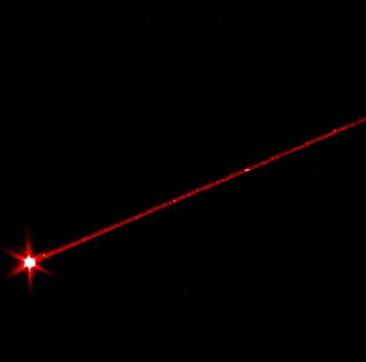
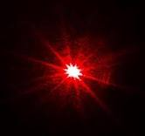
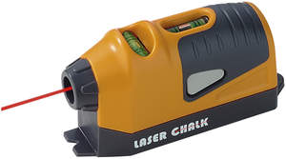
Laser Safety
1910.269(w)(8) "Lasers." Laser equipment shall be installed, adjusted, and operated in accordance with 1926.54 of this Chapter

Slide 19
1926.54 (a through l) Example: 1926.54(b) Proof of qualification of the laser equipment operator shall be available and in possession of the operator at all times. 1926.54(c) Employees, when working in areas in which a potential exposure to direct or reflected laser light greater than 0.005 watts (5 milliwatts) exists, shall be provided with antilaser eye protection devices as specified in Subpart E of this
Laser Safety

Slide 20
http://www.ehs.cornell.edu/file/Laser_Safety_Program_Guide_v2.pdf
Laser Safety
Responsibilities
Principle Investigator or Supervisor:
health and safety of those reporting to him/her
ensuring that lasers are properly installed and used
laser users have been properly trained
that their laser installations comply with the goals and requirements of this guide
Laser Users :
Each laser user is responsible for the safe operation of his/her laser
LSO (Laser Safety Officer):
responsible for assuring that laser hazards are evaluated and appropriate safety measures are implemented by the PI and users

Slide 21
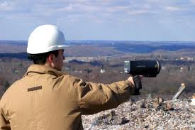
Laser Safety
Best practices
Always wear the necessary PPE for the type of laser to be used
Make sure the work area is clear and safe before using some high powered lasers
Lasers above 1mW power output
Be sure to protect the laser and its components
Construction lasers can be very expensive
http://www.consultwebs.com/ncphotos/dc/surveyers_7413_550_dpwm.jpg http://www.osha.gov/pls/oshaweb/owadisp.show_document?p_table=DIRECTIVES&p_id=1705

Slide 22
Laser Safety
REMEMBER TO:
Post signs when using lasers
Make others aware if using lasers
Tape off the section where work is being done if the laser is a Class III(b) or Class IV
And ALWAYS avoid pointing lasers at people
ALWAYS:
Wear proper PPE
Know what class laser will be used
Be aware of the surroundings to avoid accidents
Lasers are helpful tools in many ways but it is important to know how to use them safely.

Slide 23
THINK SAFETY WORK SAFELY

