Slide 1
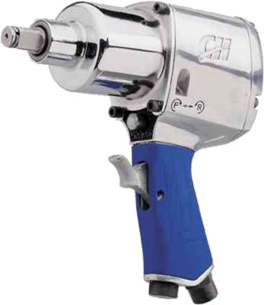
Impact Wrench Safety

Slide 2
Impact Wrenches
A socket wrench power tool used to tighten nuts and bolts.
Designed to deliver high torque output by storing energy in a rotating mass, then delivering it suddenly to the output shaft.

Slide 3
Power Sources for Impact Wrenches
Compressed Air
(most common)
Electric
Hydraulic
Portable/Battery Powered

Slide 4
Types of Impact Wrenches
Impact wrenches are made in a variety of shapes and sizes
Shapes
Inline
Butterfly
Pistol Grip
Socket Drive Sizes
From ¼” to over 3 ½”

Slide 5
Industry Uses
Construction
Automotive
Heavy Equipment Maintenance
Product Assembly

Slide 6
Industry Uses
When used in construction, the primary use is in steel erection
Extremely high torque is needed to tighten nuts and bolts to connect steel members

Slide 7
Typical Hazards
Rupturing of oil or air lines used to power tool
Oil under pressure easily punctures the skin, causing serious injury, gangrene or death.
Flying oil or debris can easily damage eyes.
Routing of pneumatic or hydraulic hoses or power extension cords to create trip hazards
Sudden torque forces generated by the impact wrench can cause a worker to lose balance or to receive a wrist injury
Damaged hoses or extension cords
Source: http://65.36.183.19/greenlee/im/99924641rev05.pdf

Slide 8
Typical Hazards
Dropping the impact wrench from elevation
Heat
Impact wrench generates heat
Contact with hot surface of impact wrench can easily burn user.
Moving Parts
Fingers and clothing can get caught
Noise
Source: http://65.36.183.19/greenlee/im/99924641rev05.pdf

Slide 9
There Was One Worker Fatality Investigated By OSHA Between 1990-2009
Source: Extracted from OSHA Accident Investigation Data 1990-2009

Slide 10
Fatality Example
A worker was walking on a 1:12 pitch roof. He slid an impact wrench down to the edge on a 90 foot wide roof.
He misjudged the roof condition (light frost on roof) and the impact wrench continued to slide down the roof. Fearing that it would go over the roof edge the worker began running after the wrench.
The worker dove to stop it, but slid off the roof edge on his stomach and fell 23 feet on the asphalt driveway. He died from his injuries.
Source: Extracted from OSHA Accident Investigation Data 1990-2009

Slide 11
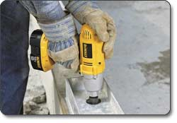
OSHA Regulations
There are no OSHA regulations pertaining specifically to impact wrenches.
Source: Information extracted from OSHA Regulations (Standards - 29 CFR)

Slide 12
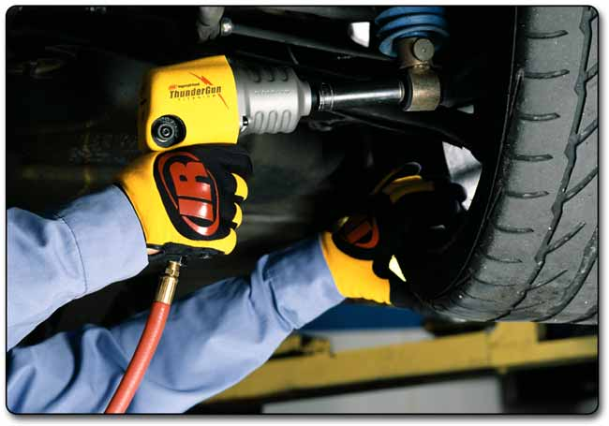
Safe Work Practices
Personal Protective Equipment
Gloves
Slip Resistant Footwear
Eye Protection
Close Fitted Clothing
Hearing Protection
Head Protection

Slide 13
Safe Work Practices
Keep work area clean
Use the proper tools for the job
i.e. – there are sockets designed specifically for use with impact wrenches
Maintenance
Service and maintenance should be performed regularly by qualified technician to ensure safety and performance.
Check for damaged parts
Tie tool off when working at elevations

Slide 14
Safe Work Practices
Remove adjusting keys and wrenches that were used to make adjustments on the impact wrench
Avoid unintentional starting
Be sure switch is in the OFF position when not in use and before attaching power source.
Disconnect from power source when not in use
Store idle equipment in dry location to prevent rust
Route hoses in a safe manner
Prevent entanglement and tripping caused by hoses
Check hoses/cords for damage, remove from service if damaged

Slide 15
Think Safety Work Safely

