Slide 1
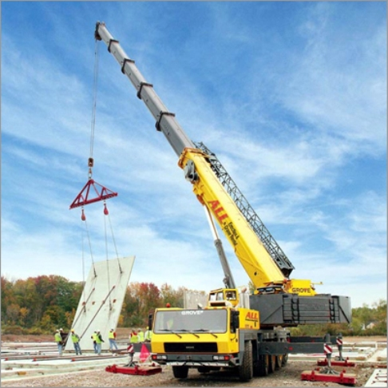
HYDRUALIC BOOM CRANE SAFETY

Slide 2
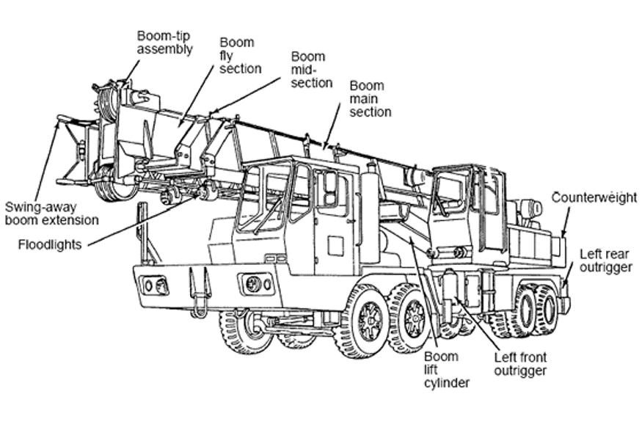
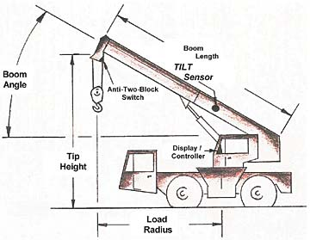
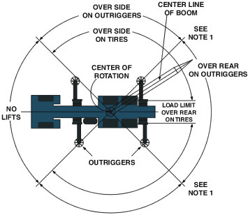
What is a Hydraulic Boom Crane?
A crane with a telescoping boom

Slide 3
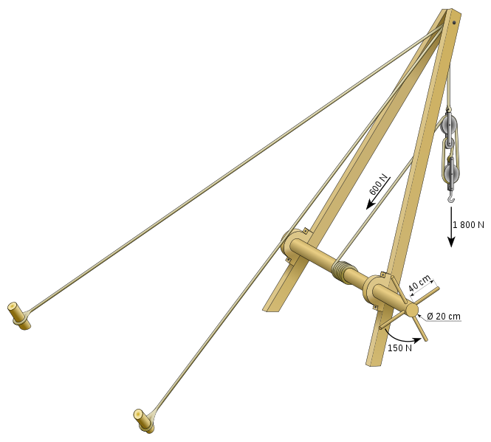
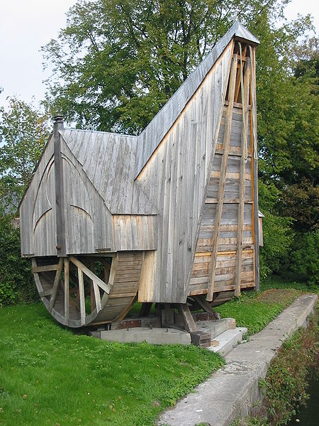
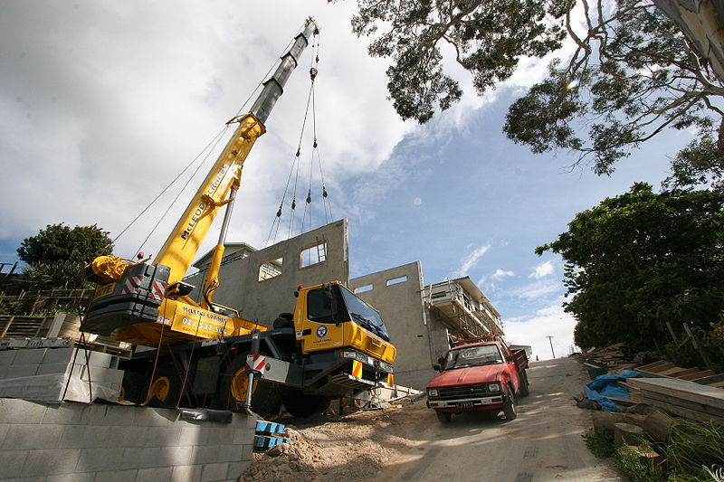
History of the Crane in Construction
The earliest use of cranes can be dated back to the 6th Century BC by the Greeks.
Cranes have evolved throughout the history of construction as man’s needs and desires to build have changed.
Early Greek Crane
Medieval Crane
Modern Hydraulic Crane

Slide 4
The Hydraulic Crane
Most commonly used to lift or place heavy objects such as structural steel or tilt up panels
Advantages of the hydraulic crane include mobility and size-to-strength ratio
Hydraulic cranes use fluids and a variety of pistons to transfer forces from one point to another. Essentially, when one piston goes down another goes up.
Two main factors in crane design and selection are: 1.) Must be able to lift the specified load
2.) Must be able to remain stable and not topple when the load is lifted

Slide 5
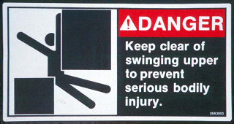
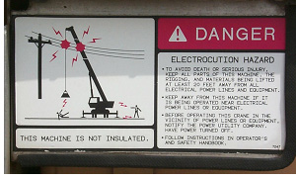
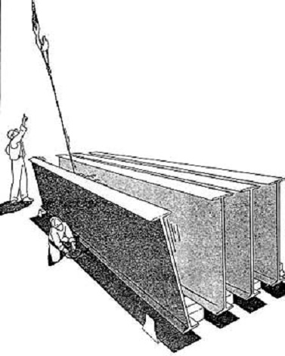
Associated Hazards
Electrical Hazards
Caught-In, Compressed or Crushing Hazards
Struck-By Hazards
Other Hazards

Slide 6
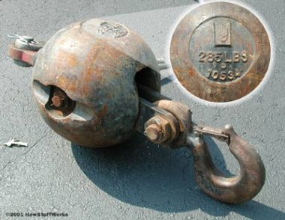
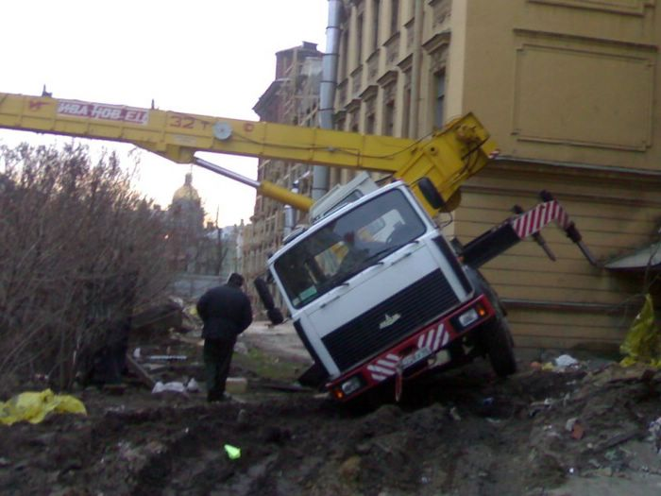
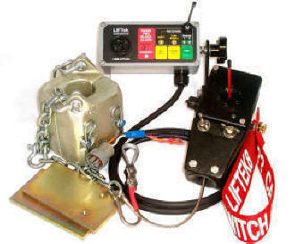
13 Common Reasons for Crane Failure (MacCollum 1980)
1. Overloading – beyond crane cap.
2. Side pull
3. Outrigger failure
4. Hoist limitations – for conditions
5. Two-blocking
6. Killer Hooks - exceeding load
capacity
Crane Hook
Anti two Blocking system
Crane overload

Slide 7
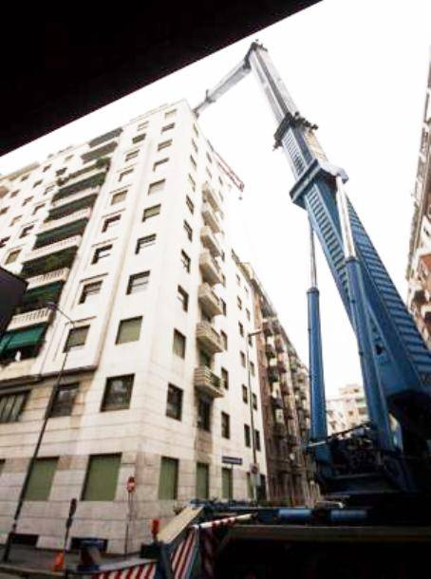
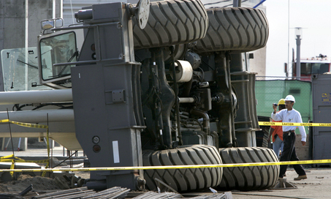
13 Common Reasons Continued (MacCollum 1980)
7. Boom buckling
8. Upset/Overturn
9. Unintentional turntable turning
10. Oversteer/crabbing – creating instability
11. Control confusion
12. Access/egress to work area
13. Power-line contact
Boom Buckling
Over Steering

Slide 8
Could This Have Been Prevented?
A worker was rigging steel that was to be installed on the roof of a structure for a track to be used with an overhead crane. The 25 ft long by 25 in. tall by 14 in. wide beam weighed 1,825 lb, and was being lifted with a nylon sling located near its center. One end of the beam rose approximately 8 to 10 ft off the floor before the opposite end began to rise. The crane operator had started to lower the beam to correct the imbalance when the beam slid approximately 6 in. in the sling. At that point, the sling was cut and the beam fell, pinning the rigger to the ground and killing him.

Slide 9

Case Studies
Two workers were in the process of landing two 54-sheet bundles of 3/4 inch plywood, being set on the 3rd floor deck with a crane. As the lower bundle was placed on the deck, the sheets in the top bundle began to slide out causing the entire bundle to fall onto the victim striking him in the back of the head.
1926.550 (a)19

Slide 10
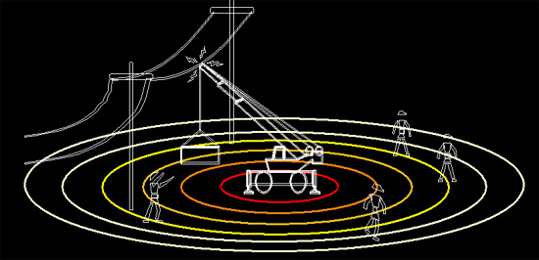
Case Studies
A young truck driver and his employer were electrocuted when the boom of a truck-mounted crane contacted a 7,200-volt conductor of an overhead power line. The driver had backed the truck up the steeply sloped driveway under a power line.
The tip of the crane boom contacted a conductor of the overhead power line and completed a path to ground through the truck and the driver. The company president attempted to render assistance and apparently contacted the truck, completing a path to ground through his body. He died on the scene. The truck driver died a short time later.
1926.550 (a) 15(i), (ii)

Slide 11
OSHA Regulations
Crane operations primarily regulated by subpart N of OSHA regulations
1926.550 (a) 15(i)- For lines rated 50kV or below, minimum clearance between the lines and any part of the crane or load shall be 10’
15(ii)- For lines rated over 50kV, minimum clearance between the lines and any part of the crane or load shall be 10’ plus 1’ for every 30 kV over 50kV.
15(iii)- In transit with no load and boom lowered the equipment clearance shall be a minimum of 4’ for voltages less the 50kV, 10’ for voltages 50-345kV, and 16’ for voltages up to and including 745kV

Slide 12
OSHA Regulations
19- All employees shall be kept clear of loads about to be lifted and or suspended loads
(g) 6(iii)- Tag lines shall be used unless their use creates and unsafe condition
(g) 6(iv)- The crane or derrick operator shall remain at the controls at all times when the crane engine is running and the platform occupied
1926.552 (a)2- Rated load capacities, recommended operating speeds, and special hazard warnings or instructions shall be posted on the cars and platforms

Slide 13
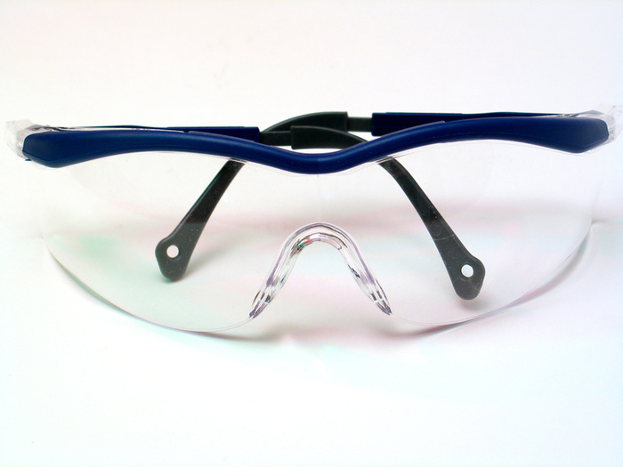

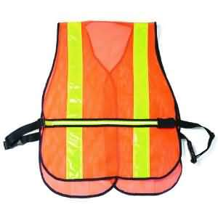
Personal Protective Equipment
Hard hats
Gloves
ANSI 85 safety glasses
Steel-toed boots
Safety vests
Jeans and shirts with 4” sleeves

Slide 14
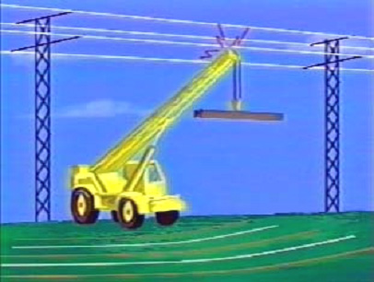
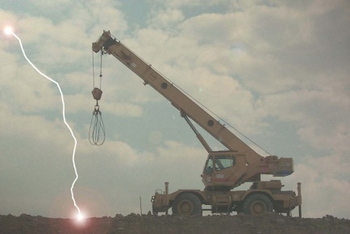
Safe Work Practices
Working Around Electric Power Lines
Maintain at least minimum distances from power lines as required by OSHA regulations
Ensure the use of a spotter for the crane operator
Assume all overhead wires are energized
Use tag-lines or proximity warning devices when available
Be aware of inclement weather conditions

Slide 15
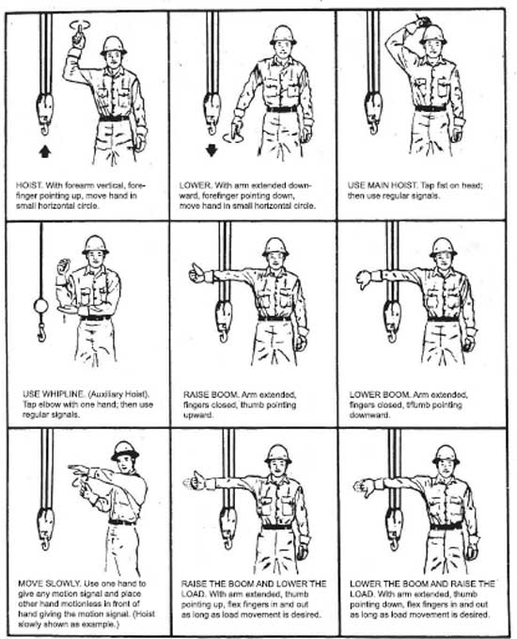
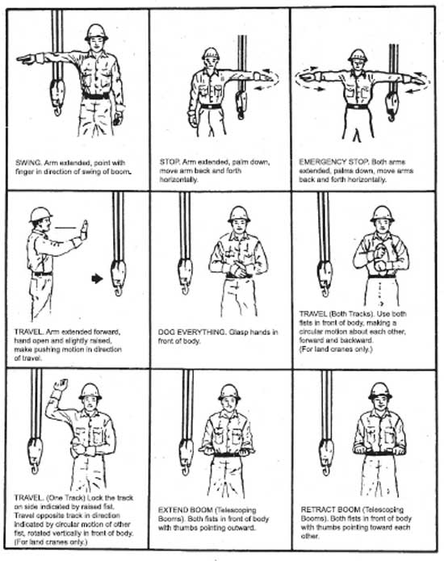
Safe Work Practices
Know and Rehearse the Crane Signals

Slide 16
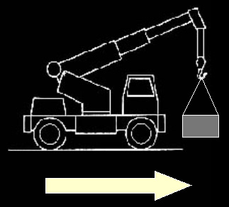
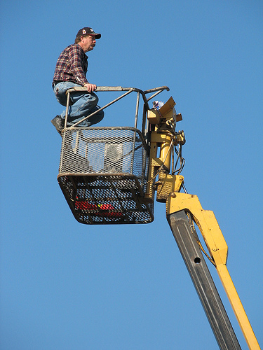
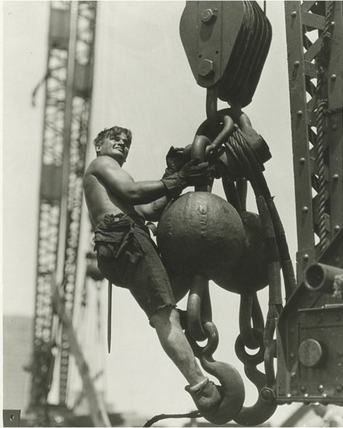
Safe Work Practices
Traveling with a load
No extra riders on the crane
Crane boom should be lowered
Avoid sudden starts and stops
Always travel in the forward direction

Slide 17
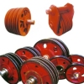
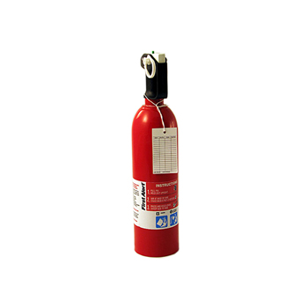
Safe Work Practices
Always conduct pre-operation inspections
Manufacturer’s operating and maintenance manual
Guarding exposed moving parts
Swing clearance protection
Boom stops
Jib boom stops
Boom angle indicator
Boom hoist disconnect, automatic boom hoist shutoff
Two-blocking device
Powered controlled lowering
Leveling indicating device
Sheaves
Crane Sheaves/pulleys
OSHA regulations require a minimum 5BC fire extinguisher on board the crane

Slide 18
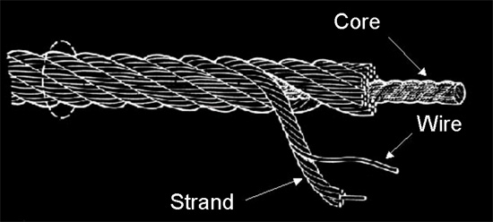
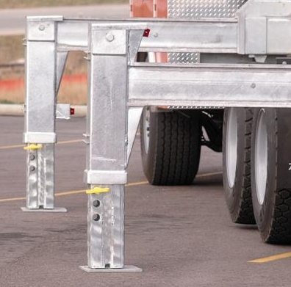
Safe Work Practices
Inspection Checklist Continued
Main hoist and auxiliary drums system
Main boom, jib boom, boom extension
Load hooks and hook blocks
Hydraulic hoses, fittings, and tubing
Outriggers
Load rating chart
Wire rope
Cab—controls, gauges, glass, fire extinguisher,
warning lights, horn, wipers, etc.
Braking systems
Turntable/crane body
Counterweight
Rubber tires (where applicable)
OSHA-Subpart P section (a) paragraph 7
Ensure outriggers are functioning properly and free of corrosion

Slide 19
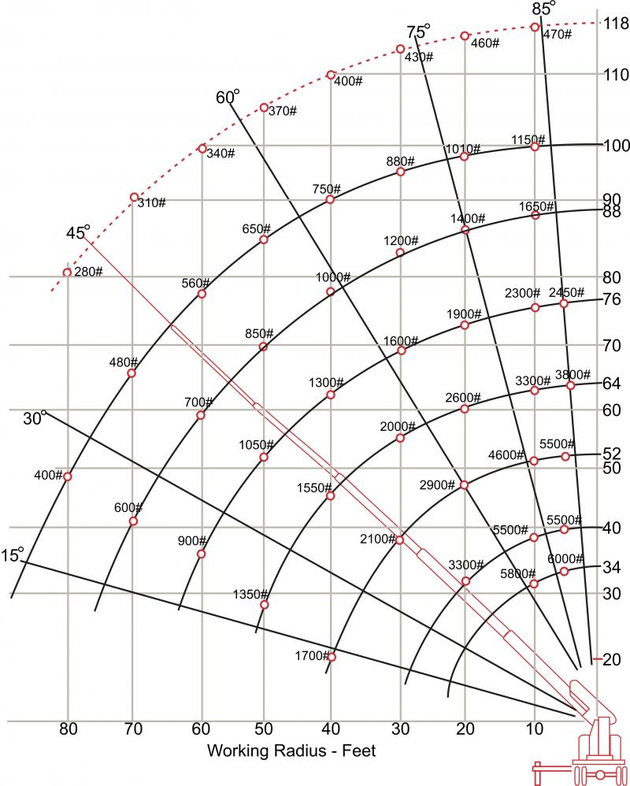
Safe Work Practices
Know the capacity of the crane when extended to various lengths and at different angles. Ensure the operator has read and understands load chart located on the crane or user manual.
Know with certainty the magnitude of the load being lifted
Note that as the radius of the boom increases the maximum load decreases

Slide 20
THINK SAFETY
WORK SAFELY

