Slide 1
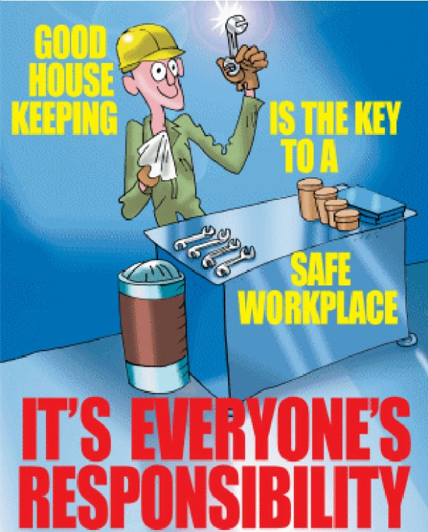
Housekeeping
<number>
Source: http://www.healthandsafety.co.uk/shop/

Slide 2
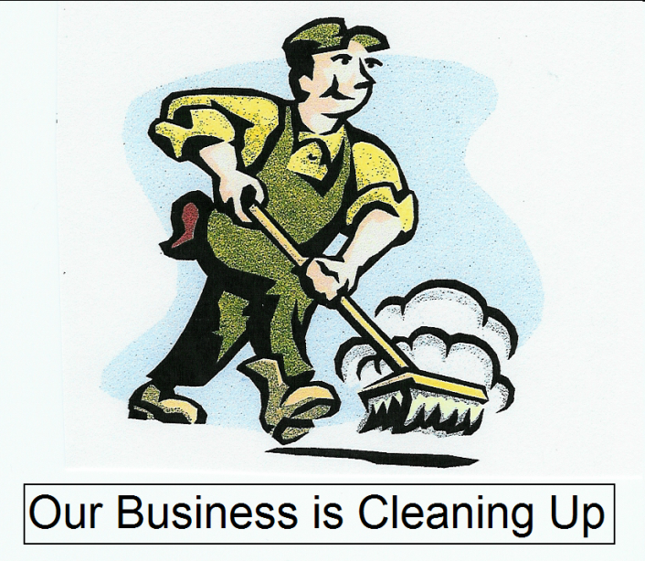
Introduction → scope
Housekeeping involves keeping the construction site safe for workers and others, and covers such things as keeping work areas neat and tidy, removing waste, and laying out the site, storage and maintenance areas for accident/fire prevention.
<number>

Slide 3
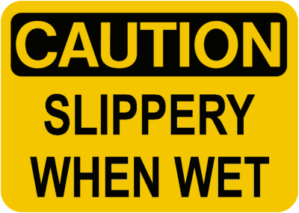
Introduction → concern
Good Housekeeping is the foundation of accident prevention
A neat, clean and orderly workplace is a safe workplace
The benefits of keeping a tidy workplace far exceed the small additional effort that is required
<number>

Slide 4
Introduction → practice
Maintain the proper storage of materials
Keep floors and access ways clear
Proper disposal of waste
Fire prevention
Maintain a clean work site
<number>

Slide 5
Benefits of Housekeeping to Construction
Promotes a healthier and safer workplace
Minimize risk of accidents
Lowers Insurance Costs
Efficient working conditions → Increased Productivity
Increased Worker Pride → Increased Productivity & Quality
Increased Productivity → Saving Time
<number>

Slide 6
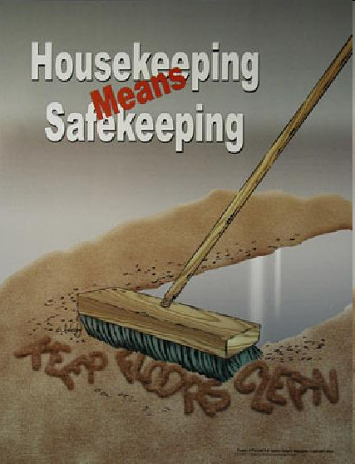
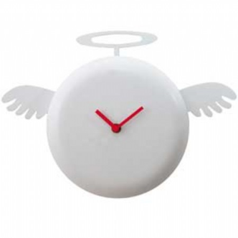

Benefits
Accidents and Injuries can be prevented through adequate planning, implementing and monitoring of housekeeping practices.
  Saving time = Saving money &
  On Time Delivery
<number>

Slide 7
Typical Hazards of Poor Housekeeping
Poor Housekeeping could cause slips, trips, and falls.
Throughout the nation, over 1 million people suffer from injuries caused by slips, trips, and falls each year
15% of lost time injuries are a result of falls
60% of these falls are from slips and trips
Causes of slips:
  - Wet or oily surfaces
  - Spills
  - Loose rugs or mats
Causes of Trips:
  - Poor lighting
  - Clutter in the way
  - Obstructed view
  - Loose/ ruffled carpeting
<number>

Slide 8
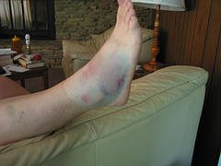
Injuries from Slips, Trips, and Falls
Typical Hazards of Poor Housekeeping
Stains/ Sprains
Torn ligaments
Broken bones
Back or spine injuries
Death
<number>

Slide 9
Statistics on Injuries or Fatalities
Slips, Trips, and Falls are the #1 leading cause of injury
Slips, Trips, and Falls represent 20% of all claims
2006-2010 fiscal years there were 9,876 cases
Total incurred costs of these claims:
$41,543,173 +
Note: Not all these injuries were caused mainly because of poor housekeeping; good housekeeping, however, could help avoid a great many of them!
<number>
Source: www.dhrm.state.va.us/workerscomp/pptdownloads/STF.ppt

Slide 10
Examples → Housekeeping Accidents
A worker slipped on a wet surface and fell 26 feet to his death on to a pile of scrap metal.
A worker was attempting to pick up some nails he had dropped and fell 25 feet to his death.
A worker was walking backwards directing a front-end loader when he tripped over scrap metal on the ground and was run over by the front-end loader
A worker was operating a forklift in a housekeeping operation to move a metal bucket from one area to another. The bucket fell off of the forklift falling 35 feet below, killing one worker and injuring another. The bucket was unstable on the forklift.
<number>
Source: Information extracted from OSHA construction worker fatality data (1990-2007)

Slide 11
OSHA Regulations → 1926.25
1926.25 - Housekeeping
(a) There should be no materials with protruding nails or any other debris around work areas, passageways, or stairs.
(b) Combustible debris must be removed regularly.
(c) Containers for waste, trash, oily rags, and other refuse must be provided. In addition, containers for garbage and other oily, flammable, or dangerous waste must have covers. All must be emptied frequently.
<number>

Slide 12
OSHA Regulations → 1926.250
1926.250 - General Requirements for Storage
(c) Housekeeping. Storage areas must be kept free from materials that can be a hazard (tripping, fire, explosion, harboring pests)
<number>

Slide 13
OSHA Regulations → 1926.1127
1926.1127 - Cadmium
(j) Housekeeping.
(1) All surfaces shall be maintained free of accumulations of cadmium.
(2) HEPA-filtered vacuum equipment or an equally effective filtration system shall be used for vacuuming.
(3) All cadmium contaminated goods shall be bagged and tagged for disposal.
<number>

Slide 14
OSHA Regulations → 29 CFR 1910.1001
The employer shall also provide, at no cost to employees who perform housekeeping operations in an area which contains ACM or PACM, an asbestos awareness training course, which shall at a minimum contain the following elements:
  health effects of asbestos, locations of ACM and PACM in the building/facility, recognition of ACM and PACM damage and deterioration, requirements in this standard relating to housekeeping, and proper response to fiber release episodes, to all employees who perform housekeeping work in areas where ACM and/or PACM is present.
Each such employee shall be so trained at least once a year.
<number>

Slide 15
OSHA Regulations → Housekeeping & Asbestos
Housekeepers and custodians should never sand or dry buff asbestos containing floor tiles, and only wet stripping methods should be used during stripping operations.
If abrasion pads are required they should be low abrasion pads, and should be used at speeds below 300 RPM.
<number>

Slide 16
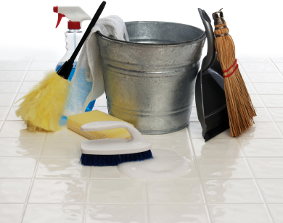
Best Practices → Good Housekeeping Procedures
Have a set time for housekeeping
Make a safety checklist (use daily)
Clean as work is performed
Remove hazards before starting work
Inspect and clean all PPE before use
Use the right equipment: brooms, vacuums, mops, compounds, gloves, eyewear, work shoes, and masks
Put away tools not in use in their proper storage areas.
<number>

Slide 17
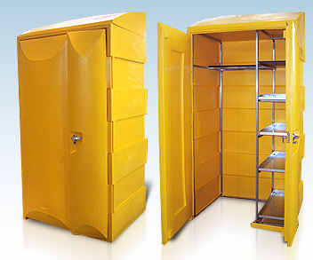
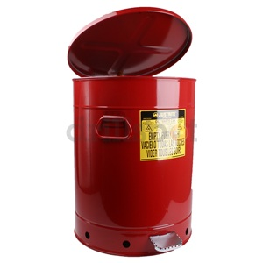
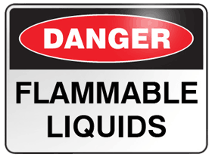
Best Practices →Fire Prevention
Store flammable and combustible liquids in approved flammable liquid containers
Keep reactive chemicals separated
Keep combustibles away from electrical equipment and machinery
Clearly mark exits in case of emergency
<number>

Slide 18

Best Practices: → Housekeeping Checklist
    Are protruding nails from scrap lumber, and other debris kept clear from work areas, passageways and stairs, in and around buildings and other structures?
    Are combustible scrap and debris, and surplus material being removed at regular intervals during the course of construction?
    Are containers being provided for the collection and separation of waste and trash?
    Do the containers for the hazardous wastes (oily rags and flammables) have lids?
    Are all loose or light material that is stored on roofs or on open floors secured?
    Are stairways, passageways, ladders, scaffold and gangways free of material, supplies and obstructions ?
<number>

Slide 19
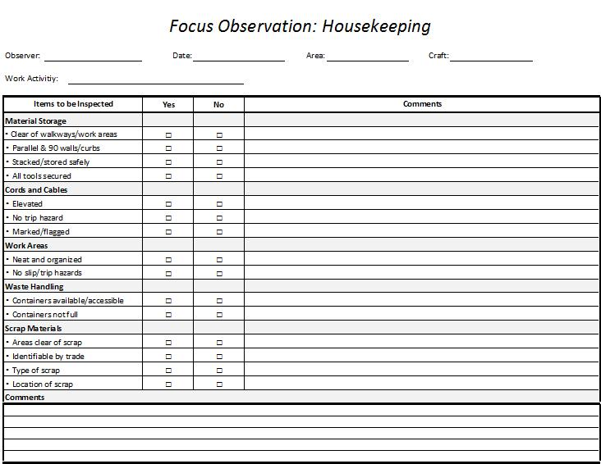
<number>

Slide 20
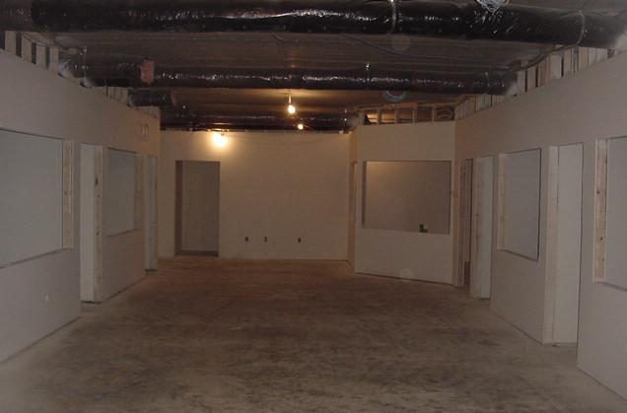
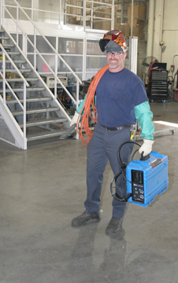
Housekeeping Grade Scale: 1-10
10. Exceptional
  Everything in proper place
  Displays pride of job
  Indicates top notch performance
- Workers should also keep their equipment orderly because it can also create safety hazards
<number>
Notes:
http://www.wolfconsulting.com/sec_networking/AboutOffice.asp (clean construction)
http://www.millerwelds.com/education/articles/story119.html (worker)
<number>

Slide 21
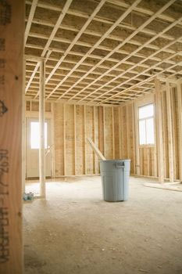
Housekeeping Grade Scale: 1-10
8-9. Pretty Good
  Almost no stray items
  Small amounts of trash
  Minimal slip/trip hazards
  Most issues can be remedied
<number>
Notes:
http://www.squadrallc.com/ (clean site)
<number>

Slide 22
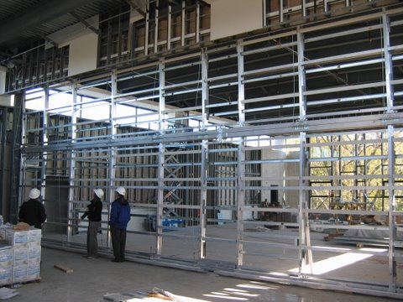
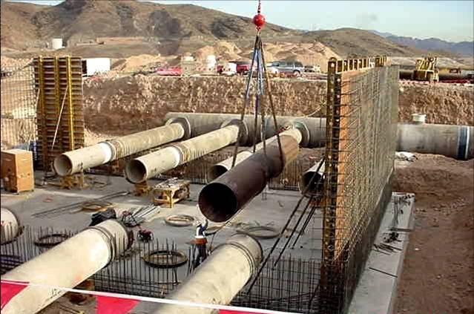
Housekeeping Grade Scale: 1-10
6-7. Good
  A few items noted
  Trash accumulating in some areas
  Increase in slip/trip hazards
  Most issues can be remedied
<number>
Notes:
http://shalomrav.wordpress.com/2007/10/
http://cmaanet.org/project_achievement_awards_06.php
<number>

Slide 23
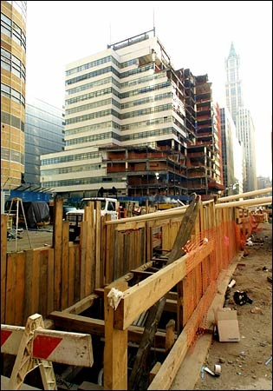
Housekeeping Grade Scale: 1-10
4-5. Fair
  Many deficiencies
  Trash accumulating and encroaching on areas
  Abundant slip/trip hazards
  Will take much effort to clean up
<number>
Notes:
http://wirednewyork.com/forum/showthread.php?t=4244
<number>

Slide 24
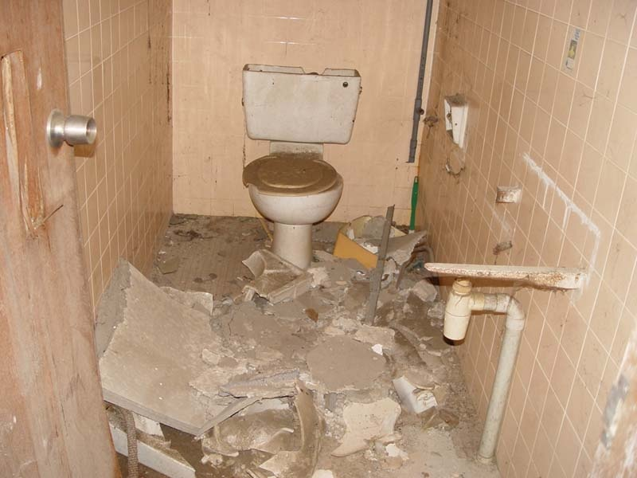
Housekeeping Grade Scale: 1-10
3-2. Poor
  Significant issues
  Too much trash to be able to work properly
  Significant fire risks
  Needs immediate attention
<number>
Notes:
http://www.spi.com.sg/haunted/haunted_houses/punggol_farm.htm
<number>

Slide 25
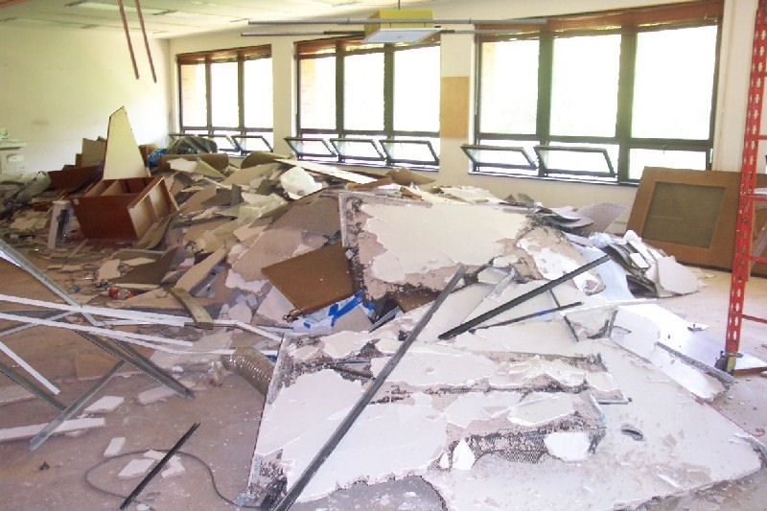
Housekeeping Grade Scale: 1-10
1. Totally Unacceptable
  Significant impact on Safety/Health of workers
  Unable to work
  Production must stop and resume only when concurrence of all stakeholders
  Potential contractual remedies
<number>
Notes:
http://findahaulersandiego.com/
<number>

Slide 26


GOOD vs. BAD
Housekeeping Grade Scale: 1-10
See the Difference?
<number>

Slide 27

Housekeeping Things to Remember
Slips, trips, and falls can be easily prevented with good housekeeping
A neat and clean workplace is a safe workplace
Be aware of potential housekeeping hazards by cleaning as work progresses
Identify and eliminate hazards before starting to work
Good Housekeeping Benefits Everyone!
<number>

Slide 28
Think Safety
Work Safely
<number>

