Slide 1
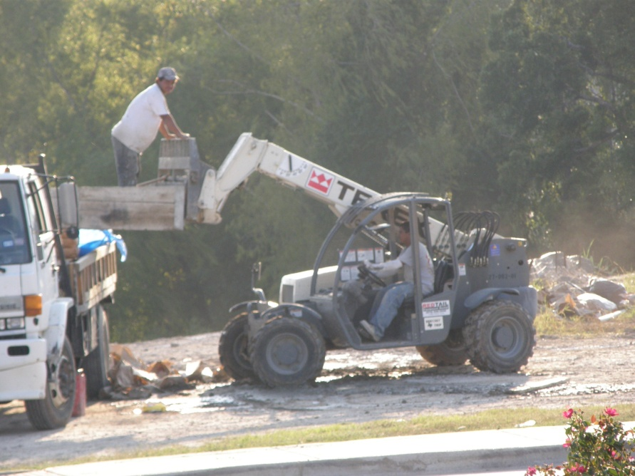
Horseplay

Slide 2
Horseplay – What is it ?
When an individual lacks focus on their current tasks and starts goofing around
Engaging in a playful manner that usually disregards all safety precautions

Slide 3
Horseplay
OSHA violations
Injuries
Fatalities
HORSEPLAY

Slide 4
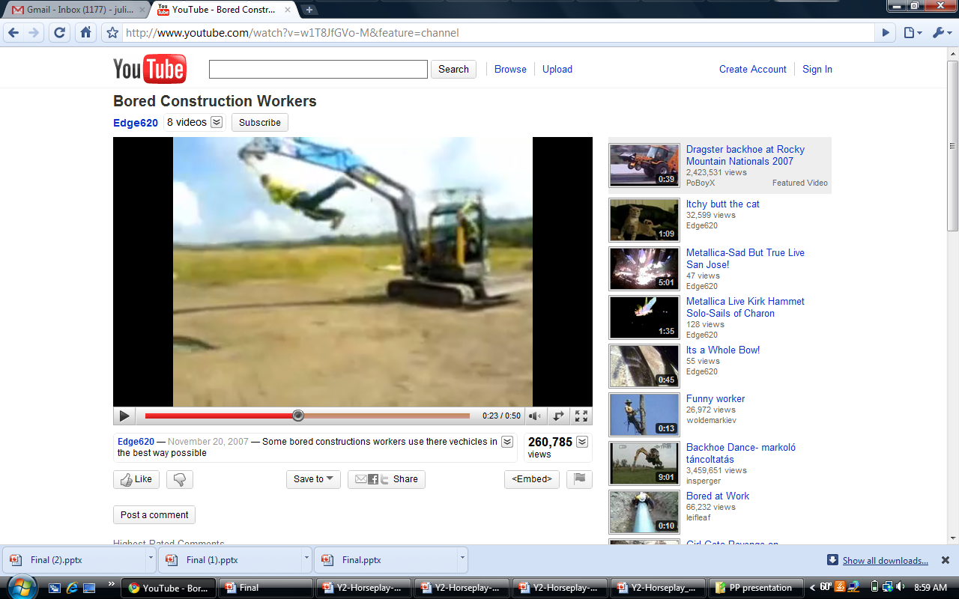
Examples of Horseplay
Example of Horseplay in Construction
Source : http://www.youtube.com/watch?v=w1T8JfGVo-M&feature=related

Slide 5
How is it Reported ?
OSHA Reporting Requirements specify that all injuries sustained from horseplay are reported under the injury sustained. There is no ‘horseplay’ category:
  Example: Two workers were slap-boxing on a roof. One worker stepped off the roof and sustained a fall injury. The injury was then reported as a fall.

Slide 6
Injuries
Horseplay has become an increasing problem. The ability to film stunts and display them on video sites such as Youtube has increased this practice.
Source : http://www.youtube.com/watch?v=w1T8JfGVo-M&feature=related

Slide 7
Fatalities
A total of three deaths can be linked specifically to horseplay through the OSHA-investigated Fatalities from 1990 thru 2007

Slide 8
Fatalities
A worker was standing on a tractor battery box playing with the controls
Driver warned the the worker to stop ‘horse playing’ and to get off the tractor
While playing with the controls, the worker put tractor into reverse and lost his balance.
He was then crushed when he fell underneath the wheel after losing his balance
Source: U.S. Department of Labor, Bureau of Labor Statistics

Slide 9
Fatalities
Victim reported as “playing” on scaffolding 4’ high
Standing on a cantilevered plank the victim lost balance and fell hitting the cross braces.
Suffered fatal internal injuries from the fall
Source: U.S. Department of Labor, Bureau of Labor Statistics

Slide 10

Fatalities
A worker was elevated approximately 20 feet above the ground on the forks of a forklift
He was crushed between a concrete overhang and the load backrest of the lift. According to several eyewitnesses he and his coworker, who was operating the forklift, were "horsing" around when the accident occurred.
Source: U.S. Department of Labor, Bureau of Labor Statistics

Slide 11
OSHA Regulations
1926.21 The employer shall instruct each employee in the recognition and avoidance of unsafe conditions and the regulations applicable to his work environment to control or eliminate any hazards or other exposure to illness or injury.

Slide 12
OSHA Regulations
Title 29 Code of Federal Regulations, Parts 1900-1926 – OSHA - Appendix A to _ 1910.1450
  (g) Horseplay: Avoid practical jokes or other behavior which might confuse, startle or distract another worker (23).

Slide 13
Safe Work Practices
PPE –
Hardhat
Safety glasses
Hearing protection
Work boots
Rubber boots
Gloves

Slide 14
Safe Work Practices
Take every task and job serious when working in any environment
Stop it or report it. When seeing horseplay, try to stop it. If the horseplay does not stop, report it to a supervisor. A life might be saved.

Slide 15
THINK Safety
Work safely

