Slide 1
Garden Hoes

Slide 2
What is a Garden Hoe?
Dictionary.com defines a garden hoe as:
  a long-handled implement having a thin, flat blade usually set transversely, used to break up the surface of the ground, destroy weeds, etc.
Source: Dictionary.com
Picture: Clip Art

Slide 3
History of Garden Hoes
Forked sticks were the earliest known hoes and were seen in cave drawings.
Heavy flaked-stone implements were mounted with bitumen and used in Mesopotamia.
Hoe blades have also been made of animal antlers, shoulder blades, and shells.
Source: http://thegardenersrake.com/garden-history-the-hoe

Slide 4
Using a Garden Hoe
Garden hoes are primarily used in landscaping to slice the soil around weeds.
Proper usage is as follows:
  1.Raise the hoe away from the body up to about the waist level.
  2. Swing the blade down to the ground towards the body, striking at a 45 degree angle.
  3. After penetrating the soil, lift out the weed and its roots.
Source: http://landscaping.about.com/od/weedsdiseases/ss/weed_fabrics_3.htm

Slide 5
Hazards
Hoes are relatively safe tools to use, however one should be aware of the following hazards:
  Blisters
  Back Strain
  Wrist Strain
  Lacerations on feet
  Heat-related injuries

Slide 6
Fatality Statics
OSHA did not investigate any hoe-related fatalities from 1990 thru 2007.

Slide 7
Heat-Related Illness
From 1999-2003, a total of 3,442 deaths were reported in America from exposure to extreme heat.
Heat related illness include:
  Heat rash, heat cramps, heat edema, heat tetany, fainting, heat exhaustion, and heat stroke.
Heat exhaustion and heat stroke need IMMEDIATE medical attention.
Be sure to stay hydrated and rest often when working outside for long periods of time.
Source: http://www.cdc.gov/mmwr/preview/mmwrhtml/mm5529a2.htm
Source: http://firstaid.webmd.com/tc/heat-related-illnesses-topic-overview?page=2

Slide 8
Best Practices
The following PPE should be used when using a garden hoe:
  Closed-toed shoes or work boots to prevent foot injuries.
  Gloves to prevent blisters and other hand injuries.
  Safety glasses to prevent debris from entering the eyes .
  Sunscreen to prevent sunburns.

Slide 9
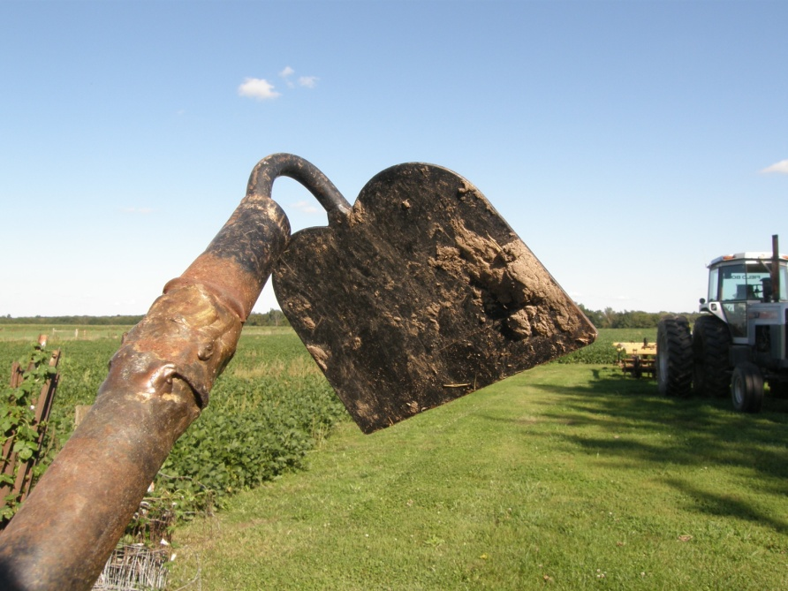
Best Practices
Before using a garden hoe, it should be inspected thoroughly to prevent injury.
  Check for a solid and comfortable handle.
  Test for proper length.
  Ensure a solid attachment of the head to the shaft.
  Inspect to be sure the head has a sharp edge.
Photo: Dr. Jimmie Hinze

Slide 10
Best Practices
Be sure the hoe is sharp prior to use and periodically check it during use
Keep solid footing when using the hoe
Switch from right hand to left hand to avoid fatigue
Inspect the area prior to work to avoid surprises

Slide 11
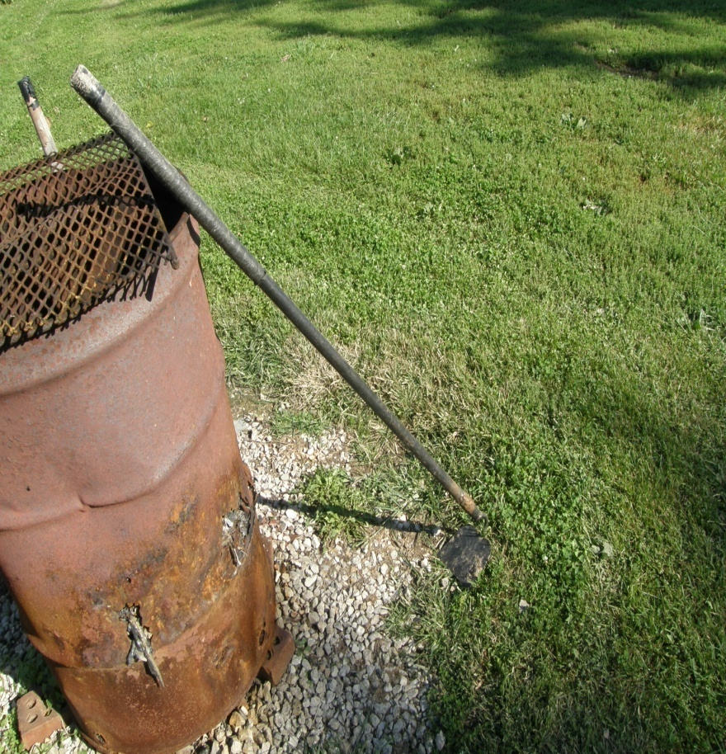
Best Practices
Be sure to rest frequently, especially if back or wrist pain occurs.
Do not choke up too far on the handle of the garden hoe.
Be aware of the surroundings and do not hoe near others.
Watch out for snakes, spiders, fire ants, and other creatures that may be in the work area.
Photo: Dr. Jimmie Hinze

Slide 12
Think Safety
Work Safely

