Slide 1
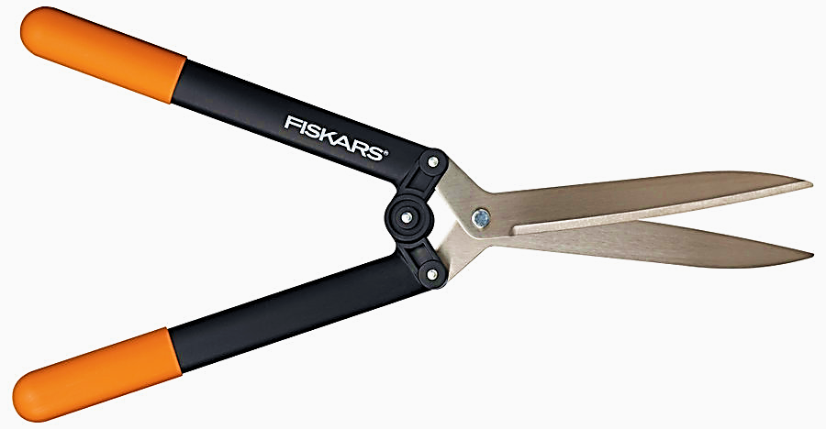
Hedge Shears
“Power-Lever® Hedge Shears (FiberComp®)” Fiskars Lawn And Garden – Browse Products - Fiskers.com. 2011. <http://www2.fiskars.com/Products/Yard-and-Garden/Hedge-Shears/PowerLever/Power-Lever-R-Hedge-Shears-FiberComp-R>

Slide 2
What Hedge Shears Are
Hedge Shears are a long-bladed landscaping tool, averaging 12 to 28 inches in length. The blades are connected at a cross swivel, very similar to that of a pair of scissors.
Their large size makes them perfect for long cuts across a large surface area, such as a bush or hedge, hence its name.
Designed with numerous variations from its original manual straight bladed ancestor, with each having their own advantages depending on the job:
Manual vs. Electric
Straight Blade vs. Serrated Blade
Source: “Hedge Shears” Yardener. 4/15/2011. Yardener 2010
<http://yardener.com/YardenersToolshedofProducts/HandTools/HandToolsForPruning/HedgeShears>

Slide 3
When to Use a Pair of Hedge Shears
The intent behind this long-bladed design is to provide its user an extremely even and level cut across a large area of foliage.
Perfect for smoothing out the growth of a decorative bush or hedge, it requires little skill on the part of its user to make clean, level cuts.
The light trimming of new foliage shoots affects the behavior of the shrubbery’s future growth, and will likely eventually give the plant a denser, less spindly appearance.

Slide 4
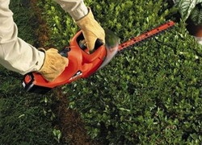
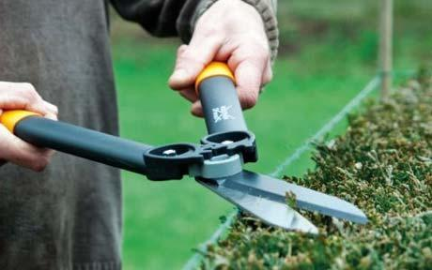
What Kind of Hedge Shear is Needed
Manual vs. Electric
What is the scope of work? Is the job expected to cover an area that would take longer than an hour to do manually?
What are the considerations in safety procedures that are expected of each?

Slide 5
What Kind of Hedge Shear is Needed
Manual vs. Electric
Scope of Work
Manual
Efficient at small, more precise trimming jobs, and the slow control results in fewer mistakes.
With a well-sharpened, well-oiled pair of shears, the cutting of minor foliage of less than 3/8” in diameter should be of little difficulty. Any thicker stems will present greater difficulty with making smooth and even cuts. The life of the shears will be the victim to its misuse.
Source: “Hedge Shears” Yardener. 4/15/2011. Yardener 2010
<http://yardener.com/YardenersToolshedofProducts/HandTools/HandToolsForPruning/HedgeShears>

Slide 6
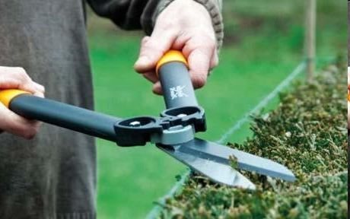
What Kind of Hedge Shear is Needed
Manual vs. Electric
Scope of Work
Electric
Much more practical in the construction industry given the volume of work often required, generally in post construction landscaping.
An electric shear can quickly cover comparatively long distances when compared to manual hand shear. Electric shears require a very steady hand, because a large mistake or slip is much easier to make.

Slide 7
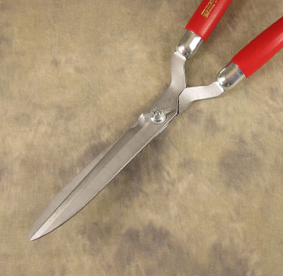
What Kind of Hedge Shear is Needed
Manual vs. Electric
Safety Variations
Manual
This tool really has no “safe” position; with the blades open there exists the risk of an injury.
Whether the blades stay open or closed, accidental stabbing is a real issue, and with such long, sharp blades, any amount of force in a stabbing can create seriously traumatic injuries.

Slide 8
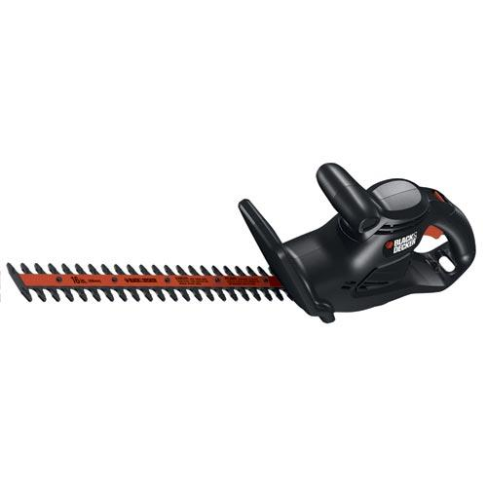
What Kind of Hedge Shear is Needed
Manual vs. Electric
Safety Variations
Electric
The tip of the electric shear has
no sharp point like its manual
variation. Chances at an accidental
stabbing are highly unlikely.
Unfortunately, this power instrument is designed for operation with two hands but it can be operated with one hand. A stray hand can easily get caught in the path of the trimming blades. Electrocution of the user after an accidental slip over the power cord is also a major issue with this machine.

Slide 9
What Kind of Hedge Shear is Needed
Straight Edge or Serrated
When To Get Serrated
Has a much more industrious, durable blade. It never needs sharpening and will always keep at its peak cutting strength.
Its cutting ability is greater than that of standard straight edge, and can manage tasks that would give a straight edge user trouble.

Slide 10
Spot Where Safety May Be an Issue
Any situation that offers the possibility of taking a hand off of the handle of a hand shear or the guide of an electric shear creates serious issues in user safety. These situations would include:
Unstable work surfaces, such as working on a ladder, One hand is usually needed to be free to maintain stability on the ladder.
Dangerous work environments with many distractors, such as working near a street, that will steal away a worker’s attention from the dangerous tool being used.
Being under the influence of any mind altering drug would of course have a drastic impact on the ability to handle tools responsibly.

Slide 11
Hedge Shearing Injuries
OSHA has not investigated any fatal injury pertaining to hedge shears from 1990 to 2009.
The combination of hand shear and electric shear injury statistics vary by degree (some are specific to construction):
Lacerations to the extremities
Electrocution from the introduction of water to the circuit
Electrocution from cutting into the trimmer’s power cord
Puncture wounds from falling shears
Shearing injury that took place on a ladder, resulting in a fall

Slide 12
Hedge Shearing Injuries – The Risks Are Real
“Mother found dead with son, 2, hugging
her body after she was electrocuted by
hedge trimmer”
-July 16th, 2010
A women in the United Kingdom received a fatal electric shock from her electric trimmer after a botched home repair on the wiring.
“The two ends of the socket were attached in the wrong way and were very, very dangerous. It was said “her death could have been easily prevented with a cheap, plug-in circuit breaker available from any DIY store.”
Source: “Mother found dead with son,2, hugging her body after she was electrocuted by hedge trimmer” Daily Mail Reporter. July 16, 2010. <http://www.dailymail.co.uk/news/article-1295232/Mother-dead-electrocuted-hedge-trimmer.html>

Slide 13
OSHA’s Regulations Concerning Hedge Shears
Power Hand Shear Practices Are Regulated in:
OSHA Part Number 1910 Subpart P: Hand and Portable Powered Tools and Other Hand-Held Equipment.
Standard 1910.243 – Guarding of Portable Powered Tools
1910.243(a)(2)(iii)(a)
All routers, planers, laminate trimmers, nibblers, shears, scrools, and jig saws with blade shanks a nominal one-fourth of an inch wide or less, may be equipped with either a positive “on-off” control, or other controls as described by para. (a)(2)(i) and (ii) of this section.
Source: “OSHA Regulations”. Occupational Safety and Heath Administration. Current (2007).
<http://www.osha.gov/pls/oshaweb/owadisp.show_document?p_table=STANDARDS&p_id=9850>

Slide 14
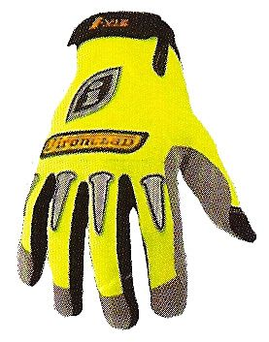
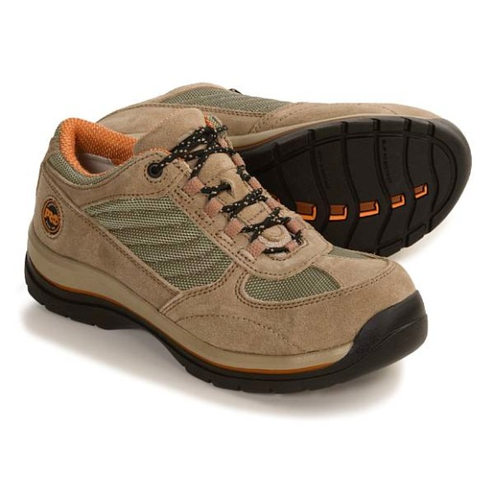
Keeping Safe Concerning PPE’s
What materials can keep users safe during the job?
Gloves –
Vital for the protection of hands from minor lacerations, but with the power of electric shears, caution need still be at the forefront of the user’s mind.
Closed-toed Shoes –
Protection from the tool falling from the user’s hands, any tough material protecting the body from the blades of shears will be beneficial.

Slide 15
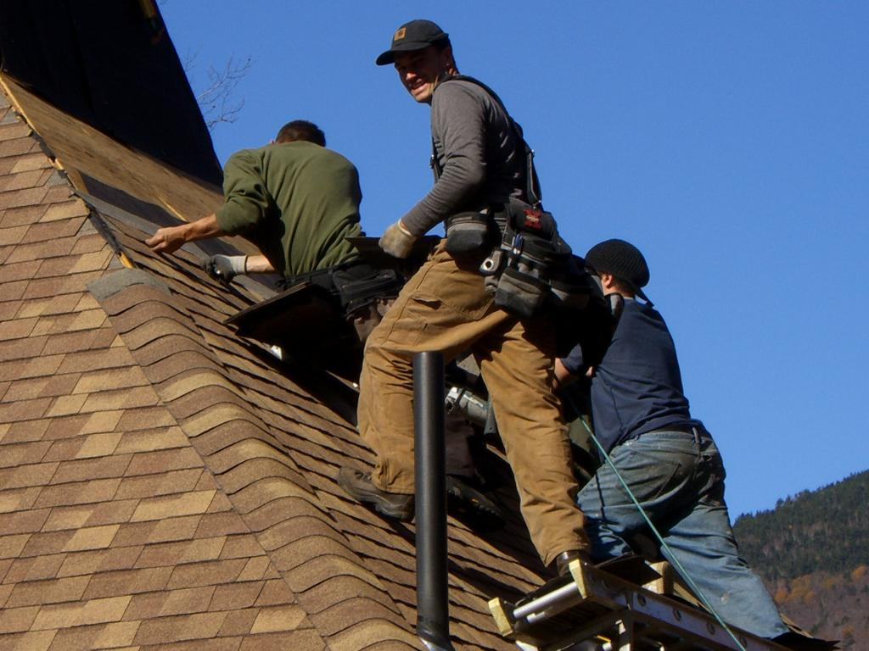
Keeping Safe Concerning PPE’s
What materials can keep the user safe during the job?
Eye Protection
Nothing but a proper goggle cover can protect eyes from an accidental stabbing, or from the debris shot off from an electric shear. Absolutely vital.
Long Sleeves/ Long Pants
Any extra surface separating skin from blade is a plus.

Slide 16
Safe Work Practices with Electric Shears
Use an electric shear that has the cutting teeth and guard close enough together so a finger cannot fit between them.
Be sure the trimmer has two handles; one should be a wide forward handle high above the cutting blade.
Make sure the trimmer is light enough to handle easily.
Use a heavy duty three-wire extension cord with a three-pronged plug. The cord must be GFCI protected. Make sure the extension cord is moisture-resistant and in good repair.
Avoid ever using this device on a ladder or at a relatively unstable height. Use an extended pole trimmer to gain access to elevated areas.
Source: “A Summer Survival Guide” Illinois Department of Public Health Publications. Damon T. Arnold, Director. 4/2011 <http://www.idph.state.il.us/public/books/summer3.htm>

Slide 17
Safe Work Practices with Hand Shears
Inspect shear blades for damage or wear that may affect the ease and quality of the cut. This will drastically reduce body strain, and keep movements safe and fluid.
When not in use, never keep the blades open, or left on the ground. Always have the tool handy on a raised working surface where it is clearly visible and stable.
Pay attention to the environment, such as a potential traffic danger, a pit or divot that could cause unstable footing, or bystanders that may approach from an unexpected direction.
When travelling with shears, avoid pointing the blades up, as a tripping hazard could easily lead to a traumatic injury.
Source: “A Summer Survival Guide” Illinois Department of Public Health Publications. Damon T. Arnold, Director. 4/2011 <http://www.idph.state.il.us/public/books/summer3.htm>

Slide 18
Think Safety
Work Safely

