Slide 1
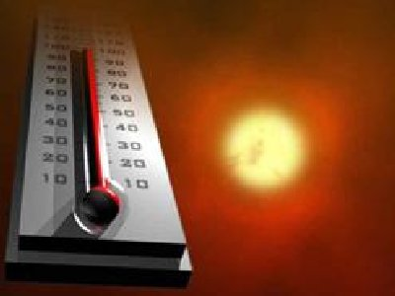
Heat
<number>

Slide 2
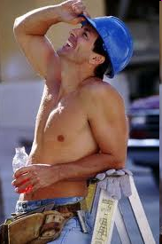
Heat in Construction
Heat can KILL construction workers if dealt with improperly
This is especially true in the southern states the summer temperature is extremely high
Heat can also bring abnormal feelings to workers and significantly reduce their productivity
<number>

Slide 3
Heat is dangerous in construction
Emergency treatment after heat-related disorders appear is sometimes TOO LATE to save a life
Heat affects construction workers most because they are MOSTLY exposed to the environment longer than many other occupations
<number>

Slide 4
Heat is dangerous
Extremely heavy physical workload accompanied with summertime heat can raise the occurrence possibility of heat-related incidents.
Heat is sometimes ignored as a safety factor by construction personnel.
<number>

Slide 5
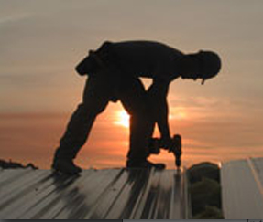
Construction Trades Affected
Trades with high levels of sun exposure are the most common construction trades effected.
Roofing Workers
Site Workers
Concrete Workers
Road Workers
Landscaping Workers
<number>

Slide 6
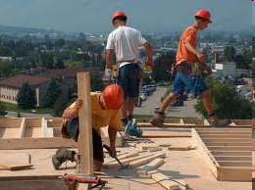
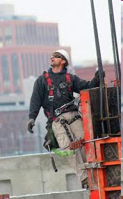
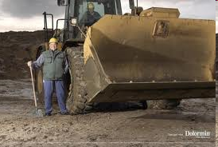
Construction trades affected
Other Workers w/ high exposure to heat
Signal person and
equipment operator
Wood structure worker
Source: http://crooksandliars.com/node/37255/print/
Source: http://www.coloribus.com/focus/catchy-pain-relief-ads/11461905/
Steel Structure Worker
Source: http://jobs.ezinemark.com/most-dangerous-jobs-in-the-world-77361e690ac6.html/
<number>

Slide 7
Types of Heat-Related Disorders
Dehydration
Sunburn
Heat Rash
Heat Exhaustion
Heat Cramps
Heat Syncope
Heat Stroke
<number>

Slide 8
Dehydration
Symptom:
Headache, muscle cramps, sudden exposure of visual snow, decreased blood pressure, dizzy and faint while standing up, unconsciousness or even death.
Causes:
Rapid lose of water within a short period.
Losing over 2% of the normal water volume can cause thirst and discomfort, while losing
5%-6% will result in sleepiness, nausea, paresthesia.
10%-15%, will result muscle spastic, dim vision and delirium,
over 15%, it is life threatening and should be avoided
<number>

Slide 9
Dehydration
Prevention tips:
Replenish Fluids and Electrolyte Levels
Drink Sufficient Amount of Water Regularly (About 1 cup every 15 minutes)
If the urine is only lightly colored or colorless, chances are that dehydration is not occurring; if urine is deeply colored or urination occurs only after many hours or not at all, water intake may not be adequate to maintain proper hydration
Source: www.wikipedia.com
<number>

Slide 10
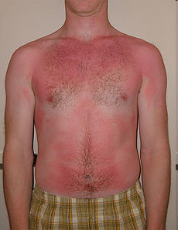
Sunburn
Symptom
Initial redness followed by varies degree of pain. Other symptoms are edema, itching, peeling skin, fever and syncope
Cause
Cause by excessive exposure to UV radiation and will increase the risk of skin cancers.
Prevention Tip
Apply sunscreen both before and during work in the sun
Work in the shade whenever possible
If already sunburned, stay
out of the sun as much as possible
Source: www.wikipedia.com
Source: Center to Protect Workers’ Rights. “Heat Stress in Construction”. December 2005.
<number>

Slide 11
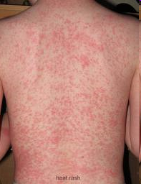
Heat Rash
Symptom
Skin may be red, The most common areas are the neck, shoulders, torso, armpits, groin and the backs of the knees and elbows.
Skin will feel prickly or itchy and may burn or sting.
Redness or swelling is a sign of infection. The affected area may be hot to the touch. It may cause a fever or swollen lymph nodes.
<number>

Slide 12
Heat Rash
Cause
Heat rash develops when sweat ducts become blocked and perspiration is trapped under the skin. Symptoms range from superficial blisters to deep, red lumps. Some forms of heat rash can be intensely itchy or prickly feeling.
<number>

Slide 13
Heat Rash
Prevention tips
Wear clothes that are lightweight and loose, as well as clothes that are made of a natural fiber, such as cotton, or material that pulls sweat away from the skin, such as polypropylene.
Sprinkle cornstarch or talcum powder on skin when getting dressed to keep skin dry.
Take cool baths or showers frequently in hot weather.
Drink plenty of water and stay hydrated.
<number>

Slide 14
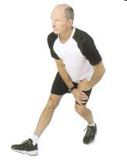
Heat Cramps
Symptom
Excessive pain in muscle
Involuntary muscle spasms
Cause
Rapid loss of electrolytes such as sodium, potassium, calcium and magnesium from the heavy sweating process
<number>

Slide 15
Heat Cramps
Prevention tips
Rest and cool down
Drink clear juice or an electrolyte-containing sports drink
Practice gentle, range-of-motion stretching and gentle massage of the affected muscle group
Source:http://www.mayoclinic.com/health/first-aid-heat-cramps/FA00021
<number>

Slide 16
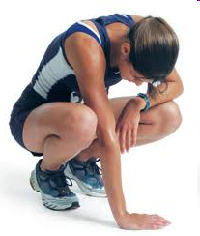
Heat Exhaustion
Symptom
Heavy sweating
Paleness
Muscle cramp
Tiredness
Weakness
Dizziness
Headache
Nausea or vomiting
Fainting
Source: CDC.gov. CDC Prevention Guide for Emergencies and Disasters.
<number>

Slide 17
Heat Exhaustion
Cause
Exposure to high temperatures and inadequate or unbalanced replacement of fluids. Those most prone to heat exhaustion are elderly people, people with high blood pressure, and people working or exercising in a hot environment.
Source: CDC.gov. CDC Prevention Guide for Emergencies and Disasters.
<number>

Slide 18
Heat Exhaustion
Prevention tips
Drink cool, non-alcoholic beverages, as directed by a physician
Rest
Cool shower, bath, or sponge bath
An air-conditioned environment
Wear lightweight clothing
Source: CDC.gov. CDC Prevention Guide for Emergencies and Disasters.
<number>

Slide 19
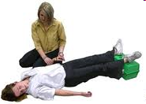
Heat Syncope
Heat Syncope is another stage in the same process as heat stroke, occurs under similar conditions as heat stroke and is not distinguished from the latter by some authorities. The basic symptom of heat syncope is a body temperature above 40°C (104°F) with fainting, but without mental confusion, which does occur in heat stroke.
Source: http://www.wikipedia.com/
<number>

Slide 20
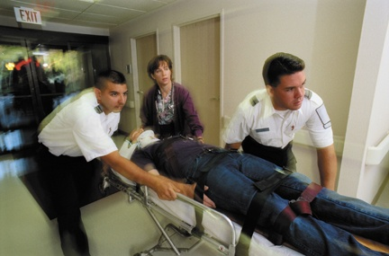
Heat Stroke
Symptom:
Dry, pale skin or
hot, red skin
Mood changes, irritability, confusion
Seizures or fits
Collapse (without response)
Greater temp than 105.1F(40.6 C)
Lack of sweating
Permanent disability if emergency treatment is not given.
<number>

Slide 21
Heat Stroke
Cause:
Substances that inhibit cooling and cause dehydration
Age-related
Consumption of alcohol, caffeine, stimulant or other medications
<number>

Slide 22
Heat Stroke
Prevention tips
Avoid overheating and dehydration
Dress with light, loose-fitting clothing
High temperatures without proper cooling could be dangerous and even fatal
Be careful with not only surrounding temperature but also humidity because higher humidity can reduce the human body’s natural cooling through evaporation
Drink sport drinks or salt water frequently
Source:http://www.emedicinehealth.com/heat_exhaustion_and_heat_stroke/article_em.htm
Source: http://www.cdc.gov/niosh/topics/heatstress/
Source: www.wikipedia.com
<number>

Slide 23
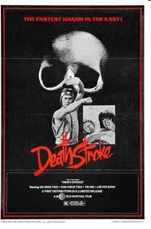
Heat Stroke Consequences
Heat stroke is a form of hyperthermia (abnormally elevated body temperature) with accompanying physical and neurological symptoms. Unlike heat cramps and heat exhaustion, two less-severe forms of hyperthermia, heat stroke is a true medical emergency that can be fatal if not properly and promptly treated.
<number>
DEATH WILL OCCUR IF NOT DEALT WITH PROPERLY!!!!!

Slide 24
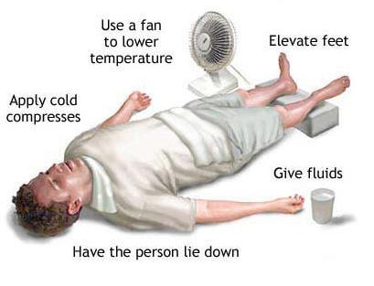
Heat Stroke Emergency Treatment
<number>

Slide 25
Emergency Treatment of Heat Disorder
Move the victim into the shade
Call for medical help
Remove or loosen boots & clothing
Pour water & ice on the victim
Fan the victim
Elevate the victim’s legs
Massage the victim’s arms & legs
If victim is conscious, give the victim lightly salted water or an electrolyte beverage
Stay until medical help arrives
Source: OSHA Quick Card. “Protect rself from Heat Stress”.
<number>

Slide 26
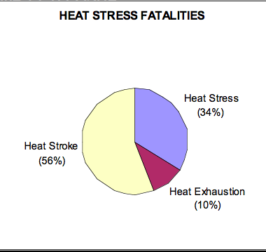
Fatality Statistics
OSHA investigated 50 fatalities between 1990 thru 2007 that were heat related.
Heat Stress - 17 cases
Heat Exhaustion – 5 cases
Heat Stroke – 28 cases
Source: OSHA Fatality Statistics, 1990-2007
<number>

Slide 27
OSHA
OSHA does not have any provisions that specifically address heat stress
Source: http://www.osha.gov/SLTC/heatstress/
<number>

Slide 28
Question Posed to OSHA
Scenario: I am an electrician with thirty years of experience. Currently, I'm employed as an electrician by the Greater Orlando Aviation Authority, at Orlando International Airport, FL. For the past ten years I have been wearing lightweight, light colored, loose fitting clothing while working in the heat and humidity. However, my employer has now instituted the mandatory use of heavy flame resistant uniforms which has to be worn at all times despite the fact that most of the daily work activities involve relamping, and not working in front of an open hot electrical circuit.
Question: Why can't the employees wear the regular loose fitting, lightweight clothing when relamping which is done 90 percent of the time, and wear the flame resistant clothing when we are called to work in front of the hot electrical circuit?
Source: http://www.osha.gov/pls/oshaweb/owadisp.show_document?p_table=INTERPRETATIONS&p_id=27578
<number>

Slide 29
OSHA response
Response: OSHA's standards require employers to provide appropriate personal protective equipment (PPE) to protect employees exposed to electrical hazards encountered during the course of their duties. See, e.g., 29 CFR 1910.132, 29 CFR 1910.137 and 29 CFR 1910.335(a). If the conditions under which the employees are working pose heat stress hazards, the employer needs to evaluate such hazards and determine what appropriate action needs to be taken while still protecting the employees from electrical hazards. The employer could, for example, provide flame resistant clothing in lightweight, breathable fabric. While OSHA does not have a specific standard covering heat stress hazards, the agency has previously cited employers who have allowed their employees to be exposed to serious physical harm from excessively hot work environments. The General Duty Clause, Section 5(a)(1) of the Occupational Safety and Health Act of 1970 (the Act), requires each employer to, "furnish to each of his employees employment and a place of employment which are free from recognized hazards that are causing or are likely to cause death or serious physical harm." of heat-related illness.
Source: http://www.osha.gov/pls/oshaweb/owadisp.show_document?p_table=INTERPRETATIONS&p_id=27578
<number>

Slide 30
OSHA response
Response: Some methods of abating heat stress hazards in workplaces include, but are not limited to:
Permitting workers to drink water or cold liquids (e.g., sports drinks) at liberty;
Establishing provisions for a work/rest regimen so that exposure time to high temperatures and/or the work rate is decreased;
Developing a heat stress program which incorporates the following:
A training program informing employees about the effects of heat stress, and how to recognize heat-related illness symptoms and prevent heat-induced illnesses;
A screening program to identify health conditions aggravated by elevated environmental temperatures;
An acclimation program for new employees or employees returning to work from absences of three or more days;
Specific procedures to be followed for heat-related emergency situations; and
Provisions that first aid be administered immediately to employees displaying symptoms of heat-related illness.
of heat-related illness.
Source: http://www.osha.gov/pls/oshaweb/owadisp.show_document?p_table=INTERPRETATIONS&p_id=27578
<number>

Slide 31
Temperature classification used
Core temp (rectal, esophageal, etc.)
Hypothermia<35.0 °C (95.0 °F)
Normal36.5–37.5 °C (98–100 °F)
Fever>37.5–38.3 °C (100–101 °F)
Hyperthermia>38.4–39.9 °C (101–104 °F)
Hyperpyrexia>40.0–41.5 °C (104–107 °F)
<number>

Slide 32
How Workers should do?
Gradually Acclimate to Work Environment
Usually in 4-6 days a man can acclimate to a hot working environment
Be Aware of Environmental Heat
Proper trained to realize heat hazard (see attached case study)
Take Rest Breaks
Usually 2-3hours work should accompany with at least 15min rest in shaded place
Wear Light Colored Clothing
But do not compromise other safety requirement which need proper clothing
Drink Plenty of Water
Includes sport drinks such as Gatorade
Avoid Caffeine or Heavy Meals
No fast food or other heavy food
Source: Center to Protect Workers’ Rights. “Heat Stress in Construction”. December 2005.
<number>

Slide 33
Best Practices related to Heat
No specific form of equipment is mentioned that is required to be used by construction workers to avoid or mitigate heat-related hazards
However, wearing light-colored and light-weighted clothing can reduce the possibility of being affected by heat-related hazards
Take frequent, short breaks in a cool shaded place
Eat dietary meals before working under an excessive heat environment
Drink large amounts of purified or cooled water frequently during exposure to sunlight
<number>

Slide 34
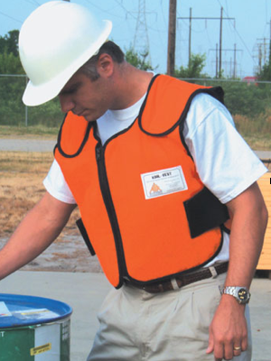
Clothing and PPE
Hard Hat with Wide Brim
Cooling Vests & Clothing
Hard Hat Cool Pack
Loose-fitting Clothing
Reflective Clothing
Wetted Clothing
<number>

Slide 35
Conclusion
Heat stress illness and injuries can be prevented
Workers working under excessive temperature should wear loose clothes and hydrate frequently
Construction manager should realize the symptoms and prevention tips of different types of heat-related disorders
Call the doctor immediately if on-site emergency does not work
Management commitment is a must to heat safety
Source: http://www.osha.gov/SLTC/heatstress/
<number>

Slide 36
Think Safety Work Safely
<number>

