Slide 1
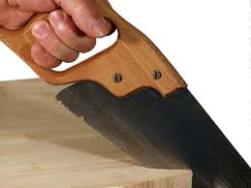
Handsaw Safety

Slide 2
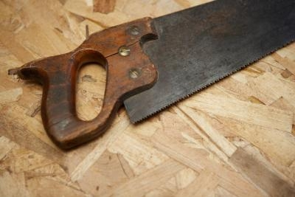
Background
A handsaw is a tool used in woodworking and carpentry.
Used to cut pieces of wood into different shapes. This is usually done in order to join the pieces together and create a wooden structure or system.
They operate by having a series of sharp teeth that are harder than the wood being cut.

Slide 3
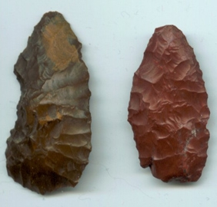
History
Hand saws date back to the Neolithic period and were some of the first tools ever invented.
Used to hack and saw at a material rather than simply cutting.

Slide 4
History
Hand saws have changed significantly throughout history.
Their basic purpose has remained the same.
Romans angled the teeth outward in order to cut a larger groove so the blade would not jam.
The Handsaws Throughout History
By Robert Demers

Slide 5
Use
Hand saws only use is to cut material.
The type of handsaws focused on are the type of handsaws that cut wood.

Slide 6
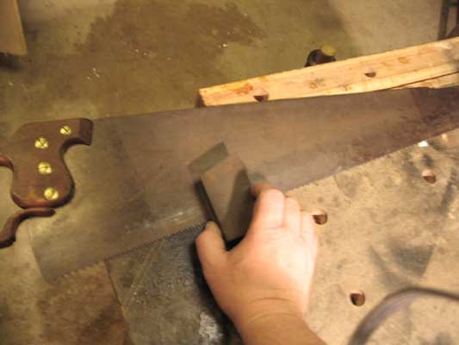
Hazards
Splinters
Flying particles
Cuts and lacerations on the hands or limbs
Saw dust inhalation

Slide 7
Construction Fatality (1 fatality in construction was investigated by OSHA from 1990 thru 2009)
A worker was electrocuted when his hand saw made contact with a 7620-Volt power line. He was trying to remove a tree limb that was touching the power line. After being electrocuted, he fell 25 feet.
Source: Extracted from OSHA accident investigation data 1990-2009

Slide 8
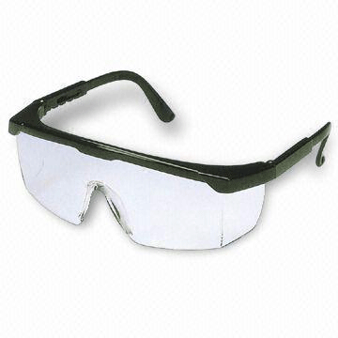
Safety
Gloves
Eye protection
Boots
Hardhat
Inhalation protection (if necessary)

Slide 9
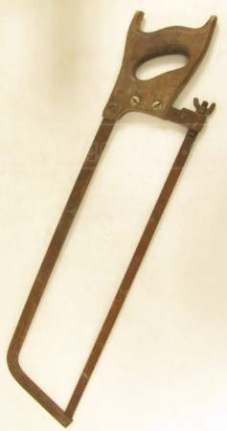
Best Practices
Cut on level surface
Keep hands away from blade
Start slow so blade does not jump
Arrange the cut so that the scrap piece falls free when the cut is finished
Never force the blade

Slide 10
Best Practices
Wear the necessary safety equipment
Work in an area free of debris and that is well ventilated

Slide 11
Best Practices
Make sure there are no nails or other foreign objects in the material being cut
Keep blade sharp

Slide 12
Best Practices
Never use a bent saw
Never use a saw with missing teeth
Never use a saw with a loose or broken handle
Never saw without supports
Measure twice cut once

Slide 13
Think Safety
Work Safely

