Slide 1
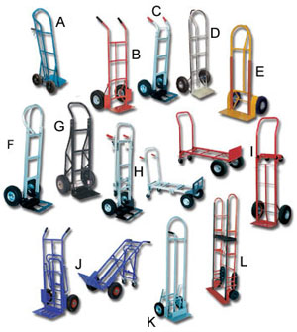
Hand Trucks
Assortment of Heavy Duty Hand Trucks: These durable, yet lightweight hand trucks are built to handle loads of up to 600 lbs.
Source: Wheeled Hand Truck." HandTrucks.com, the leading source for Hand Trucks, Utility Carts, Dollies, Hand Truck Wheels and Pallet Jacks. Web. 12 Apr 2011. <http://www.handtrucks.com/>

Slide 2
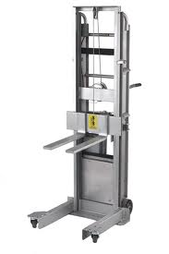
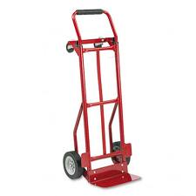
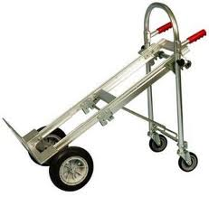
Description
Two or four wheels
Handle used as a lever
Made from tube steel, aluminum, or high impact plastics
Can be motorized.
Common Types of Hand Trucks

Slide 3
Standard Usage
General utility device to carry:
Boxes
Bulky and Heavy objects (refrigerators, etc.)
Commonly used in:
Beverage and food service deliveries
Miscellaneous applications

Slide 4
Two-wheeled hand truck hazards
The principal causes of the injuries are the mishaps resulting from improper lifting, failing to use available equipment and unsafe work practices..
Load falling over.
Back problems if used incorrectly.
Source: Materials Handling and Storage Preparation." awdc.net. N.p., n.d. Web. 12 Apr 2011. <http://www.awdc.net/awdc_files/file/OSHA-Lessons/37_Materials_Handling_and_Storage.pdf>.

Slide 5
Four-wheeled hand trucks hazards
Similar to the two-wheeled versions.
However, pay extra attention to loading procedures. Four-wheeled trucks can be easily tipped, so make sure that the load is balanced and secure.
These should generally be pushed instead of pulled, except for those trucks equipped with a fifth wheel and a pulling handle.
Objects and loads may fall and injure hands, feet and legs.
Source: Materials Handling and Storage Preparation." awdc.net. N.p., n.d. Web. 12 Apr 2011. <http://www.awdc.net/awdc_files/file/OSHA-Lessons/37_Materials_Handling_and_Storage.pdf>.

Slide 6
Selection of hand truck
Important to choose right size and design to handle specific load.
Curved bed trucks, for example, are designed to handle drums.
Think about loading and operating the hand truck safely.
Source: Materials Handling and Storage Preparation." awdc.net. N.p., n.d. Web. 12 Apr 2011. <http://www.awdc.net/awdc_files/file/OSHA-Lessons/37_Materials_Handling_and_Storage.pdf>.

Slide 7
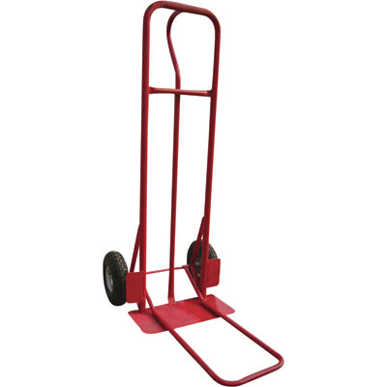
2-Wheel Industrial Hand Truck— 800-Lb. Capacity, Includes Plate Extender
Source: 2 Wheeled Hand Truck." HandTrucks.com, the leading source for Hand Trucks, Utility Carts, Dollies, Hand Truck Wheels and Pallet Jacks. Web. 12 Apr 2011. <http://www.handtrucks.com/>

Slide 8
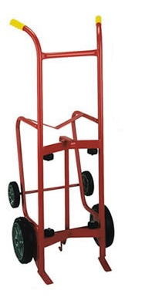
4 Wheel Standard Drum Truck- 1000 lb Capacity
Source: 4 Wheeled Hand Truck." HandTrucks.com, the leading source for Hand Trucks, Utility Carts, Dollies, Hand Truck Wheels and Pallet Jacks. Web. 12 Apr 2011. <http://www.handtrucks.com/>

Slide 9
Fatalities
No known fatalities were investigated by OSHA that pertained to the use of hand trucks.
Source: Information extracted from OSHA construction worker fatality data (1990-2009)

Slide 10
OSHA Regulations
The OSHA regulations do not specifically mention the use of hand trucks.

Slide 11
Powered hand trucks Hazards
Most dangerous kind of hand truck.
Operators must be trained to use them.
Potential for back injuries strains, sprains and contusions if used incorrectly due to capacity to handle and lift bigger loads.
When an individual is descending along a decline, the load has the potential to get away from the hand truck operator. This places additional stress on the operator to restrain the truck and control the rate of descent.
Source: Materials Handling and Storage Preparation." awdc.net. N.p., n.d. Web. 12 Apr 2011. <http://www.awdc.net/awdc_files/file/OSHA-Lessons/37_Materials_Handling_and_Storage.pdf>.

Slide 12
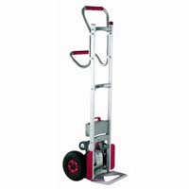
Powered Stair Climbing Hand truck
Source: “Powered Hand Truck." HandTrucks.com, the leading source for Hand Trucks, Utility Carts, Dollies, Hand Truck Wheels and Pallet Jacks. Web. 12 Apr 2011. <http://www.handtrucks.com/>

Slide 13
Safe Work Practices: Powered Hand Trucks
Things to keep in mind when using powered hand trucks:
- Never operate a powered truck with wet or greasy hands.
- Always keep a hand on the handle and face the direction of travel.
- Enter elevators by backing in.
- Stay alert for pedestrians and obstructions.
- Stop at intersections to avoid collisions.
- Never ride or permit others to ride on the truck.
Source: Safety Meeting Presentation HAND TRUCK SAFETY." ncsu.edu. N.p., n.d. Web. 12 Apr 2011. <http://www.ncsu.edu/ehs/www99/right/training/meeting/handtruc.html>.

Slide 14
General Safety Practices

Slide 15
Personal Protective Equipment Requirements
Always wear gloves to protect hands from getting caught in between the handles and nearby objects/structures. Gloves also help secure a stronger grip and thus help decrease the chances of the hand truck slipping underneath the hands.
Wear proper shoes. No open-toed shoes should be worn when operating a hand truck. This reduces risk of toe injury in the event a load or the hand truck itself were to fall on top of the feet.
Source: Materials Handling and Storage Preparation." awdc.net. N.p., n.d. Web. 12 Apr 2011. <http://www.awdc.net/awdc_files/file/OSHA-Lessons/37_Materials_Handling_and_Storage.pdf>.

Slide 16
General Safety Practices
Size up the load to be moved.
Devise a clear path for moving the hand truck.
Work in teams in congested areas.
Check load positioning, angle, stability.
Make sure tires are inflated.
Use a hand truck that is appropriate for the job and the load to be carried.
When stacking items on the truck, keep the heaviest load on the bottom to lower the center of gravity.
Balance the load forward on the axle of the hand truck, so the handle will not carry the weight.
Source: Safety Meeting Presentation HAND TRUCK SAFETY." ncsu.edu. N.p., n.d. Web. 12 Apr 2011. <http://www.ncsu.edu/ehs/www99/right/training/meeting/handtruc.html>.

Slide 17
Safe Work Practices: Two and Four-wheeled Hand Trucks
Follow proper lifting techniques to place the load on the hand truck.
Place the heaviest objects on the bottom.
Do not lift heavy items to place them on the hand truck, but rather slip the lip of the hand truck under the load.
Position the load so it rests on the axles so the weight will be carried by the truck and not the handles.
Make sure the load will not slip, shift or fall. This may require securing it to the truck.
Source: Safety Meeting Presentation HAND TRUCK SAFETY." ncsu.edu. N.p., n.d. Web. 12 Apr 2011. <http://www.ncsu.edu/ehs/www99/right/training/meeting/handtruc.html>.

Slide 18
Never stack items so high so visibility will be impeded.
When carrying multiple boxes side by side, attempt to stagger them to “lock in” the boxes.
Be sure the items to be transported on the hand truck are sturdy enough to be moved in this manner.
Secure any bulky, awkward or delicate objects to the truck.
Source: Safety Meeting Presentation HAND TRUCK SAFETY." ncsu.edu. N.p., n.d. Web. 12 Apr 2011. <http://www.ncsu.edu/ehs/www99/right/training/meeting/handtruc.html>.

Slide 19
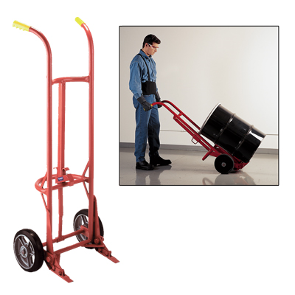
Proper Lifting Techniques for 2 and 4-wheel Hand trucks
Source: 2 and 4 Wheeled Hand Trucks." HandTrucks.com, the leading source for Hand Trucks, Utility Carts, Dollies, Hand Truck Wheels and Pallet Jacks. Web. 12 Apr 2011. <http://www.handtrucks.com/>

Slide 20
Always Remember!
Hand truck injuries typically occur by getting the hands pinched between the handles and a nearby stationary object or structure.
Be careful when moving through tight spaces. The use of gloves can provide extra protection.
Make sure to park the trucks in a designated area, never in aisles or other places where they may cause a trip hazard.
In general, proper use of hand trucks can reduce one of the nations' leading workplace safety issues - back injuries.
Source: Safety Meeting Presentation HAND TRUCK SAFETY." ncsu.edu. N.p., n.d. Web. 12 Apr 2011. <http://www.ncsu.edu/ehs/www99/right/training/meeting/handtruc.html>.

Slide 21
Always Remember!
Hand trucks, especially the two-wheeled hand trucks, can be quite unstable without a load on them.
Be sure to maintain full control of the hand truck from the time it is empty up to the time a load is placed on it and transported.
Similarly be aware of the instability of hand trucks during storage. Store the hand trucks so they will not fall accidently in the storage area.
Source: Safety Meeting Presentation HAND TRUCK SAFETY." ncsu.edu. N.p., n.d. Web. 12 Apr 2011. <http://www.ncsu.edu/ehs/www99/right/training/meeting/handtruc.html>.

Slide 22
Think Safety Work Safely

