Slide 1
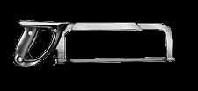
HACKSAWS

Slide 2
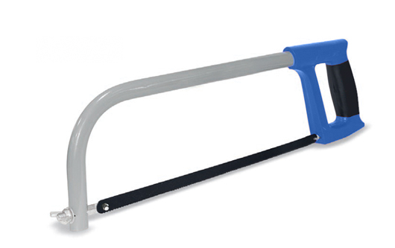
Description
A hacksaw is a fine-toothed saw with a blade under tension in a frame.
Used for cutting materials such as metal or bone.
Standard Hacksaws

Slide 3
Hand-Held Hacksaws
Consists of :
metal arch and handle
Pins (for attaching a narrow disposable blade)
Screw (used to put thin blade under tension)
Blade (can be installed to cut toward or away from handle)
http://www.creativecrash.com/system/photos/000/061/377/61377/big/hacksaw02d_show2.jpg

Slide 4
Hand-Held Hacksaws (Blade)
Blades are available in standardized lengths
Available by tooth count.
Choose blade based on:
Thickness of material
Min. of 3 teeth in material
http://www.creativecrash.com/system/photos/000/061/376/61376/big/hacksaw02d_show.jpg

Slide 5
Panel Hacksaws
Eliminates the frame
Saw can cut into panels of sheet metal with no restriction from frame
http://upload.wikimedia.org/wikipedia/commons/6/61/Panel_hacksaw.JPG

Slide 6
Power Hacksaws
Type of hacksaw that is powered by electric motor.
Stationary machine (mostly)
Used in place of band saw for cutting metal stock to length
Provides a cleaner cut
http://upload.wikimedia.org/wikipedia/commons/c/c2/SawMachine.jpg

Slide 7
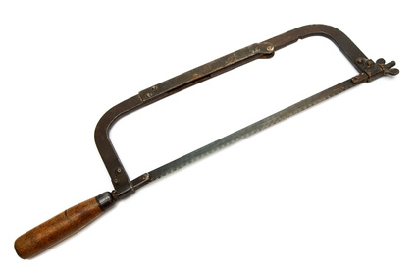
History
Hacksaws were first fabricated in 1915.
They were products first manufactured by Lenox.
http://us.123rf.com/400wm/400/400/svlumagraphica/svlumagraphica0812/svlumagraphica081200058/3991708.jpg

Slide 8
Power Hacksaw Hazards
Cuts
Reciprocating blade
Electrical Shock
Noise

Slide 9
Hacksaw PPE
Safety Gloves
Safety Glasses
Hearing Protection (if applicable)

Slide 10
Power Hacksaw Precautions
always ensure the machine is switched off before making adjustments to the machine
Beware of blade breakage
Hazard check all guards are in position
Ensure the vice and table are firmly locked before switching on the machine
Do not wear loose clothing or jewelry

Slide 11
Power Hacksaw Precautions
Hazard : adjust the feed speed before starting the machine
Use cutting fluid
Do not: wear gloves while operating this equipment
Never attempt to cut non linear cuts

Slide 12
Hand-held Hacksaw Hazards
Cutting hazard
Twisting/breaking hazard
Loose blade hazard

Slide 13
Hand-held Hacksaw Precautions
Choose the right blade for the right job
Coarse tooth blades make for faster work
Finer blades are needed for cutting thinner metal
Use a vice to secure metal to be cut
Move the body forward and back as a cut is made

Slide 14
Hand-held Hacksaw Precautions
Use long even strokes
Do not put too much pressure on blade
When the cut is nearly complete, ease up to prevent the severed section from causing harm.
Clean and store saw appropriately after use

Slide 15
Injury Statistics
Name of study: “Occupational injuries among construction workers treated in major metropolitan emergency department in the United States.”
By: Laura S Welch, MD, Katherine L Hunting, PHD, Judith Anderson Marawski, MSc

Slide 16
Study Objective
Objective: The aim of this study was to profile construction worker injuries for more information about causes of nonfatal injuries and to identify injury trends for further investigations and prevention programs.
Scand J Work Environ Health 2005; 31 suppl 2:11-21

Slide 17
Injury Statistics Results
Injuries from sharp objects posed the most worker injuries in this study
Scand J Work Environ Health 2005; 31 suppl 2:11-21

Slide 18
Injury Statistics Results
Injury from sharp objects was the number 1 ranked source of injury
26% of construction workers studied were injured by a sharp object
There were 12 incidents of injuries related to HACKSAWS
Scand J Work Environ Health 2005; 31 suppl 2:11-21

Slide 19
Osha regulations
1926.301 Hand tools
1926.302 Power-operated hand tools

Slide 20
Safety Procedures
Use the right blade for the right job
Use a vice to secure metal to be cut
Move the body forward and back as a cut is made
Use long even strokes

Slide 21
Safety Procedures
Do not put too much pressure on blade
When the cut is nearly complete, ease up to prevent the severed section from
causing harm.
Clean and store saw appropriately after use
If using a Power Hacksaw, do not cut round stock

Slide 22
Think Safety Work Safely

