Slide 1
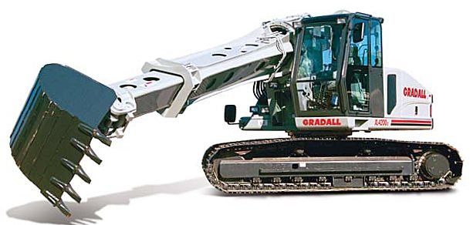
Gradall Excavators

Slide 2
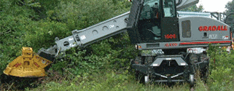
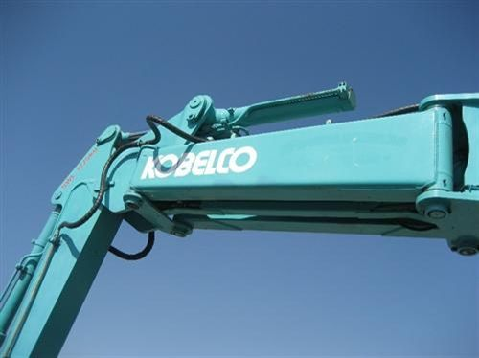
Introduction to Gradalls
The Gradall is a type of Hydraulic Excavator that utilizes a rotational, telescoping and titling boom rather than a knuckle boom.
The Gradall comes in three main types wheeled on-road, wheeled off-road and tracked.
Telescoping Boom
Knuckle Boom

Slide 3
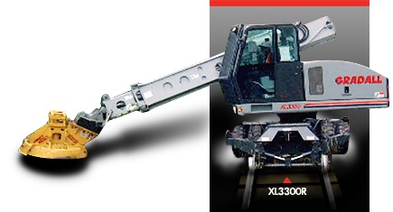
Uses
The Gradall is a fairly versatile tool that can be used for:
-Excavation
-Demolition
-Mining
-Brush Clearing
-Industrial Maintenance
-Railroad Maintenance

Slide 4
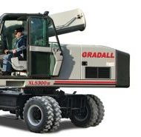
Safety Concerns
When using a Gradall the driver and all workers in the vicinity need to be aware of the boom swing and more notably the counterweight swing
The driver’s view is often obstructed which can lead to many accidents
Counterweight hanging over cab

Slide 5
OSHA Fatality Statistics for Gradalls
During the period from 1990 thru 2007 five deaths involving Gradall equipment were investigated by OSHA.
Three of these five deaths were classified as a caught-in-between involving the counterweight
Source: Extracted from OSHA Accident Investigation Data 1990-2007

Slide 6
Case Study
An operator was advised to fill a small hole in the road with the Gradall. He was being helped by another worker. The operator was aware of the worker’s position until he swung the boom to load gravel. He lost sight of the worker and swung the boom back crushing the worker between the counterweight and the cab. The worker had moved to put away his shovel. The worker died from his injuries.
Source: Extracted from OSHA Accident Investigation Data 1990-2007

Slide 7
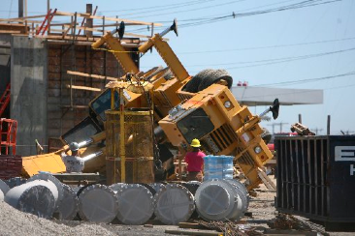
OSHA Regulations
No specific OSHA regulation’s pertain to the Gradall
Source: Extracted from OSHA Accident Investigation Data 1990-2007

Slide 8
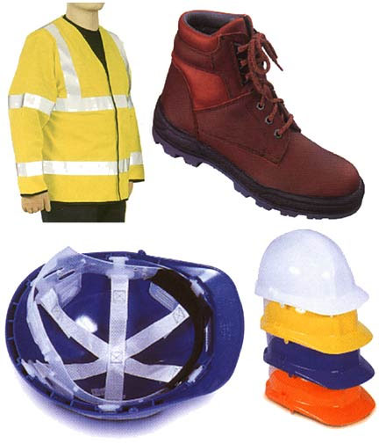
Safety Equipment
Basic PPE should be worn at all times, this includes: Hard hat
Work boots
Hearing protection
Safety glasses
Reflective safety vest
Note: Thick work gloves should be used only if
they do not interfere with control operation

Slide 9
Operational Safety
The Gradall should have a certified operator at all times. The operator can be certified through Gradall’s SAF-T training course.
Gradall can be contacted at
330-339-8468 for more info
on the operators training course

Slide 10
Before Using The Gradall
Scout the work to be done
Formulate a plan with employees on how work will be accomplished
Know the machines limits
Make sure all systems are checked and functional
Check to make sure attachments are functional and properly attached

Slide 11
Think Safely
Work Safely

