Slide 1
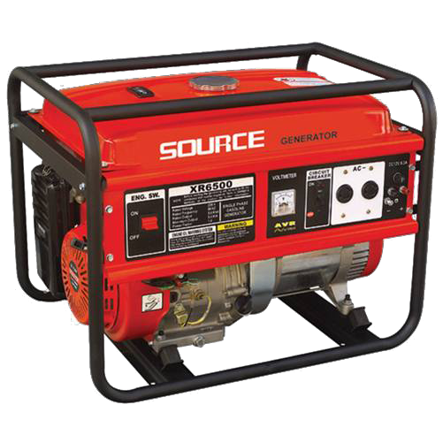
Portable Generators
<number>
www.nairanaira.com

Slide 2
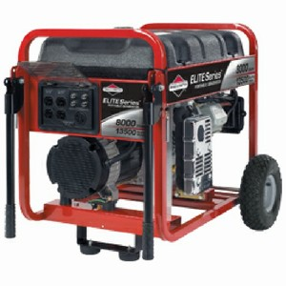
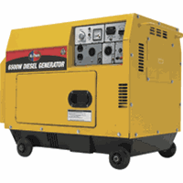
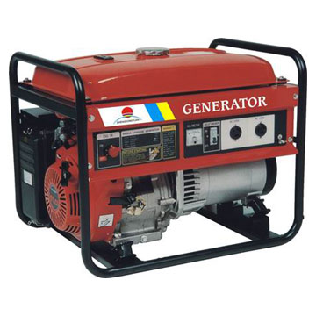
Generators
Generators convert gas or diesel fuel into usable electricity (that is, mechanical energy into electrical energy).
If used and maintained properly, gas generators are relatively safe.
Portable generators are defined by OSHA as “internal combustion engines used to generate electricity” (OSHA, 2009).
<number>
http://www.bouncehousesplano.com/generator.jpg and www.peakpowertools.com/Portable-Generators-s/1.htm
Notes:
<number>

Slide 3
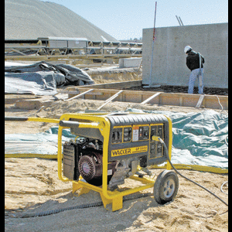
Generators in Construction
Generators are commonly used in the construction industry to power tools and machinery when there is little or no access to electricity on the job site. They are useful prior to temporary or permanent power being installed.
They are also commonly used during cleanup or recovery efforts after a natural disaster.
<number>
www.forconstructionpros.com

Slide 4








Generator Hazards
Electrocution
Carbon Monoxide Poisoning
Fire and Burns
Noise and Vibration
<number>

Slide 5

1. Electrocution
Generators can produce a significant amount of electricity, thereby exposing workers to the possibility of being electrocuted.
The risk of electrical shock due to improperly-grounded receptacles or their use in wet conditions has led to several accidents and deaths.
<number>
Notes:
<number>

Slide 6
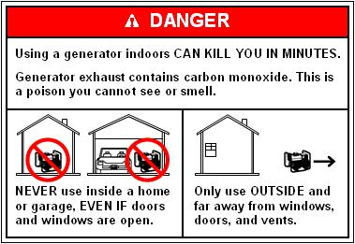
2. Carbon Monoxide Poisoning
Generators release carbon monoxide (CO) while running and these fumes can accumulate into toxic levels in a matter of minutes.
Carbon monoxide is an odorless, colorless and toxic gas. Because it is impossible to see, taste or smell the toxic fumes, CO can kill workers before they become aware of it.
<number>
http://www.cpsc.gov/cpscpub/pubs/portgen.html
Notes:
<number>

Slide 7
2. Carbon Monoxide Poisoning
Symptoms
At lower levels of exposure, CO causes mild effects that are often mistaken for the flu. These symptoms include headaches, dizziness, disorientation, nausea and fatigue.
Prolonged exposure to CO will eventually cause brain damage and death.
<number>
Notes:
<number>

Slide 8
2. Carbon Monoxide Poisoning
According to OSHA, acceptable levels of CO in the air are 50 ppm and lower.
Carbon monoxide levels above 50 ppm are deemed hazardous and may become deadly.
<number>
Notes:
<number>

Slide 9


3. Fire and Burns
When generators are not used properly, the chances of a fire or burns increases dramatically.
Generators run off very combustible liquids that can explode when ignited.
Generators also get extremely hot when running and may burn workers.
<number>
Notes:
<number>

Slide 10
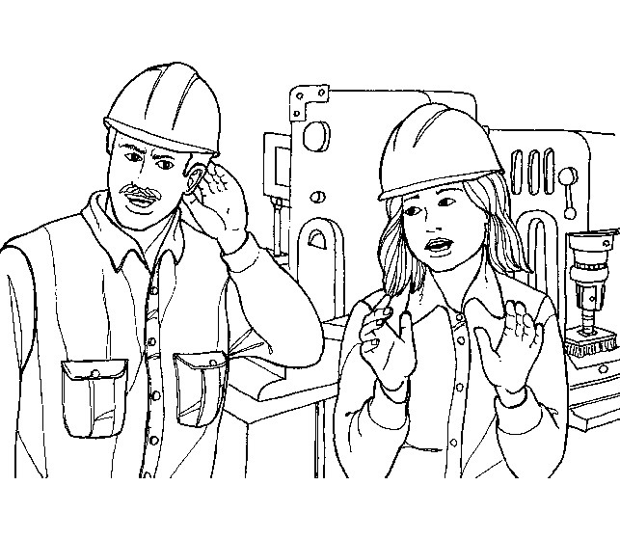
4. Noise and Vibration
Generator engines vibrate and create noise. Excessive noise and vibration could cause hearing loss and fatigue that may affect job performance.
<number>
http://actrav.itcilo.org/actrav-english/telearn/osh/noise/nomain.htm
Notes:
<number>

Slide 11
Generator Statistics
Thirty eight (38) generator fatalities were investigated by OSHA during 1990 thru 2009.
<number>
Source: Extracted from OSHA Accident Investigation Data 1990-2009

Slide 12
Generator Accidents
Several accidents and deaths have occurred where generators have been used in confined spaces resulting in the build-up of poisonous levels of carbon monoxide. The Consumer Product Safety Commission reports that numerous CO poisoning deaths have occurred through the use of portable generators.
<number>

Slide 13

Generator Fatality Example
A worker was working on a jobsite with an electrical generator. He was electrocuted when a 480 volt service was backfed through the generator.
<number>
Source: Extracted from OSHA Accident Investigation Data 1990-2009 | www.diymedicalnetwork.com

Slide 14

Generator Fatality Example
Two workers were laying tile in a single family structure.
The work was being done in a closed structure, at night, with a gas-powered generator located in the garage. All windows and doors were closed.
The bodies of the two men were found the following morning. They died from carbon monoxide poisoning.
<number>
Source: Extracted from OSHA Accident Investigation Data 1990-2009 | Photo courtesy of: www.galtmile.com/images/wilmagen.jpg
Notes:
<number>

Slide 15
OSHA Regulations
1926.404(b)(1)(ii)
  Receptacles on a two-wire, single-phase portable or vehicle-mounted generator rated not more than 5 kW, where the circuit conductors of the generator are insulated from the generator frame and all other grounded surfaces, need not be protected with ground-fault circuit interrupters. (Otherwise GFCI is required)
<number>

Slide 16
OSHA Regulations
1926.404(f)(3)
  (i) Portable generators under the following conditions, the frame of a portable generator need not be grounded and may serve as the grounding electrode for a system supplied by the generator.
  (A) The generator supplies only equipment mounted on the generator and/or cord- and plug-connected equipment through receptacles mounted on the generator, and
  (B) The non-current carrying metal parts of equipment and the equipment grounding conductor terminals of the receptacles are bonded to the generator frame
<number>

Slide 17

Best Practices:
Personal Protective Equipment
Hard Hat
Safety Glasses
Gloves
Hearing Protection
<number>
http://www.amtonline.com

Slide 18
Best Practices: Key Safety Procedures
Inspect generator prior to use.
Operate according to manufacturer’s instructions.
<number>
Notes:
<number>

Slide 19

Best Practices: Carbon Monoxide Poisoning Prevention
Generators should only be used outdoors, never in enclosed spaces.
Do not place generators outdoors near doors, eaves, windows, or vents where the exhaust might be drawn indoors.
Make sure the generator has 3 to 4 feet of clear space on all sides to ensure adequate ventilation.
<number>

Slide 20
Best Practices: Carbon Monoxide Protection
When using generators in/near enclosed areas, portable CO monitors should be installed in order to detect harmful levels of CO.
Proper ventilation and breathing apparatus should be used when CO build up is a threat.
If getting dizzy or feeling sick while using a generator, get to fresh air immediately… do not delay!
<number>
Notes:
<number>

Slide 21

Best Practices: Shock and Electrocution Prevention
Appliances should be connected to generators using heavy-duty extension cords designed for outdoor use. The cords should be three-pronged.
Make sure cords are rated for higher wattages than the total of all appliances connected to the generator.
Do not use any damaged or frayed power cords .
<number>

Slide 22

Best Practices: Shock and Electrocution Prevention
Generators should not be used in wet conditions if at all possible.
Protect the generator from moisture but be aware of carbon monoxide risks while doing so.
Always dry hands before touching a generator.
Do not plug damaged tools into a generator.
<number>

Slide 23

Best Practices: Shock and Electrocution Prevention
Always plug electrical appliances directly into the generator using the manufacturer’s supplied cords or extension cords that are grounded.
Make sure the generator is properly grounded and the grounding connections are tight.
Some generators come with onboard ground fault circuit interrupters. It is a good practice to use plug-in GFCIs on units that do not have them onboard.
<number>

Slide 24

Best Practices: Shock and Electrocution Prevention
Never feed power from a portable generator into a wall outlet. This can create an extremely dangerous situation if the generator backfeeds electricity into the distribution system, possibly resulting in an injury or death to an unsuspecting serviceman working on the powerline.
If necessary to connect a generator to house wiring to power appliances, have a qualified electrician install appropriate equipment. Otherwise, the utility company may be able to install an appropriate transfer switch.
<number>
http://www.usfa.dhs.gov/citizens/all_citizens/co/generator.shtm
Notes:
<number>

Slide 25

Best Practices: Fire and Burn Prevention
Fuel for generators should be stored away from living areas in properly labeled, non-glass safety containers.
Generators should be shut down and allowed to cool off before refueling to prevent ignition of fuel or vapors.
Keep generator fuels away from hot engine parts.
Do not smoke around fuel containers.
<number>

Slide 26
Best Practices: Fire and Burn Prevention
Workers should avoid contact with an operating generator to avoid being burned.
Do not use frayed power cords since they may be exposed and cause a fire
<number>
Notes:
<number>

Slide 27
Best Practices: Hearing Conservation
Excessive noise can cause distractions that lead to unsafe work practices
Generators should be placed as far from work operations as possible to limit noise pollution
If noise cannot be alleviated and is above safe levels, proper hearing protection must be worn
<number>

Slide 28
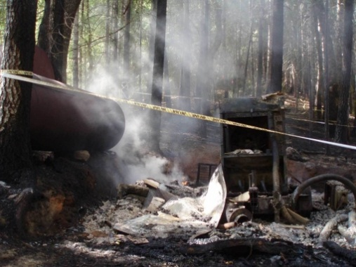
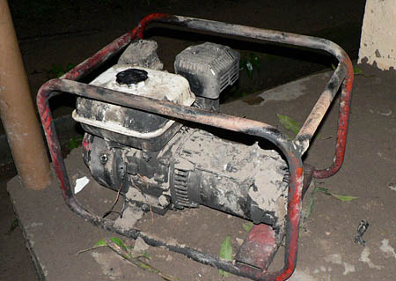
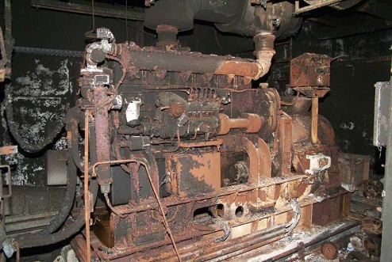
Other Key Safety Procedures
Tie down generators properly during transportation.
Use back feed protection devices to prevent electrocution from a current feeding back into the generator.
<number>
Upper photo courtesy of: www.ncjournal.wordpress.com Middle photo courtesy of: http://www.gmin.org
Lower photo courtesy of: http://www.bunkertours.co.uk/Blankenfelde%20Web/generator.jpg
Notes:
<number>

Slide 29
Think Safety
Work Safely
<number>

