Slide 1
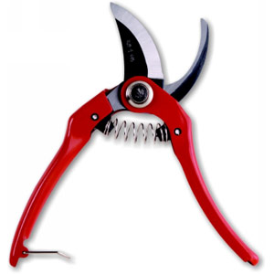
Gardening Shears

Slide 2
Designs
Short handle to be used with one hand.
Three designs of hand gardening shears
  Anvil, bypass, and parrot-beak
Anvil shears have one blade that closes onto a flat surface. Tend to crush the stems of the plants being pruned.
Bypass shears consist of two blades that pass each other to make the cut. These shears work like a pair of scissors. Typically consist of a convex upper blade and a straight of concave lower blade.
Parrot-beak shears consist of two blades to make the cut. The blades are both concave, and are used to trap the stem to make the cut. These shears are suitable for only narrower stems.

Slide 3
Usage
Great for finish garden work.
The blades are hard enough to prune hard branches of trees and shrubs
Yet able to do the delicate work pruning flowers for arranging.
Gardening shears are also used in nature conservation where fine scale work is needed.

Slide 4
Usage
The type of pruning to be done will determine the specific type of shear to be used.
  Anvil shears to do non-exacting work such as thinning shrubs.
  Bypass shears to do most garden pruning.
  Parrot-beak shears for cutting flowers. They have an anvil blade that is pointed at both ends, making it easy to get between tight stems.

Slide 5
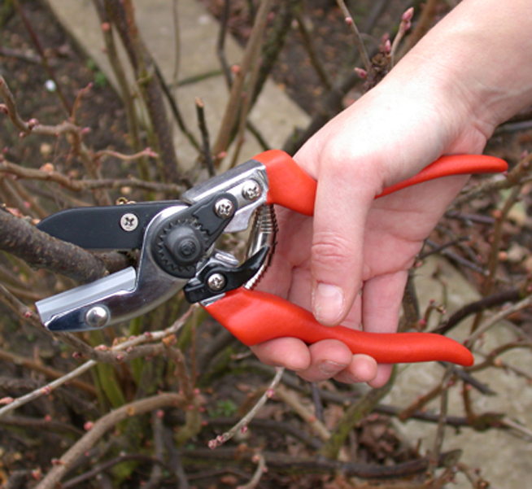
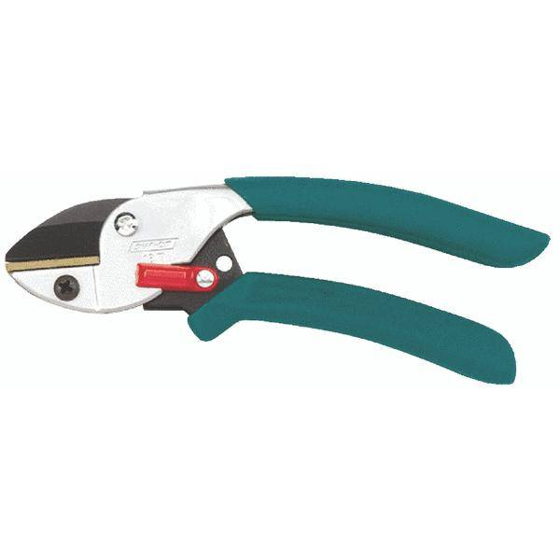
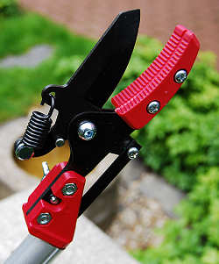
Anvil Shears

Slide 6
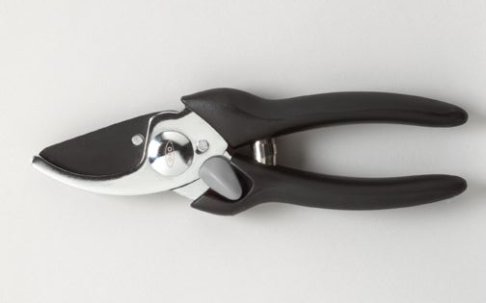
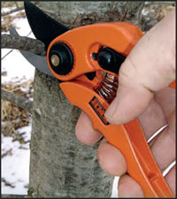
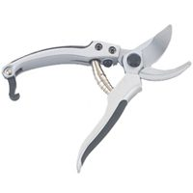
Bypass Shears

Slide 7
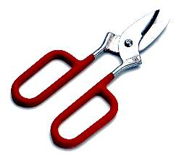
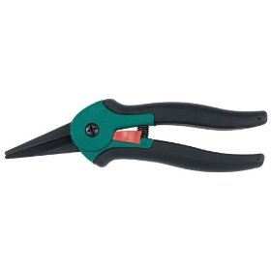
Parrot-Beak Shears

Slide 8
Hazards
Users need to be mindful of the very sharp blades that are used in gardening shears.
Being used primarily for finish garden work, users need to be careful of the plants that they are pruning.
  Plants often have thorns that can pierce the skin.
  Plants may have bugs that can bite.

Slide 9
Best Practices
Gloves should be used to protect the hands from punctures and bites.
Safety glasses are to be worn to protect from possible thorns and limbs
Hard hats are always a good practice

Slide 10
Best Practices
Users should be careful when touching blades during cleaning.
Cleaning and sharpening should be done regularly to prevent dulling of the blades.
When not in use the shears should be closed with a safety catch or a handle clasp.

Slide 11
Think Safety
Work Safety

