Slide 1
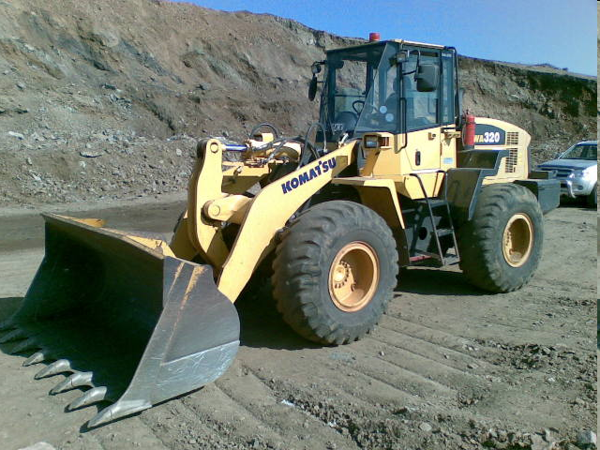
Front End Loaders

Slide 2
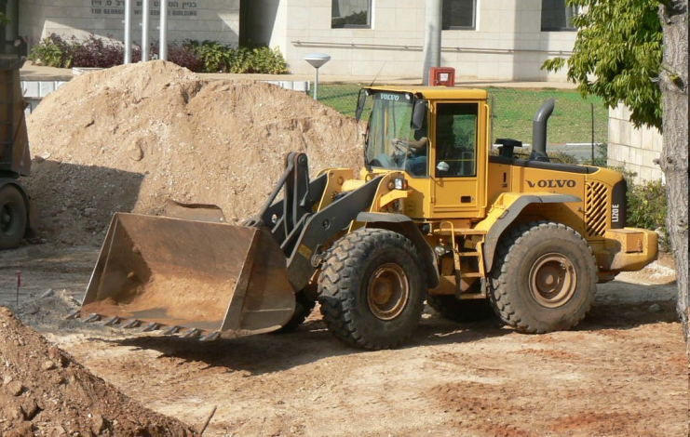
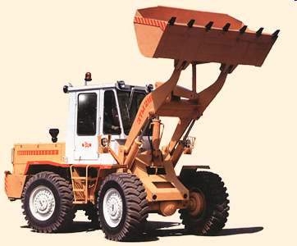
What is a Front End Loader?
A Front End Loader is a type of tractor, usually wheeled, sometimes on tracks, that has a front mounted bucket connected to the end of two arms to scoop loose debris or material such as dirt, sand or gravel. The loader then moves the material and deposits it in another location. A loader is commonly used to move stockpiled material and depositing it into an awaiting dump truck, a storage pile or into a open trench.

Slide 3
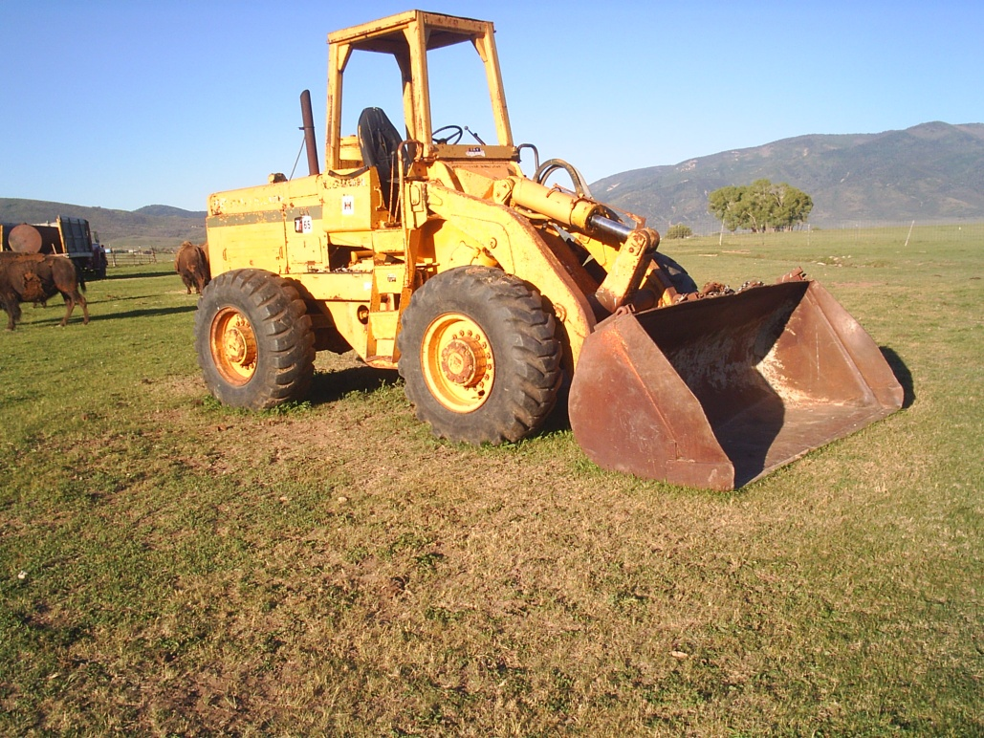
Front End Loader Operation
Front End Loaders are operated from the cab by an equipment operator

Slide 4
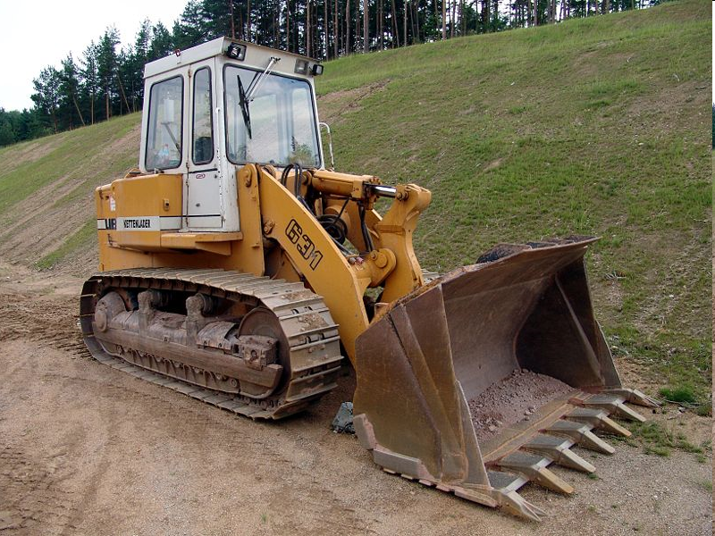
Safety Concerns
The main safety hazards associated with the use of Front-End Loaders are:
Bystanders being struck by the bucket or other part of the machine
Pedestrians being run over by the loader
Workers being caught in/between the loader and a stationary object
Rollover (working on sloping ground)

Slide 5
Struck By
Loader or bucket can strike a person. Material can also fall out of bucket and strike someone.

Slide 6
Run Over
A distracted worker or pedestrian can be run over by a loader

Slide 7
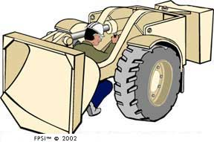
Caught In Between
Workers could be caught in between loader and other equipment or materials. Workers can also be caught in/between the moving parts of the loader, especially if it is an articulating loader
People could get caught between the loader and something else because they are not seen or because of equipment failure
During mechanical repair, the arms can lose hydraulic pressure and crush the mechanics working on them
Brakes can fail and the loader could roll until it hits an object in its way

Slide 8
Rollover
While in motion or stopped the loader can rollover, especially on steep grades or when being loaded or unloaded from a lowboy. Rollovers occur when the loader either becomes unbalanced or the ground gives way

Slide 9
OSHA Fatalities
81 fatalities involving Front-End Loaders were investigated by OSHA from 1990 thru 2009
82% of the fatalities were people (usually workers) other than the loader operator
18% of the fatalities pertained to the death of the loader operator
Source: Extracted from 1990-2009 OSHA Fatality Data

Slide 10
OSHA Fatalities Continued
Run over 20
Caught in between 18
Struck by 13
Rollover 10
Mechanical failure 08
Person in bucket 07
Thrown from 02
Dump mat’l on worker in trench 01
Swept away 01
Fell down 01
Source: Extracted from 1990-2009 OSHA Fatality Data

Slide 11
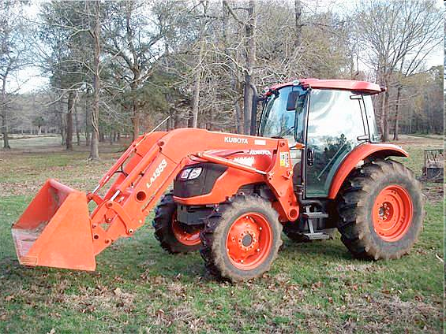
OSHA Regulations
Must have seat belts unless vehicle has no Rollover Protective Structure
Must have access roadways and grades that allow for safe use of loaders
Must have brakes capable of stopping fully loaded machine
Must have a horn with distinguishable noise
Must have guards over scissor points
Source: Obtained from OSHA 1926. 602

Slide 12
Best Practices
PPE for loader operators:
Hard hat
Safety shoes
Safety goggles
Heavy gloves
Reflector vests (as needed)
Hearing protection
Respirators (as needed)

Slide 13
Best Practices
Walk around the loader to check for people or materials (check the immediate area and the path of travel)
Become familiar with the work area:
Slopes
Direction of travel
Traffic
Holes and obstructions
Conditions of roads
Location of buried utilities

Slide 14
Best Practices
Take time to read operators manual before using loader
Before operating, check to be sure the major systems are functioning
Check to make sure the safety equipment on the loader is intact

Slide 15
Best Practices
When entering the cab, have three points of contact
Face the loader when mounting and dismounting
Warn personnel in area before starting loader
Always wear seatbelt and safety equipment as designated by the jobsite safety practices
Beware of workers standing/working nearby

Slide 16
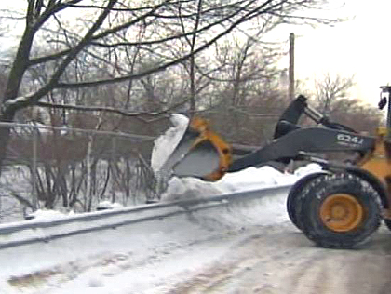
Best Practices
Bucket for Loader must be lowered while in motion
Make sure when scooping or dumping that nobody is in danger of being struck by the bucket or materials being dumped

Slide 17
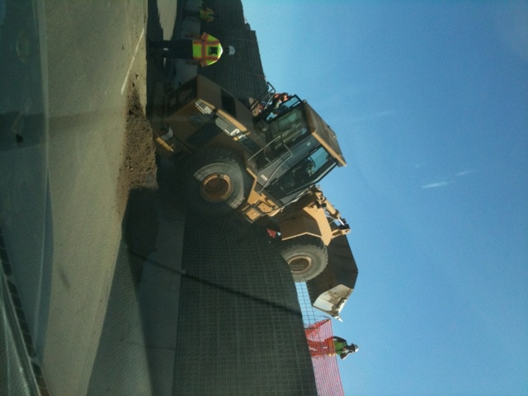
Best Practices
Drive slowly and cautiously
Be aware of the ground conditions and slope

Slide 18
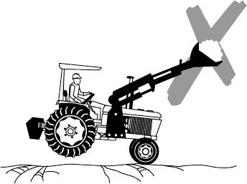
Best Practices
Do not drive loader near anybody at high speeds, and make sure nobody is coming toward loader from a blind corner

Slide 19
Best Practices
Once started, conduct operations and control check
Keep work area as flat and level as possible
When traveling, be aware of vision being obstructed
Move and turn loader at low speeds
Adjust speed of machine based on site conditions
Stay in gear when traveling downhill
Carry loader bucket at a low position during travel

Slide 20
Best Practices
Be aware of grade when backfilling.
Never undercut a high bank.
When traveling with a loaded bucket on a slope, point bucket toward the higher grade. When bucket is empty, angle bucket toward the lower grade
Make sure not to lift the bucket higher than recommended
Do not permit anyone to stand under a raised loader bucket
Never approach power lines with a raised loader bucket

Slide 21
Best Practices
Never allow workers in the loader bucket
Do not park on slopes
Do not park on overhaul roads (pull off to the side)
Lower bucket, stop engine, and lock brakes before exiting the loader

Slide 22
Think Safety
Work safely

