Slide 1
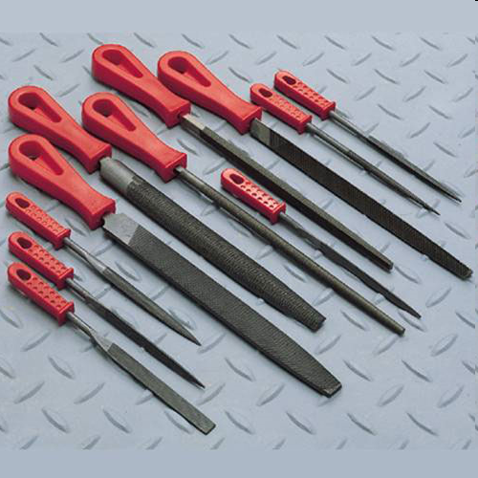
FILES
<number>
Notes:
<number>

Slide 2
FILE
A file is a hand tool used to shape material by cutting. Files normally take the shape of a hardened steel bar with metal ridges.
<number>
Notes:
<number>

Slide 3
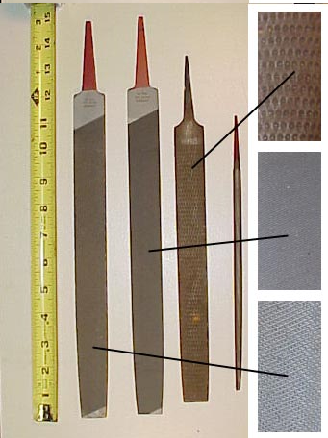
THE FILE
1
2
3
4
Point (called “Tang”)
for attaching a handle, #1,2,4 are Files and #3 is a Rasp
Files shape metal while Rasps shape wood. (Note different surface on Rasp)
Files range from 4” to 20” in length.
<number>
Notes:
<number>

Slide 4
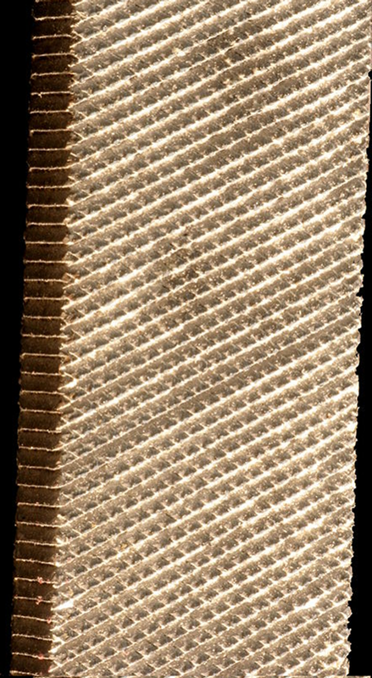
Anatomy of the FILE
Files can be double cut (pictured right) or single cut (one set of teeth).
The angle at which these teeth are cut is specific to the type of metal on which the file is to be used.
Files are designed for one particular type of metal.
As a result of the hardening process, files are brittle.
The tang portion of the file is tempered to provide flexibility and strength.
<number>
Notes:
<number>

Slide 5
History of the File
Rasps were used by Egyptians as early as 1200 B.C.
Leonardo da Vinci drew a file making machine.
www.wikipedia.org
<number>
Notes:
<number>

Slide 6
OSHA Reg. 1926.301(a),(d)
Unsafe hand tools shall never be used.
Wood handles shall be kept free of splinters and maintained tight in the handle.
www.OSHA.gov
<number>
Notes:
<number>

Slide 7
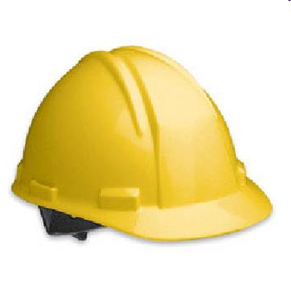
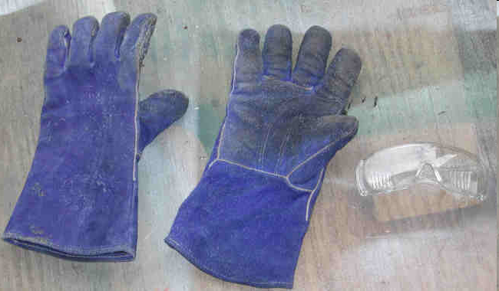
Personal Protective Equipment
Safety glasses
Heavy-duty work gloves
Hardhat
<number>
Notes:
<number>

Slide 8
Injury & Illness
In the 1900s one of the leading injury/ illness related to files was lead poisoning, due to physical contact and inhalation of lead during the process of hammering the file.
Today, nearly all injuries related to files occur while using a file in an unsafe manner.
<number>
Notes:
<number>

Slide 9
Injury & Illness
Never use a file without a handle, the tang can easily puncture or lacerate the skin.
Always use both hands while filing, use a vise to hold the metal being filed.
Always file away from the body, this prevents the file from jumping off the surface.
<number>
Notes:
<number>

Slide 10
Think Safety
Work Safely
<number>
Notes:
<number>

