Slide 1

Dump Trucks
Standard Safety Practices and Concerns

Slide 2
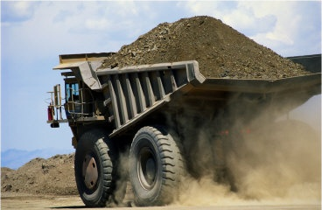
Introduction:
Dump Trucks are a common piece of equipment utilized on virtually all construction sites.
Primary use: to haul loads of loose material such as soil, gravel, or dirt to and from jobsites.
Images source: Google Images

Slide 3
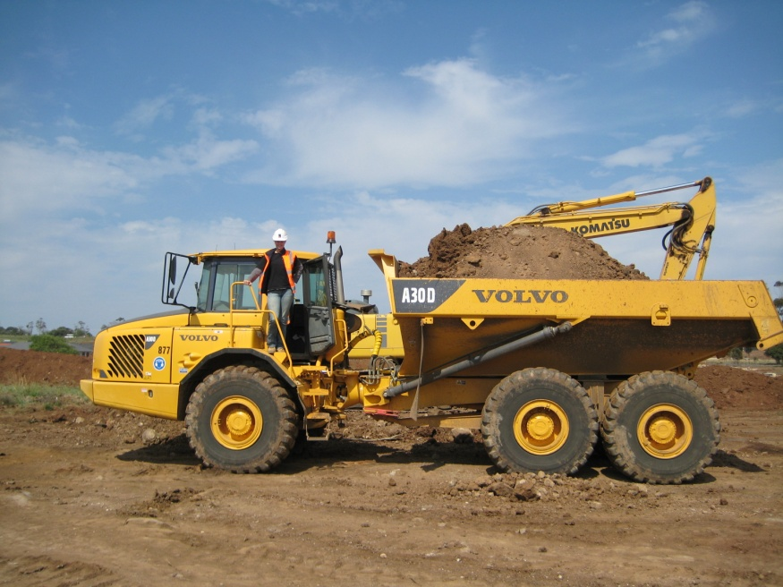
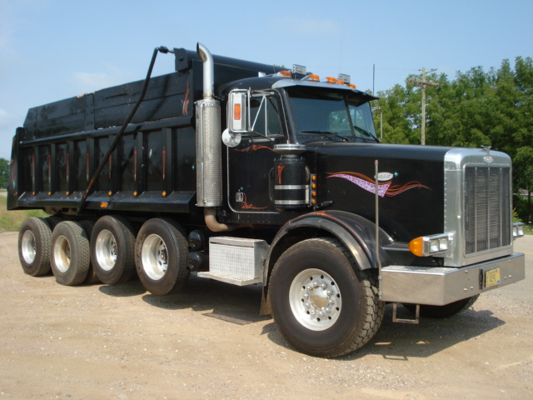
Introduction:
Two Basic Kinds:
  Off road
  On road
Off- Road
On- Road

Slide 4
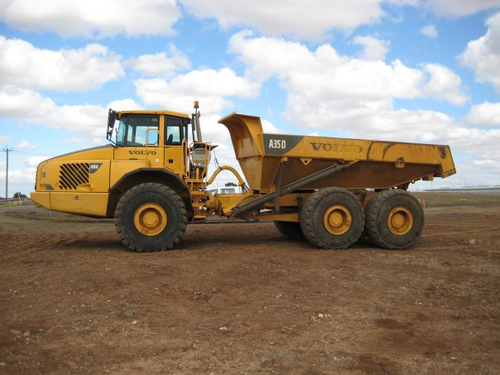
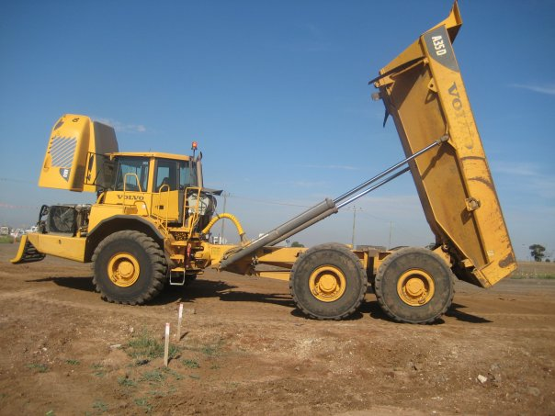
Introduction:
Cab
Hydraulic
Lift
Bed
Dump trucks are generally equipped with a hydraulically operated open-box bed hinged at the rear.
The front of the bed is lifted up to allow its contents to be deposited on the ground behind the truck at the site of delivery.
Source: www.wikipedia.com

Slide 5
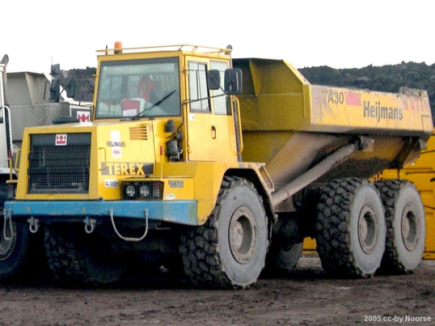
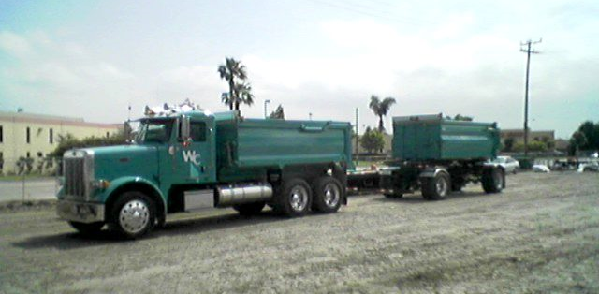
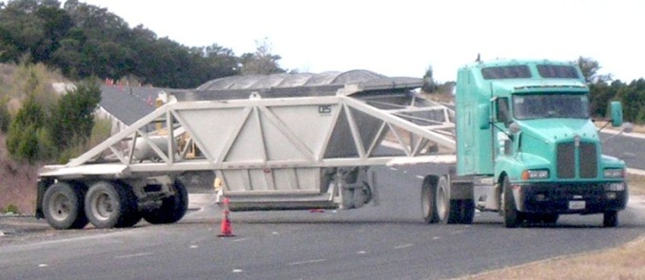
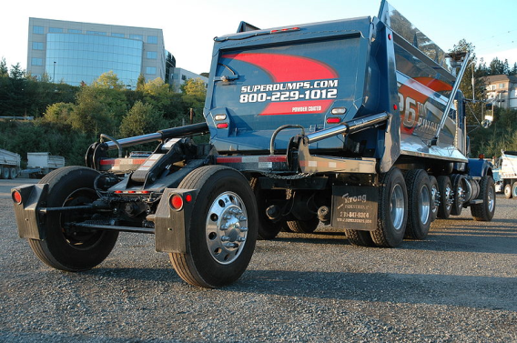
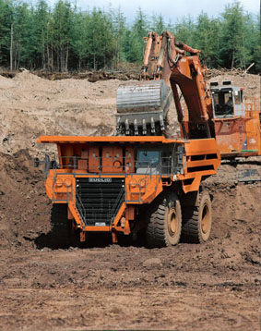
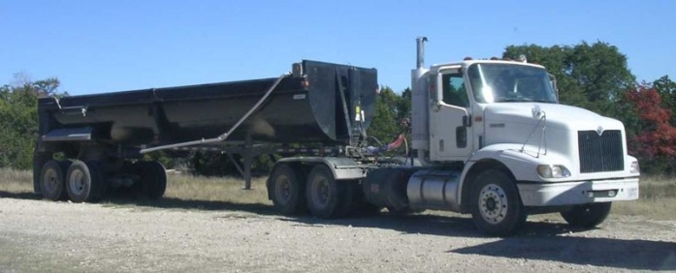
Variety of Types:
  transfer dump trucks
double and triple trailer bottom dump trucks
standard dump trucks
  super dump trucks
  semi-trailer end and bottom
  dump trucks
articulated dump trucks
Source: www.wikipedia.com

Slide 6
Primary Modes of Accident Causation:
  People being run over by dump trucks
Source: Jimmie Wayne Hinze

Slide 7
Primary Modes of Accident Causation:
  People being run over by dump trucks:
    Example:
    “A laborer, was preparing the surface of a newly back-filled trench for placement of a black top patch in a roadway. The driver of a dump truck was attempting to back up to receive a load of dirt. The laborer was run over and killed. The vehicle's back-up alarm was found to be defective; it only worked intermittently.”
Source: 1999-2007 OSHA Fatality Data

Slide 8
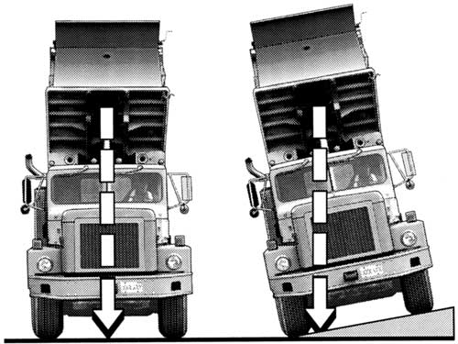
Primary Modes of Accident Causation:
  Trucks tip over due to uneven ground or poor distribution of load.
Source: http://www.construction-site-accident.com/lawyer/dump_truck_accidents.html

Slide 9
Primary Modes of Accident Causation:
  Trucks tip over due to uneven ground or poor distribution of load.
    Example:
    An employee was using a dump truck to haul excavated material to a dump site on the next level up a mountain. It appeared that the operator backed his vehicle into place, dumped his load, and was lowering his bed when the soft surface of previously dumped material gave way. His wheels sank, causing his truck to roll backward down the slope. The truck struck range boulders that had been dumped near the bottom of the slope, rolled over three or four times, and continued. The employee was thrown out of the cab was killed.
Source: 1999-2007 OSHA Fatality Data

Slide 10
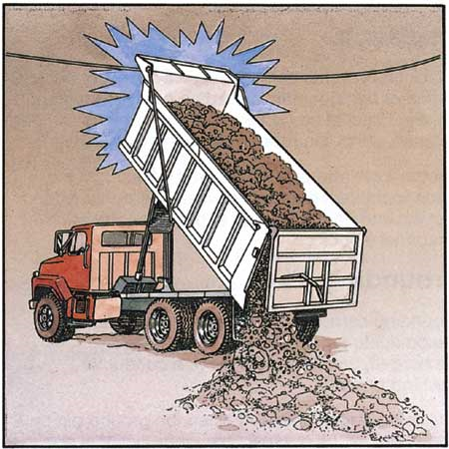
Primary Modes of Accident Causation:
  Electrocution caused by the bed becoming attached to overhead power lines.
Image Source: http://www.elcosh.org

Slide 11
Primary Modes of Accident Causation:
  Electrocution caused by the bed becoming attached to overhead power lines.
    Example:
    “An employee was dumping a load of stone at a temporary levee. The levee was being constructed to stem the flow of flood waters. He backed his dump truck into position and raised the semi-dump trailer to dump the load. The trailer contacted a 12.5-kilovolt overhead power line, which caused the truck tires to ignite. The employee jumped from his truck, but was electrocuted when he touched the truck while he was on the wet stone roadway.”
Source: 1999-2007 OSHA Fatality Data

Slide 12
Primary Modes of Accident Causation:
  Being crushed or pinned by the collapsed bed due to pin or support malfunctioning.
Image Source: http://www.elcosh.org

Slide 13
Primary Modes of Accident Causation:
    Being crushed or pinned by the collapsed bed due to pin or support malfunctioning.
    Example:
    “An employee was working on the hydraulic lift system of dump truck. He was adding a pump to increase the lifting capacity of the dump box. The dump box was elevated into position. While in the up position, the box was not blocked or cribbed as to prevent an accidental fall. Consequently, the dump box fell on the employee, crushing his head and neck. The injury resulted in a death.”
Source: 1999-2007 OSHA Fatality Data

Slide 14
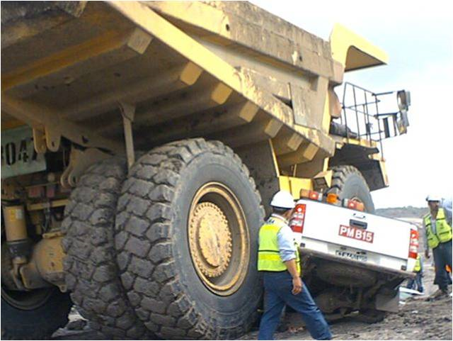
Dump Truck Dangers:
Source: http://images.google.com/imgres?imgurl=http://safetybootsandcrochet.files.wordpress.com

Slide 15
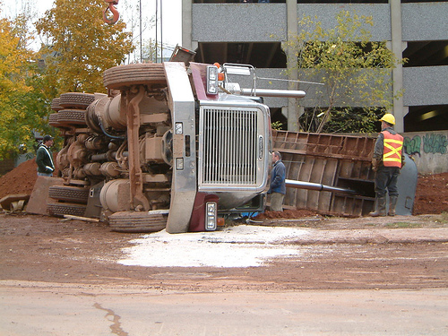
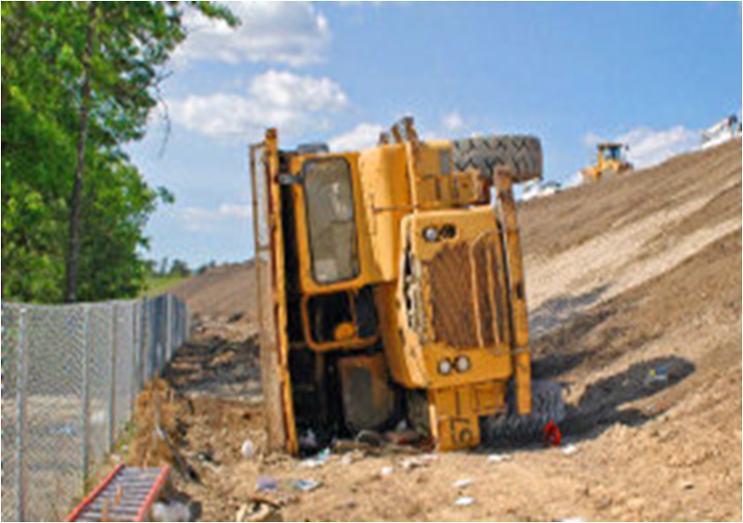
Dump Truck Dangers:
Causes for tipping:
Stability is adversely affected by one or more of the following factors:
  the unit is not on a level surface when dumping
  a large amount of material is in the upper portion of the raised box
  material does not flow out of the top portion of the box, or does not flow out of one side of the top portion
  the rear wheels settle unevenly as the load moves to the rear during dumping
  wind may exert lateral loads, especially if the box is long, as is the case with end-dump semi-trailers.
Source: http://www.construction-site-accident.com/lawyer/dump_truck_accidents.html

Slide 16
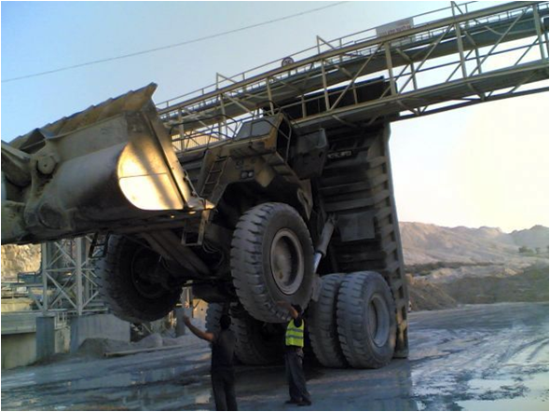
Dump Truck Dangers:
Causes for tipping:
Stability may also be affected by the unit's mechanical condition:
  poor rear suspension systems on one side of the vehicle
  uneven tire pressures in rear wheels
  worn or inadequate components of the lifting system such as pins
  worn or inadequate lifting cylinders.
Source: http://www.construction-site-accident.com/lawyer/dump_truck_accidents.html

Slide 17
Breakdown of 388 Fatalities Involving Dump Trucks

Slide 18
Nature of Dump Truck Movement
Note: Of 25 backup alarms that were not functioning on the dump trucks (all associated with fatalities), 23 resulted in deaths when traveling in reverse.

Slide 19
Description of Victim

Slide 20
Task of Dump Truck

Slide 21
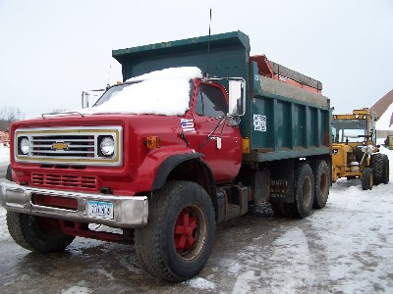
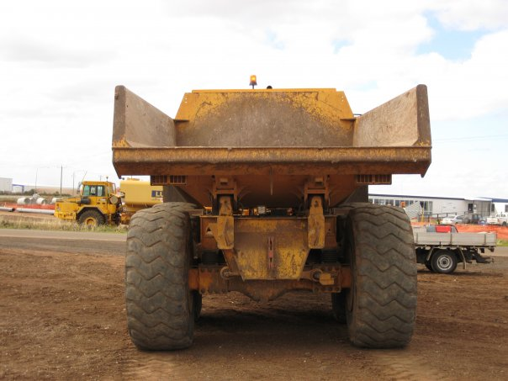
OSHA Regulations:
  1926.601 Motor Vehicles (b)
  All vehicles must have working:
  service brakes
  emergency brake system
  parking brake system.
  All vehicles need at least 2 head lights and 2 tail lights. Must have break lights.
Source: OSHA Standards 2005 subpart J-0

Slide 22

OSHA Regulations:
1926.601 Motor Vehicles (b)
All vehicles must be equipped with operable audible warning device at the operator’s station.
If vehicle has no rear view than it needs a spotter or an audible signal when backing up.
BEEP…BEEP
WATCH OUT!
OR
Source: OSHA Standards 2005 subpart J-0

Slide 23
OSHA Regulations:
1926.601 Motor Vehicles (b)
All vehicles with cabs must have a windshield & wipers.
    Broken glass must be replaced.
Defogging and defrosting devices are also required to ensure adequate visibility.
Req. Windshield wipers
Source: OSHA Standards 2005 subpart J-0

Slide 24
OSHA Regulations:
1926.601 Motor Vehicles (b)
(6) All trucks must be equipped with a cab shield to prevent loose falling material from hitting the operator.
(7) Tools & Materials must be secured when being transported in the same compartment as workers.
(8) Vehicles used to transport employees must have a secured seat for each employee carried.
(9) All vehicles must be equipped with proper seatbelts.
Source: OSHA Standards 2005 subpart J-0

Slide 25
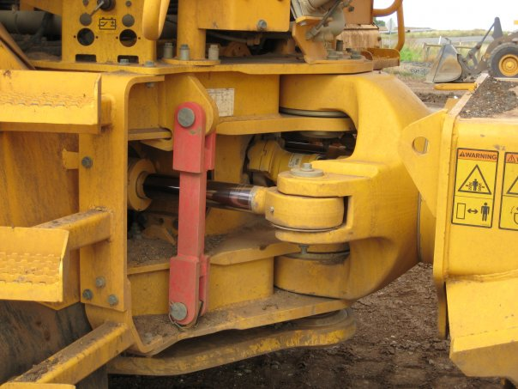
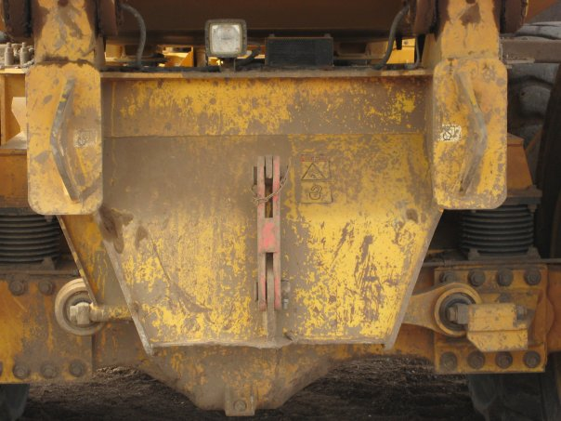
OSHA Regulations:
1926.601 Motor Vehicle (b)
(10) Truck with dumping bodies must have locked support required when being repaired or maintained
(11) Levers that control the hoisting or dumping devices must have latch that prevents bumping controls & accidentally dumping or hoisting.
(12) Trip handles must be located so that the operator is not in the path of the dumping material.
Pins are attached to trucks to lock dump bodies in place to prevent accidental lowering.
Locked support
activated inside cab
Source: OSHA Standards 2005 subpart J-0

Slide 26
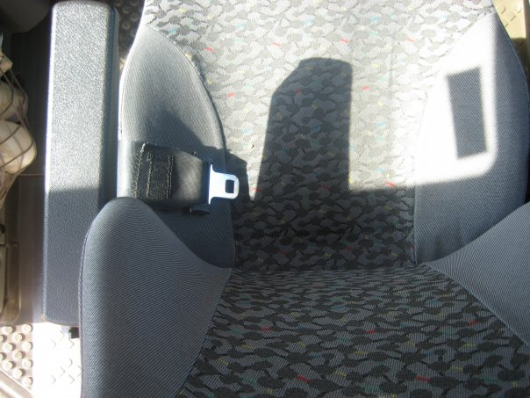
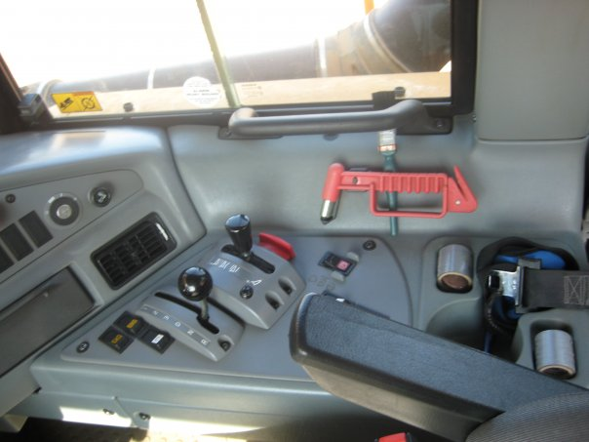
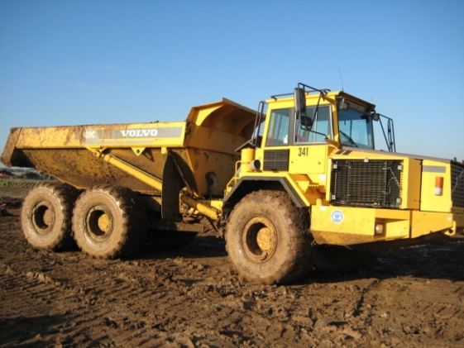
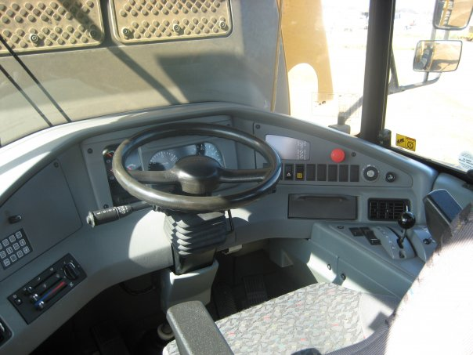
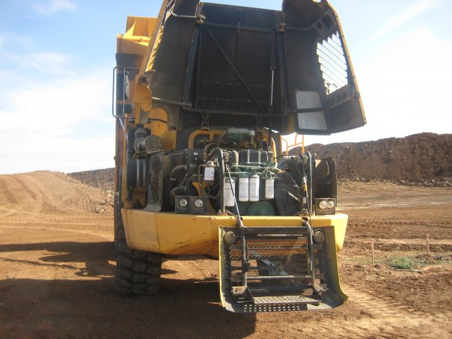
OSHA Regulations:
OSHA requires trucks be checked at the beginning of each shift to be sure all parts are in operable condition.
  Defects found must be reported and the truck must be left out of services until repaired.
Seat belts
Operating controls
Steering mechanism
Engine
Tires

Slide 27

Safety Precautions:
Operator’s guidelines:
  Dump trucks should only be operated by trained professionals.
  Operators must be well rested and attentive when operating this equipment.
  Operators must wear the required personal protective equipment
    This includes shoes , a seat belt and a hard hat when necessary.
  Operators should not use cell phones while operating this equipment

Slide 28
Safety Precautions:
Equipment precautions:
  Trucks must be maintained in good working condition at all times.
  Before starting the truck, perform a pre-start check assess the surrounding environment.
  Communicate with surrounding workers to identify possible hazards or obstructions.

Slide 29
Safety Precautions:
Maintenance:
  Check tire pressures daily. Tire pressures should be equal on each side of the vehicle.
  Examine and lubricate pins and bushings regularly.
  Inspect suspension systems under load to ensure that they work properly and provide even suspension. Weak suspension systems should be replaced immediately.
  Inspect hoist cylinders regularly. Worn cylinders should not be replaced with smaller cylinders or with cylinders rated at lower operating pressure.
  Make sure that repairs to boxes leave bottom and sides clear and unrestricted. Rough patchwork repairs near the top of the box can catch and hold sticky materials.
Source: http://www.construction-site-accident.com/lawyer/dump_truck_accidents.html

Slide 30
Safety Precautions:
Loading:
Loading of the box front-to-back must meet allowable gross weight and axle weight limitations set by the Ministry of Transportation.
From side to side it is best to load as evenly as possible.
If material is likely to flow poorly, lighten up the load in the top end of the box. A slightly smaller load will be better than a full load that causes a tip-over.
Box liners will help most materials flow better during dumping. Liners also help to keep the box in good condition.
Source: http://www.construction-site-accident.com/lawyer/dump_truck_accidents.html

Slide 31
Safety Precautions:
Check the Load:
  To avoid truck damage, the safety of others, and being cited.

Slide 32
Safety Precautions:
Dumping:
Operators should be trained to recognize areas hazardous to dumping.
Before dumping, operators should ensure that the tailgate is unlocked and that the vehicle is on a reasonably level surface.
Before spreading material by dumping it from a moving truck, make sure that the entire length of travel is reasonably level.
Trucks should not dump when they are parked side by side with another vehicle.
Other personnel such as dozer operators, surveyors, and spotters should be warned not to work near a dumping truck in case it tips over.
Workers on foot should not congregate in areas where dumping is under way.
Source: http://www.construction-site-accident.com/lawyer/dump_truck_accidents.html

Slide 33

Safety Precautions:
Always make sure tailgate is unlocked before raising body.
Be aware of the size of truck to avoid overhead power lines/overpasses when dumping.
Dump beds shall be fully lowered or blocked when being repaired or when not in use.

Slide 34
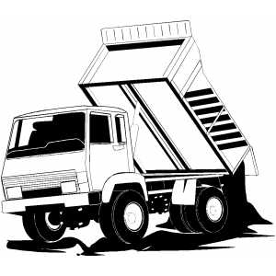
Safety Precautions:
Tipping:
  Work on flat ground when possible.
  Choose the most appropriate travel route to avoid uneven surfaces and possible tipping.
  Do not hurry or take shortcuts.
  Advise when haul roads/ routes need maintenance.
Image Source: Google Images

Slide 35
Think Safety
Work Safely

