Slide 1
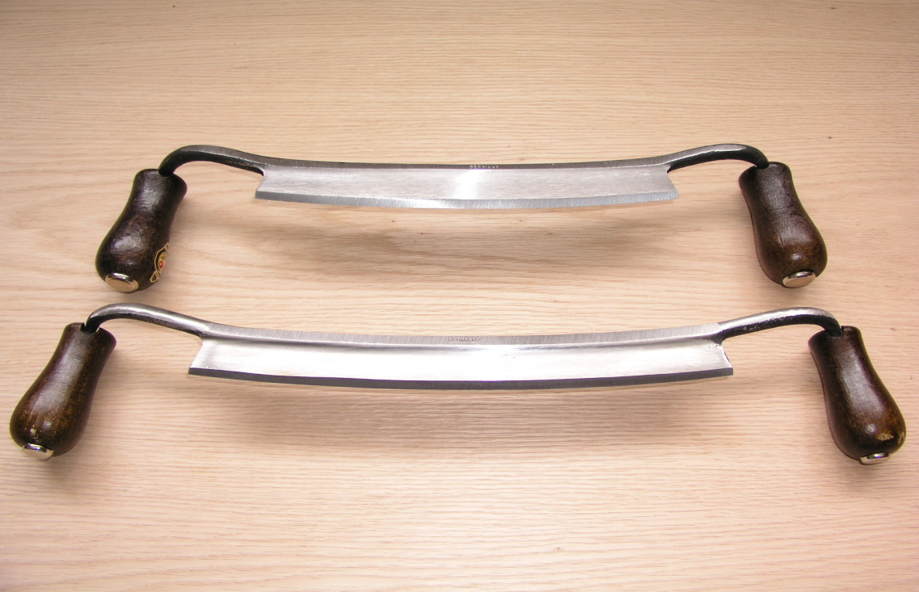
Draw knife safety

Slide 2
Draw knife
Traditional woodworking hand tool used to shape wood by removing shavings.
It consists of a blade with a handle at each end.
The blade is much longer (along the cutting edge) than it is deep (from cutting edge to back edge).
It is pulled or "drawn" (hence the name) toward the user.
Source: http://en.wikipedia.org/wiki/Drawknife

Slide 3
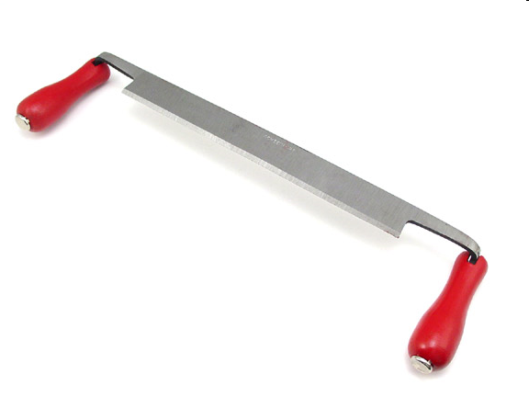
History of Draw knife
This 12" Straight Blade Draw Knife is hand forged out of the highest quality German steel by "Ox head", one of the oldest German tool companies with a tool-making tradition dating back to 1781.
Source: http://www.traditionalwoodworker.com/Draw-Knife-12-Straight-Blade-by-Iltis-Oxhead/productinfo/598-3000/

Slide 4
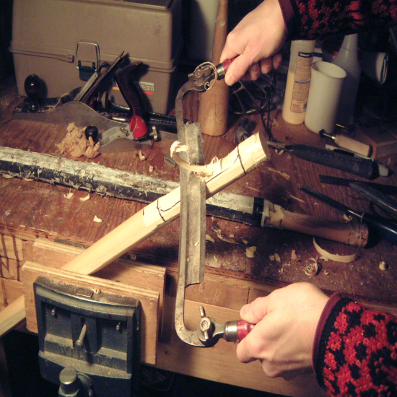
Its heavy-duty design and the cutting edge of the blade measures approximately 12“ long and 1 3/8" wide.
To make for a strong and secure attachment, the tangs (ends of the blade that are tapered) extend fully through the extra large handles which are crafted from European Hardwood
Source:http://www.traditionalwoodworker.com/Draw-Knife-12-Straight-Blade-by-Iltis-Oxhead/productinfo/598-3000/

Slide 5
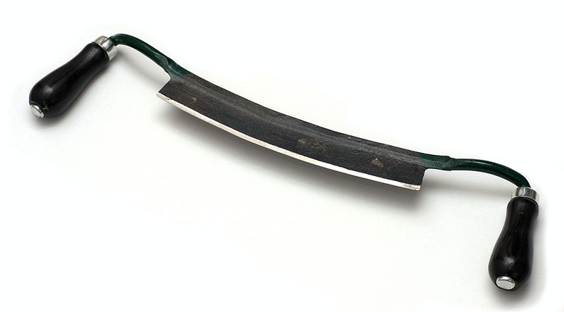
Draw knife blade
The drawknife in the illustration has a blade slightly over 9 inches long, much shorter drawknives are also made.
The blade is sharpened to a chisel bevel.
The handles can be below the level of the blade (as in the illustration) or at the same level
Source: http://en.wikipedia.org/wiki/Drawknife

Slide 6
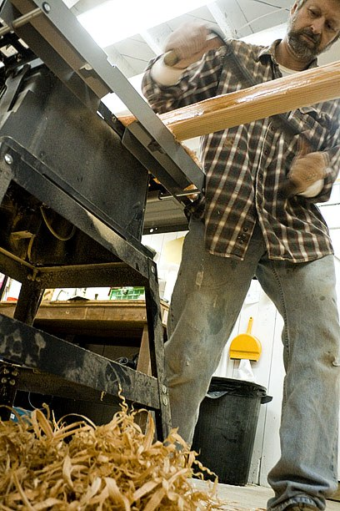
Draw knife in Construction
Draw knife is used as a carpenter's tool
In use the draw-knife is drawn towards the user to remove wood from a surface, similar to a plane but more controllable.
Draw-knives were anciently used for roughly rounding timber prior to turning on a lathe, and are still used by craftsmen around the world
Source: http://www.probertencyclopaedia.com/cgi-bin/res.pl?keyword=Blade&offset=0

Slide 7
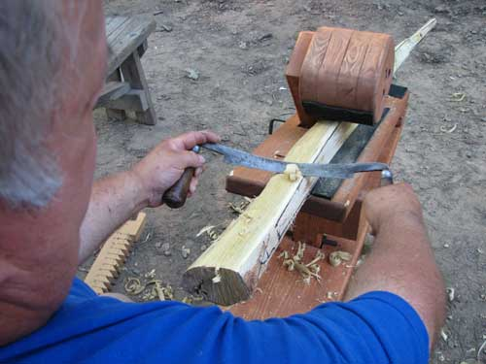
Standard Usage
1. Secure the log into a shaving horse or in a mounted vice.
2. Stand behind the end of the log. Put a hand on each handle of the draw knife facing the blade.
3. Work the drawknife under the bark at the end of the log.
Source: http://www.ehow.com/how_2161042_use-draw-knife.html

Slide 8
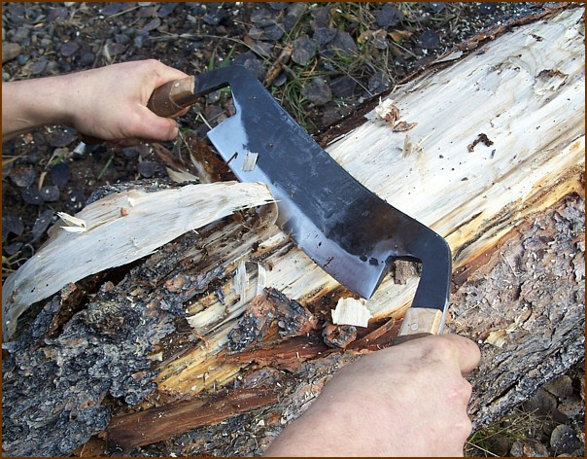
Primary Modes of Accident Causation
Splinters
Muscle strains/sprains
Particulates in the eyes
Tripping over accumulated wood residues

Slide 9
OSHA Accident Investigation Data
No construction worker fatalities involving draw knives were investigated by OSHA between 1990 and 2009.
Source: Extracted from OSHA fatality investigation data 1990-2009

Slide 10
The OSHA regulations do not specifically address the safe use of draw knives
CFR 1926

Slide 11
PPE Requirements
Wire mesh gloves and an apron if there is a risk of cuts.
Safety glasses, goggles, or other eye protection
Wear boots while working in a wet area.
Source: http://www.elcosh.org/en/document/266/d000260/hand-tools-training-guide.html

Slide 12
Safety Procedure and best practice
Use the right draw knife (size) for the job
Keep the draw knife well sharpened
Before each use, check that the draw knife does not have loose handles
Keep secure footing and balance when using the draw knife
Reference: http://www.elcosh.org/en/document/266/d000260/hand-tools-training-guide.html

Slide 13
Safety Procedure and best practice
Use draw knife on a stable work surface
Avoid awkward positions when using the draw knife
Make sure to have enough space to work, and to keep body at a comfortable angle to the work
Store draw knives in a safe location
Carry draw knife properly
Reference: http://www.elcosh.org/en/document/266/d000260/hand-tools-training-guide.html

Slide 14
THINK SAFELY
WORK SAFELY

