Slide 1
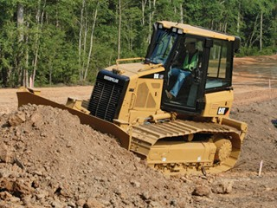
Dozers
Source: http://www.cat.com/equipment/track-type-tractors/small-track-type-tractors

Slide 2
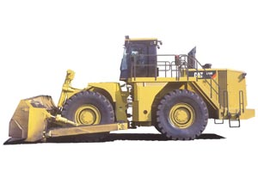
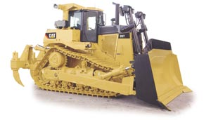
Description of a Dozer
A dozer is a tractor like machine with a blade attached to the front used to push dirt, rock, debris, and other materials. Dozers come in a variety of sizes depending on the need of the job.
There are two types of dozers, wheeled and crawler.
Crawler Dozer
Wheeled Dozer
Source: http://www.cat.com/cmms/13873485?x=7
Source: http://www.cat.com/cda/layout?m=308846&x=7

Slide 3
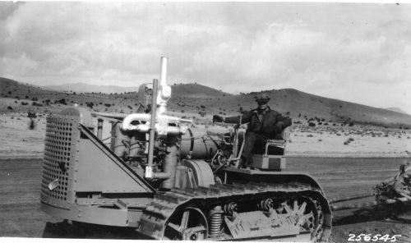
A little history on Dozers
Dozers were first manufactured by C.L. Best Company and the Holt Manufacturing Company around 1920.
These companies merged in 1925 and became known as the Caterpillar Company.
The Caterpillar 60 horsepower would become the World’s first successful bulldozer.
A 1931 Caterpillar 60
Source: http://en.wikipedia.org/wiki/Caterpillar_60
Source: http://en.wikipedia.org/wiki/File:Caterpillar-60,_1931.jpg

Slide 4
Dozers in Construction
Dozers perform various jobs in construction.
Dozer are used for backfilling areas around foundations and structures, making slopes in the site terrain, cutting out ditches, piling and clearing rubble or brush, performing rough excavation.
Dozers come equipped with various types of blades.
General Purpose,
Extended Life Blade (Thicker for longer life)
Finish Blade
Caterpillar General Duty Blade
Source: http://www.cat.com/cda/components/fullArticle?m=40680&x=7&id=87264
Source: http://www.cat.com/cda/components/fullArticle?m=40680&x=7&id=87264

Slide 5
Dozer Safety Concerns
Precautions must be taken when working with dozers on a construction site to avoid accidents.
Most accidents involve:
Operator’s line of sight being obstructive causing;
Workers being struck by dozer
Workers being pinned by dozer
Slope of terrain too steep for safe operation causing,
Dozer to roll on operator
Injuries while repairing dozer

Slide 6
Causes of Dozer Deaths

Slide 7
Direction of Dozer Travel

Slide 8
Description of Victim

Slide 9
Dozer Fatalities
Between 1990 thru 2009 OSHA investigated 181 fatality accidents involving the dozers.
Examples of Accidents
The edge of the roadway slipped out causing the dozer to rollover the edge of the bank at the road edge. It appears the dozer rolled one time. The operator was ejected and sustained fatal injuries.
As the deceased was placing a stake, he was struck and run over by a dozer. The operator of the dozer had a number of blind spots.
Source: Extracted from OSHA Accident Investigation Data 1990-2007

Slide 10
Dozer Fatalities Example
Two dozers loaded on a trailer when the trailer leaned into a ditched. The dozers slipped off the side of the trailer, and the blade of one caught and crushed a worker against a dirt bank. A large front end loader was brought to the site to lift the dozer off the victim. By this time an ambulance had arrived and the victim was transported to the hospital, where he later died.
Extracted from OSHA Accident Investigation Data 1990-2007

Slide 11
OSHA Regulations
OSHA covers bulldozer safety in the following provisions:
1926.602 Material Handling Equipment
1926.602(a)(2)(i) - Seat belts shall be provided on all equipment covered by this section and shall meet the requirements of the Society of Automotive Engineers, J386-1969, Seat Belts for Construction Equipment. Seat belts for agricultural and light industrial tractors shall meet the seat belt requirements of Society of Automotive Engineers J333a-1970, Operator Protection for Agricultural and Light Industrial Tractors.
1926.1000 Rollover Protection Structures
1926.1000(a)(2)(i) - The design objective shall be to minimize the likelihood of a complete overturn and thereby minimize the possibility of the operator being crushed as a result of a rollover or upset
Source: OSHA 29 CFR 1926 Construction Industry Regulations

Slide 12
Always Wear Proper PPE
Hard hat
Work gloves
Safety glasses
Reflective vest
Work boots

Slide 13
Work safely on a Dozer
Operator must be a qualified, competent, and trained.
Operator must wear seat belt.
Dozer must have a working audible backup signal.
Have a flagger when working in crowded areas.
Rest blade on ground before turning engine off.
Turn off engine before leaving cab of dozer.
Turn off engine before refueling dozer.
Signal operators of other nearby machines when leaving dozer.
Dozer must be equipped with roll over protection.
Operator must be aware of the grade of the surrounding terrain.

Slide 14
Think Safety Work Safely

