Slide 1

CIRCULAR SAWS
Source: http://www.osha.gov/SLTC/etools/machineguarding/saws/handheld_saws.html

Slide 2
What is a Circular Saw?
A circular saw is a motor-powered cutting tool which utilizes a circular spinning cutting blade, typically with a toothed edge
  Electric
  Battery
  Gas (not common)
Source: http://www.osha.gov/SLTC/etools/machineguarding/saws/handheld_saws.html

Slide 3
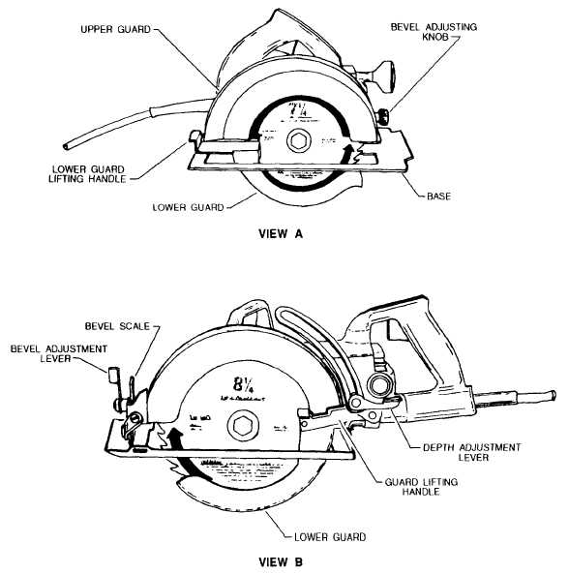
Parts of a Circular Saw
Source: http://www.tpub.com/content/construction/14043/css/14043_55.htm

Slide 4
Blades
Typical blade diameter: 4”-12”
Typical speed: 4000-8000 rpm
Applications: wood, metals, & plastics
(masonry is better cut with wet saws)

Slide 5
Blade Types
Toothed Blades
  Wood-cutting (crosscut, ripping, combination)
  Fiber cement-cutting
  Aluminum/Plastic-cutting
Non-Toothed Blades
  Masonry-cutting
  Tile-cutting
  Metal-cutting

Slide 6
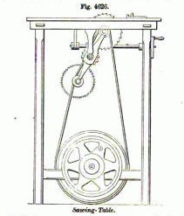
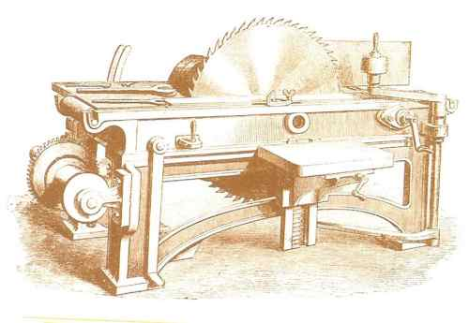
History
England (1777)
  Samuel Miller patented the circular
  sawing machine powered by a
  windmill
Harvard, MA (1813)
      Tabitha Babbitt was inspired by
      the spinning wheel to invent the
      first circular saw for use in a
      saw mill
Source: http://www.yorksaw.com/blog/history-of-the-circular-saw
Source: http://www.wooden-box-maker.com/women-in-woodworking.html

Slide 7
Safety Concerns
Machine hazards
  Point of operation
  Fast moving rotary blade
  In-running nip points (pinch points)
Kickbacks
Flying chips/material
Tool projection
Electrical hazards

Slide 8
NCBI Study
Of 266 circular saw injuries, the following was found:
125 of the injuries were to only one finger
Probability of injury increases in the digits closest to the thumb side of the hand
No significant difference in left or right hand injuries
Multiple finger injuries were found to most likely be diagonal cuts rarely resulting in amputation
Amputation was more frequent in single digit injuries
Only a few of the 3-5 finger injuries resulted in complete amputation
Source: http://www.ncbi.nlm.nih.gov/pubmed/7158079

Slide 9
Fatality Example
A worker was using a gas driven circular saw to cut a clay sewer line and was struck and cut by the tool when it "kicked back" after cutting the pipe. The saw flipped into the air and cut the right side of the employee's neck resulting in a fatal injury.
Source: Extracted from OSHA Accident Investigation Data 1990-2009

Slide 10
Fatality Example
A worker was operating a hand-held circular saw with the trigger choked in the ‘on’ position and the blade guard missing. He lost control of the saw and it struck his leg. He bled to death on the way to the hospital.
Source: Extracted from OSHA Accident Investigation Data 1990-2009

Slide 11
Applicable OSHA Regulations
§1926.300 (d3)
  Circular saws shall be equipped with a constant pressure switch that will shut off power when pressure is released.
§1926.304 (b) (b)
  Operating speed must be permanently marked on circular saws over 20” in dia.
§ 1926.304 (d)
  All portable power-driven circular saws shall be equipped with guards above and below the base plate or shoe.

Slide 12
PPE
Safety glasses with side shields
Face shield
Respirator or dust mask when
  exposed to dust
Earplugs or earmuffs

Slide 13
When using a circular saw, DO:
Check the retracting lower blade guard to make certain it works freely
Ensure that the blade is sharp enough for the material
Check the saw for proper blade rotation
Set the depth of the blade while the saw is unplugged so that the lowest tooth does not extend more than about 1/8” (0.3 cm) beneath the wood
Keep all cords clear of cutting area

Slide 14
DO:
Use two hands to operate saws - one on a trigger switch and the other on a front knob handle
Keep motor free from accumulation of dust and chips
Select the correct blade for stock being cut and allow it to cut steadily; do not force it
Secure stock being cut to avoid movement
Keep eyes on the saw while in use
Support material lengthwise when ripping slender material

Slide 15
DO NOT:
Place hand under the shoe or guard of the saw
Hold or force the retracting lower guard in the open position
Over-tighten the blade-locking nut
Twist the saw to change, cut, or check alignment
Use a saw that vibrates or appears unsafe in any way
Force the saw during cutting

Slide 16
DO NOT:
Cut materials without first checking for obstructions or other objects such as nails and screws
Carry the saw with a finger on the trigger switch
Overreach - keep proper footing and balance
Rip stock without using a wedge or guide clamped or nailed to the stock
Remove guard or prop open

Slide 17
Think Safety
Work Safely

