Slide 1
Chop Saw

Slide 2
What is a Chop Saw?
A motorized saw (also called Miter Saw or Drop Saw) that is used for making precise cuts in a workpiece.
Common uses include framing operations and the cutting of molding.
Mostly used in framing and finish carpentry industries

Slide 3
Parts of a Chop Saw
Trigger
Motor
Guard
Blade
Fence
Base
Dust Bag (optional)

Slide 4
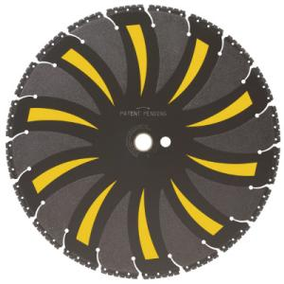
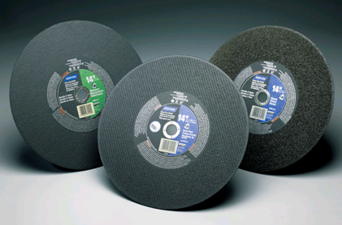
Saw Blades
Standard Sizes of Blades:
10”,12” and 14”
Material Specific
Wood or Plastic
Metals
Slate, Porcelain, and Ceramic Tile

Slide 5
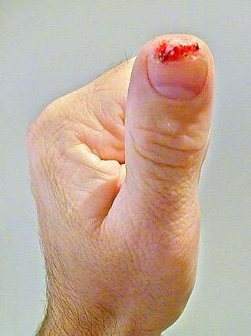
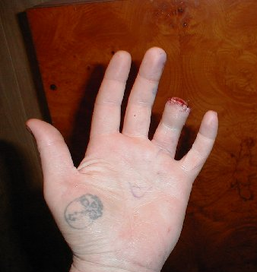
Safety Concerns
Severe Cuts
and Abrasions
Amputations
Eye Injuries
Hearing Loss

Slide 6
Safety Statistics
There were 4 OSHA-investigated fatalities involving chop saws in the time period 1990 thru 2009.
These accidents occurred from saw blades kicking back and impacting the victims
Source: Extracted from OSHA Accident Investigation Data 1990-2009

Slide 7
OSHA Regulations
1926.300 – All hand and power tools and similar equipment, whether furnished by the employer or the employee, shall be maintained in a safe condition.
1926.303c- (1) Safety guards must be provided for abrasive wheels.

Slide 8
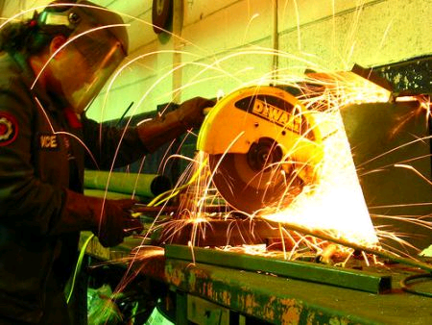
Personal Protective Equipment
What to Wear:
Safety Glasses or
Face Shield
Ear Plugs
Close-toed Shoes
Durable Clothes

Slide 9
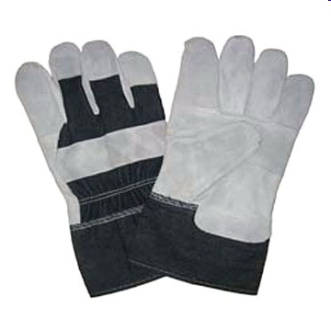
Personal Protective Equipment
What Not to Wear:
Gloves
Loose dangling clothes or jewelry

Slide 10
Good Safety Practices
Do not operate a machine A) before receiving proper instruction, B) before fully understanding how to use it
NEVER cross the arms to hold material
Wear EYE protection.
Use ALL safety guards exactly as they are supposed to be used.
Make all adjustments to machines with the power off, with the chop saw unplugged from the power source

Slide 11
Good Safety Practices
Floors should be kept as clean and dry as possible to prevent accidental slips with or around dangerous hand tools.
Use the right tool for the job.
Wear proper apparel. Do not wear loose clothing, dangling objects or jewelry. Long hair must be restrained. These may get caught in moving parts.

Slide 12
This is what safety looks like!
Notice eye and ear protection
No jewelry or clothes getting in the way
Arms are not crossed to hold material

Slide 13
Think Safety
Work Safely

