Slide 1
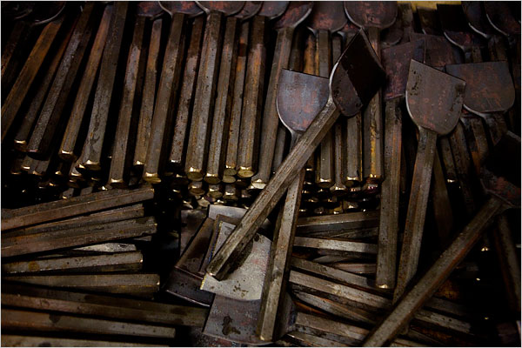
Chisels
Source: http://www.nytimes.com/slideshow/2008/02/19/business/businessspecial2/0219-CHISEL_8.html

Slide 2
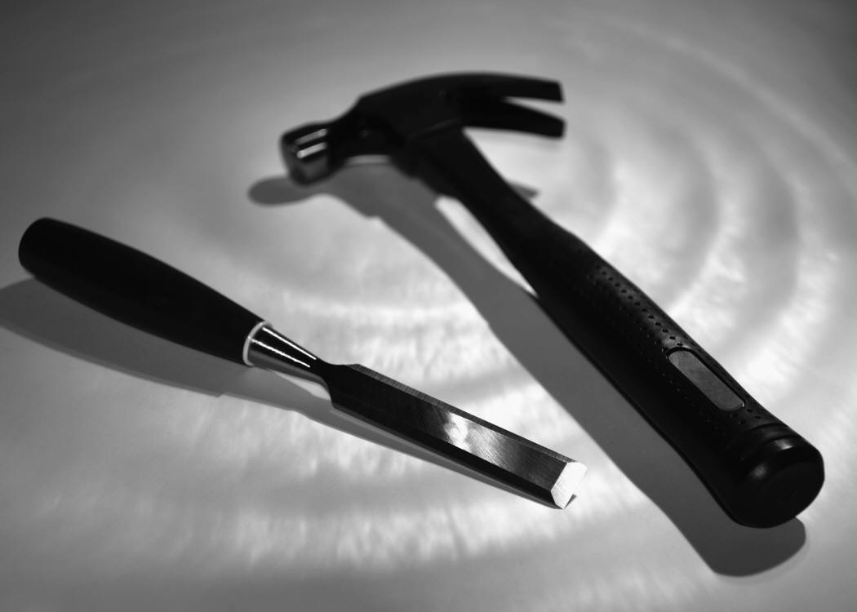
What is a Chisel?
Chisels are hand tools used to shave or chip wood, metals, concrete, and masonry. They are available for other materials as well. Most chisels are operated by striking them with a hammer, but some are simply pushed by hand.

Slide 3
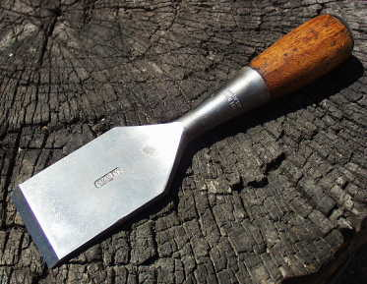
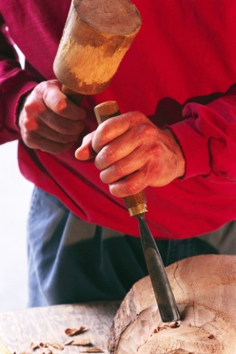
What is a Chisel?
Butt chisel: has a short blade that ranges from about 2 1/2" to 3" long and is for carving, paring and similar work. It can be used with hard-faced hammers.
Firmer chisel: has a longer blade, usually from 3 1/2" to 6", and is used mainly for cutting deeply into wood. It should be used with soft-faced hammers.
Sources: http://www.antique-used-tools.com/55chisel_2.jpg http://hand-tools.hardwarestore.com/learning/all-about-wood-chisels.aspx

Slide 4
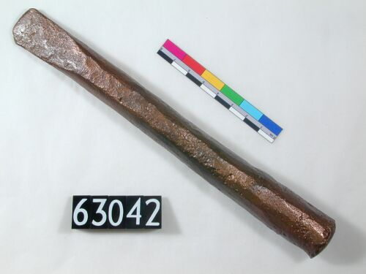
History of Chisels
“Throughout history, humans have relied on wood and stone to shelter and protect themselves, and the chisel is one of the best tools to work those materials.”
“Early chisels made out of flint that date back 10,000 years have been discovered, while more modern versions are made out of tempered steel.”
The ancient Egyptians used chisels to carve stone for the pyramids.
Sources: http://www.forbes.com/2005/08/04/tools-stone-working-chisel-cx_de_0804chisel.html
http://www.digitalegypt.ucl.ac.uk/tools/archive/uc63042.jpg

Slide 5
Typical Safety Concerns
“If a chisel is used as a screwdriver, the tip of the chisel may break and fly off, hitting the user or others nearby
If a screwdriver is used as a chisel, it can slip and cause a puncture wound
If a chisel is aimed toward the body when struck, it can slip and injure the user
A chisel used to perform work for which it was not designed can break and injure the user
Sources: http://www.osha.gov/Publications/osha3080.html http://safety.ag.utk.edu/safetyplan/17Shopweb/17shopsafety.htm

Slide 6
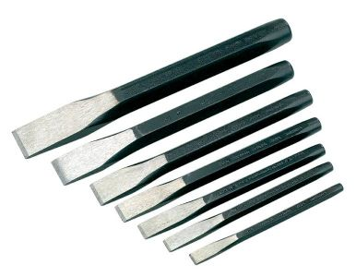
General Safety Concerns
If chisel head is allowed to become “mushroomed,” there is a danger of metal fragments flying off
If the chisel is not struck carefully with a hammer, it is possible to hit one’s hands with the hammer
Fragments of the material being chiseled can fly off, creating a hazard
A dull chisel is a dangerous chisel
An unshielded chisel can pose a
cutting hazard when not in use
Sources: http://www.stanleytools.com/default.asp?TYPE=STATICLEFT&PAGE=tooltips_chisels.htm&LEFT=left_solutions.htm
http://www.osh.dol.govt.nz/order/catalogue/archive/coldchisels.pdf

Slide 7
OSHA Investigated Injuries
Out of 13,510 OSHA investigated deaths and injuries from 1990 to 2009, 6 incidents involved the use of chisels during the event.
Of these 6:
1 death directly involved electrocution by an metal chisel, attributed to a malfunctioning extension cord.
Source: Extracted from OSHA Accident Investigation Data 1990-2009

Slide 8
OSHA Investigated Injuries
Out of 13,510 OSHA recorded deaths and injuries from 1990 to 2009, 6 incidents recorded the use of chisels during the event.
Of these 6:
3 involved falling off a ladder while using a chisel (2 deaths + 1 injury)
Source: Extracted from OSHA Accident Investigation Data 1990-2009

Slide 9
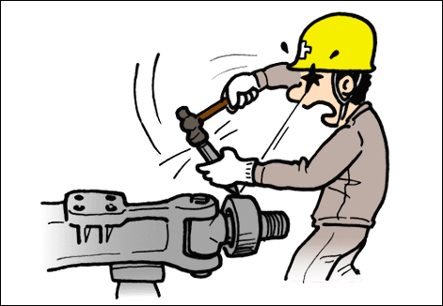
OSHA Investigated Injuries
Out of 13,510 OSHA recorded deaths and injuries from 1990 to 2009, 6 incidents recorded the use of chisels during the event.
Of these 6:
None were primarily caused by a chisel “hand tool”
Source: Extracted from OSHA Accident Investigation Data 1990-2009

Slide 10
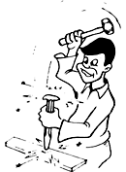
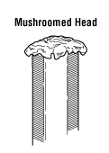
OSHA Regulations
1926.301(c) Impact tools, such as drift pins, wedges, and chisels, shall be kept free of mushroomed heads.
Sources: http://images.ccohs.ca/oshanswers/g11(2).gif http://www.kleintools.com/usecarehandbook/images/pg.28-1.GIF
OSHA 29 CFR 1926 Construction Industry Regulations

Slide 11

ANSI Safety Standards
“All-steel chisels and punches (not wood chisels having wood or plastic handles) are subject to chipping that can cause bodily injury much the same as steel hammer faces. Therefore, applicable ANSI safety standards require the warning WEAR SAFETY GOGGLES to be on each tool.”
Sources: http://hand-tools.hardwarestore.com/learning/all-about-wood-chisels.aspx http://www.raygirling.com/ryobi/images/glasses.gif

Slide 12
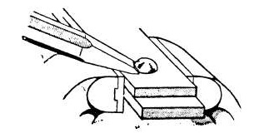
Safe Work Practices
Always wear protective eyewear, gloves, and hearing protection
Keep chisel heads free of “mushroomed” heads
Always keep chisel edges sharp
Use an appropriate chisel for a given task, based on the type of material being cut and the size of chisel needed
Unless the material is heavy enough to withstand movement from hammer blows, it is important to clamp or otherwise secure it against movement
Sources: http://www.ccohs.ca/oshanswers/safety_haz/hand_tools/chisels.html
http://www.osh.dol.govt.nz/order/catalogue/archive/coldchisels.pdf
http://listoftools.com/images/removing_a_rivet_head_with_a_chisel.png

Slide 13
Safe Work Practices
Do not use a chisel as a pry bar or wedge
Keep chisel cutting edges sheathed when not in use
Never carry a chisel in pockets
Always cut away from the body
Never use a chisel as a
screwdriver or vice versa
Sources: http://www.ccohs.ca/oshanswers/safety_haz/hand_tools/chisels.html
http://www.osh.dol.govt.nz/order/catalogue/archive/coldchisels.pdf
http://www.gibsontimberframes.com/store/sheath3.jpg

Slide 14
Common Problem
“Accident reports have shown a pattern of injuries from the chisel.
Smashed hands from missing the chisel with a hammer.
Cuts from flying metal shards. Repetitive motion injuries from vibrations.
Hearing loss from the high-pitched ringing of a struck tool.
By adding a protective cap to the chisel’s head, the chisel is easier to strike without missing, and it prevents the head from mushrooming.
The insulated handle helps dampen noise and vibration.
Source: http://www.nytimes.com/2008/02/20/business/businessspecial2/20chisel.html

Slide 15
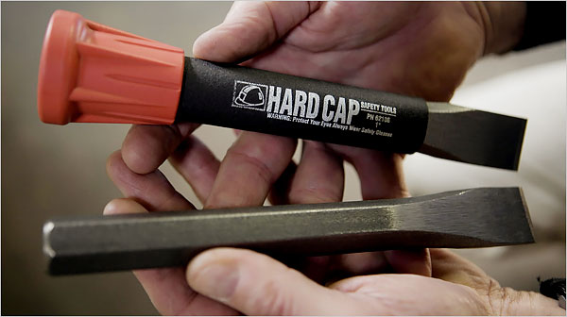
One Company’s Solution
Source: http://www.nytimes.com/slideshow/2008/02/19/business/businessspecial2/0219-CHISEL_10.html

Slide 16
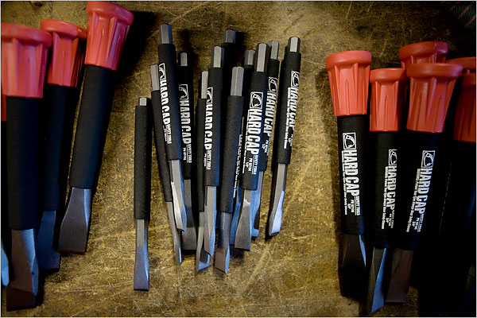
One Company’s Solution
“The cap’s larger surface and better grip gave workers the confidence to hit the bolts and rods more forcefully than they would with a standard chisel.
“…by wrapping it in a fiber-reinforced polymer sleeve that makes it safer to use and faster-cutting…”
Source: http://www.nytimes.com/2008/02/20/business/businessspecial2/20chisel.html

Slide 17
Think Safety
Work Safely

