Slide 1

Chiggers

Slide 2
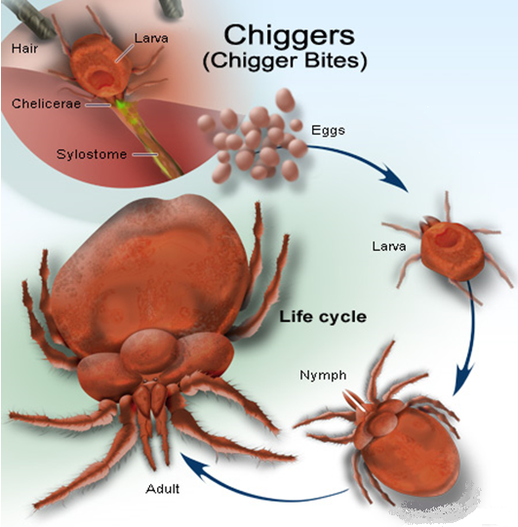
What are Chiggers?
Chiggers are often referred to as “Red Bugs”
Chiggers are the larvae of harvest mites
They go through 4 stages of life
  Egg, Larva, Nymph and Adult
Chiggers are barely visible to the naked eye, they are about 1/150th of an inch in length
Adult mites have eight legs and are completely harmless

Slide 3
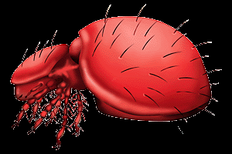
A Closer Look
Juvenile chiggers have six legs, they are the most harmful
The tiny, six-legged larval stage is a parasite found on many animals as well as humans.
Larval chiggers (such as this one shown) move very quickly on the ground and crawl onto feet or legs until reaching a place such as the ankles, under socks, or behind knees.

Slide 4
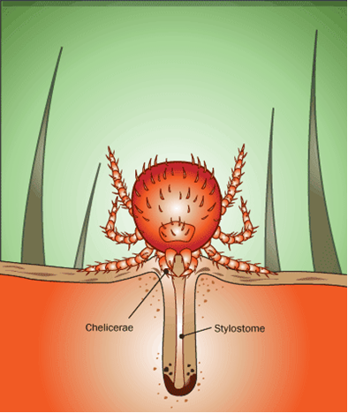
How Do Chiggers Feed?
Once a chigger is on the skin, it pierces and injects enzymes into the skin in order to digest the skin cells
It then sucks up all the digested tissue with a tube called a stylostome
They do not actually suck blood, as is often assumed
Chigger bite irritation will develop 1 or 2 days after the exposure so the host may not associate the bite with the exposure to the chigger
Chiggers generally stay with the host for 3 to 5 days and then will drop off to begin the next life stage, the Nymph stage, where it will feed off plants.

Slide 5
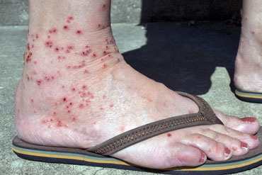

Symptoms
Chigger bite irritation will develop 1 or 2 days after exposure so the chigger may not be apparent on the host when the bump finally appears
Small red bumps appear on the skin in the affected area.
A rash may appear where several chiggers bites have occurred in one area
These tiny red bumps will remain for several days, but usually go away without scarring after treatment
Chiggers in North America are not associated with carrying any diseases

Slide 6
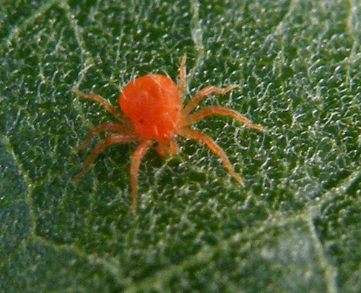
Treatment
Once the rash appears, the chigger is usually no longer present
The best thing to do for a chigger bite is to wash the affected area with warm soapy water
Epsom salt baths also may alleviate the itching
Covering the bite areas with nail polish, calamine lotion, Vaseline, or baby oil can also help to reduce pain and itching
Without treatment, the rash will last 2-3 weeks

Slide 7


Prevention
Chiggers generally prefer warm, covered areas of the body.
Cover the entire body with the repellent and especially focus on covering the arms and legs.
Apply repellant to shoes, waistlines, and lower pants legs
When choosing a repellant to combat chiggers, choose one that contains DEET
There are also several types of insecticides that can be applied to the ground in order to combat chiggers

Slide 8
Breeding Areas for Chiggers
Chiggers most often concentrate in disturbed forests where trees have been cut but are re-growing.
They thrive in areas that have underbrush such as shrubs, brambles, briars, weeds, and saplings.
In early spring, female mites lay eggs that will start hatching in early April
Chigger numbers will peak in midsummer but will stay high into late fall.
Only a hard freeze will kill them off.

Slide 9
Where Do Chiggers Live?
In the US, Chiggers are very prevalent in the hot and humid areas
They are found in the Southeast, the South, and the Midwest
They are not usually found in the far northern areas, mountainous regions or deserts
The life cycle for chiggers is usually 2 to 12 months and they generally are more active in the warmer months
The larvae will usually congregate in groups on matted vegetation or on low hanging bushes and plants so they have easy access to prospective hosts

Slide 10
Fatality Statistics
There are no known fatalities that are attributed to chiggers

Slide 11
OSHA Regulations
Chiggers are not specifically mentioned in the OSHA Regulations

Slide 12
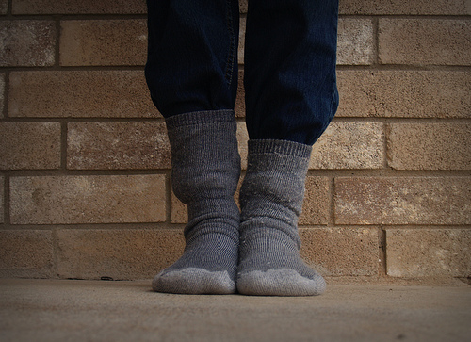
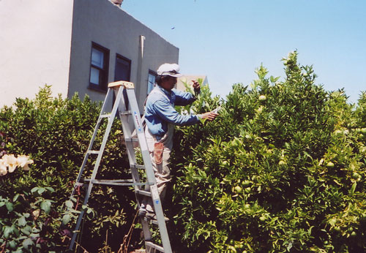
PPE and Clothing
Wear boots with jeans and a long-sleeved shirt to help prevent chiggers from jumping onto workers
Chiggers are attracted to skin, so covering as much skin as possible gives the best results
Tuck jeans into long socks and button long-sleeved shirt wrist cuffs helps prevent chiggers from migrating to the skin.

Slide 13
Chiggers in Construction
Chiggers are not normally a serious concern on construction sites
There are only a few instances when contractors should take measures to protect from chiggers
Take precautions when performing clearing and/or site work in mild to heavily wooded areas
Employers should require the use of long sleeves and long pants when working in areas where chiggers could be present
Employers should also be sure to provide adequate amounts of repellant

Slide 14
Think Safety
Work Safely

