Slide 1
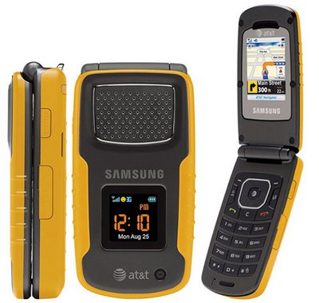
Cell phones

Slide 2
Introduction
Cell phones have been very evident everywhere including the construction industry.
By using cell phones people can communicate quickly and efficiently on construction site, especially when providing equipment and performing construction activities.
Modern cell phones have many features, like mp3, movie, and Internet that can distract workers’ attention from their working site.

Slide 3
Primary Modes of Accident Causation
Decreased awareness of surroundings and potential hazards in construction site.
Becoming Less sensitive to warnings, alerts.
Distractions caused by the use of a cell phone can lead to accidents to the user as well as others.

Slide 4
Statistics
2,600 deaths and 330,000 injuries in the United States each year related to cell phone distraction.
Drivers are 18% slower to react in cars.
Motorists in conversation are less skilled than drunk drivers with an alcohol level exceeding 0.08.
Source: Britt, Robert Roy. “Drivers on Cell Phones Kill Thousands, Snarl Traffic.” February 1, 2005.

Slide 5
OSHA Regulations
Data reveal that a majority of the construction fatalities related to the use of cell phones involved a person being backed over and crushed while talking on the cell phone.
From these incidents it appears that talking on a cell phone cannot only be distracting but can also cause a blocked view as cell phone users often turn away from noise sources in order to hear better.
Source: OSHA Fatality Data 1990 - 2007

Slide 6
OSHA regulations
Two other fatalities investigated by OSHA:
1) A worker fell while speaking on the cell phone
2) The operator of a vehicle grasping for a cell phone mistakenly drove forward over a worker
Source: OSHA Fatality Data 1990 - 2007

Slide 7
Best Practices
Except for use by supervisory personnel, personal phone calls should be prohibited on cell phones. If personal phone calls must be made they shall occur either on the office phone line or during breaks taken offsite.
Cell phones should not be used while workers are operating equipment or machinery. The user shall stop operation if the use of the cell phone is required and ensure a safe surrounding prior to using the cell phone.
Users should keep their cell phone ring tones and alerts at a minimal volume so as to not distract those in the surrounding area.

Slide 8
Think Safety
Work Safely

